Slide 1
PhonePe Data Analysis - Michael Antony J
Business Insights | Data-Driven Decisions

Slide 2
Agenda
Transaction Dynamics
Device Dominance
State-wise Analysis
User Registration Trends
Insurance Analysis
Conclusion

Slide 3
Transaction Dynamics
Strong growth in transactions (2018–2024)
Increase in both count and amount
Growth accelerated post-2020
Q4 shows highest activity
Focus: Infrastructure, seasonal campaigns, premium services

Slide 4
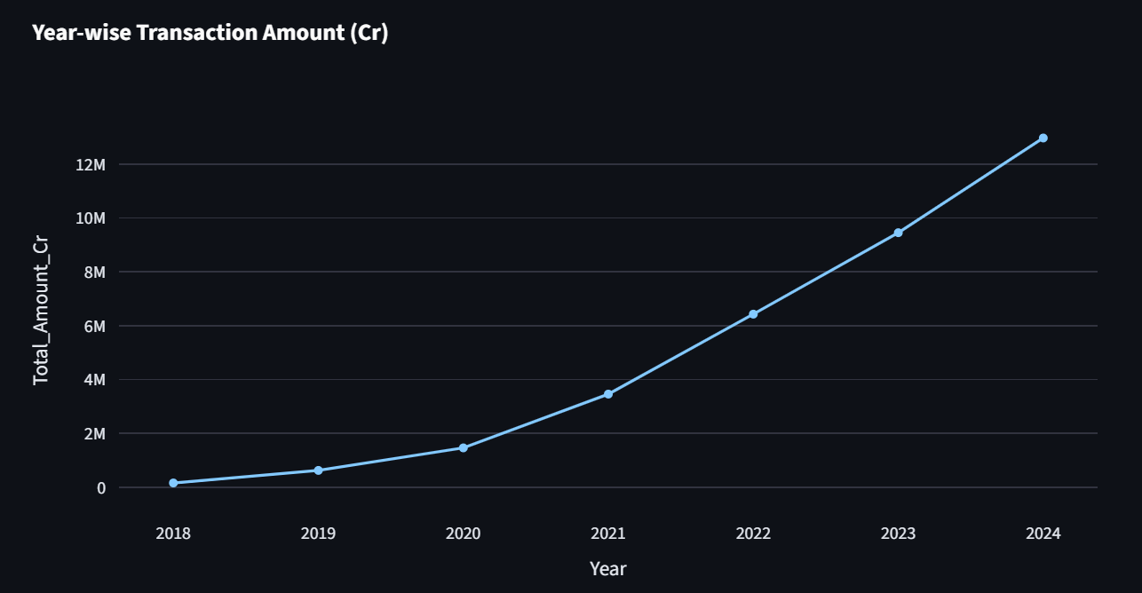
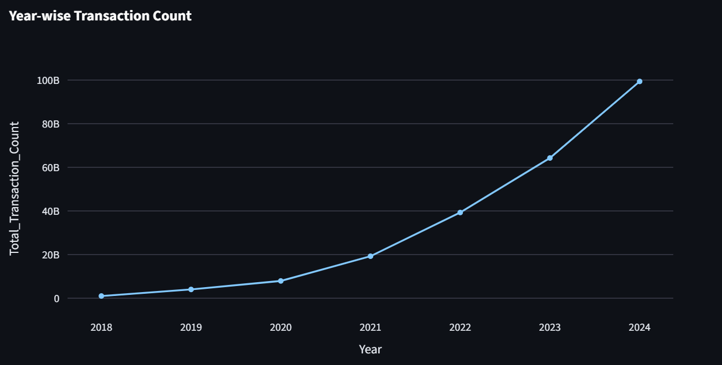

Slide 5
Device Dominance
Xiaomi leads (~26%), followed by Samsung and Vivo
Market dominated by top 3–4 brands
Mid-range brands have moderate share
Premium brands have lower share
Focus: Partnerships, optimization, targeted expansion

Slide 6
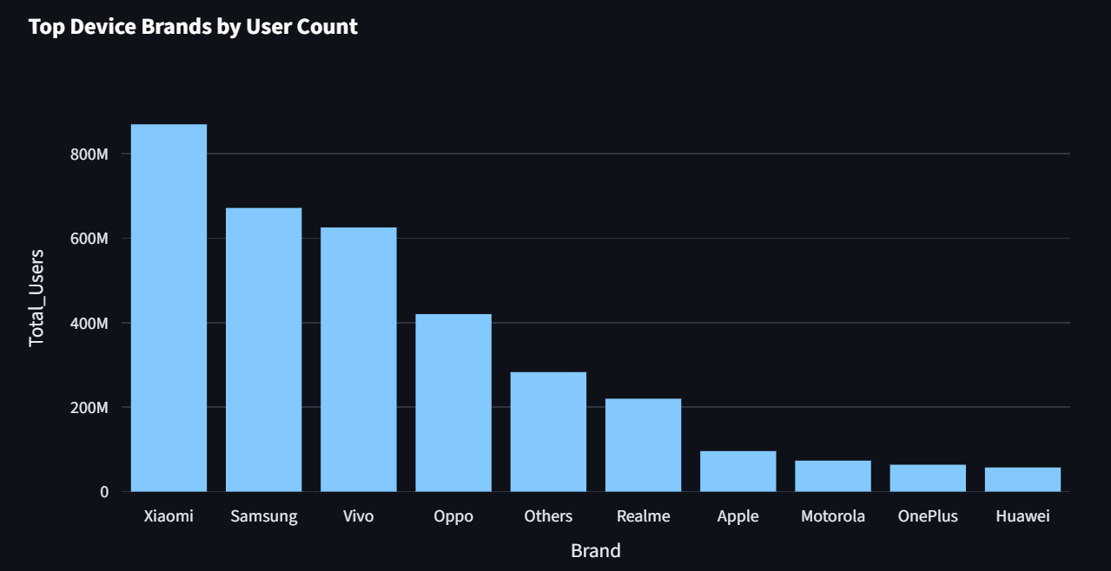

Slide 7
State-wise Transaction Analysis
Maharashtra & Karnataka show highest transaction activity
Telangana leads in transaction value
Moderate levels in UP, Rajasthan, Andhra Pradesh
Lower levels in some states
Focus: Regional strategies and expansion

Slide 8
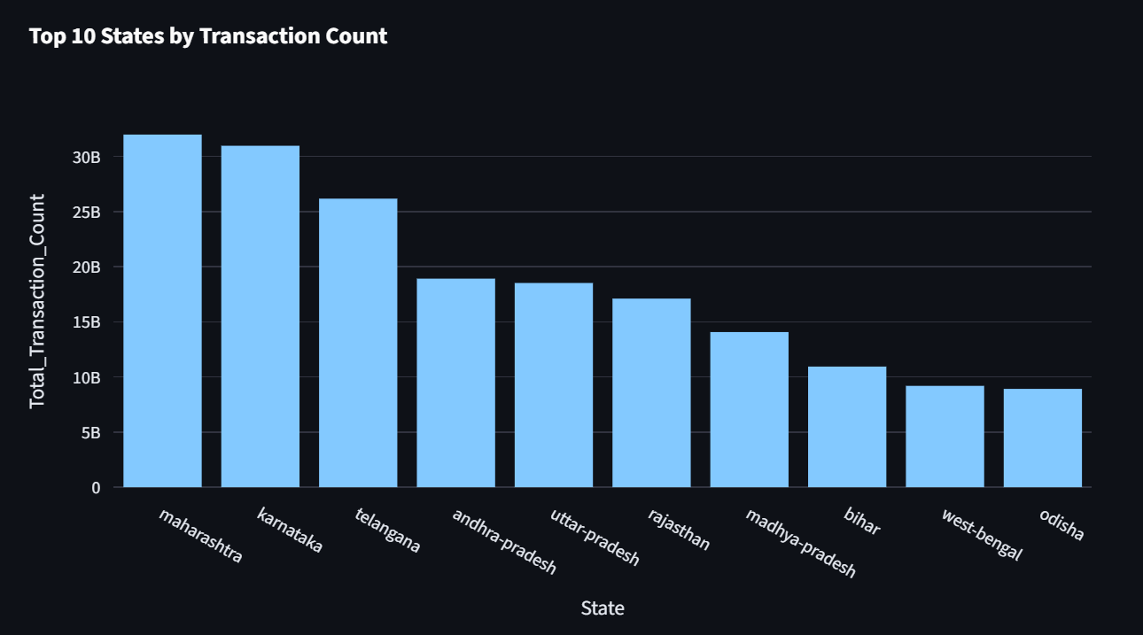

Slide 9
User Registration Analysis
Consistent growth in registered users (2018–2024)
App opens increasing steadily
Top states: Maharashtra, UP, Karnataka
Growth and engagement rising together
Focus: Retention, acquisition, scalability

Slide 10
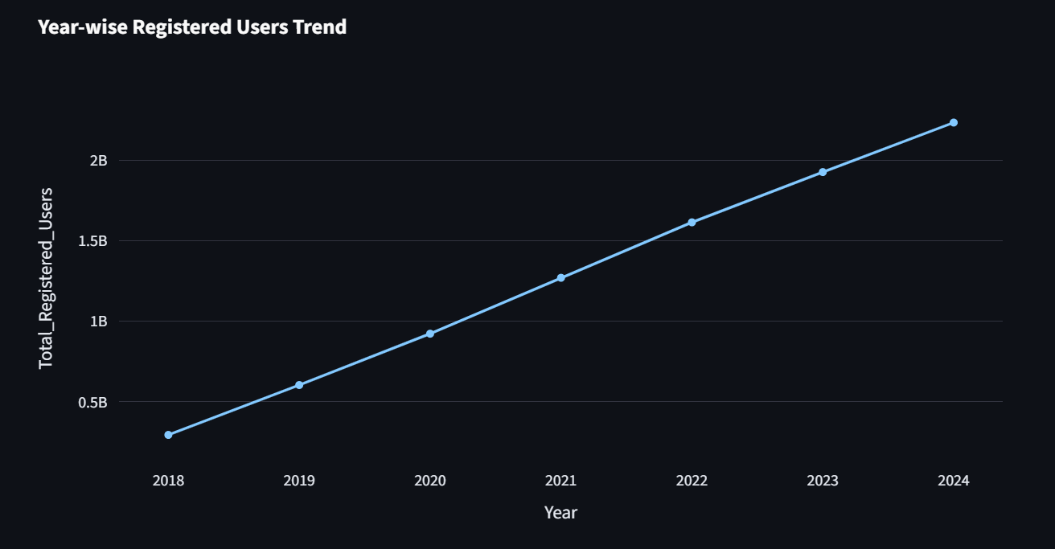

Slide 11
Insurance Analysis
Insurance transactions increasing (2020–2024)
Karnataka & Maharashtra lead
Moderate contribution from other states
Concentration in top regions
Focus: Expansion and awareness

Slide 12
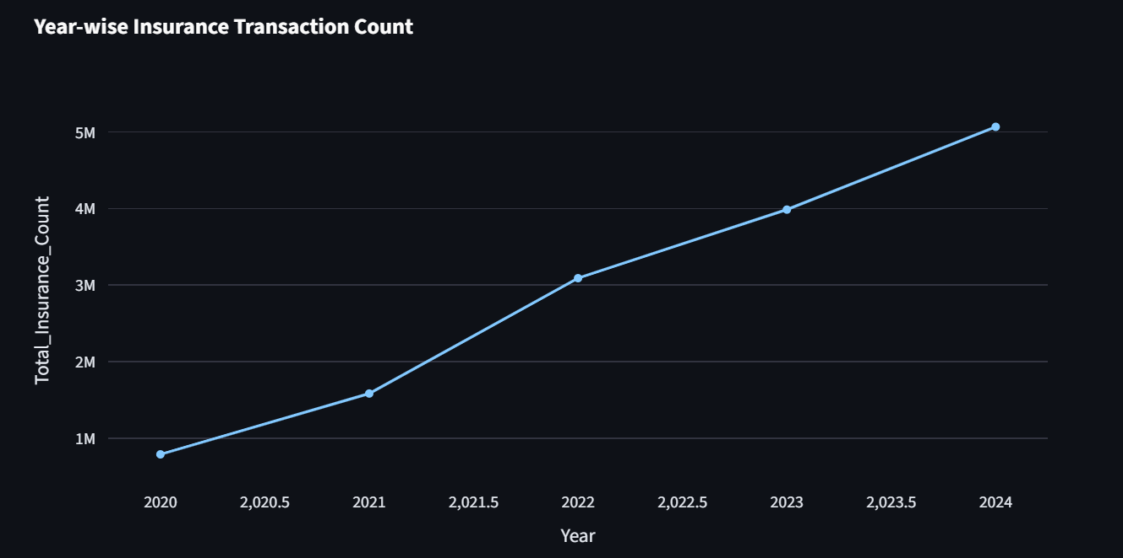

Slide 13
Conclusion
Digital payments are rapidly growing across India
User base and engagement are increasing consistently
Market is concentrated but expanding
Opportunities exist in underpenetrated regions
Data-driven strategies can drive future growth

