Slide 1
R Bikeshare Project
Michael Feduk

Slide 2
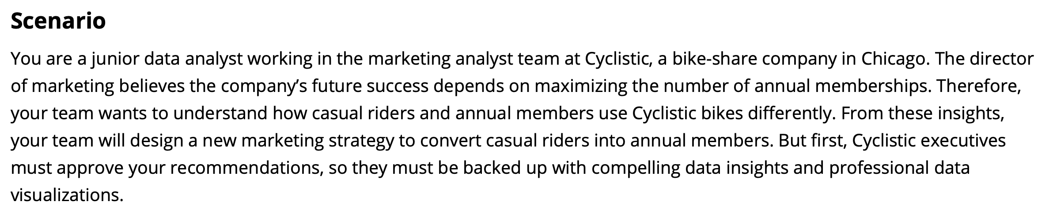
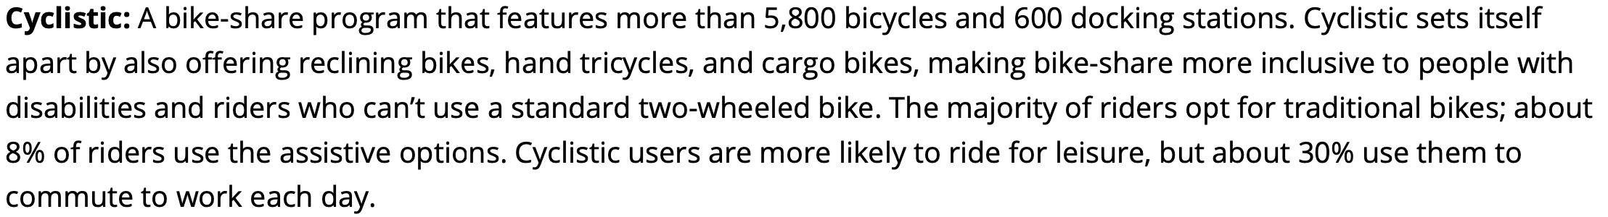

Slide 3
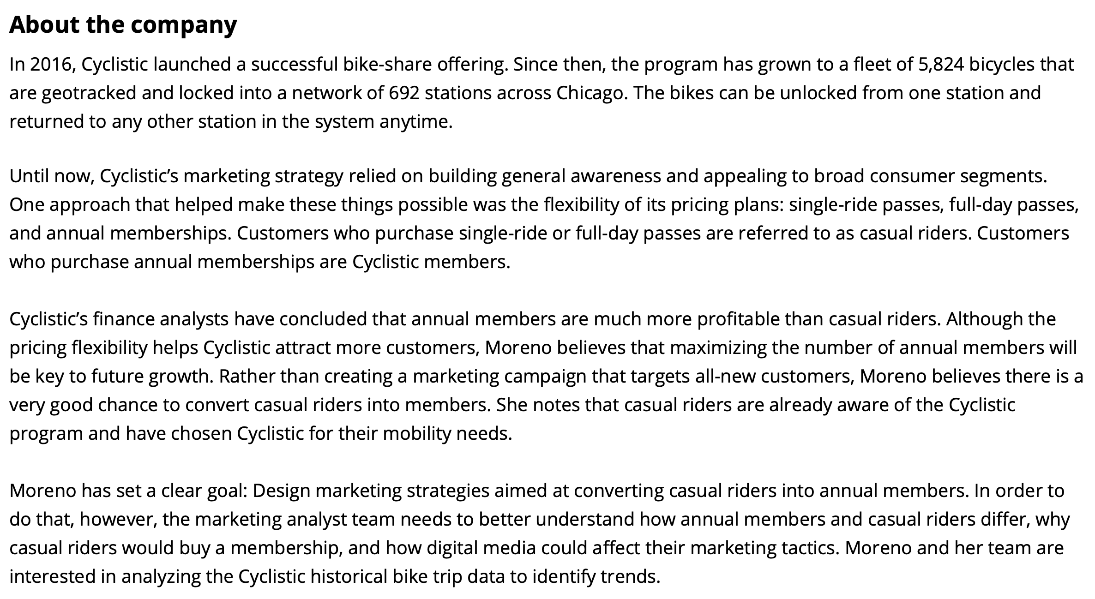

Slide 4
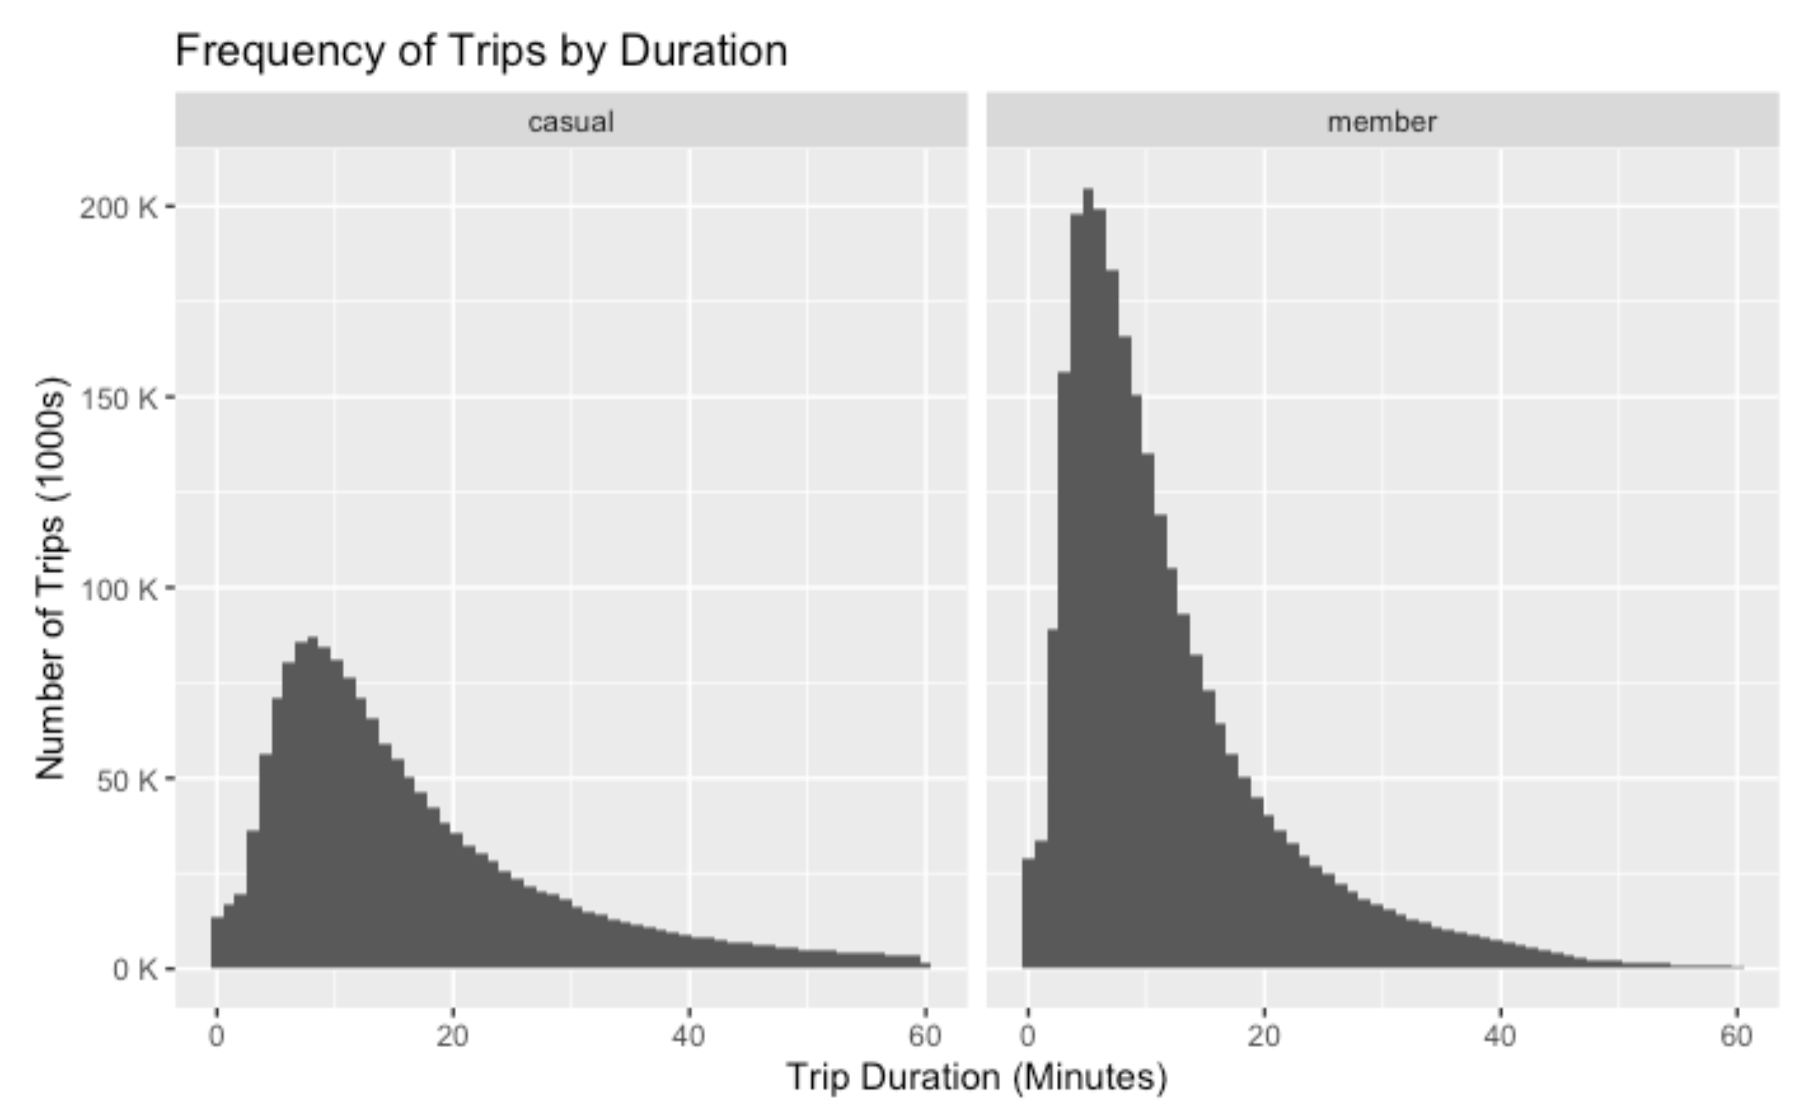
Median trip lengths:
Member: 9:10
Casual: 14:02
Total number of trips:
Member: 2.332 M
Casual: 2.026 M

Slide 5
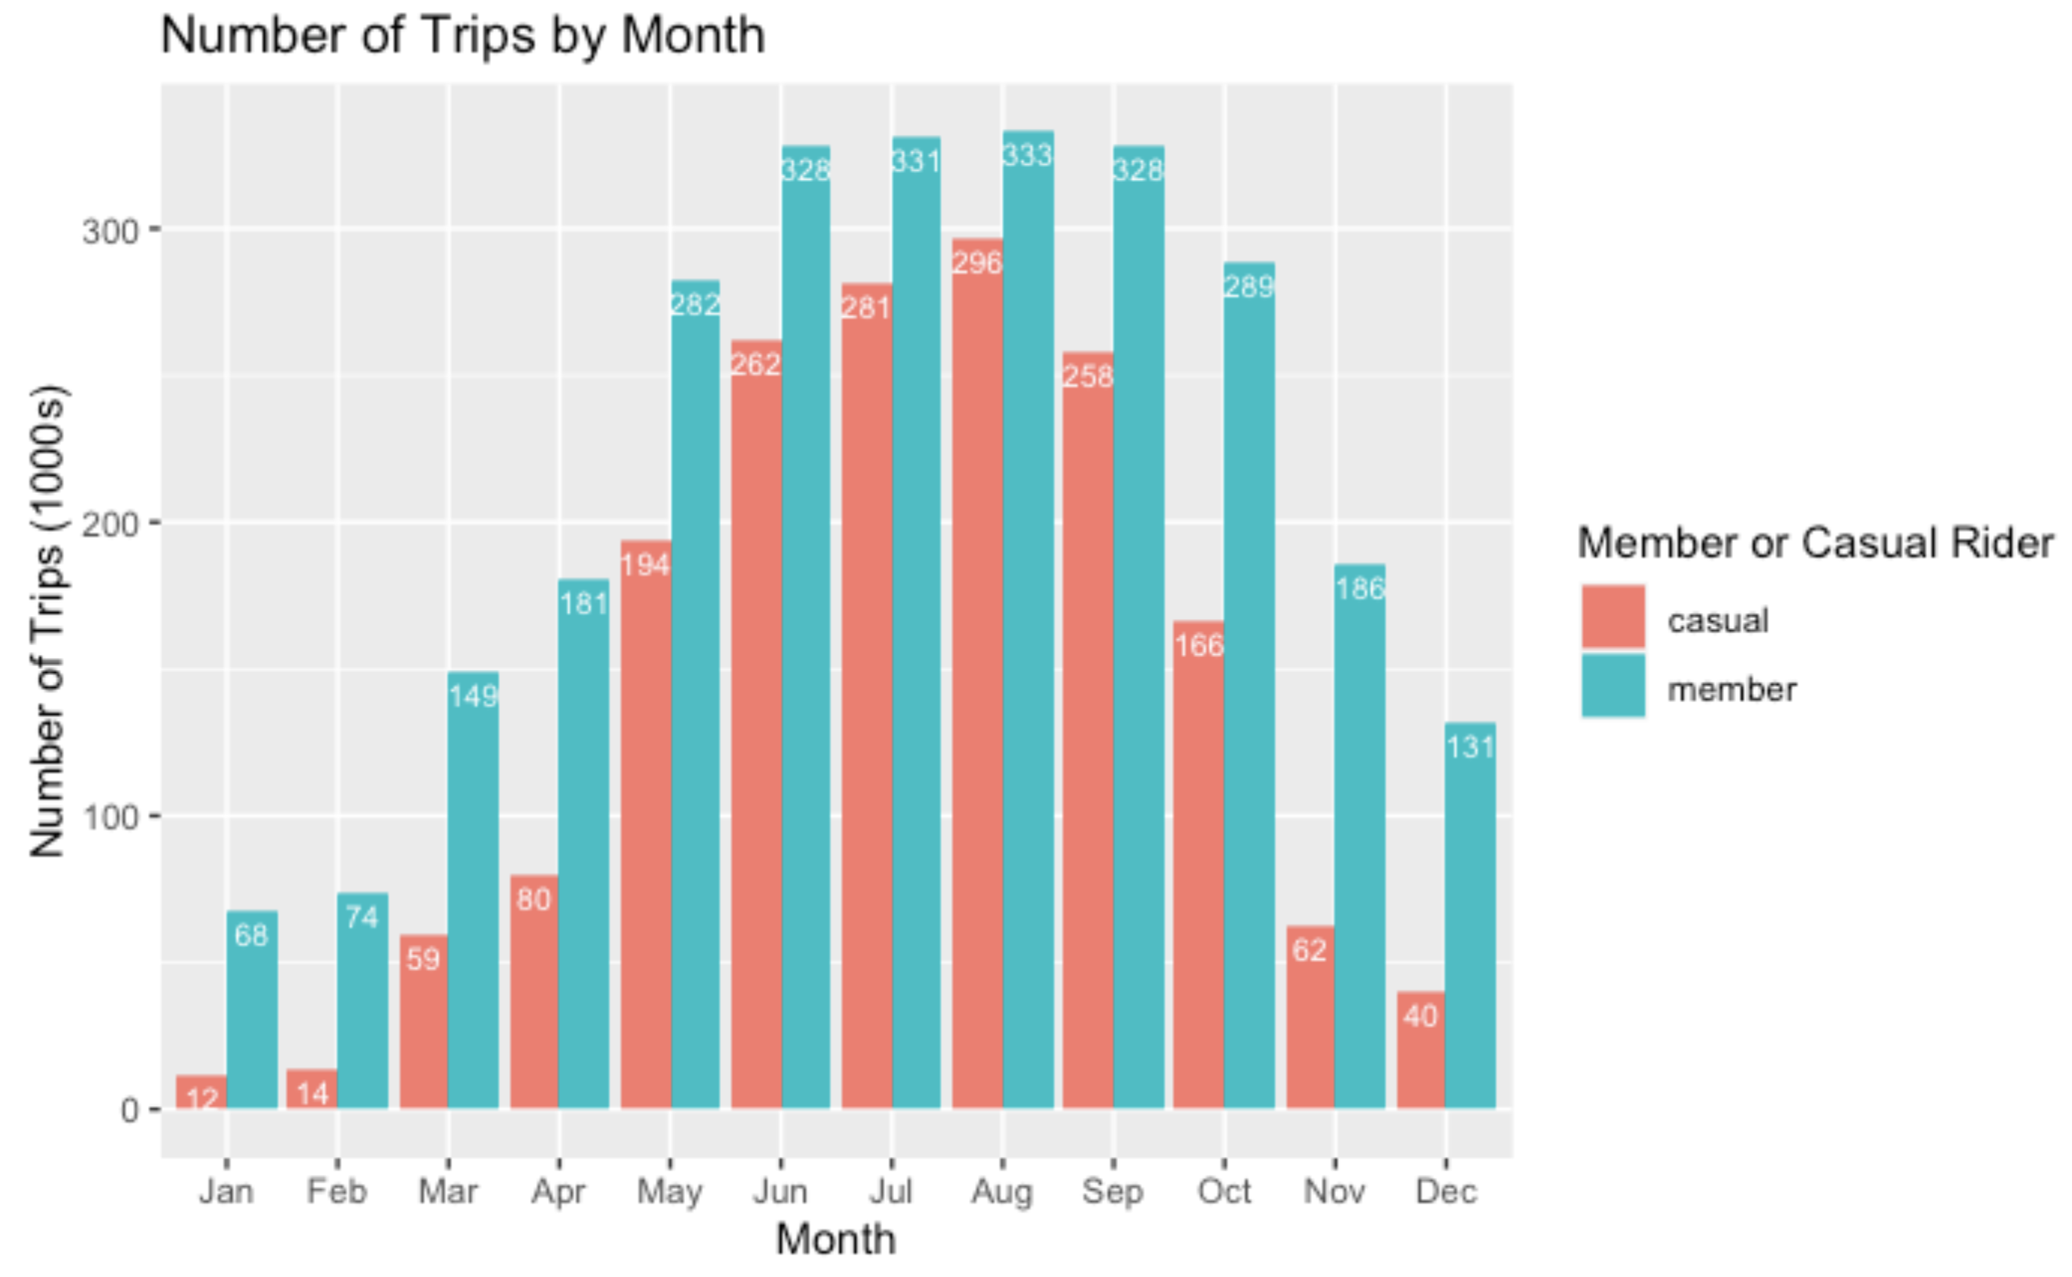
Casual riders at their peak May-Sep
Very low numbers Nov-Apr

Slide 6
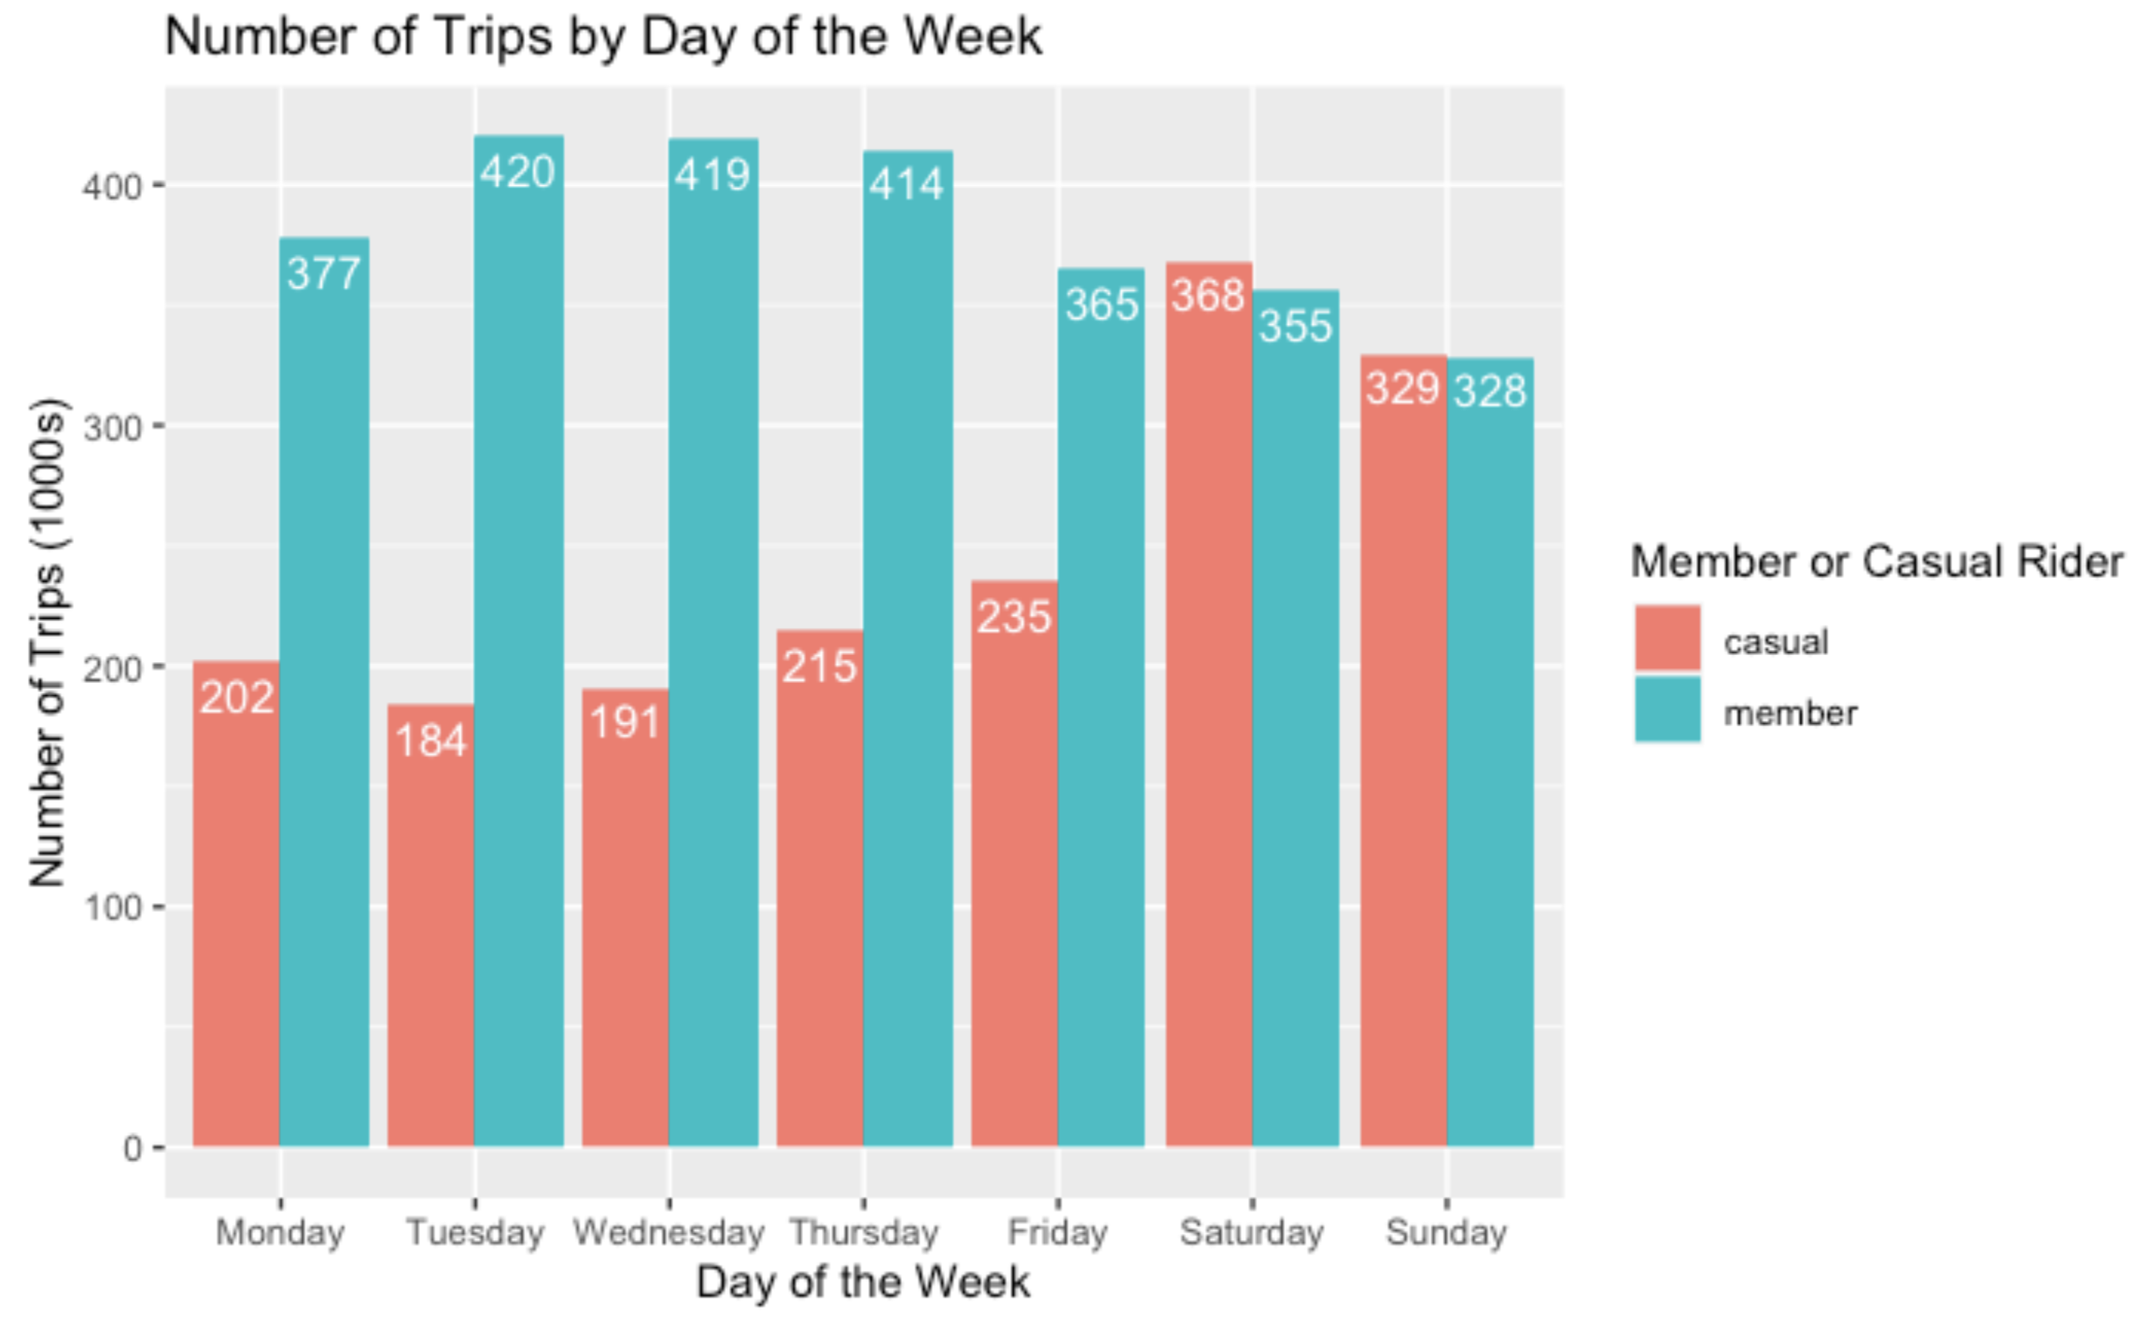
Casual riders peak during weekends
Members probably more likely to commute

Slide 7
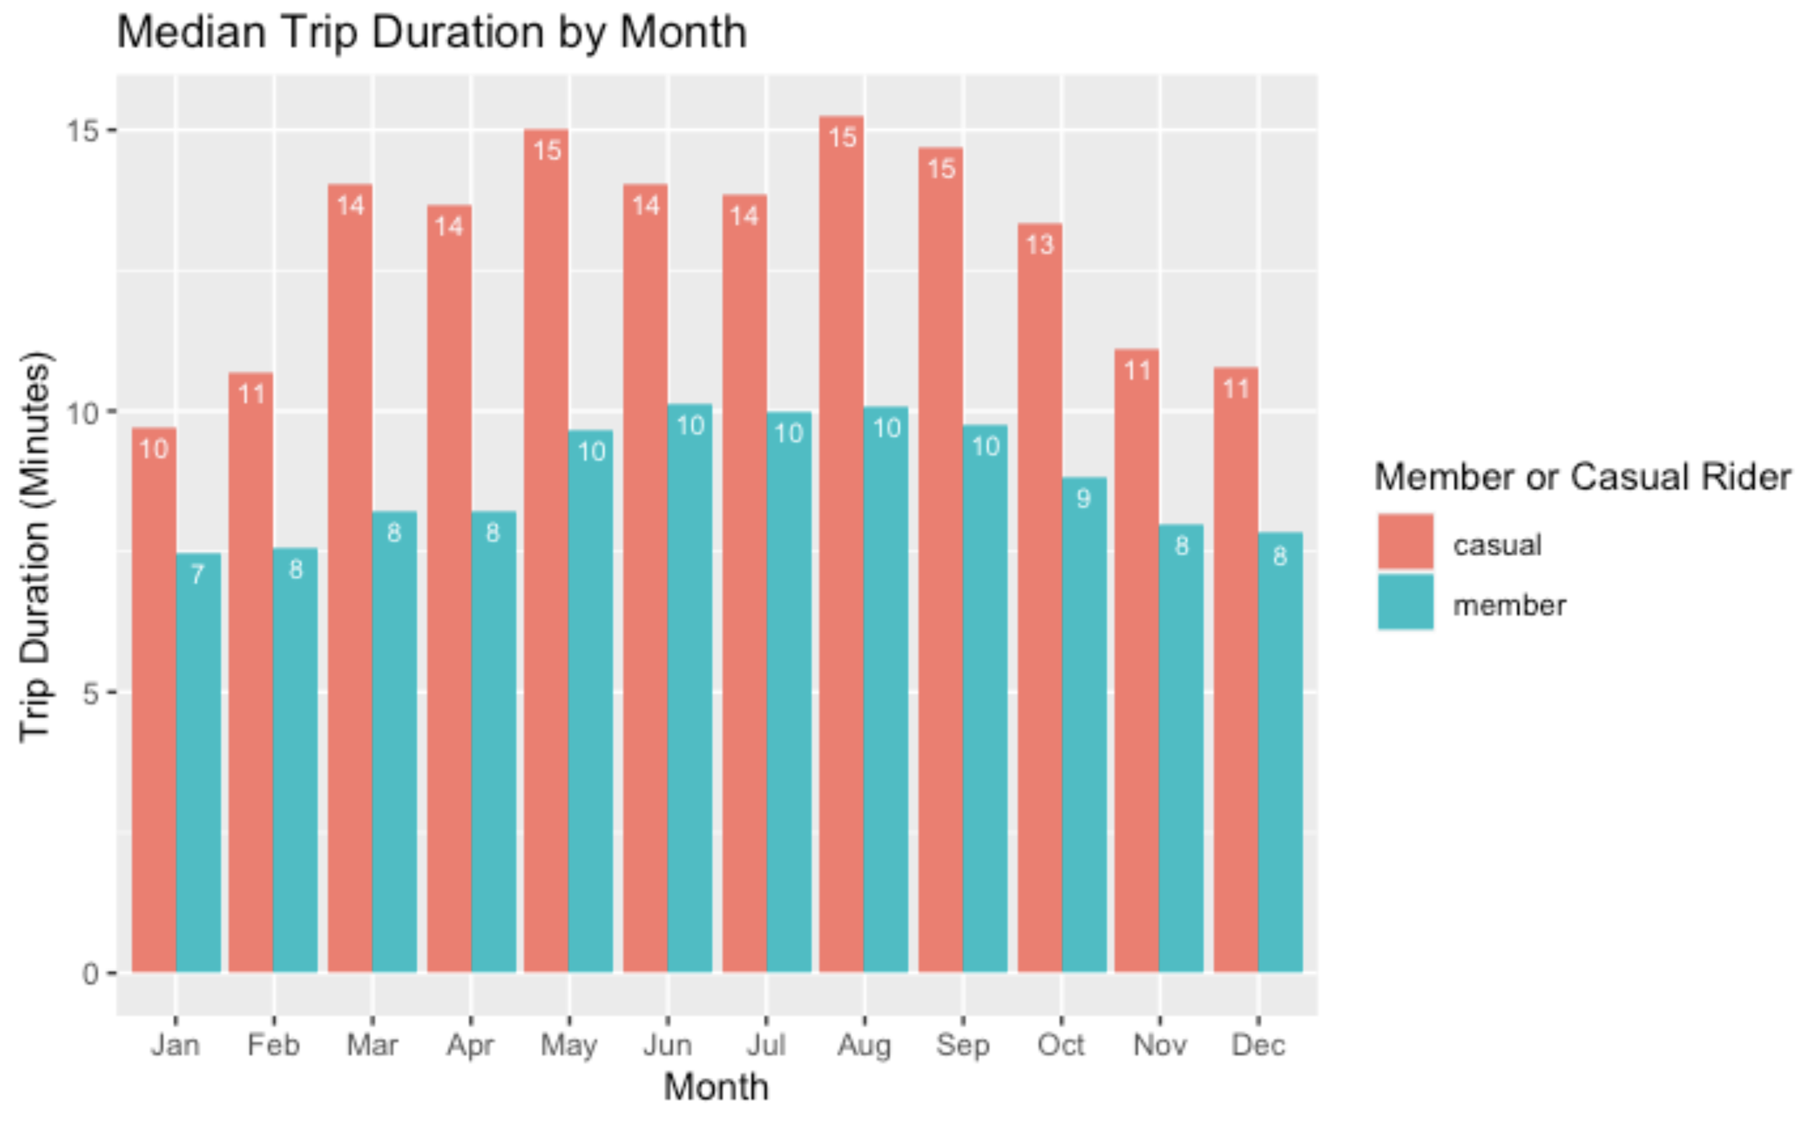
Casual riders take longer trips throughout the year
Maybe because they're less frequent?

Slide 8
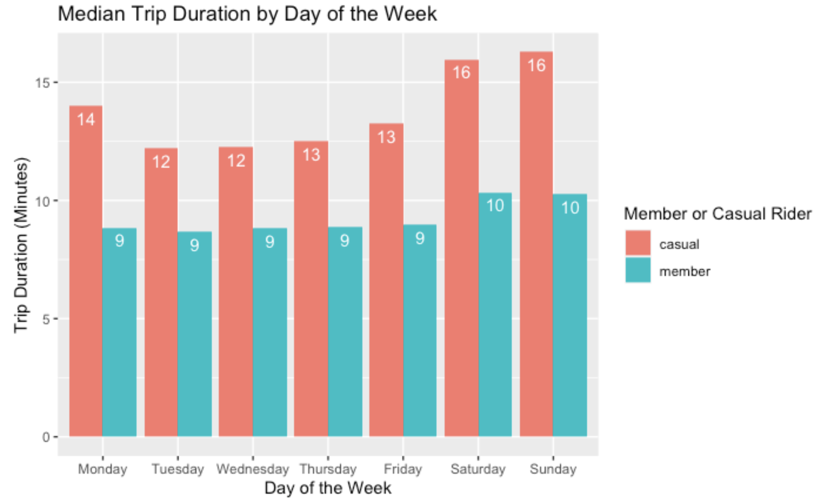
Casual riders take longer trips throughout the week
Maybe because they're less frequent?

Slide 9
Conclusion: marketing recommendations
To the casual rider: "You're just as likely to ride our bikes during this summer season, however when winter rolls around members are four times more likely to bike. Stay consistent throughout the year with a Cyclistic annual membership!"
To the casual rider: "Congrats, you ride our bikes more than our members on the weekend! Where are you during the week though? Members are two times more likely to bike then. Stay consistent throughout the week with a Cyclistic annual membership!"
Advertising efforts should be focused on the periods of time when casual riders are most using the service: Friday through Sunday and May through September.
They are most likely to purchase an annual membership if they've used the service recently (availability heuristic)

