Slide 1
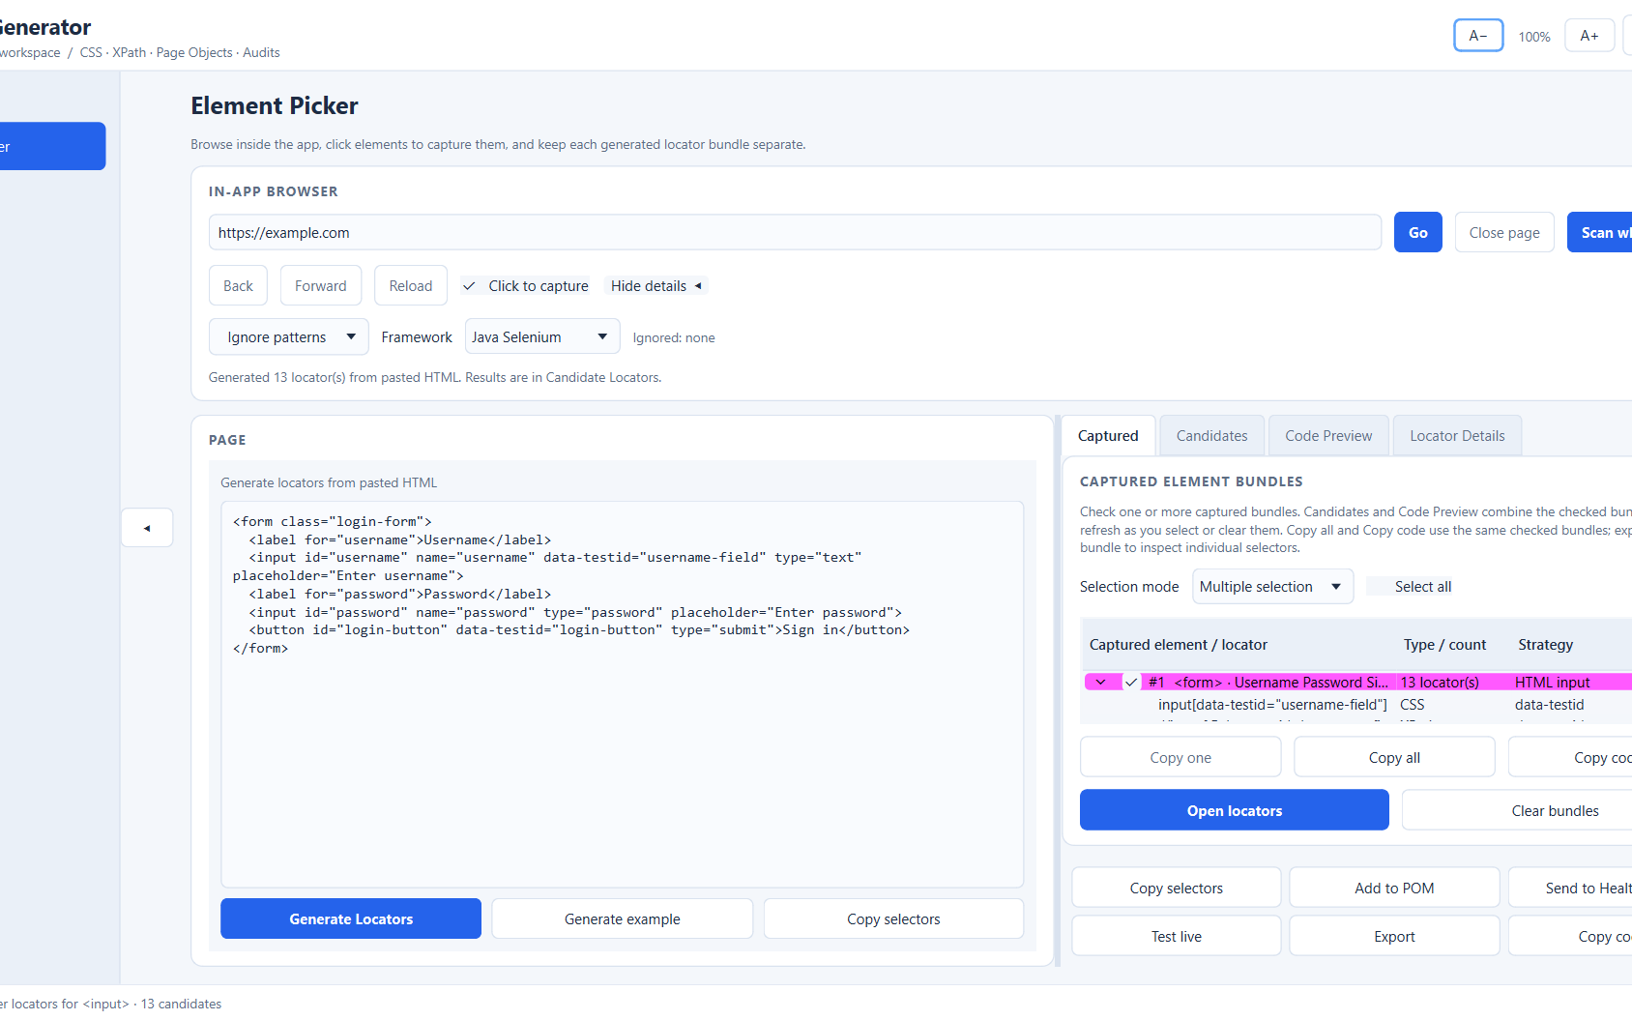
LOCATOR GENERATOR
Build better UI automation locators
Generate, capture, audit, and export CSS and XPath selectors in one desktop workspace.
Standalone Windows build available
A practical workspace for test automation engineers

Slide 2
APP OVERVIEW
From captured element to reusable code
Capture page elements, review their selectors, and carry the ones you trust into code and exports.
1
Capture
Use the embedded picker, paste HTML, or scan a page for elements.
2
Review
Inspect ranked locator candidates and select one, several, or all.
3
Reuse
Build Page Objects and give each locator a useful variable name.
4
Validate
Run Health Audit and live tests against the page when available.
5
Export
Export the selected locator data to CSV or formatted Excel.
Locator Generator • CSS and XPath automation toolkit

Slide 3
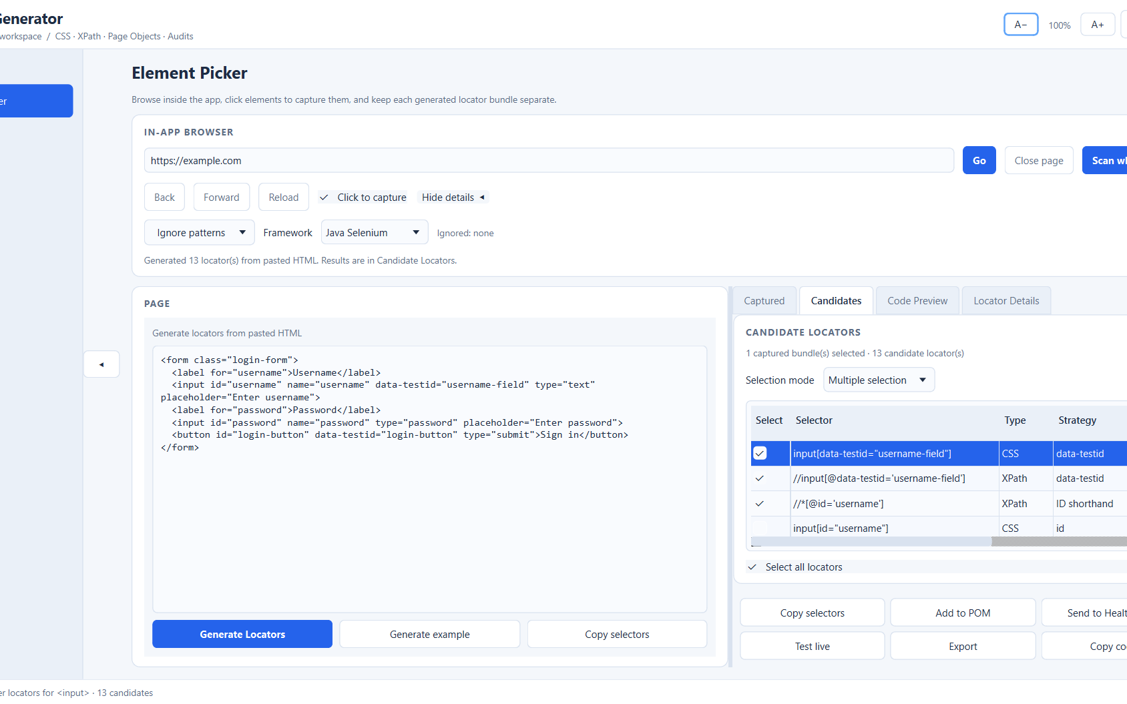
LOCATOR WORKSPACE
Capture and review locators in Element Picker
Candidate review
Inspect selector type, strategy, score, stability, and match information.
Choose individual candidates or select all generated locators.
Preview framework bindings and exclude unwanted locator patterns.
Copy, test, audit, add to Page Objects, or export selected locators.
Locator Generator • CSS and XPath automation toolkit

Slide 4
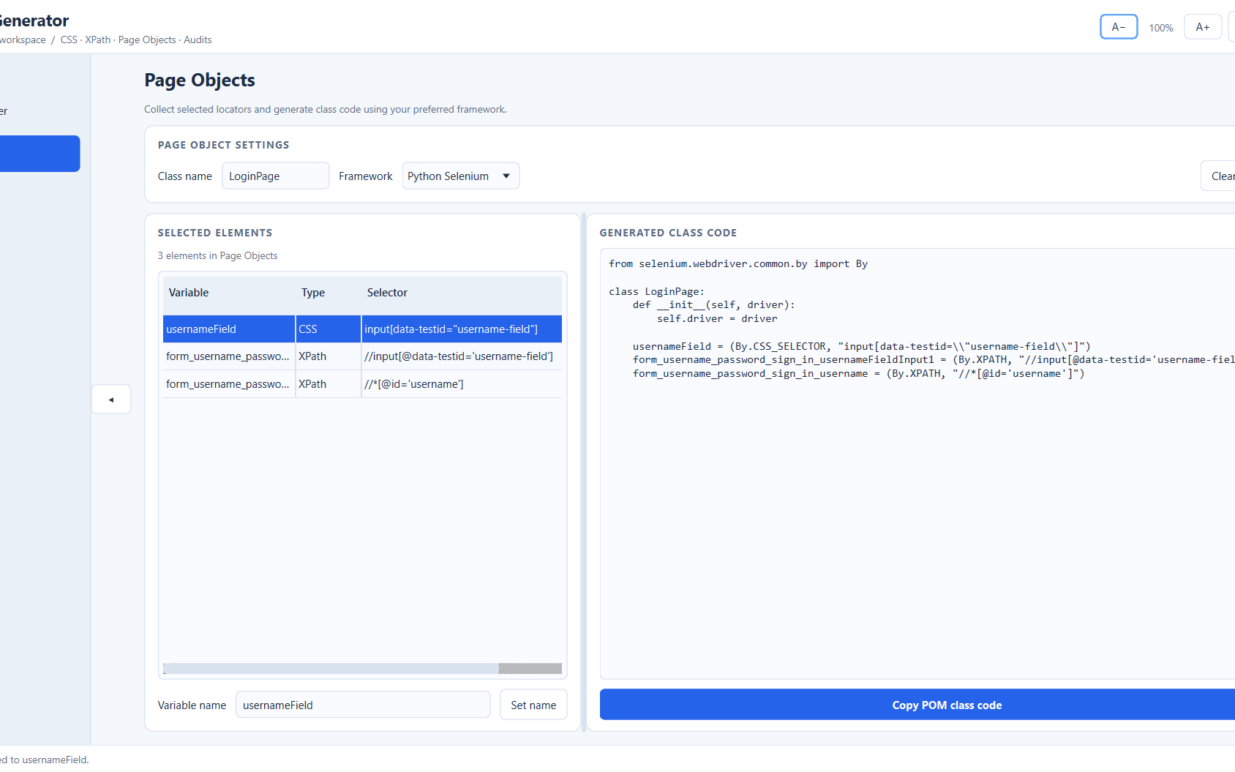
PAGE OBJECTS
Reuse selected locators in Page Objects
Name elements for your tests
Choose a class name and automation framework.
Give each locator a clear variable name, such as usernameField.
Review generated class code and copy it into your test project.
Use the embedded picker to capture elements; Selenium supports live browser workflows.
Locator Generator • CSS and XPath automation toolkit

Slide 5
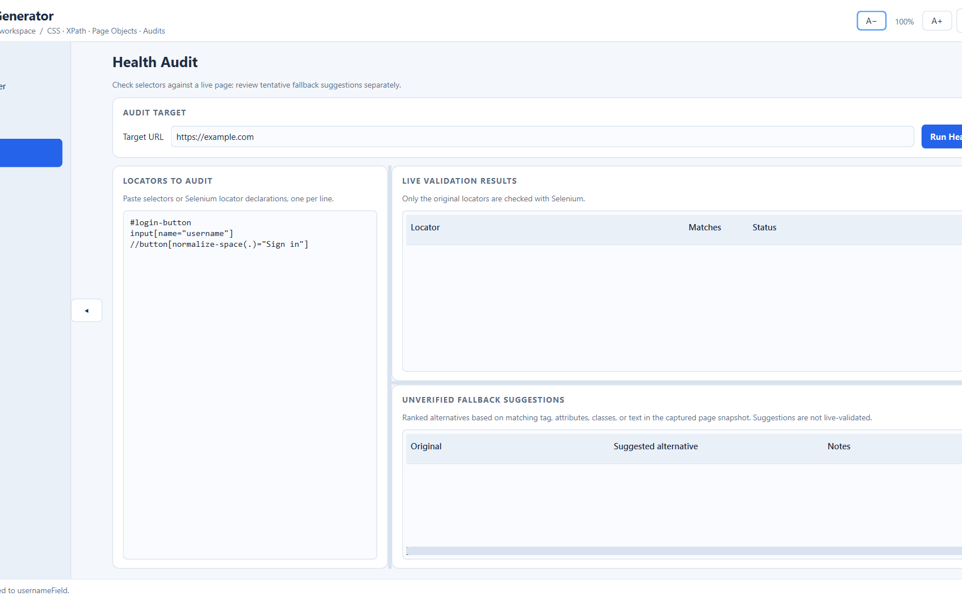
HEALTH AUDIT
Review failures with clear validation context
Validation and fallback suggestions
Run the audit against a target page and supplied selectors.
See live validation results in a dedicated table.
Review ranked alternatives derived from the captured DOM snapshot.
Snapshot alternatives remain suggestions until tested against the page.
Locator Generator • CSS and XPath automation toolkit

Slide 6
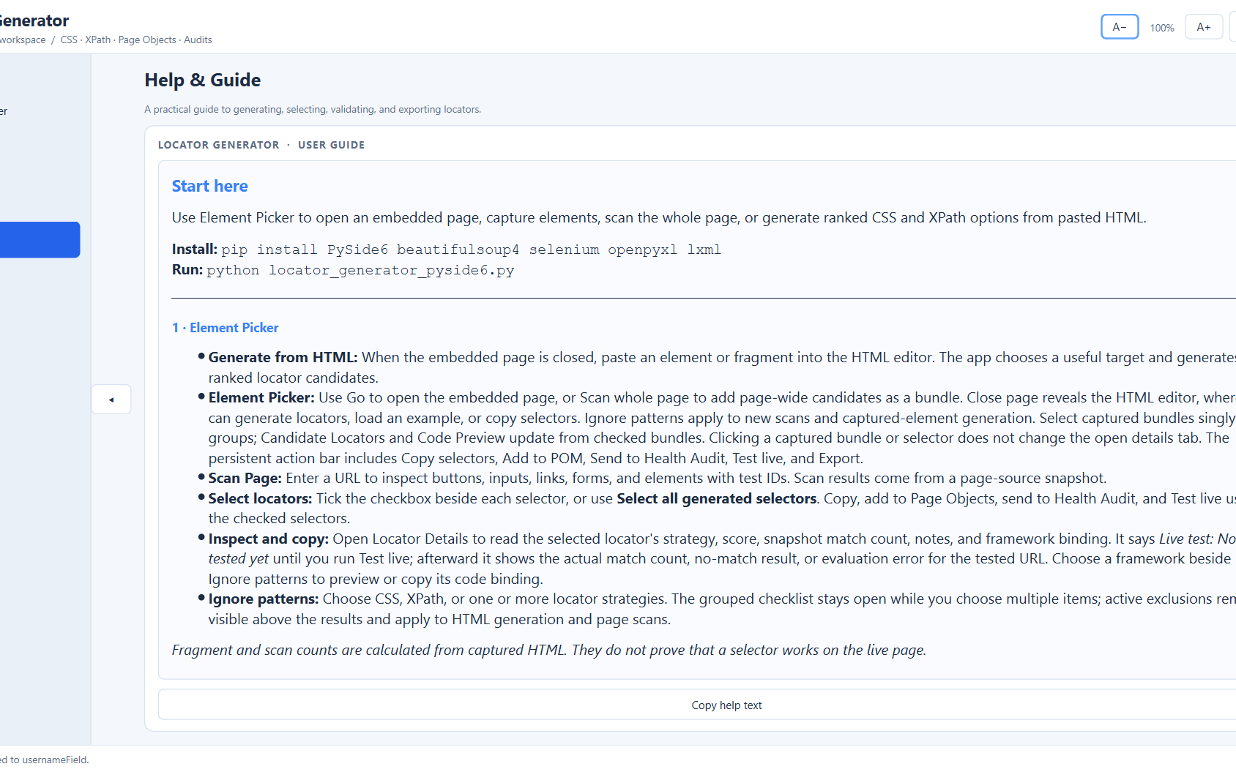
GETTING STARTED
A focused desktop tool with practical guidance
Quick start
Download the standalone Windows EXE; no Python setup is needed.
Or install Python 3.10+ and PySide6 to run the source version.
Use Chrome or Edge for Selenium-based live workflows.
Always verify generated selectors in your own test environment.
Scores and stability labels are guidance, not guarantees.
Locator Generator • CSS and XPath automation toolkit

