Slide 1
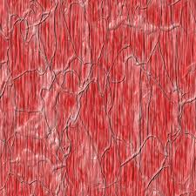
Myoclonic epilepsy with ragged-red fibers (MERRF)
Michael Gill
Ragged Red Fibers

Slide 2
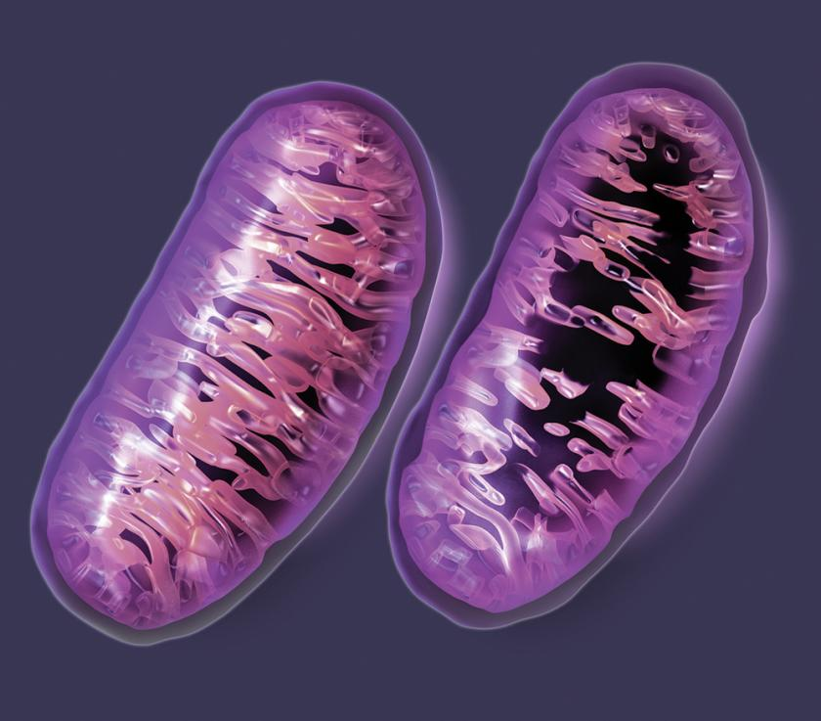
What it is and symptoms
It is a mitochondrial syndrome (affects the mitochondria)
It is called “ragged red fibers” because muscle fibers appear ragged and red in a muscle biopsy.
MERRF is a very rare genetic form of epilepsy. The symptoms are:
- muscle twitches
- being very weak and stiff
- seizures
- difficulty with coordination and motor skills
- increases risk of dementia
Diagram of a mitochondria

Slide 3
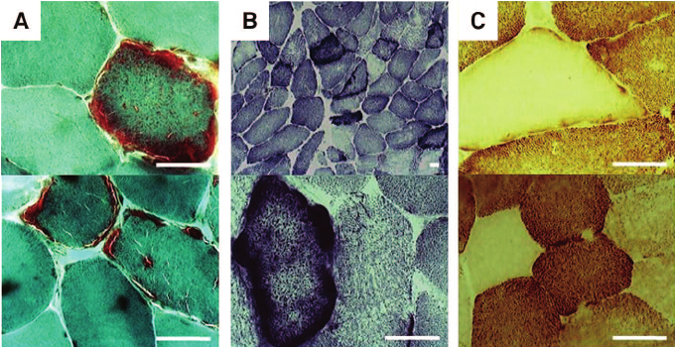
Causes
It is caused by a mutation, which in turn is caused by a pathogen in the mitochondrial DNA
Always and only transmitted by maternal inheritance
Which means, only the mother will pass it on to children
Ragged red fibers stained with different chemicals

Slide 4
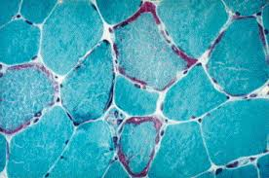
Diagnosis
Muscle fiber of someone with MERRF. The red spots are buildups of mutated mitochondria
It can be diagnosed through muscle biopsy (looking for ragged red fibers--92% of patients had this)
Looking for certain mutations, A8344G accounts for 80% of the cases, T8356C, G8361A, and G8363A account for 10%, and 10% have no mutations (at least visible to examiners) in the DNA of the mitochondria
there is no way to know for certain if a patient has MERRF.

Slide 5

Treatment
There is no known cure for MERRF, so treatments are just given to relieve symptoms
They are given antiepileptic drugs for the seizures
Patients are given physical therapy to improve their motor skills
Drugs are used to treat the other symptoms
Epilepsy treatment

Slide 6

Prognosis
The prognosis is not good, as the disease will continue to progress and not stop, given as there is no cure. The severity varies per person, and some patients may have a reasonably long life without too many problems.

Slide 7
Citations
Cohen, Bruce H. “MERRF: Myoclonus Epilepsy and Ragged Red Fibers.” Egyptian Journal of Medical Human Genetics, Elsevier, 4 Dec. 2015, www.sciencedirect.com/science/article/pii/B9780128008775000036.
Davis, Ryan L., et al. “Mitochondrial Diseases.” Egyptian Journal of Medical Human Genetics, Elsevier, 8 Jan. 2018, www.sciencedirect.com/science/article/pii/B9780444632333000105.
Newman, Maureen. “Myoclonus Epilepsy Associated with Ragged-Red Fibers (MERRF) Diagnosis Discussed by Researchers.” Mitochondrial Disease News, 1 June 2015, mitochondrialdiseasenews.com/2015/05/04/myoclonus-epilepsy-associated-ragged-red-fibers-merrf-diagnosis-discussed-researchers/.
DiMauro, Salvatore, and Michio Hirano. “MERRF.” Advances in Pediatrics., U.S. National Library of Medicine, 3 June 2003, www.ncbi.nlm.nih.gov/pubmed/20301693.

