Slide 1
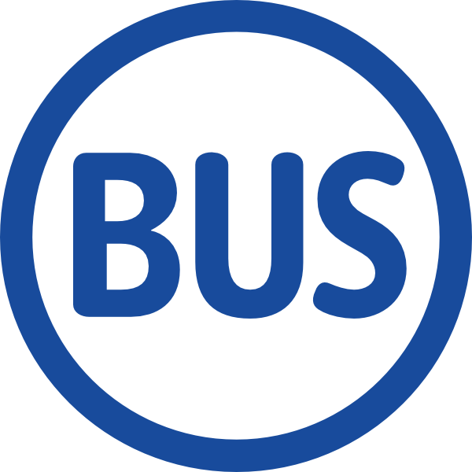
Busgazer
Revolutionary Public Transit Experience
Smarter City

Slide 2
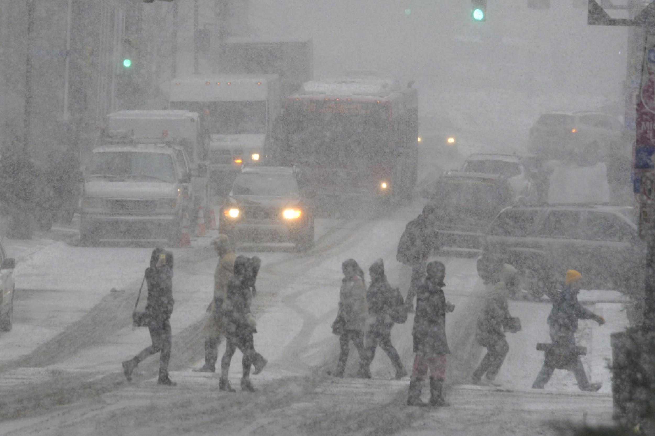
Downtown Pittsburgh 01/09/2015, By Jon Schmitz, Pittsburgh Post-Gazette
Notes:
Start with a story about how busgazer was born

Slide 3
Problem
Waiting for buses in the chilly is painful
Disconnected passengers
Boring riding experience
Notes:
focus on passengers when talking about social network

Slide 4
Solution
Busgazer: a mobile platform that provides
a social network that connects
bus drivers
local passengers
tourists
city news, events, restaurants, etc.
realtime bus arrival information

Slide 5
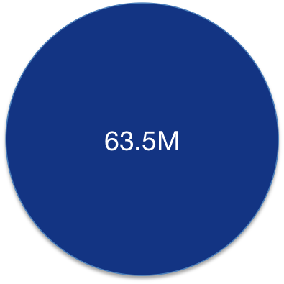
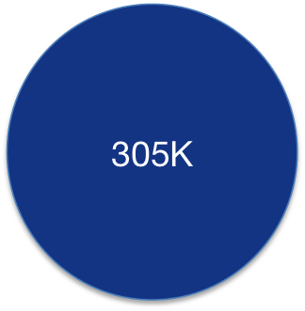
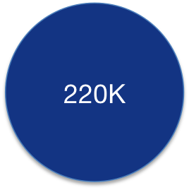
Market
Start with Pittsburgh, target all cities around the world.
TOTAL PASSENGERS* DAILY PASSENGERS* PITTSBURGH POPULATION
*Port Authority of Allegheny County 2013
Notes:
global market sounds nice to business people

Slide 6
Competitors
Transit, moovit, ezRide, Tiramisu, PAT …
Our core competency
Accuracy
User friendly interface
Social & Interactivity
Notes:
Our claim is backed by our techniques, product and user feedbacks

Slide 7
Revenue Model
Personalized Ads
Location based Ads
User sponsored buses and bus stops

Slide 8
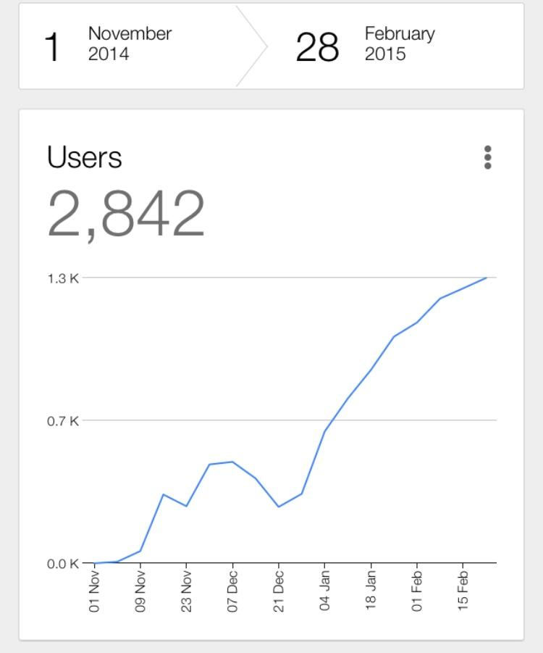
Our Users
Launch Time:
Apple App Store: Nov 8th, 2014
Google Play: Dec 4th, 2014

Slide 9
User Feedbacks
“FANTASTIC APP!!!...”
“I even uninstalled my other transit app because yours is superior. HAIL PITT!”
“I love this app soooo much that I was practically depressed without it.”

Slide 10
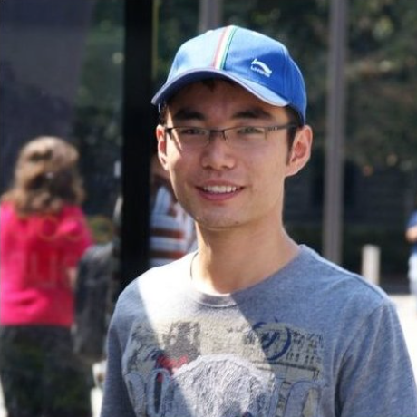
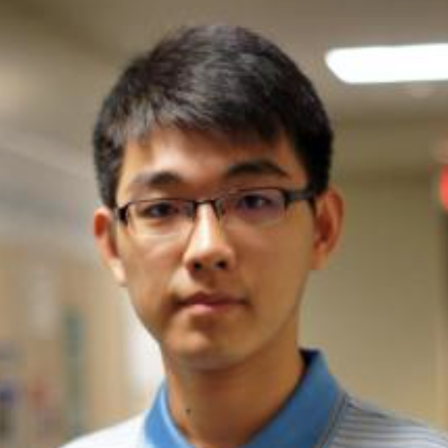

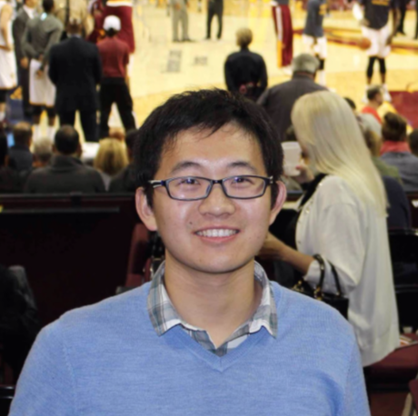
Team
Ouyang Jiannan
PhD Student
CS @ PITT
Operating Systems
Xiangmin Fan
PhD Student
CS @ PITT
Human Computer Interaction
Lingjia Deng
PhD Student
CS @ PITT
Natural Language Processing
Xiaolong Cui
PhD Student
CS @ PITT
Distributed systems

Slide 11
Backup Slides

Slide 12
Pittsburgh Weather
Waiting for buses in the chilly is painful
Temperature/C | 2014.11 | 2014.12 | 2015.01 | 2015.02
Below 0 | 16 | 21 | 29 | 27
Below 10 | 1 | 0 | 0 | 18
Below 20 | 0 | 0 | 0 | 2
Pittsburgh Lowest Temperature (2014.11 - 2015.02)

Slide 13
Realtime Info Benefits
Benefits of realtime bus arrival information
Reduces waiting time
Prevents people from missing their buses
Increases satisfaction and eventually promotes ridership

