Slide 1

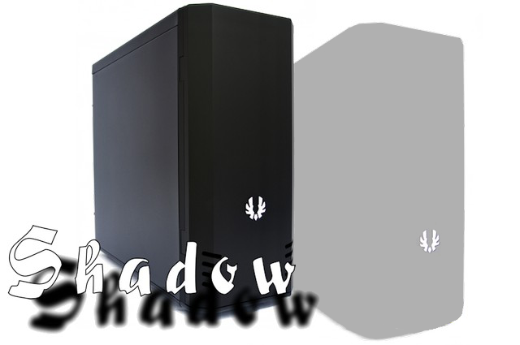


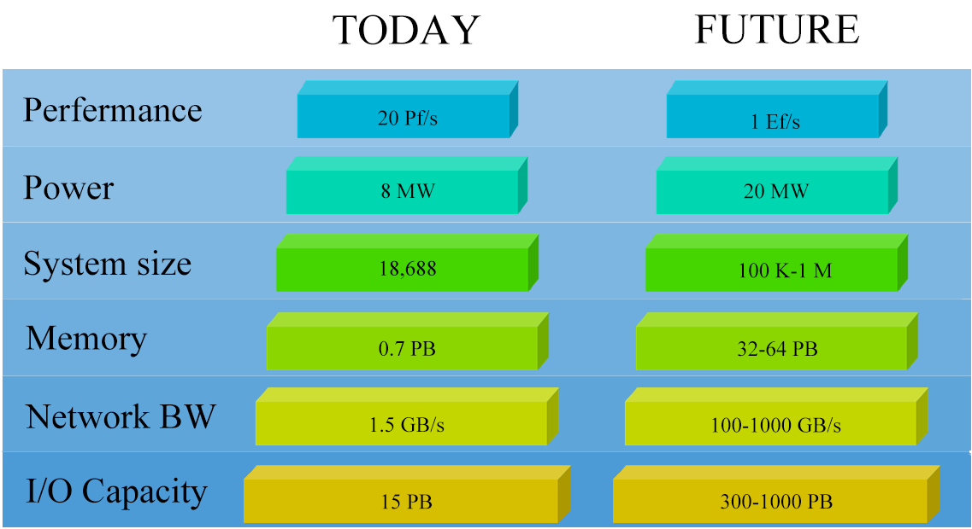
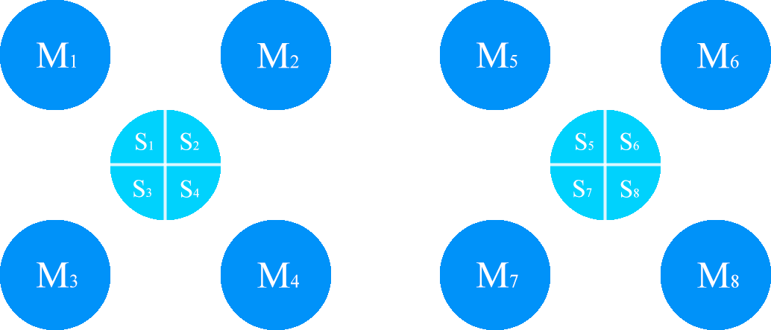
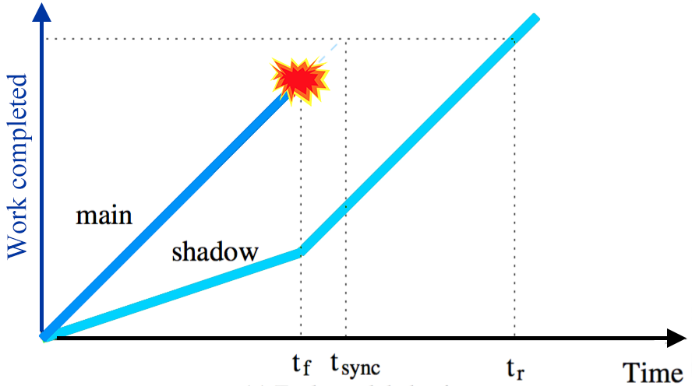
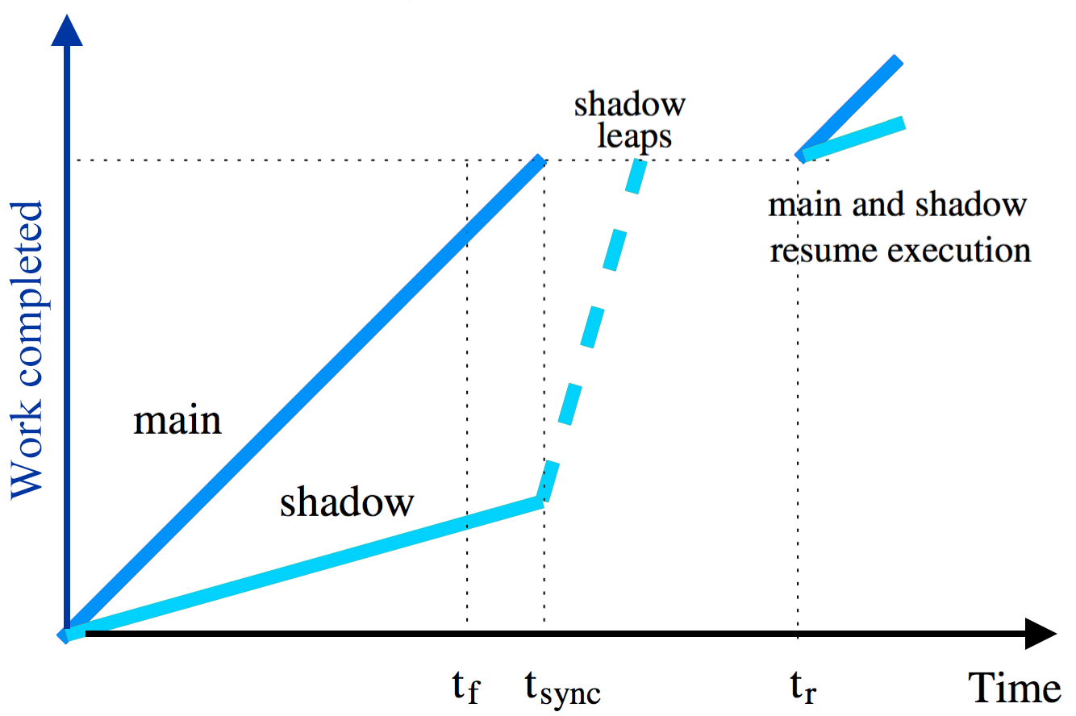
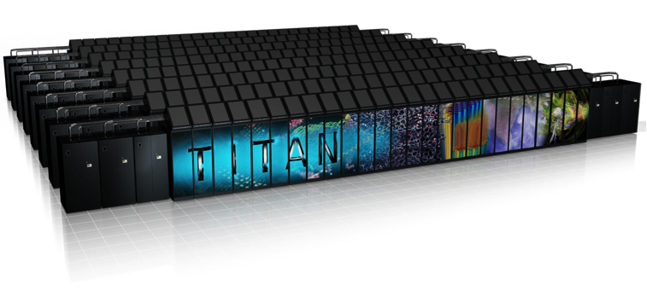
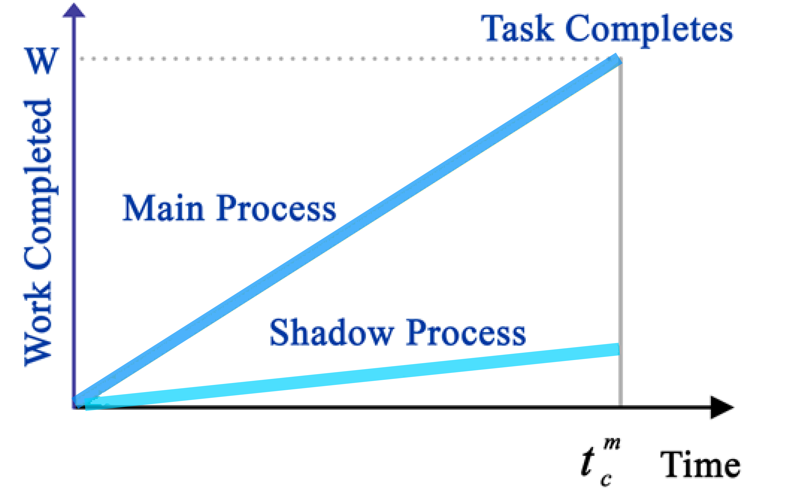
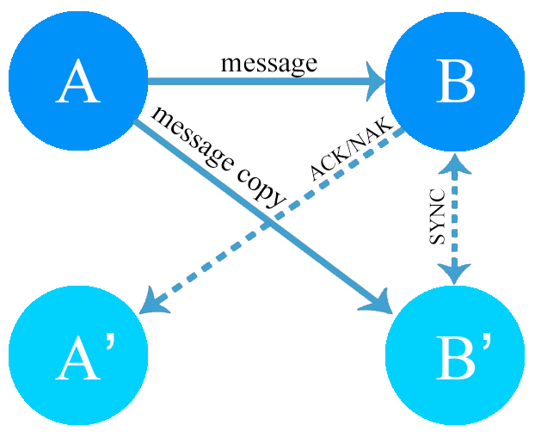
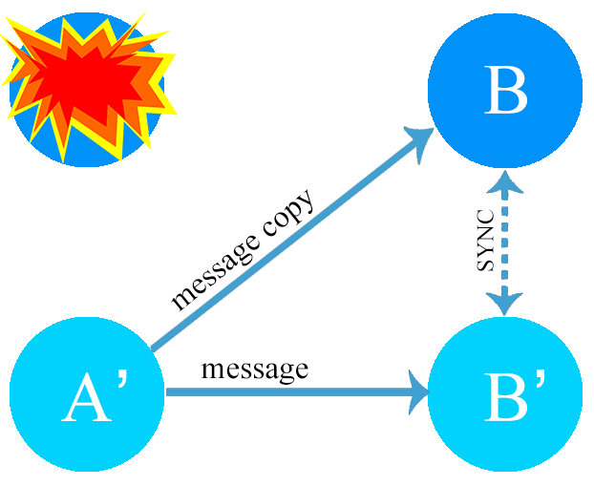
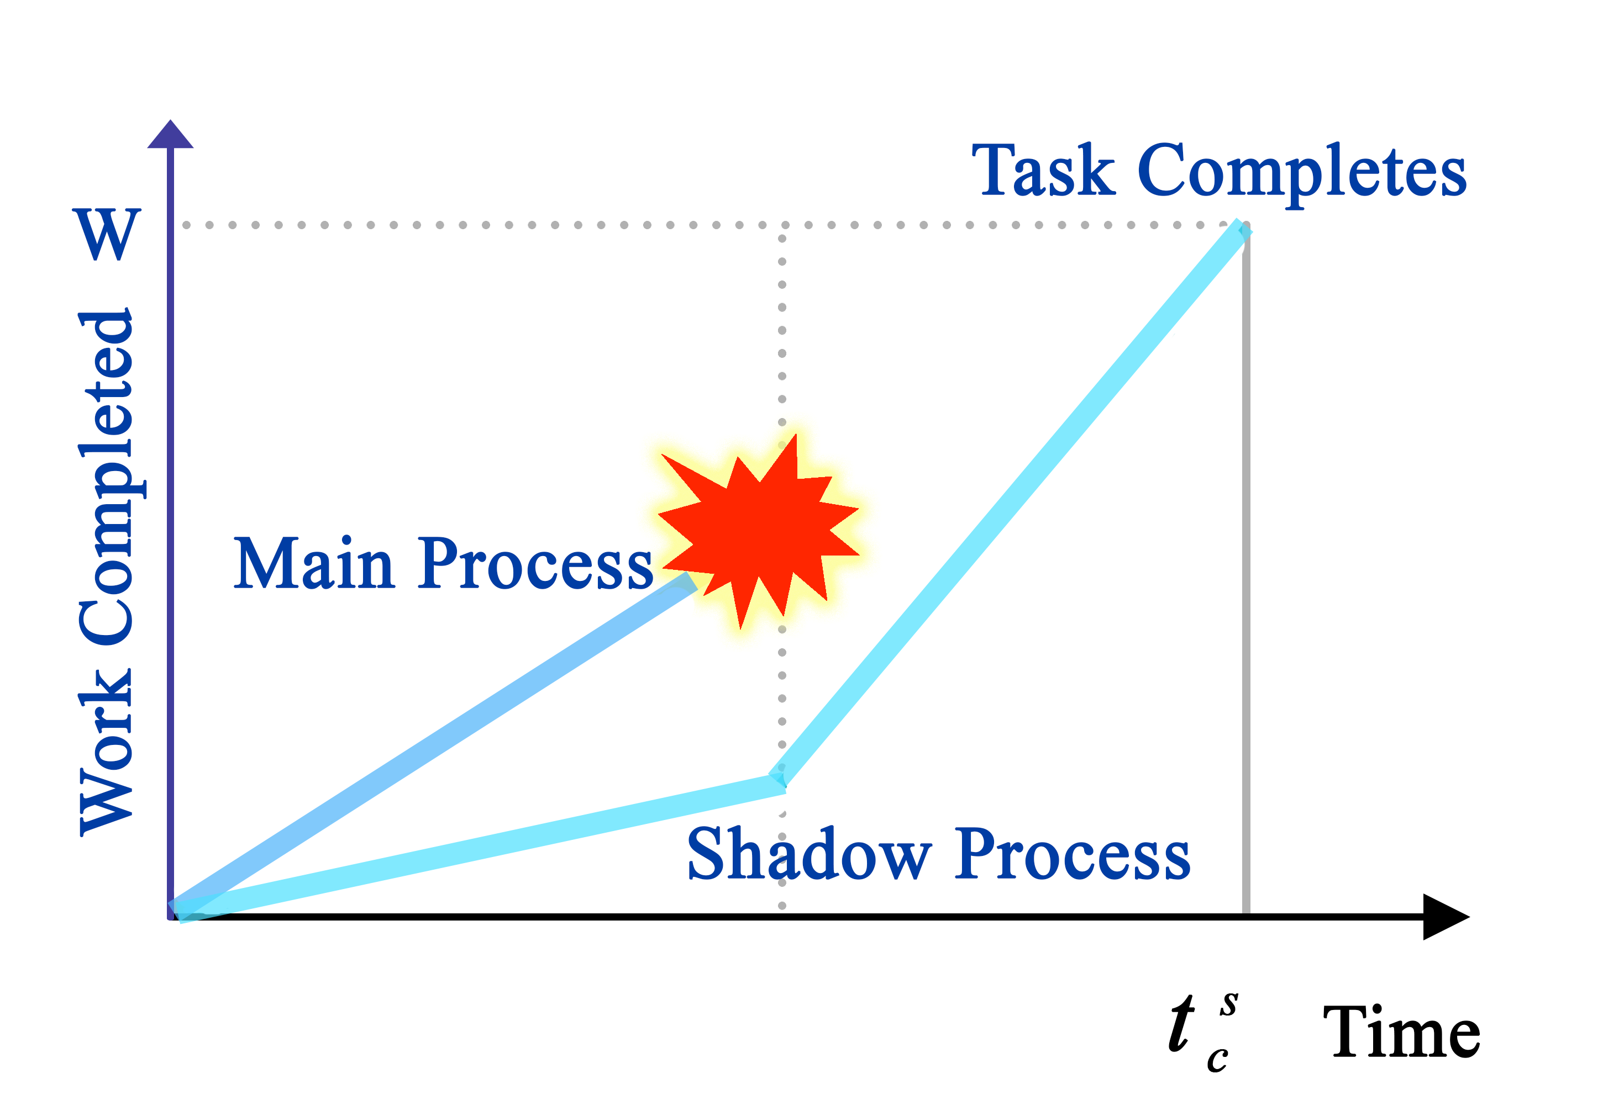
Leaping Shadows: Adaptive and Power-aware
Resilience for Extreme-scale Systems
Xiaolong Cui¹, Tariq Alturkestani², Esteban Meneses³, Taieb Znati¹, Rami Melhem¹
¹Computer Science, University of Pittsburgh, USA
²King Abdullah University of Science and Technology, Thuwal, Saudi Arabia
³School of Computing, Costa Rica Institute of Technology, Costa Rica
Introduction
Shadow Collocation
Shadow Leaping
System scale keeps growing for both HPC and Cloud.
Collocate multiple shadow processes on each node
Reduces shadow processes’ execution rate
Reduces hardware and power requirement
The lagging shadow processes can benefit from the faster execution of the main processes
Sync states from the main processes to the shadows
Overlap leaping
with recovery
Forward progress with minimized power
Reduces main and shadow distance
System level failure rate will increase by orders of magnitude
Power/energy consumption will dominate CAPEX
Minimizes
subsequent
recovery
time
Low efficiency + high cost
Lazy Shadowing
MPI Implementation
Each process is associated with a “shadow”
Shadow processes initially execute at reduced rate
Upon failure of a main process, its shadow process increases execution rate to recover and complete task
A library (lsMPI) is inserted between application and MPI that transparently supports Leaping Shadows
World’s #1 Open Science Supercomputer
Flagship accelerated computing system | 200-cabinet Cray XK7 supercomputer
18,688 nodes (AMD 16-core Opteron + NVIDIA Tesla K20 GPU)
CPUs/GPUs working together – GPU accelerates | 20+ Petaflops
Failure detection is delegated to User Level Fault Mitigation
Reduced execution rate
The Fault Tolerance Spectrum
Power/Energy savings
Fault Tolerance
Dynamic increase of rate upon failure
Roll-back
Leaping Shadows
Replication
Main process duplicates each message
ACK/NAK is used to guarantee consistent promotion of a shadow process in the case of a failure
Main process is responsible for resolving non-determinism, such as MPI_ANY_SOURCE receive, MPI_Wtime( )
Collectives use lsMPI internal point-to-point communications
Time redundancy
Enables trade-off between time and space redundancy
Space redundancy
Delay minimized
CONTACT: Xiaolong Cui xic51@pitt.edu
This poster is supported by US DoE funding.

