Slide 1
An Energy-Aware Resiliency Scheme for Exascale Computing
Bryan Mills
PhD Proposal Presentation
April 5, 2013

Slide 2
Agenda
Background and Motivation
Exascale Computing?
Resiliency and Energy Challenges?
Thesis Statement
Preliminary Work
Shadow Computing
Analytical Model
Proposed Work
Simulation, Implementation, etc.
What is the Contribution?
Timeline

Slide 3
Background and Motivation
An Energy-Aware Resiliency Scheme for Exascale Computing

Slide 4
Exascale Computing
“One or more key attributes of the system achieve a 1,000 times the value of a corresponding attribute of a “Petascale" system” [1]
Three dimensions
Functional performance
Flops per second
Physical attributes
Shrink Petascale down to a desktop
Application performance
Speed of science
[1] K. Bergman, et.al. Exascale computing study: Technology challenges in achieving exascale systems. 2008
Notes:
As defined by Exascale Working Group
Reference

Slide 5
Functional Performance
1,000 times more powerful than petascale
Titan is 58x smaller
Computer | Petaflops | Growth
Exascale | 1000
Exascale GAP
Titan | 17.59 | 58x
Sequoia | 16.32 | 62x
K Computer | 10.51 | 100x
Mira | 8.16 | 125x
JUQUEEN | 4.14 | 250x
* Top 500 (http://www.top500.org/)
Notes:
Reference top 500 ( http://www.top500.org/)

Slide 6
History
Key to petascale was the multicore processor
Titan has 18,688 computing nodes with 299,008 cores (16 cores each)
Each node has a GPU capable of 1.17 teraflops a second!
Led to monumental developments in…
Operating Systems
Compilers
Algorithms
File Systems
Architecture

Slide 7
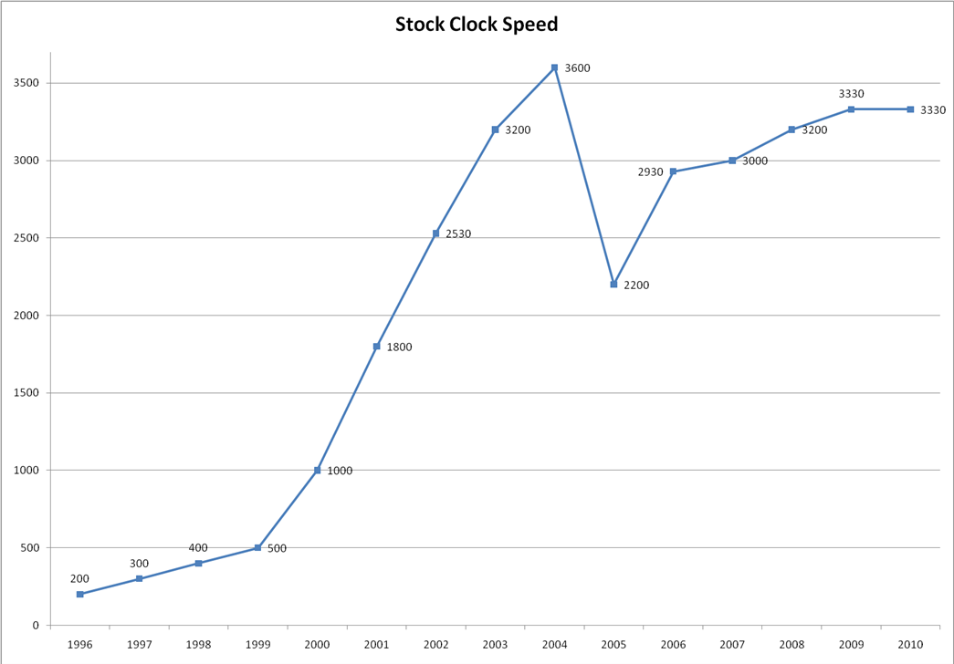
Why Parallelism?
Clock speeds have plateaued in last 5 years
* http://www.maximumpc.com/ (history of multicore processors)

Slide 8
Future
Hit physical limits of speed but continuing to shrink die size paving way for more cores
Exascale will also be achieved by exploiting parallelism, testing the limits of our petascale solutions
Many-core not Multi-core
We will see 100s if not 1000s of cores per chip
Titan is demonstrating this with its use of GPUs

Slide 9
Major Challenges at Scale
Making the transition to exascale poses numerous unavoidable scientific and technological challenges
Harnessing the Potential of Massive Parallelism
Effective use of unprecedented levels of concurrency requires new conceptual and programming paradigms
Reducing Power Requirements
Based on current technology, scaling today’s systems to an Exaflop level would consume more than a Gigawatt of power
Resiliency to Failure
An immediate consequence of exascale computing is that the frequency of errors will increase
Notes:
Hoover dam produces 2.08 Gigawatt when running a full capacity
animate

Slide 10
Energy Challenge
DoE has set an energy target of 20 megawatt for exascale computing
Requires a minimum of 23x reduction in energy!
Computer | Energy (MW) | Growth | Projected (MW)
Exascale | - | - | 20
Exascale GAP
Titan | 8.20 | 58x | 475.6
Sequoia | 7.89 | 62x | 489.2
K Computer | 12.65 | 100x | 1265.0
Mira | 3.95 | 125x | 493.8
JUQUEEN | 1.97 | 250x | 492.5
Notes:
Hoover dam produces 2.08 Gigawatt when running a full capacity
Requirement/constraint

Slide 11
Resiliency Challenge
Mean time between failure (MTBF) projected to be 5-20 years per node
At best we are looking at a node failure every 10 minutes if we simply scale todays technology
Computer | # Nodes | Growth | Projected | MTBF (20yr)
Titan | 18,688 | 58x | 1,083,904 | 9.69 minutes
Sequoia | 98,304 | 62x | 6,094,848 | 1.72 minutes
K Computer | 80,000 | 100x | 8,000,000 | 1.32 minutes
Mira | 49,152 | 125x | 6,144,000 | 1.71 minutes
JUQUEEN | 28,672 | 250x | 7,168,000 | 1.46 minutes
Notes:
Mention MTTI

Slide 12
Faults at Exascale
Faults will no longer be exceptional events but part of normal operations
Faults every 10 minutes!
Resiliency to faults are clearly a critical component along the path to exascale
Notes:
Face of failure

Slide 13
Major Challenges at Scale
Making the transition to exascale poses numerous unavoidable scientific and technological challenges
Harnessing the Potential of Massive Parallelism
Effective use of unprecedented levels of concurrency requires new conceptual and programming paradigms
Reducing Power Requirements
Based on current technology, scaling today’s systems to an Exaflop level would consume 500 Megawatts of power
Resiliency to Failure
An immediate consequence of exascale computing is that the frequency of errors will increase
Notes:
Hoover dam produces 2.08 Gigawatt when running a full capacity
animate

Slide 14
Fault Tolerance
Two methods exist today
Replicated State Machine
Processes are replicated and executed in parallel
Checkpoint and Restart
Periodic execution state information is written to stable storage and reloaded in the event of failure

Slide 15
State Machine Replication
Processes are replicated and if one process fails a replica process will take over execution
This requires at least 2x the resources
Replica processes must coordinate to detect failures and ensure system consistency
This technique is not currently used in high performance computing due to overhead

Slide 16
Checkpointing
Coordinate checkpointing requires all working nodes to pause execution and write state to stable storage
This is the standard method of checkpointing today
It takes at least 20 minutes to write a checkpoint [1]
Recall faults occur every 10 minutes!
Over 70% of the execution time will be wasted on writing checkpoints and recovering from failures
[1] Franck Cappello. FAULT TOLERANCE IN PETASCALE/EXASCALE SYSTEMS: CURRENT KNOWLEDGE, CHALLENGES AND RESEARCH OPPORTUNITIES, 2009

Slide 17
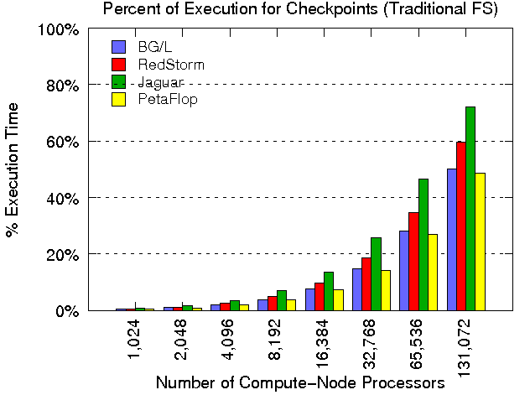
Checkpointing Overhead*
*Sandia Report

Slide 18
Can Checkpointing Scale?
Strongly believed that checkpointing cannot provide efficient fault tolerance in exascale systems
Other checkpointing
Uncoordinated checkpointing
Message Logging
Checkpointing time can be reduced
Copy on write
Incremental Differences
Notes:
Uncoordinated checkpointing requires a “sync” on failure only, but if failures are common we will be paying that cost a lot.
Message logging will require lots of memory.
Reducing checkpointing time seems relevant regardless of rollback recovery method. However this is a loosing battle because as the number of nodes grow MTTI will increase thus forcing the checkpoint to be more efficient, eventually checkpointing time will exceed MTTI.

Slide 19
Energy Concerns
Fault tolerant schemes fail to address the energy concerns
State replication increase energy by 2x
HPC community largely dismisses this due to this fact
Checkpointing and energy is still being explored
Notes:
Memory might be a bigger concern now than processors
More importantly neither of these techniques address energy…

Slide 20
Thesis Statement
Is it possible to build a scalable, energy-aware fault tolerant exascale computing infrastructure?
If so, how can we build such a system?
Shadow Computing?

Slide 21
Preliminary Work
An Energy-Aware Resiliency Scheme for Exascale Computing

Slide 22
Shadow Computing
The basic idea of shadow computing is to associate a suite of “shadow processes” with each main process.
Shadow processes run at lower processor speed than the speed of the primary process.
The number of “shadow processes” associated with a primary process is determined based on the performance requirements of the applications, including response time and energy constraints, and the propensity of the system to failures
The concept of a shadow process bears similarity with a “pure” process replication
Shadow computing aims at saving energy, while maintaining same level of fault-tolerance
Notes:
Novel Idea…

Slide 23
Shadow Computing with Failure
Main Process
Fails
Task Completes
Work Completed
Main Process
Shadow Process
Increases Speed
After Failure
Shadow Process
Time

Slide 24
Shadow Computing without Failure
Task Completes
Work Completed
Shadow Process
Terminates
Main Process
Shadow Process
Time

Slide 25
Shadow Computing
Task
Starts
Main
Fails
Task
Completes
X
Main
Process
Shadow
Process
Shadow process runs along side of the main process but unlike replication it runs at two different execution speeds, one before failure and one after
Speed of shadow before failure
Speed of shadow after failure

Slide 26
Preliminary Research Questions
Is it possible to save energy using shadow computing while meeting application requirements?
How would one determine energy optimal execution speeds for the shadow process?
Answer: Develop and Study an Analytical Model

Slide 27
Expected Energy Model
X
Main
Process
Competition time of main process without failure
Targeted Response time of the task
Shadow
Process
If Failure
Energy of Main
Energy of Shadow
No Failure
Energy of Main
Notes:
Model represents one individual task being executed by one main process and one shadow process. Goal is to see if this saves us energy.

Slide 28
Expected Energy Model
X
Main
Process
Shadow
Process
Energy consumed over time t at speed
If Failure
Energy of Main
Energy of Shadow
Probability density function representing probability of failure at time t
No Failure
Energy of Main
Notes:
Model represents one individual task being executed by one main process and one shadow process. This was developed to answer the question “does this save energy”?

Slide 29
Expected Energy Model
X
Main
Process
Shadow
Process
If Failure
Energy of Main
Energy of Shadow
No Failure
Energy of Main
Notes:
Review each part of the formula, discuss how we “build” up the expected energy model.

Slide 30
Observations
Pure Replication and Rollback-Recovery are special cases of shadow process
Replication:
Checkpointing:

Slide 31
Optimization Problem
Objective is to find execution speeds which minimize the expected energy
- Failure distribution
- Energy at speed for duration t

Slide 32
Constraints
The speed of the main must be fast enough to complete before time t_{R}
Minimum work constraint ensures enough work is done by the shadow before failure to enable the task to finish by the targeted response time t_{R}
Constrain the lower and upper bounds on the speed
Notes:
Minimum work constraint becomes very important when applied to HPC

Slide 33
Constant Values
Time of completion of the main process is fixed given the work and speed of the main process
Because our model fixes the speed of the shadow after failure we must set it such that the shadow can finish given the worst case failure (at t_{c})
Notes:
This last constant allows us to reduce the optimization problem to 2 variables, speed before and after failure.

Slide 34
Application to HPC
It is expected that in HPC execution would be set to the fastest possible speed
There main process executes at maximum speed
If the main process fails we assume some “laxity factor”,
This gives us the targeted response time
Notes:
Note that this further reduces the optimizations problem to 1 unknown variable, speed before failure.
For example if W=100 units, sigma_max = 1 units/sec and alpha = 1.25 then t_R = 125
Cost of fault tolerance

Slide 35
Energy and Failure Model
Energy Model – For our analysis we assume that the power function is defined as the squared value of the speed.
Failure Model –This analysis assumes an exponential probability density function.
Notes:
By assuming this energy and failure model can derive a closed form solution for HPC

Slide 36
Closed Form Solution for HPC
Take derivative with respect to the , set to zero and solve for

Slide 37
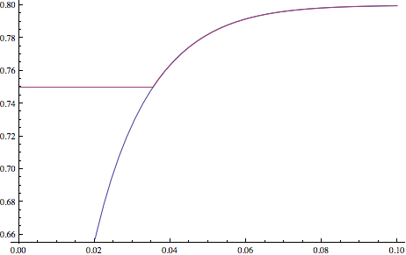
Not so fast…
We forgot about minimum work constraint
Optimal found numerically
σ_{s,b}
Optimal found in closed form
λ
W=100, R=125

Slide 38
Minimum Work Constraint
Ensure enough work is done by the shadow before failure to make sure it will finish
It places a lower bound on the speed of the process before
Notes:
Wait…. The solution in previous slide doesn’t account for the minimum work constraint. This places the following lower bound and needs to wrapped in a Minimum function.

Slide 39
Results
Energy savings over pure replication, for job size of 12 hours
Notes:
Depending on the laxity factor one will save more energy.

Slide 40
Results
Energy savings over pure replication as a function of job size, MTBF = 10 days
Notes:
Note the “min” savings shifts towards 10 days, why? Because if failure occurs early in our model then we still save energy, the worst case is if failure occurs near 10 days. This is not easy to see with smaller jobs. However energy savings are consistent.

Slide 41
Current Conclusions
Shadow computing has the potential to save energy while maintaining same fault tolerance level and application requirements
Highly dependent upon the amount of laxity

Slide 42
Proposed Work
An Energy-Aware Resiliency Scheme for Exascale Computing

Slide 43
Proposed Work
Expand Analytical Model
Simulation
Implementation
Comparison to Checkpointing

Slide 44
Expand Analytical Model
Expand model to relax the following restrictions
Main process executes at fixed speed
Jointly derive speed of replica-set to meet requirements with minimum energy
Fixed Targeted Response Time
Reward driven response time
Single Failure in the replica-set
Allow for shadow and main process failures
Single Shadow
To provide additional fault tolerance we want to expand study to include multiple replicas

Slide 45
Simulation
Build a general simulation framework for evaluating fault tolerance techniques at exascale levels
Simulation framework
Define metrics to capture
Evaluate Shadow Computing using framework
Performance Assessment
Comparative analysis

Slide 46
Implementation
Assess feasibility of shadow computing
Implement within existing HPC runtime environment
MPI based environment
It may be necessary to “remove” some functions in MPI to ensure deterministic message sends
May consider new computational models beyond MPI
Evaluate overhead of implementation
Compare with existing fault tolerant techniques

Slide 47
Comparison to Checkpointing
Compare shadow computing to checkpointing
Simulation
Implementation
Find the “cross-point” where shadow computing outperforms checkpointing
Number of nodes
Energy consumption
Throughput
Notes:
Why? Because checkpointing is #1 now so we should see when it crosses over and become worse than shadow computing.
See where the cross point of shadow computing.

Slide 48
What is this contribution?
Fault tolerance is a system that masks the application from faults by using some form of redundancy
Hardware
Software
Information
Time
Notes:
Hardware = replication
Software = write the same “code” twice
Information = Copy data, RAID
Time = Rollback and Recovery

Slide 49
Where is this contribution?
Fault Tolerance
Rollback Recovery
Shadow Computing
Replication
Time redundancy
Enables tradeoff between time and hardware redundancy
Hardware redundancy

Slide 50
Proposed Timeline
An Energy-Aware Resiliency Scheme for Exascale Computing

Slide 51
Timeline
April 2013
Define reward-based model
Define simulator architecture and basic components
May 2013
Begin implementing in MPI
Work on defining evaluation model
June 2013
Continue implementing in MPI
Continue work on simulator
July 2013
Execute experiments in both MPI and simulator
August 2013
Finish executing experiments
Finalize and publish results, targeting conference DSN and HPC

Slide 52
Timeline
Sept 2013
Extend model for multiple shadows, extend simulator for multiple shadows
October 2013
Compare various fault tolerant schemes in exascale computing
November 2013
Refine model and finalize results for publication
December 2013 – April 2014
Write dissertation
Write journal papers
May 2014
Defend dissertation

Slide 53
Questions?
Shadow Computing is cool
… lets study it more
… please!

Slide 54
Exascale Timeline
Systems | 2009 | 2014 | 2017 | 2020
Peak Perf. | 2 Peta | 20 Peta | 100-200 Peta | 1 Exa
Memory | 0.3 PB | 1.6 PB | 5 PB | 10 PB
Node Perf. | 125 GF | 200GF | 200-400 GF | 1-10TF
Node Mem BW | 25 GB/s | 40 GB/s | 100 GB/s | 200-400 GB/s
Node Ccurrncy | 12 | 32 | O(100) | O(1000)
Intercont BW | 1.5 GB/s | 22 GB/s | 25 GB/s | 50 GB/s
Nbr of Nodes | 18,700 | 100,000 | 500,000 | O(Million)
Total Ccurrncy | 225,000 | 3,200,000 | O(50,000,000) | O(Billion)
Storage | 15 PB | 30 PB | 150 PB | 300 PB
IO | 0.2 TB/s | 2 TB/s | 10 TB/s | 20 TB/s
MTTI | Days | Days | Days | O(1 Day)
Power | 6 MW | ~10MW | ~10 MW | ~20 MW

Slide 55
What is a Fault?
Fault is a deviation from expected system behavior
Operational Fault
Faults at the lowest level (ie hardware)
Design Fault
Result of design itself (ie software bugs)
Failures are application visible faults

Slide 56
What is Fault Tolerance?
System which masks the application from faults by using some form of redundancy
Hardware
Software
Information
Time

Slide 57
Example of Fault Tolerance
Show example of 3-redundent voting processors

Slide 58
Fault Tolerant Components
There are four main components of fault tolerance
Fault Detection
Fault Containment
Fault Recovery
Fault Preparedness

Slide 59
Fault Tolerance at Exascale
Faults will be part of the normal system behavior and not an exceptional event
Show graph of fault times at exascale (simulation)

Slide 60
QoS of Fault Tolerance
Application or System will need to specify
Resiliency to Faults
Some systems will be able to accept “some” faults
Execution Speed
Set speed of execution, although capability computing will always want to run as fast as possible
Completion Time
Capacity computing will be concerned with throughput
Energy Consumption
Either the application or system will specify available energy

Slide 61

Closed Form Solution for HPC
Derive a closed for solution using standard optimization techniques
Find derivative, set to zero and solve for
Notes:
Show methodology

