Slide 1
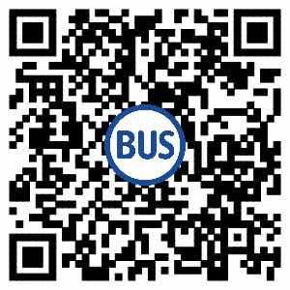
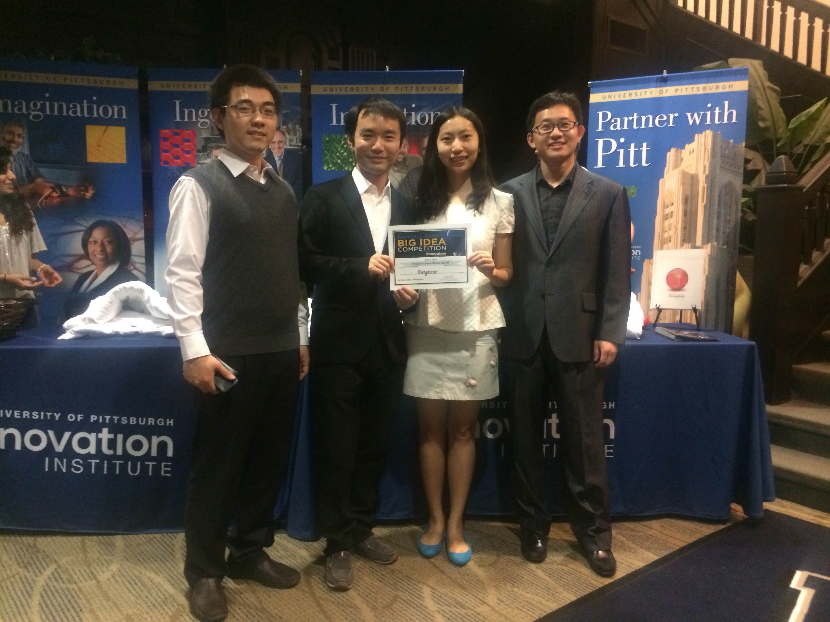
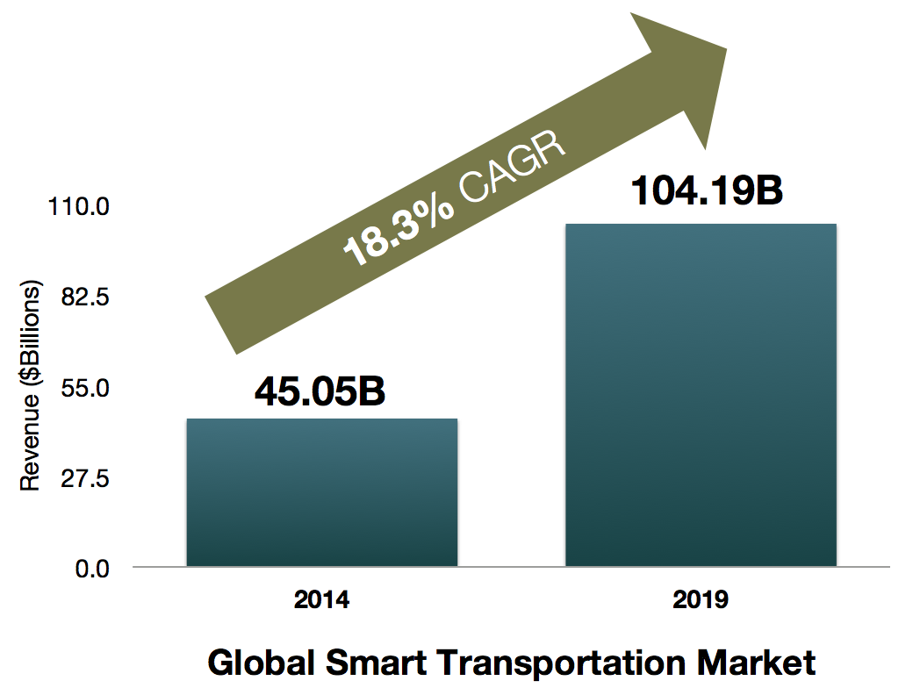
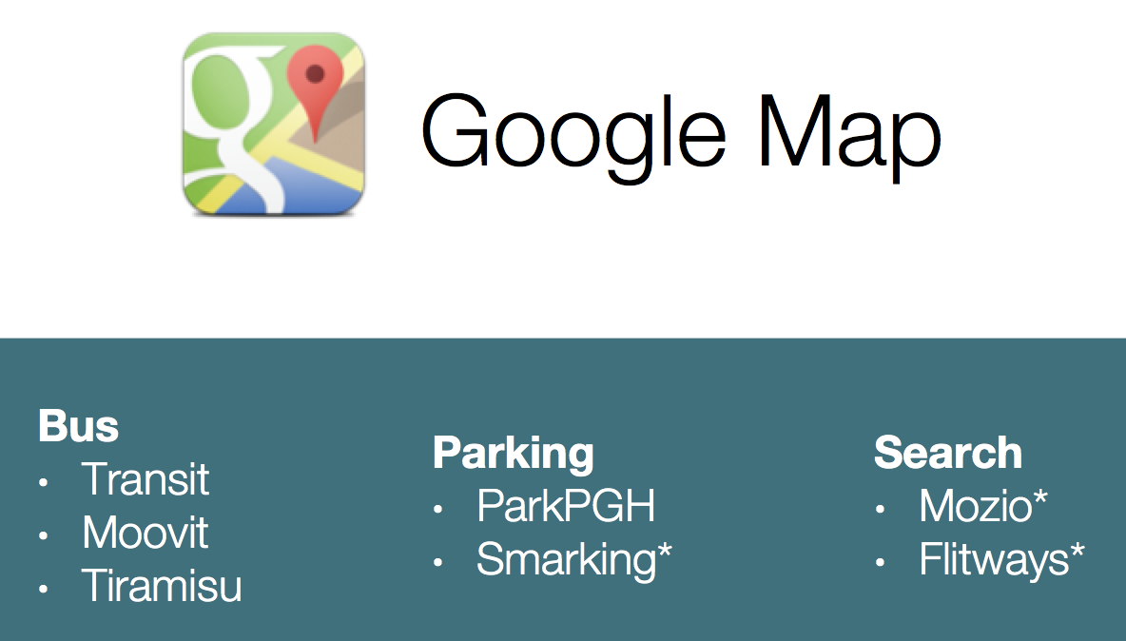

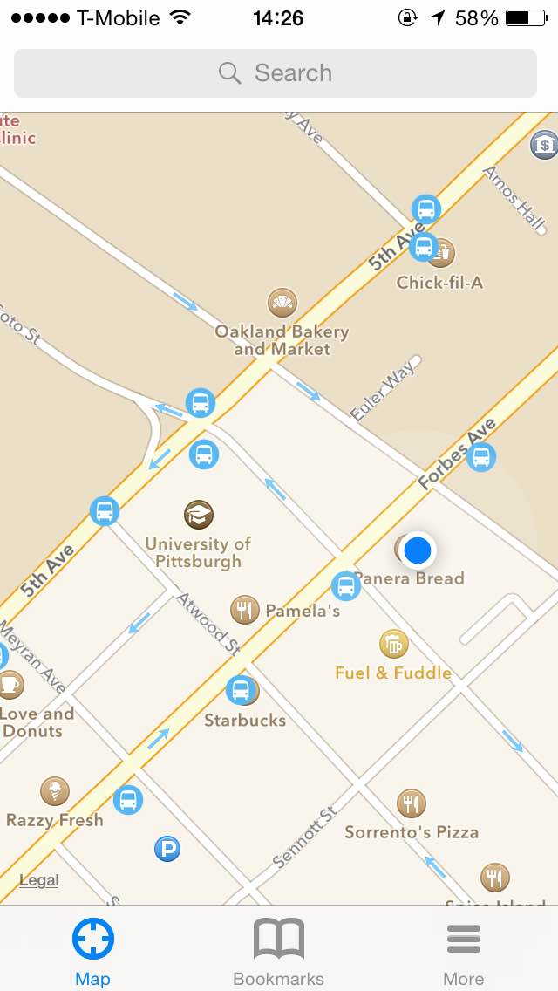
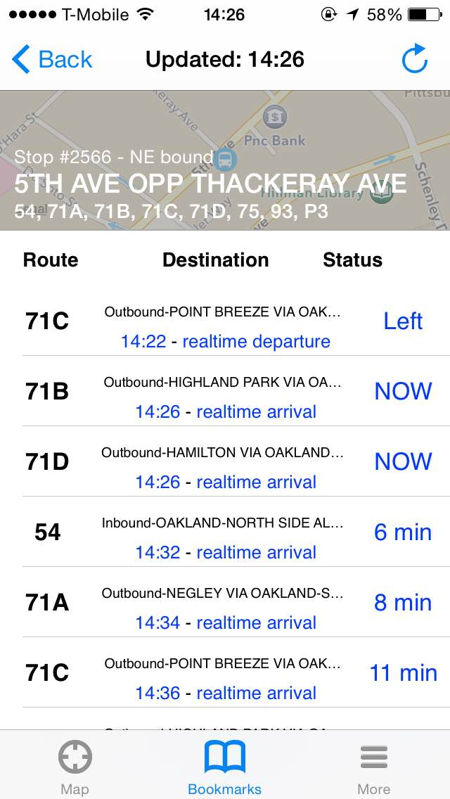

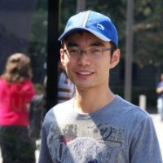
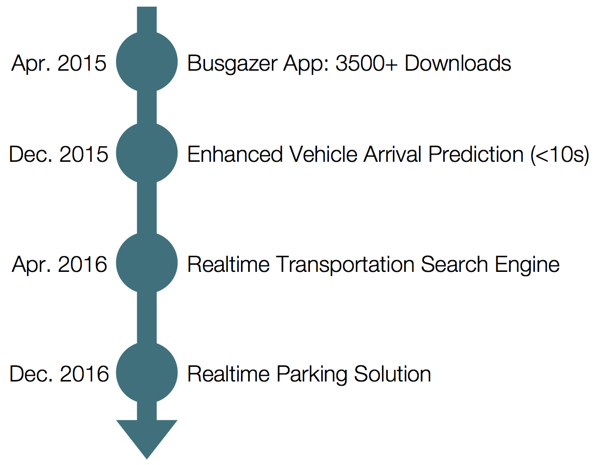
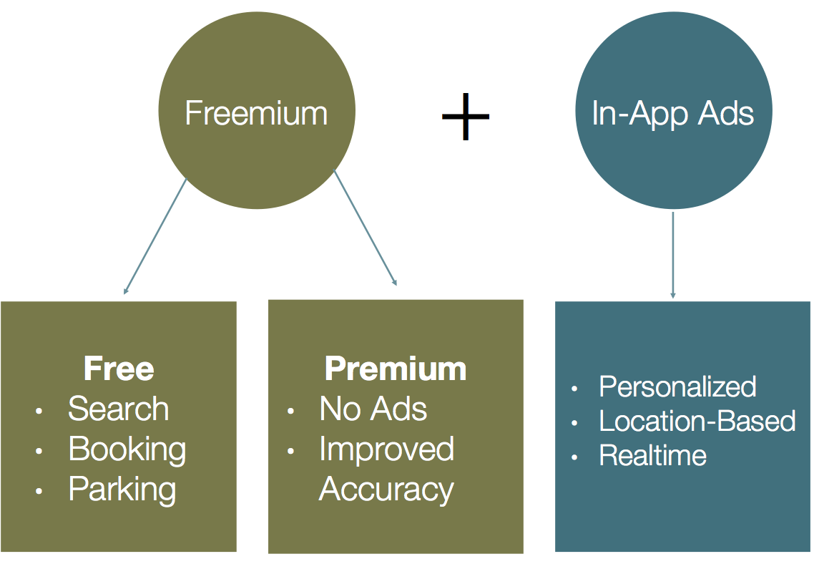
RTrans: A Revolution In Transit Systems, And A Leap Towards Smarter Cities
Jiannan Ouyang, Lingjia Deng, Xiangmin Fan, Xiaolong Cui
RTrans
Summary
Solution
Market
Team
The complexity and uncertainty in our transportation systems make people feel terrible when travelling around. Especially when you get to an unfamiliar city, much effort is needed to know how you can get to your destination, how much time it takes, what the cost is, and small mistakes can lead to huge costs.
RTrans aims at providing a real-time transportation search engine that provides user-friendly, accurate and complete point-to-point transit solutions (including buses, taxis, uber cars, shuttles, and even parking information for private cars) for users to compare and choose from.
The proposed solution is a mobile app that with one click, users will get all the information that they need for point-to-point travelling. Currently, we have a prototype that provides accurate bus arrival predictions in Pittsburgh. It has gained over 3,500 users since deployment in Nov. 2014.
At the heart of our approach is the real-time transportation data collected from both smartphone sensors and transportation agencies. On top of that, we deploy machine learning and artificial intelligence techniques on our huge data set to extract, label, and classify useful information. Finally, point-to-point transit solutions are delivered in a timely and user-friendly manner based on users' requests.
Target Market:
Competitors:
Jiannan Ouyang
Team Lead
Ph.D. Student
Operating System
Xiangmin Fan
Ph.D. Student
HCI
Lingjia Deng
Ph.D. Student
Artificial Intelligence
Xiaolong Cui
Ph.D. Student
Distributed System
We have a team, there is a pain, we have the solution. We have a beautiful product, and we have attraction.
Contact
Competitive Advantage:
High-tech
Complete
User-friendly
Future
Revenue Model:
The welcome page is a map where you can see all the bus stops
All bus lines with accurate predictions are presented to users in response to requests
Jiannan Ouyang
PhD Student ouyang@cs.pitt.edu Computer Science Department University of Pittsburgh

