Slide 1


CompTIA Security+
(Exam: SY0-701)
Chapter 2: Cryptographic Solutions and Threats

Slide 2
Objectives
Cryptography Concepts
Implementations of Cryptography
Cryptographic Tools
Public Key Infrastructure (PKI)
Threats
Social Engineering

Slide 3
CompTIA Exam Objectives
1.4 Explain the importance of using appropriate cryptographic solutions.
2.1 Compare and contrast common threat actors and motivations.
2.2 Explain common threat vectors and attack surfaces

Slide 4
Chapter 2: Cryptographic Solutions and Threats
► Cryptography Concepts

Slide 5
Cryptography
Practice and methods used to protect security of information through encoding.
Encoding- making sure information can only be read by authorized subjects
Algorithms- mathematical operations, rules
Encryption- one form of cryptography, relies on algorithms to scramble data
Decryption- reversing or descrambling encrypted data
Cryptanalysis- looking for weaknesses or errors in cryptographic system

Slide 6
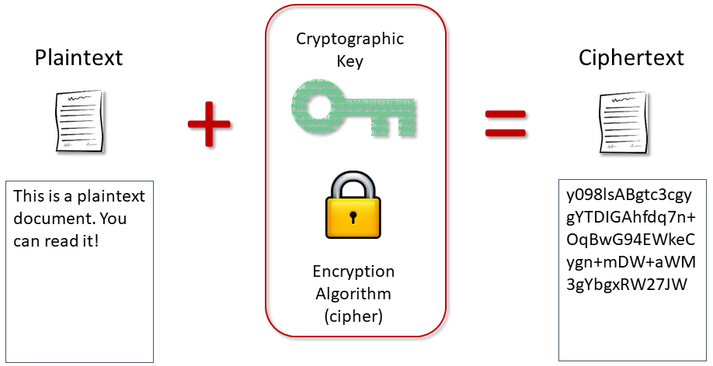
Cryptography Terms
Plaintext- unencrypted data
Ciphertext- encrypted data
Cipher- (or algorithm) process that encrypts/decrypts data
Cryptographic key- string of data, used with cipher, to secure data

Slide 7
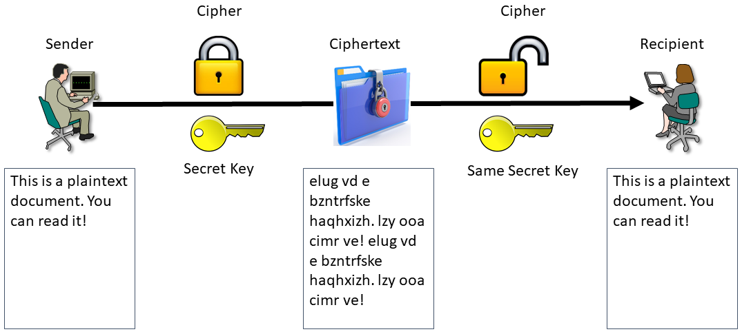
Symmetric Encryption
Used for confidentiality (privacy)
Same shared secret key used for both encryption and decryption
Fewer compute resources required, fast, good for bulk encryption of large blocks of data
Problem- secure storage and distribution of key
AES, DES, IDEA, RC4

Slide 8
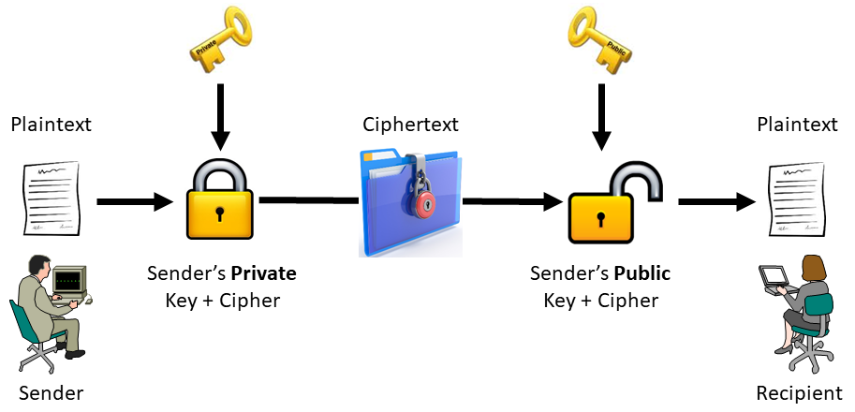
Asymmetric Encryption
Public/private key pair
  Keys are linked, but unique
  Cannot derive on key from other
  Private key kept secret, public key distributable
Each key reverses operation of other key
Problem- extensive resource consumption, slow, used for small amounts of data
Used for non-repudiation, key exchange, authentication
Also referred to as Public Key Cryptography
ECC, RSA

Slide 9
Key Length
Key is string of characters, used in determining transformation and security of data
Length measured in bits, denotes total number of possible key values
Longer key, generally more secure (e.g. 1024 bits compared to 2048 bits, assuming same cipher), affects cryptanalysis success rate
Should be random (or pseudo-random), disorderly, uncertain

Slide 10
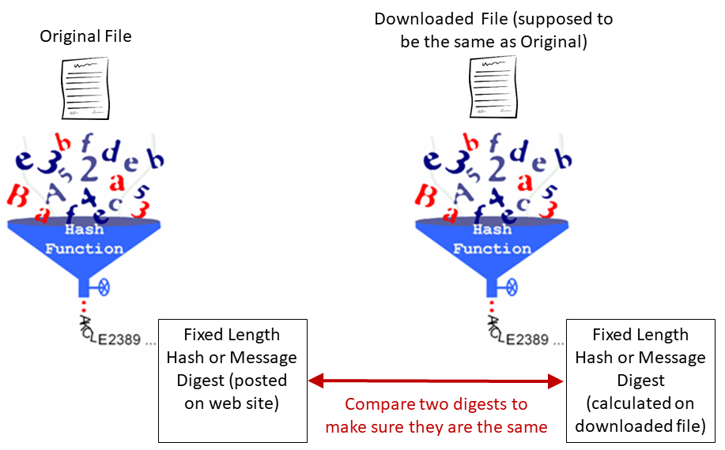
Hashing
Takes input and creates fixed length output (message digest), unique representation of data
NOT encryption/decryption
One-way function- cannot derive original data from digest
Anti-collision- multiple plaintexts should not result in output of same digest
Used for data integrity, message authentication, password storage
MD5, SHA, RIPEMD

Slide 11
Digital Signatures (1)
Combines public key cryptography with hashing
Provide non-repudiation, integrity, authentication
DSA, ECDSA, RSA

Slide 12
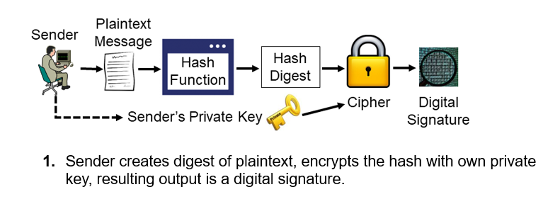
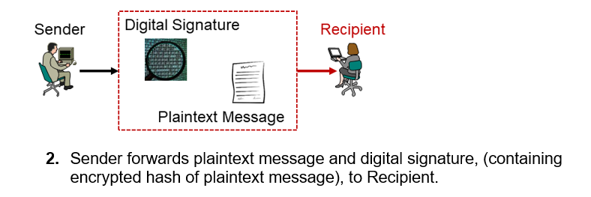
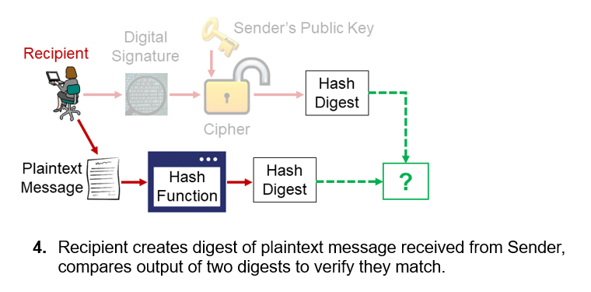
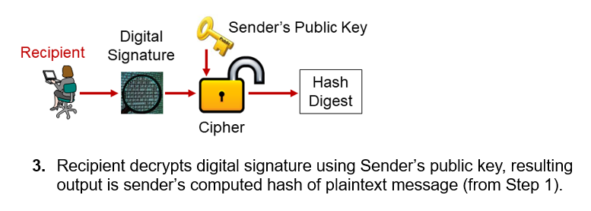
Digital Signatures (2)

Slide 13
Chapter 2: Cryptographic Solutions and Threats
► Implementations of Cryptography

Slide 14
Encryption
Data states
  Data at rest, data in transit, data in use
  Data lifecycle

Slide 15
Encryption Levels – Data at Rest
Disk, partition, volume, file
Full disk- encrypt whole disk
  Commonly implemented by self-encrypting drive (SED)
Partition- and volume-level
  Commonly implemented by software (operating system)
File-level
  Files, folders
  Implemented by software/OS

Slide 16
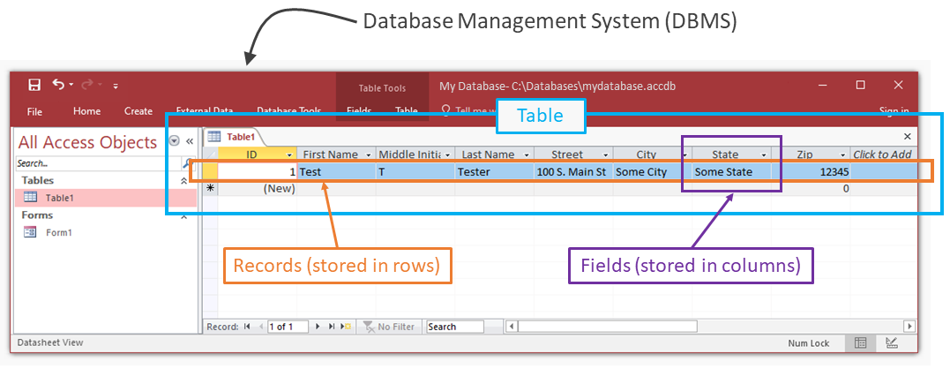
Encryption Levels – Database (1)
Database
  Collection of structured data (data fits into confines of database table)
  Database management system (DBMS)
  Managed by database administrator (DBA)
  Data organized into tables, rows (records), columns (fields)

Slide 17
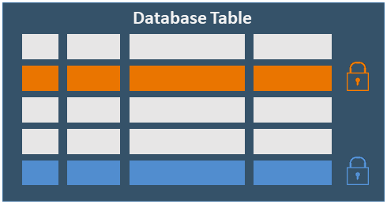
Encryption Levels – Database (2)
Database-level encryption
  Data-at-rest (including database logs and backups)
  Protection data from theft of storage media
Record-level encryption (also called row-level)
  Each record (row) in table
  encrypted with separate key pair
  Enforce access restrictions at
  record-level
  Supports compliance

Slide 18
Transport/Communication Encryption
Protects data in transit between two or more points
Vulnerable to eavesdropping, data outside control of administrator
Transport Layer Security (TLS)
Internet Protocol Security (IPsec)

Slide 19
Key Exchange (1)
Symmetric encryption problem- secure exchange of shared key
Asymmetric encryption advantage- secure private key
Combine these
  Symmetric key for bulk encryption
  Asymmetric key to encrypt symmetric key for exchange
Hash-based message authentication Code (HMAC)

Slide 20
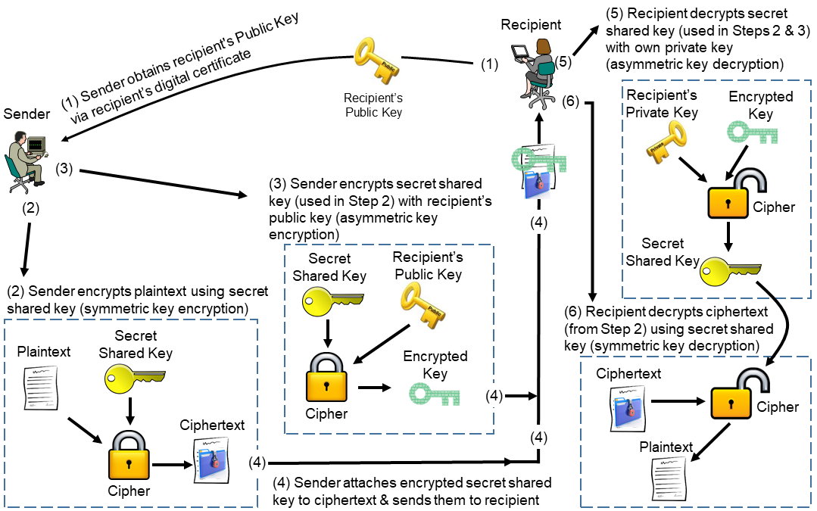
Key Exchange (2)

Slide 21
Key Exchange (3)
Important points to consider about example of key exchange:
Shared key never changes
Same cipher is used throughout the exchange for both encryption and decryption
Plaintext message never changes
Recipient’s private key, should be kept secret, and never shared
More the recipient’s public key is distributed, the more vulnerable it can become
Encrypting the plaintext, will not encrypt the shared key. Nor will encrypting the shared key, encrypt the plaintext. The same concept applies to decryption.

Slide 22
Perfect Forward Secrecy (PFS)
Key exchange deprecated, due to risks of key compromise
PFS key agreement mitigates risks of key exchange (keys never exchanged)
  Sender and recipient’s stations agree on key value
  New, unique, ephemeral key value generated each session
  Short-lived, have expiration
  Once expired, key no longer useful
Diffie-Hellman Ephemeral (DHE)
Elliptic Curve DHE (ECDHE)

Slide 23
Key Escrow
Used for secure storage of cryptographic keys
  Trusted third-party
Storage for copies, backups
Same operational functions and vulnerabilities as original key

Slide 24
Obfuscation (1)
Making data or message unclear, unintelligible, or difficult to understand.
Steganography- concealing, or embedding secret information within a non-secret digital cover medium.
  Digital cover mediums- document, video, picture, text, audio, network protocol
  Prove integrity, non-repudiation
  Covert channels

Slide 25
Obfuscation (2)
Tokenization- replaces sensitive data with different, randomly generated, undecipherable, non-sensitive, substitute (called a token)
  Reversible, authorized request with token can access original data in vault
Data masking- all or part of dataset hidden
  Substitute, masked data shows in place of original
  Social Security number, 123-45-6789
          Masked, xxx-xx-6789

Slide 26
Salting and Key Stretching
Password hashes
User-generated passwords can be low entropy, Vulnerable to brute force, dictionary attack
Salting
  Adds entropy to password
  hash algorithm(salt + plaintext password) = hash
  Slows down password attack, prevents use of rainbow tables (lists of pre-computed hash lists)
Key stretching
  Number of additional rounds of hashing, making key longer and more disorderly
  Slows down password attack
  Password-Based Key Derivation Function 2 (PBKDF2)

Slide 27
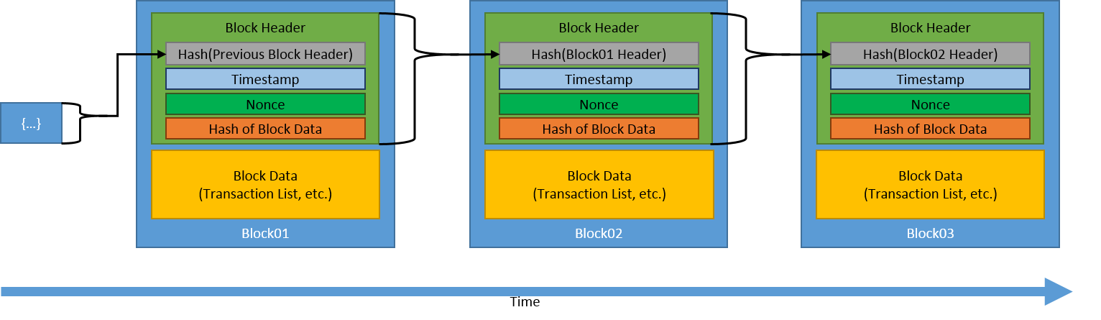
Blockchain
Expanding list of transaction records, secured using cryptography
Each new block hashed with unique identifier based on previous block’s data
Linking blocks via hashing provides tamper-evidence
Open public ledger
Distributed across peer-to-peer (P2P) network
Decentralized
Example uses include data registries, cryptocurrency, digital identification, supply chain management, and financial services

Slide 28
Chapter 2: Cryptographic Solutions and Threats
► Cryptographic Tools

Slide 29
Key Management System
Key lifecycle
  Generation, distribution, storage, renewal, expiration, revocation, destruction
Decentralized key management
Key management system
  Centralized
  Performs all tasks in key lifecycle
  Hardware cryptoprocessors

Slide 30
Hardware Cryptoprocessors
Trusted Platform Module (TPM)
  Hardware module, embedded into chipset or CPU
  Create and store keys, secure boot
Hardware Security Module (HSM)
  Plug-in PCIe card, network attached appliance, USB form factor
Secure enclave
  Protects unauthorized access to date (keys) loaded into system RAM

Slide 31
Chapter 2: Cryptographic Solutions and Threats
► Public Key Infrastructure (PKI)

Slide 32
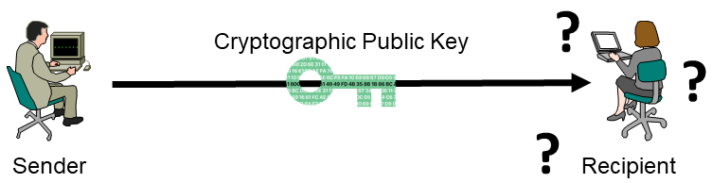
Public Key Infrastructure (PKI)
Remember, the public key may be known by anyone. It’s freely available.
Q. How does the recipient prove the identity of the public key holder (sender in this example)?
A. Through the use of public key infrastructure (PKI) and digital certificates!

Slide 33
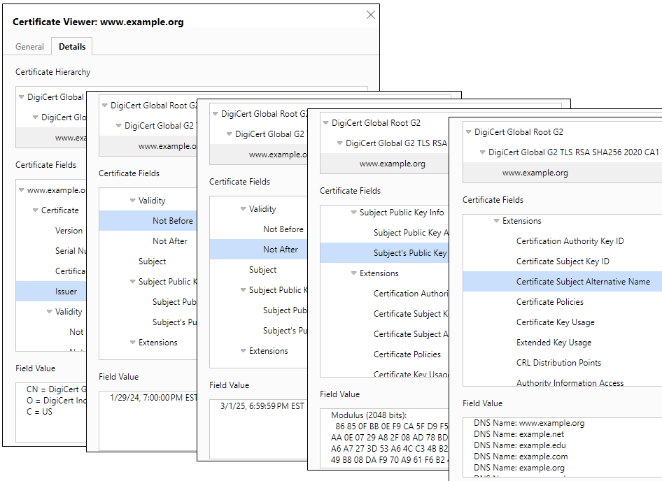
Digital Certificates
Similar to electronic ID card
Proves certificate owner’s identity
Distributes owners public key
Digitally signed by trusted party
Information identifying subject (SAN), validity period, issuer, subject’s public key
PKCS (Public Key Cryptography Standards), P12
Self-signed- not signed by trusted CA
  Untrusted, without use of PKI

Slide 34
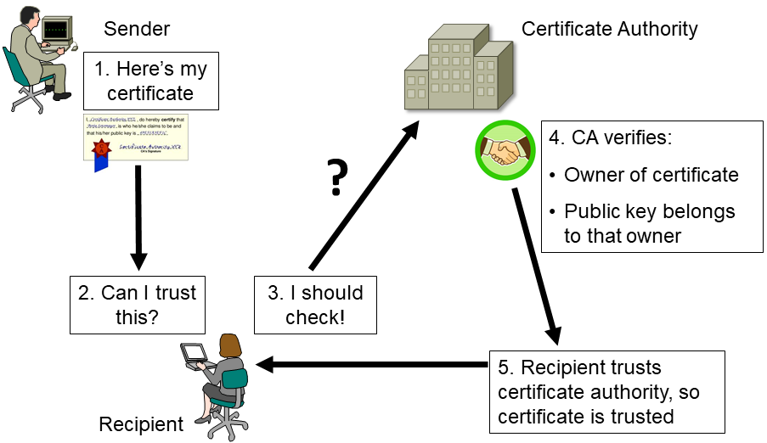
Certificate Authority (CA)
Trusted authority
  Signs, issues, stores digital certificates
  Self-signs its own certificate
  Confirms identity of certificate owner
  Guarantees validity of certificate
  Establishes trust in PKI
  Enforces certificate and key lifecycle
Private or third-party

Slide 35
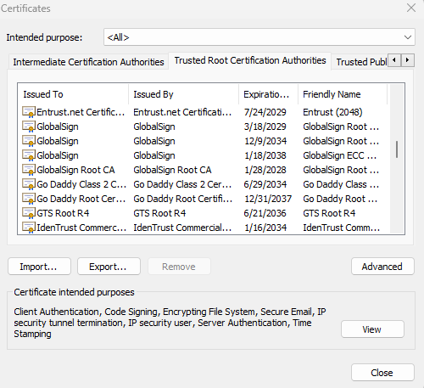
Root of Trust
Inherently trusted source
Root certificate
  CA’s public key
  Self-signed by root CA
  Signs other certificates
  Installed/imported by client
  If compromised, PKI untrusted

Slide 36
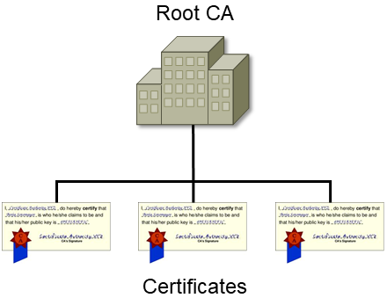
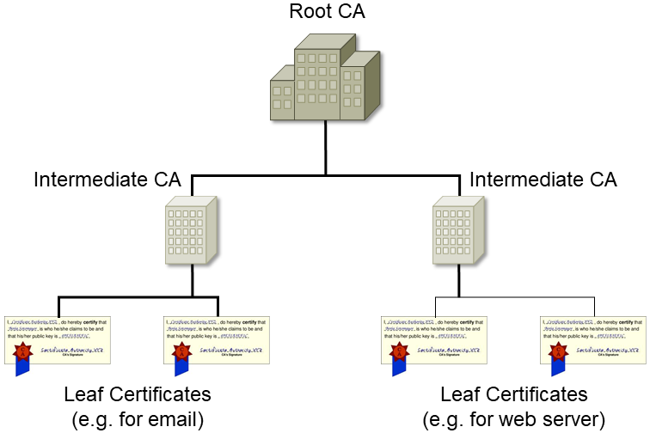
Certificate Hierarchy
Single CA hierarchy
  Carries out all certificate functions
  SPoF, higher risk of exposure/compromise
  Typically used on private network
Multiple CA hierarchy
  Two tiers
  Root CA, Intermediate CAs, leaf certificates

Slide 37
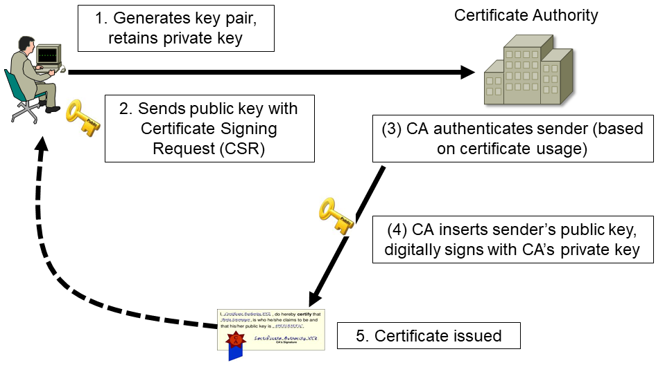
Certificate Signing Request (CSR)

Slide 38
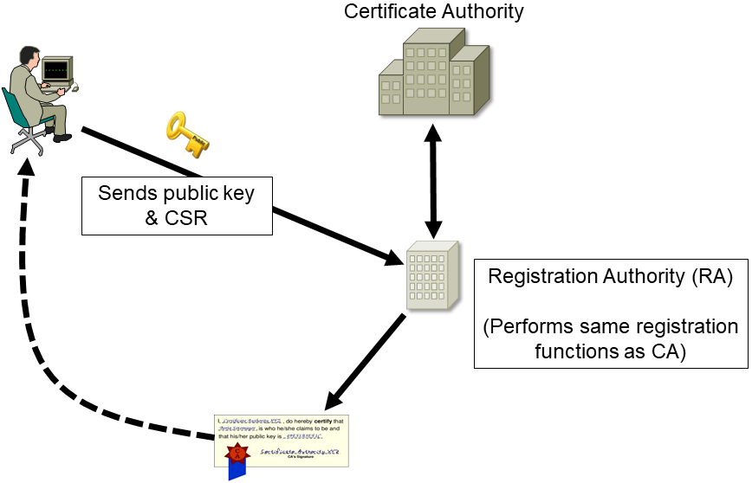
Registration Authority (RA)
Subordinate of Root CA

Slide 39
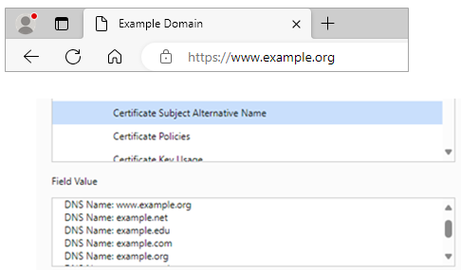
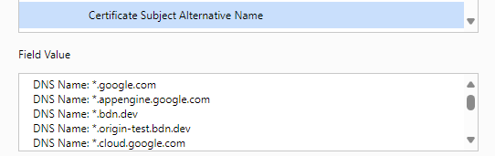
Subject Alternative Name, Wildcard Certificates
Subject Alternative Name (SAN)
  Identifiers: URI, IP address, FQDN
  Verified by browser to match site
  presently visiting
Wildcard certificate
  List of subdomains
  covered by certificate
  Indicated by asterisk in
  FQDN

Slide 40
Certificate Revocation
Suspension- temporary hold for period of time, can be reinstated
Revocation- certificate no longer valid, cannot be reinstated
Reason codes
Certificate Revocation List (CRL)
  Lists of suspended, revoked certificates
  Browser downloads CRL and checks site being visited against list
Online Certificate Status Protocol (OCSP)
  Browser queries single certificate for each site visit
  CRL not downloaded, fast, real-time status updates

Slide 41
Chapter 2: Cryptographic Solutions and Threats
► Threats

Slide 42
Threats
Any incident with the potential to negatively impact business operations or assets is considered a threat.
  Business operations- functions that allow organization to provide products and/or services to customer base
  Business assets- items of value to the organization such as data, network, hardware, software, building structures, cloud services, people, trademark, reputation

Slide 43
Threat Actors
Group, individual, or instigator of a threat.
Attributes of threat actors:
  Internal/external- level of access threat actor has before attack
  Resources/funding- monetary capability of threat actor
  Level of sophistication/capability- ability of threat actor to carry out highly advanced attacks

Slide 44
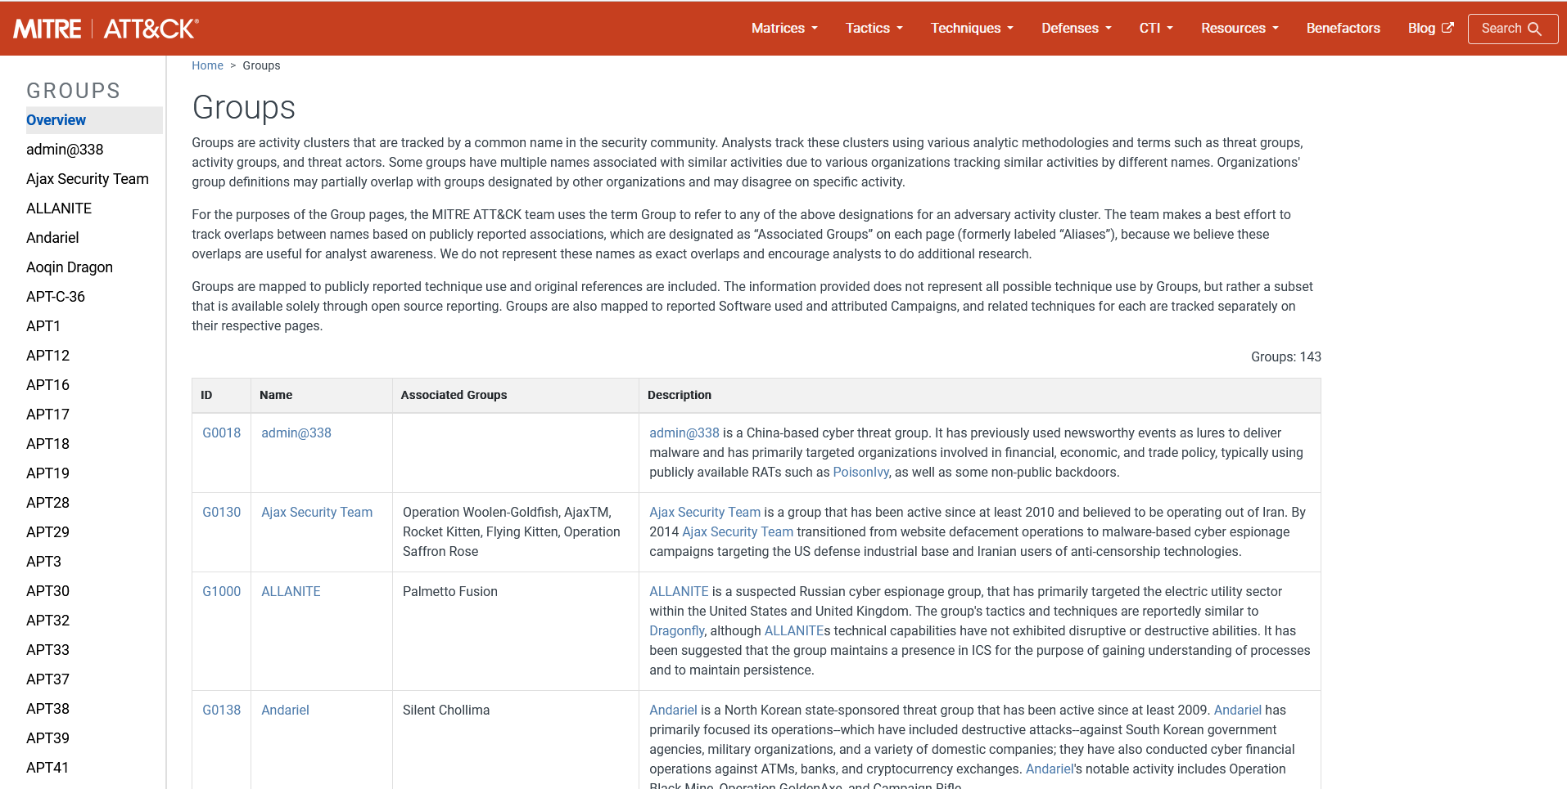
Nation-State Threat Actors and APT
Funded and protected by national government or military
High level of sophistication and ability
Highly targeted attacks
Advanced Persistent Threat (APT)
Data theft, disruption of services, deception and disinformation, espionage, war efforts
Screenshot © 2024 The MITRE Corporation. This work is reproduced and distributed with the permission of The MITRE Corporation. (https://attack.mitre.org/groups/)

Slide 45
Organized Crime and Hacktivist Actors
Organized crime
  Can be highly funded
  Operate across geographical jurisdictions
  Financial profit, money-laundering, espionage, IP theft, fraud, extortion, blackmail
Hacktivist
  Hacker groups
  Working together for common cause
  Shift public opinion, spread civil unrest and disobedience, obtain and leak confidential information

Slide 46
Insider Threat Actors and Shadow IT
Insider threat actor
  Has or previously had authorized access
  Employees, suppliers, contractors, customers, business partners
  Revenge, financial gain, damage
Shadow IT
  Insider attack
  Use of unauthorized IT resources
  Expansion of attack surface, privilege escalation, unauthorized access, data loss, service disruption

Slide 47

Unskilled Attackers
Unskilled attackers
  Attacker with little cyber skill
  Use of prebuilt tools without capability to create own tools
  Attacking for fun, impress others, learn skills on own

Slide 48
Motivators of Threat Actors (1)
Motivators describe intent
  Intentional and unintentional (accidental)
  Maliciously motivated or opportunistic
  Damaging or harmless

Slide 49
Motivators of Threat Actors (2)
Data exfiltration- unauthorized transfer of information
  Insider or external
  Email message and attachments, external storage devices, cloud storage
  Revenge, extortion or ransom, data for sale
Espionage- exfiltration of sensitive, secret, confidential information
  Nation-state actors
  Political, economic, or military purposes

Slide 50
Motivators of Threat Actors (3)
Service disruption- prevent legitimate use of organization’s technology resources
  Insider or external
  Chaos, competition, decoy, disagreement of target organization’s beliefs or views
Blackmail- force payment in exchange for not revealing stolen information
  Financial gain

Slide 51
Threat Vectors and Attack Surface
Threat vectors
  Methods and pathways used by attacker to exploit, gain access, compromise
Attack surface- collection of threat vectors
  In an organization, within an app, on a system or network, or a human
  Addition of vectors increases attack surface, while removing vectors decreases attack surface

Slide 52
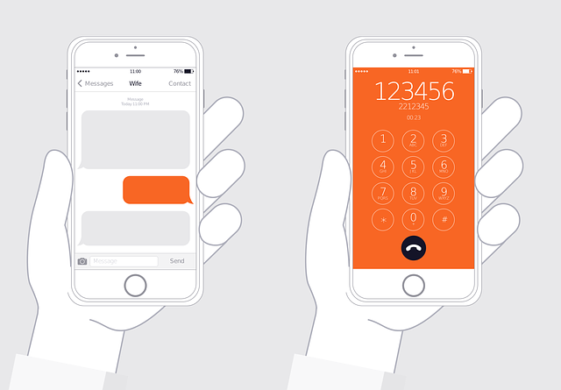
Message-based Threat Vectors
Email
Short Message Service (SMS)
Instant Messaging (IM)
Voice call

Slide 53
Image-based and File-based Threat Vectors
Image-based threat vector
  Deceiving target into clicking on or opening an image
  Malicious image attachments, embedded images in email body directing browser to fake website
  Concealment of information in an image
    Data exfiltration, bypass security controls, deliver malicious code
File-based threat vector
  Malicious code delivered via download, email, removable device
  User enticed into opening file which executes payload
  Common file types/formats
  Images, videos, audio, documents/PDFs, scripts, installers/executables

Slide 54
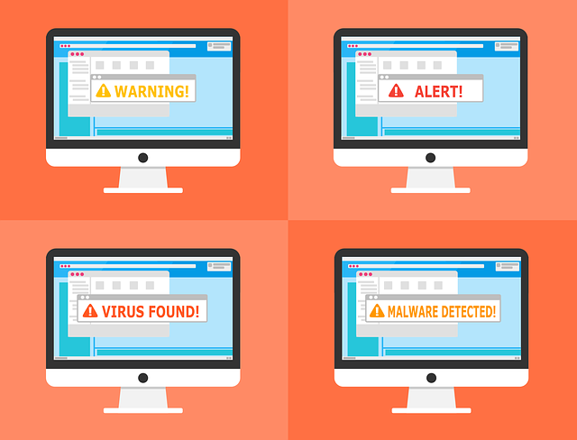
Vulnerable Software Threat Vectors (1)
Software that contains security flaws, weaknesses, vulnerabilities in code or product design
Operating systems, applications, device drivers, firmware, embedded systems
Causes: Application crashes, execution of malicious code, unauthorized access to software or system
Patch management

Slide 55
Vulnerable Software Threat Vectors (2)
Client-based vs agentless scanning
Search system and software for known vulnerabilities and reports findings
  Client-based
    Scanning software installed on each host, results sent back to collection server
  Agentless
    Nothing installed on host, server reaches out to host and scans across network
    Results collected at server

Slide 56
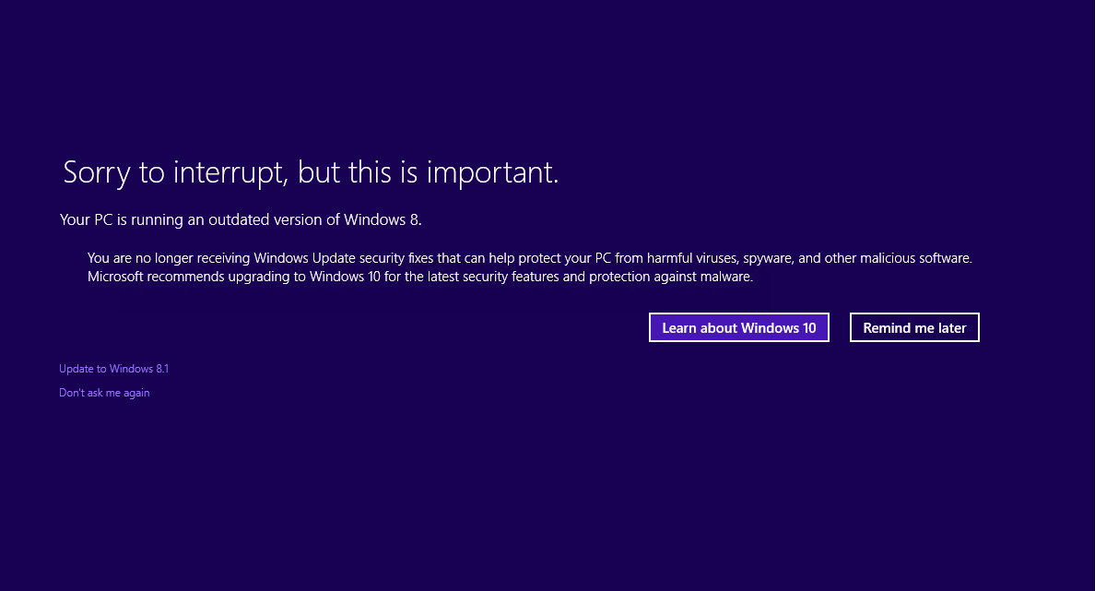
Unsupported System and Application Threat Vectors
Vendor no longer providing security updates or patches
End-of-life
Remove affected system or app and replace with updated product
Where replacement is not feasible, isolate or sandbox

Slide 57
Unsecure Network Threat Vectors
Unsecure network- fails to enforce confidentiality, integrity, and availability
Wireless
Wired
Bluetooth
Open service ports (UDP and TCP)
Default credentials

Slide 58
Supply Chain Attack Surface
Complex process of design, development, manufacturing, warehousing, and wholesaling or retailing to deliver products and/or services to customers
Broad attack surface, possible attacks at any step
Suppliers
Vendors
Managed service providers (MSPs)
Risk management supporting trusted and reputable suppliers, vendors, MSPs

Slide 59
Chapter 2: Cryptographic Solutions and Threats
► Social Engineering

Slide 60
Human Vectors/Social Engineering
Psychological manipulation, influence, deception that plays on human emotions
Gain information through reconnaissance to facilitate unauthorized access
Convince user to perform an action for illegitimate reasons

Slide 61
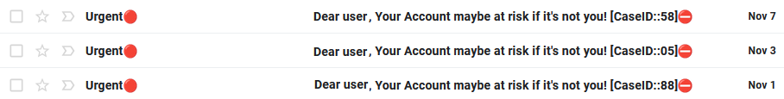
Phishing, Vishing, and SMiShing
Phishing
  Manipulation of subject into acting on a spoofed or malicious message
  Victim directed to spoofed site
  Scammer captures user’s credentials, installs malware, runs malicious code

Slide 62
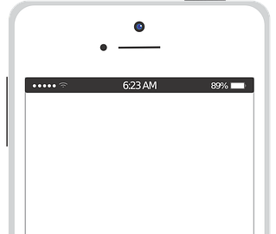
Phishing, Vishing, and SMiShing
Vishing
  Phishing using voice communication
  Intimidation or urgency
SMiShing
  Phishing using short messaging service (SMS) text messaging
Thursday, Oct 22 4:11 AM
Your account has been disabled. To reactivate, update immediately, access http://signin.accountactivate.com.ru/p0o1kklwbd76a

Slide 63
Misinformation and Disinformation
Both are false or misleading information
Difference lies in the intent
Misinformation
  Distributing information that is believed, at the time, to be accurate.
    In reality, it turns out to be false
Disinformation
  Intentionally distributing inaccurate information as if it were true

Slide 64
Impersonation and Pretexting
Impersonation
  Intentionally pretending to be someone you are not to get someone to act
  Centers on inability of victim to verify attackers identity
  Intimidation, authority, imitation of coworker, other trusted individual or organization
Pretexting
  Creating a credible and realistic sounding fictional story based on information about victim

Slide 65
Brand Impersonation and Business Email Compromise
Brand impersonation
  Fraud used to fake organization’s merchandise, logo, website, business or social media profiles for financial gain, reputational damage
Business email compromise
  Attacker poses as trusted vendor, supplier, business partner, customer, employee, colleague
  Attacker uses spoofed or compromised email account
  Deception, financial gain, data theft, other impersonation type attacks

Slide 66
Watering Hole Attack and Typosquatting
Watering hole attack
  Organization attacked through compromised third-party websites their users visit as opposed to a direct targeted attack
Typosquatting
  Capitalizes on misspelled domain names
  Attacker registers close spelling of legitimate website domain name
  Manually typed in browser or links in phishing messages
  Malware, phishing, financial gain, counterfeiting, affiliate links, spoofing

Slide 67
Summary
In this chapter, you will have learned:
Cryptography Concepts
Implementations of Cryptography
Cryptographic Tools
Public Key Infrastructure (PKI)
Threats
Social Engineering

