Slide 1
OVERVIEW

Slide 2
TERTIARY CONTROL

Slide 3
Cost model of the generators

Slide 4
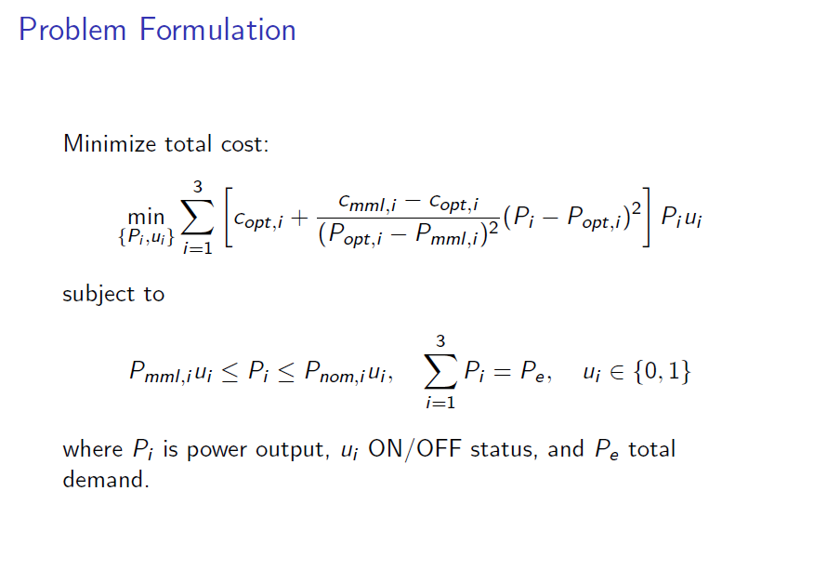

Slide 5
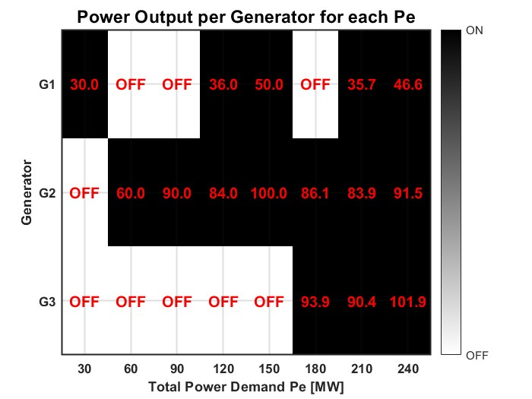
Solution
We used MATLAB as the software, in particular the fmincon function to find the solution for this problem. Due to the complexity of the problem—being nonlinear with integer variables—we employed brute force by testing all possible combinations of the three generators. In a real-case scenario with many generators, a better approach would be to use a nonlinear solver or, for faster solutions, to approximate the cost function quadratically.
We have use matlab as software, in particular we use fmincon() function to find the solution for this problem.
Because the problem is nonlinear with integer variables, we used brute force to test all combinations of the three generators for each power demand. For larger systems, nonlinear solvers or quadratic cost approximations would be more practical.

Slide 6
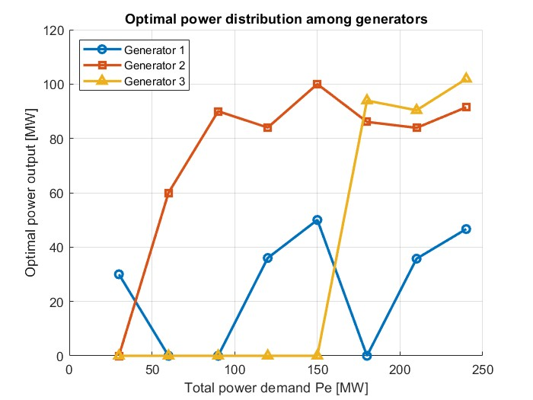
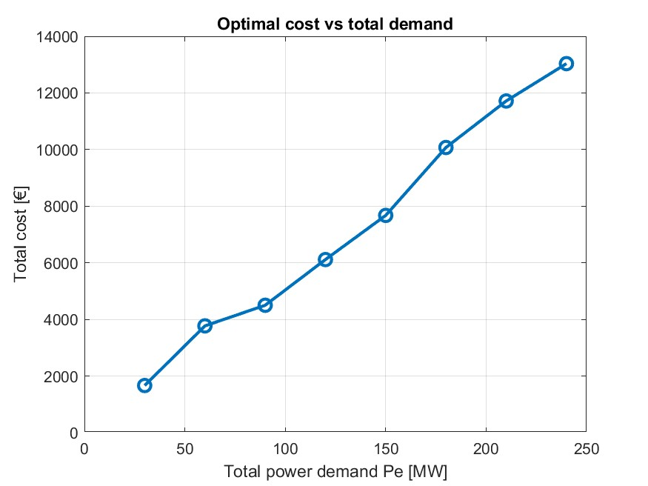
Results

Slide 7
SECONDARY CONTROL

Slide 8
Model of the generators

Slide 9
DISTURBANCES

Slide 10
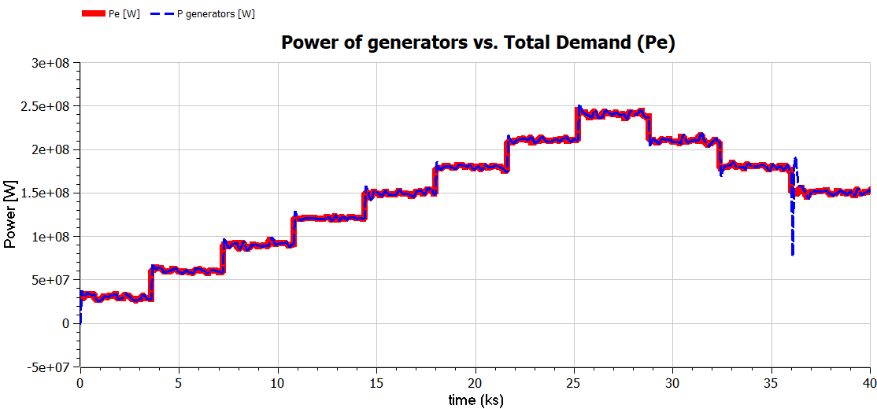
FINAL RESPONSE
Response without tertiary control

Slide 11
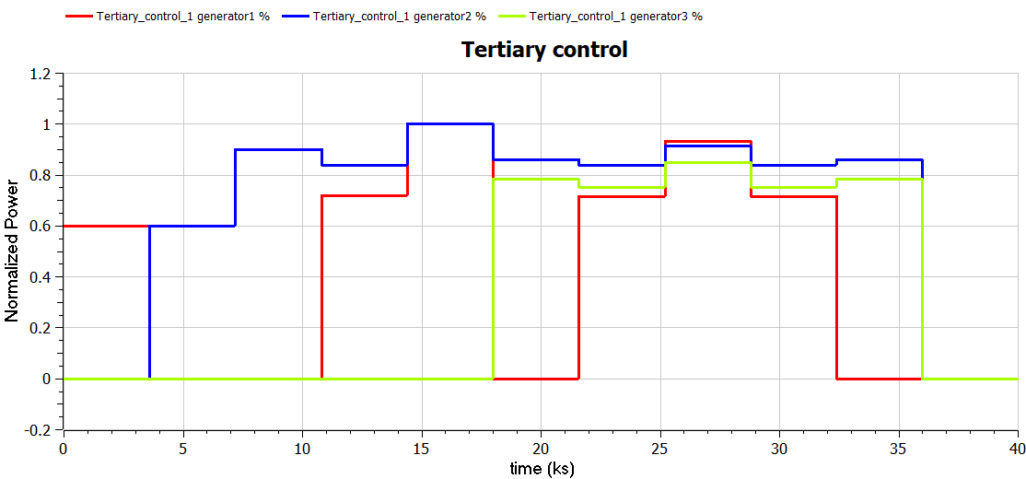

Slide 12
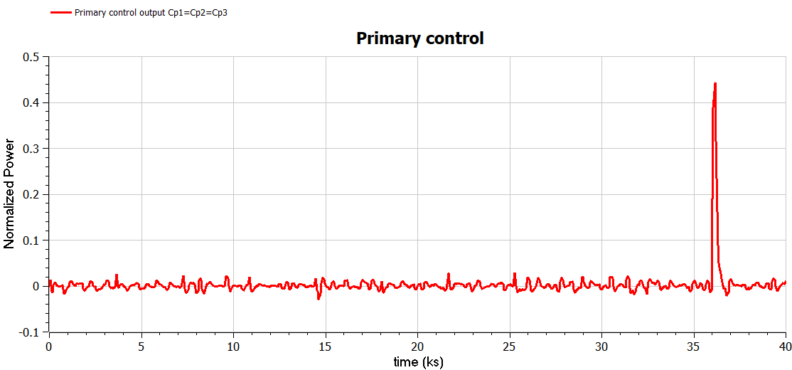

Slide 13
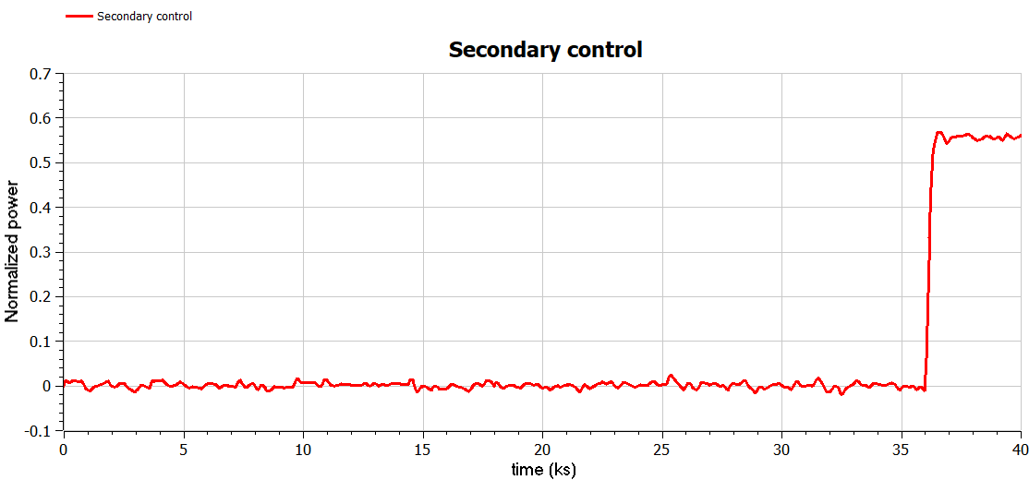

Slide 14
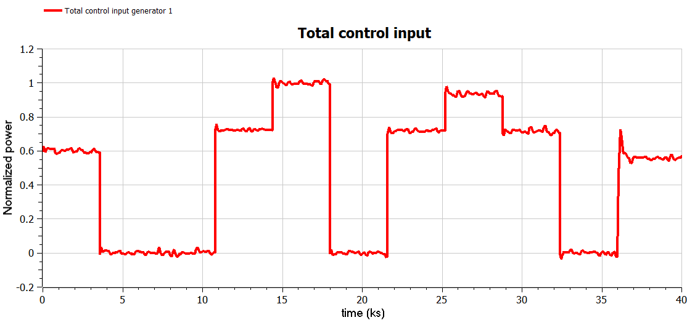

Slide 15
