Slide 1
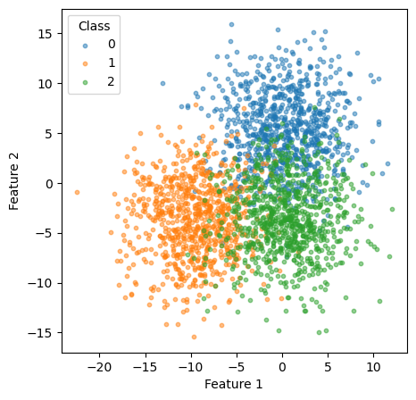
‘Traditional’ classification
(balance of likelihood)
Comformal classification
(sets)
Classification in overlap region based on highest probability: ‘orange’
Classification in overlap region based on all relevant areas of coverage: {orange, green}

