Slide 1
Combining Deep Reinforcement methods and Health Systems Simulation in SimPy

Slide 2
Elements of RL
Environment: all observable and unobservable information relevant to us
Observation: sensing the environment
State: the perceived (or perceivable) environment
Agent: senses environment, decides on action, receives and monitors rewards
Action: may be discrete (e.g. turn left) or continuous (accelerator pedal)
Policy, π (how to link state to action; often based on probabilities)
Reward signal: aim is to accumulate maximum reward (return) over time
Memory: A database of state, action, reward, new state for each action taken
Value function of a state: prediction of likely/possible long-term reward from a particular state
Q: prediction of likely/possible long-term return from performing a particular action. Frequently includes the idea of discount, such that future rewards have less value the further out they are in time. The discount rate is symbolised as gamma, ɤ.
Advantage: the difference an action makes to long term reward compared with other possible actions.
Target: the value we wish to update our network to predict (equivalent to observed value or label in normal supervised learning)

Slide 3
Motivation
Use Deep Reinforcement Learning to help manage complex environments, such as
  ED (escalation/de-escalation)
  Hospital (bed management)
  Ambulance (ambulance locations)
Develop and test methods in simulated environment
  Use a standard OpenAI gym environment interface to enable easy transfer of RL methods from more established areas
  Partially train Deep RL agents in simulated world before let lose in the real world.

Slide 4
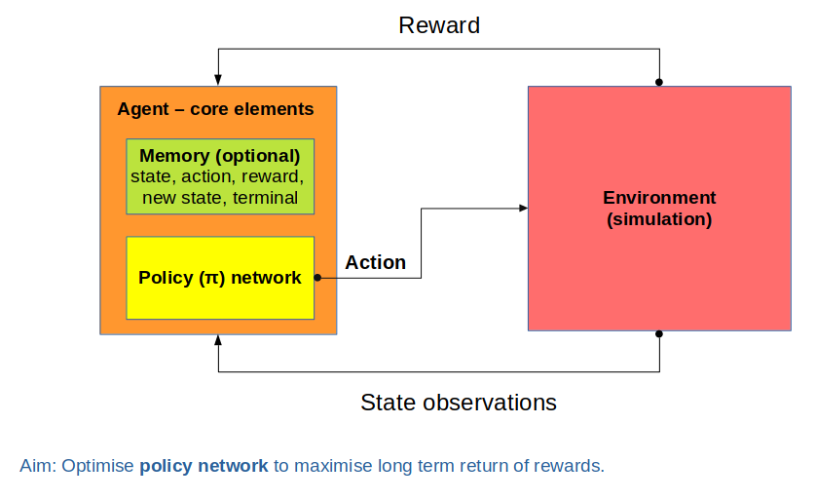
PyTorch
SimPy

Slide 5
Components of a Gym-compatible simulation
A state space
A reward structure
A choice of actions
An initialise (reset) method that returns the initial state observations
A way to recognise and return a terminal state (end of episode)
A way to make sure the action is legal/possible
A step method that passes an action to the environment and returns:
  the new state observations
  reward
  whether state is terminal
  additional information
A method to render the environment

Slide 6
We need a method to pass an action to a SimPy environment, and then pass control back to the agent
The method we will use is:
  Step through simulation in time steps
  Each step called from the agent causes:
    The requested action to be carried out in the sim
    The sim to move on one time step
    The sim returns new state, reward, terminal, info
  We could also stop the simulation (and return control to the agent) by using simpy method whereby the model runs until a specified event is triggered.

Slide 7
Interface actions
reset()
  Initialise environment
  Return first state observations
step()
  Take an action.
  Update state (run simulation for next step).
  Return observations, reward, terminal, info
render()
  Display the environment (if requested)

Slide 8
Hospital sim
Very simplified!!
  At start, load hospital with calculated average load
    # Patients = mean arrivals per day * mean los
    Use inverse exponential distribution for los
    Get ‘remaining los’ by multiplying los by random 0-1
  During simulation
    Create patients; sample inter-arrival time depending on day of week.
    Use inverse exponential distribution for los
  Agent actions
    Once daily the agent can request bed change by -10, -5, 0, +5, +10
    Changes in bed numbers take 2 days before they occur

Slide 9
Reward
Our aim is to maximise long term rewards
But rewards can be penalties
  Frame as negative rewards
  Maximising rewards will minimise penalties (loss)
Default setting in sim
  Aim for reserve (free) beds of 0.05 * # patients
  Penalty = abs (actual spare beds – target spare beds)

Slide 10
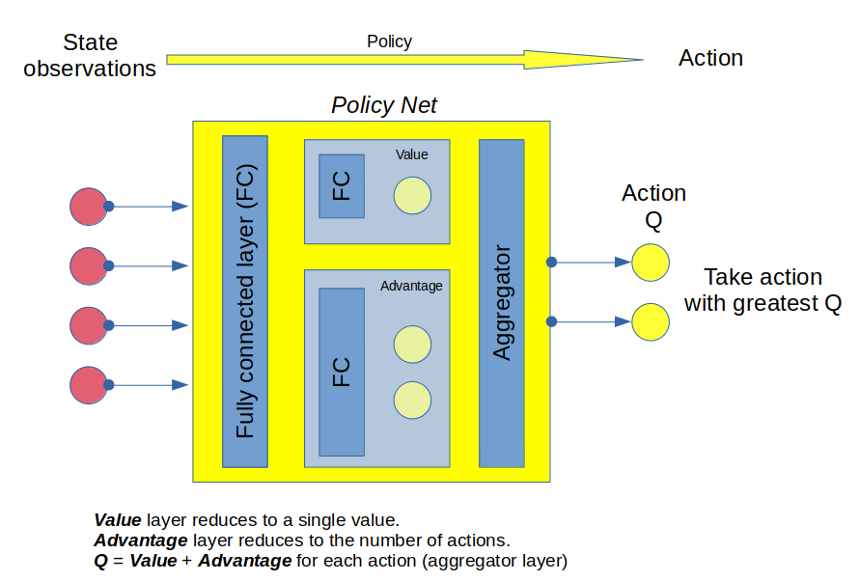
Duelling DQN

