Slide 1
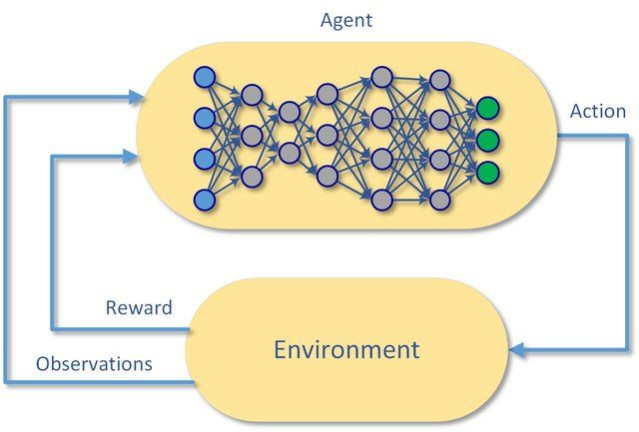
Deep Reinforcement Learning

Slide 2
RL involves…
Sensing something of the environment
Trial and error search
A way to balance best predicted action (exploitation) vs. exploration
Linking state -> action -> reward + new state
Working out how to maximise long term rewards (return), sometimes at the cost of short term rewards
Uncertainty in sensing and linking action to reward
  Observations may be inaccurate
  Action may not lead to the expected state
Learning leads improved choice of actions (policy, π) over time

Slide 3
Elements of RL
Environment: all observable and unobservable information relevant to us
Observation: sensing the environment
State: the perceived (or perceivable) environment
Agent: senses environment, decides on action, receives and monitors rewards
Action: may be discrete (e.g. turn left) or continuous (accelerator pedal)
Policy, π (how to link state to action; often based on probabilities)
Reward signal: aim is to accumulate maximum reward (return) over time
Memory: A database of state, action, reward, new state for each action taken
Value function of a state: prediction of likely/possible long-term reward from a particular state
Q: prediction of likely/possible long-term return from performing a particular action. Frequently includes the idea of discount, such that future rewards have less value the further out they are in time. The discount rate is symbolised as gamma, ɤ.
Advantage: the difference an action makes to long term reward compared with other possible actions.
Target: the value we wish to update our network to predict (equivalent to observed value or label in normal supervised learning)

Slide 4
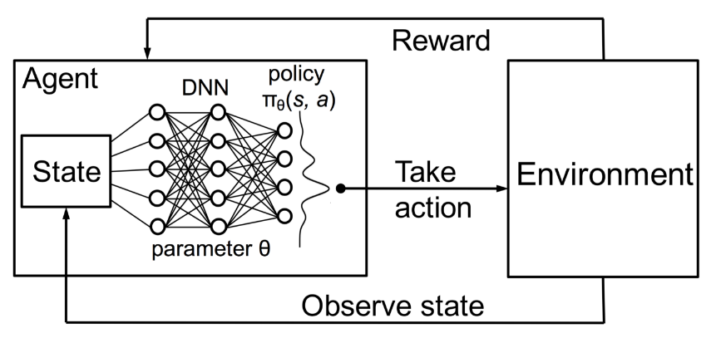
High level view
Collecting Experience:
I was in state s
I took action a
I landed in state s’
I received reward r
(I reached terminal state)
We store each step as:
[State, action, reward, next state, terminal]
For each state we are given a set (vector) of observations

Slide 5
Cross entropy method
Play k episodes using current model and environment
Calculate return (total reward) for each episode
Keep best episodes (e.g. top 30-50%)
Train on best episodes using observations and actions taken
  Aim is to create a policy network that recommends action based on current state (does not model value/Q of actions; it simply learns actions that lead to best final return)
  Output is probability for each possible action – choose action in accordance with probability (allows for exploration that increases with uncertainty)
Repeat until no further improvement or until a target is reached (or a limit of computer resources consumed)
(Requires complete episodes)

Slide 6
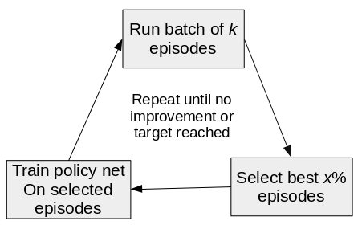
Cross entropy method

Slide 7
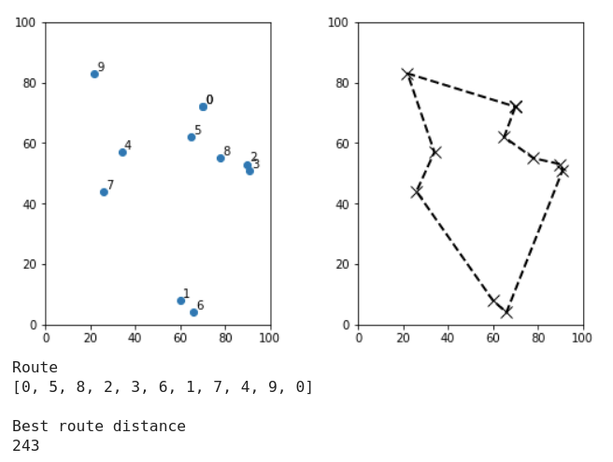
The Travelling Salesman Problem (TSP)
Finding the shortest route that covers all cities, visiting each city once.

Slide 8
OpenAI Gym Environments
gym.openai.com
A collection of environments (e.g. Atari games) with a standard interface
Allows easy testing and transfer of RL models between different environments
We have written a simple TSP environment compatible with OpenAI gym.

Slide 9
OpenAI Gym Environments
All environments have two key methods:
  reset(): Sets/resets environment and returns first set of observations
  step(action): Takes action. And returns:
    obs, reward, terminal, info
Observation in TSP is a concatenation of two lists: 1) cities visited, 2) current city (one-hot). Example:
  [1,0,1,0,0,0,1,0]
  Have visited cities 0 and 2, currently at 2.
Reward in TSP = max permitted reward – distance travelled
  Max permitted reward = max possible distance between any two points
  If city already visited, reward = 0 - distance travelled

Slide 10
Value, Q, and Q learning

Slide 11
A simple state, action, reward, next state graph
a1, r=1
S8
a1, r=1; a2, r=1
a1, r=3
S4
a2, r=2
a1, r=1
S9
a1, r=1; a2, r=1
S2
a1, r=2
S2
a2, r1
S5
a2, r=8
S1
a2, r=1
S10
T
a1, r=1; a2, r=1
a1, r=8
a1, r=1; a2, r=1
a1, r=1, a2, r=1
S6
a2, r=1
S3
a1, r=1
a2, r=2
S11
a1, r=1
S7
a2, r=2
S12
Use state(s), action (a), reward (r), next state (s’) format.
For example, taking action 1 from state s2:
s,a,r,s’ = [s2, a1, 3, s4]

Slide 12
A simple state, action, reward, next state graph
a1, r=1
S8
a1, r=1; a2, r=1
a1, r=3
S4
a2, r=2
a1, r=1
S9
a1, r=1; a2, r=1
S2
a1, r=2
S2
a2, r1
S5
a2, r=8
S1
a2, r=1
S10
T
a1, r=1; a2, r=1
a1, r=8
a1, r=1; a2, r=1
a1, r=1, a2, r=1
S6
a2, r=1
S3
a1, r=1
a2, r=2
S11
a1, r=1
S7
a2, r=2
S12
Use state(s), action (a), reward (r), next state (s’) format.
For example, taking action 1 from state s2:
s,a,r,s’ = [s2, a1, 3, s4]

Slide 13
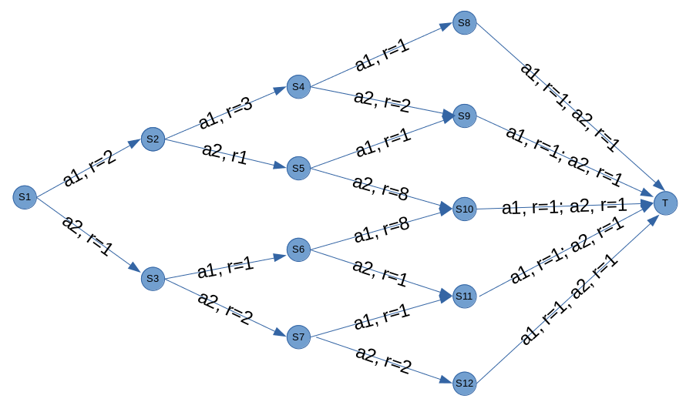
Q: Q(s,a) = r + ɤ.maxQ(s’,a’)
Bellman equation; The Q of any state and action is the immediate reward achieved +
the discounted maximum Q value (the best action taken) of next best action,
where gamma (ɤ) is the discount rate.
Q is best thought through from the terminal state (T) backwards)
S8 to S12 all go to the terminal state with a reward of 1. There is no possibility of further reward. So Q is simply the reward, 1.
Taking action 1 from state S4, leads to sate S8, with a reward of 1.
  We know state S8 has a Q of 1 (whichever action is taken. If we use a discount rate (ɤ) of 0.9, the Q of [S4, a1] is the immediate reward (1) + 0.9 * Q(S8) = 1.9
Taking action 2 from state S4, leads to sate S9, with a reward of 2.
  We know state S9 has a Q of 1 (whichever action is taken. If we use a discount rate (ɤ) of 0.9, the Q of [S4, a2] is the immediate reward (2) + 0.9 * Q(S9) = 2.9

Slide 14
Q: Q(s,a) = r + ɤ.maxQ(s’,a’)
Bellman equation; The Q of any state and action is the immediate reward achieved +
the discounted maximum Q value (the best action taken) of next best action,
where ɤ is the discount rate.
Now working back to S2, let’s look at action 1 [S2, a1] :
  Action 1 from state S2 leads to state S4.
  State S4 has Q values of 1.9 and 2.9 depending on the action taken in state S4
  For the Bellman equations we take the best future Q of the next state, which is 2.9
  So the Q of [S2, a1] = immediate reward + ɤɤ * best Q available in the next state = 3 + (0.9 * 2.9) = 5.61

Slide 15
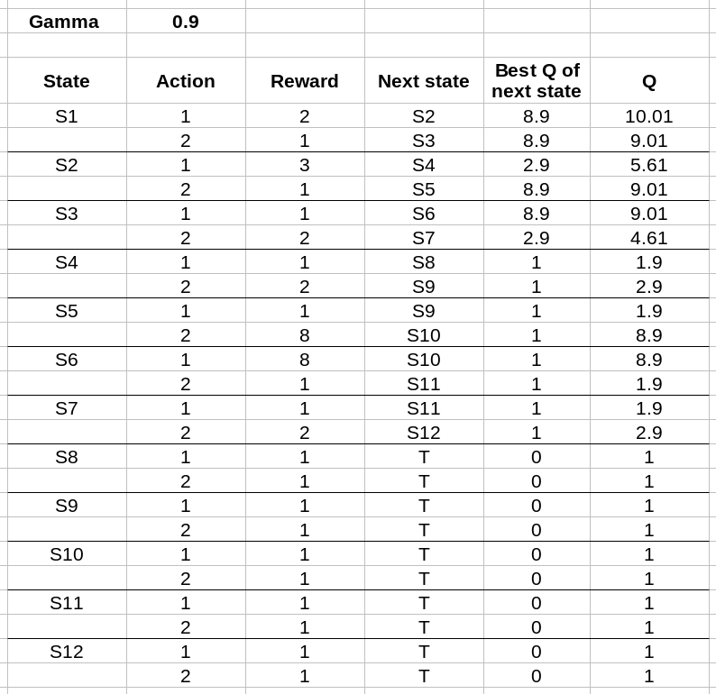
Calculated Q values
If we follow the best Q:
S1 → a1 → S2 (reward = 2)
S2 → a2 → S5 (reward = 1)
S5 → a2 → S10 (reward = 8)
S10 → a1 or a2 → T (reward = 1)
Total reward = 12
Note: At S2 we took an action with lower immediate reward.
This is an example of a Q table but in complex environments we cannot collect information on all states/actions (this is also impossible if the state contains continuous variables, such as velocity).
Neural nets will often rely on similarity between a current state and one encountered before.

Slide 16
Updating Q in a network
Updating Q in a network is performed by random sampling* from a memory of s/a/r/s’
We update Q based on the reward and best Q of next step. We only need to look one step ahead and update based on that. This is temporal differential learning. Updates can happen while learning (no need to complete episodes).
Early on the network will have a very incomplete understanding of Q. There may be limited knowledge of rewards, and some rewards will not have been sampled sufficiently to update network.
The performance of the network is especially poor early on. During this stage it is usual to have a significant level of random exploration to help ensure a wider range of s/a/r/s’ are experienced
As more data (experience) is collected, and as more training iterations are performed, predicted Q will become closer to actual Q.
*We can prioritise training examples with Prioritised Experience Replay

Slide 17
Example
We start with no idea of Q (we will set al at zero to make it easier to see what is going on, but a neural net will start with all random numbers).
The following technique is a boot-strapping technique. It has been said that one of the biggest surprises in RL is that it works!
The network provides the target value for best Q of next step. So the network is updating itself based on its own predicted values!

Slide 18
Our first random sample is action 1 from state S4
a1, r=1
S8
S4
S9
S2
S2
S5
S1
S10
T
S6
S3
S11
S7
S12
S4, action 1 → r=1, s’=s8
No knowledge of s8 so we set Q of S4/a1 to = 1 (just the reward)

Slide 19
Our second random sample is action 1 from state S2
S8
Note: Any effect of reward between S8 and T is completely ignored at this stage in development of our understand of Q values.
a1, r=1
a1, r=3
S4
S9
S2
S2
S5
S1
S10
T
S6
S3
S11
S7
S12
S2, action 1 →r=3, S’ = S4
We know something about S4/a1
For S4 the max Q is 1 (S4, a1. We don’t know about action 2 yet, so assume it is zero here)
S2, action 1: Q = reward + ɤ maxQ S4 = 3 + (0.95 * 1) = 3.95 (if ɤ = 0.95)

Slide 20
Carrying on…..
Repeat this bootstrapping
Not surprisingly early on in the development of Q network the predictions of best action are not good!
So, it is common to:
  Perform a large number of random actions to store in memory before even starting to train the network.
  Only gradually increase the proportion of actions that are selected by the network (rather than random choice) after training begins.

Slide 21
DQN Basic Method
Initiate parameters for Q(s,a) with random weight.
Perform a number of random actions before training starts
With reducing probability select a random action, or best current action,
argmax Q(s,a)
Execute action a, and observe reward r and next state s.
Store transition (s,a,r,s’) in the memory
Sample random mini batch of transitions from the memory. Random sampling from the replay buffer avoids autocorrelation problems that can occur if using current state net
For every transition in the buffer, calculate y=r if the episode has ended at this step, or
y = r + ɤ(max Q)
Update Q(s,a) in network by minimising the loss in respect to model parameters
Repeat from (2)

Slide 22
Double DQN
Double DQN contains two networks. This amendment is to decouple training of Q for current state and next state which are closely correlated when comparing input features.
The policy network is used to select action (action with best predicted Q) when playing the game.
When training, the predicted best action (best predicted Q) is taken from the policy network, but the policy network is updated using the predicted Q value of the next state from the target network (which is updated from the policy network less frequently). So, when training, the action is selected using Q values from the policy network, but the the policy network is updated to better predict the Q value of that action from the target network. The policy network is copied across to the target network every n steps (e.g. 1000).
(It is called a target network because it provides the target for updating, just as the labels or observed values provide the target for a supervised learning neural network)

Slide 23
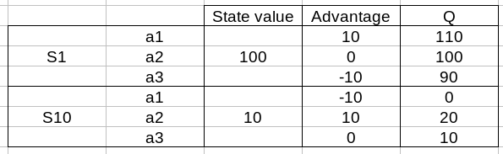
Duelling DQN
In standard DQN we estimate Q for each action in a single step. In duelling DQN we estimate the value of the state (the mean of all action Q) and the advantage of each action (the difference in Q compared to the average Q) as separate heads in the network, and then aggregate them so Q = value + advantage
State value (mean of all action Q)
Input vector
Output
Fully connected
Fully connected (dense) layer(s)
Advantage
(difference from mean Q for each action)
Aggregate
+
Fully connected
Note: The output is again Q, just as with our normal DQN, but we have got to the value of Q via splitting into value and advantage

Slide 24
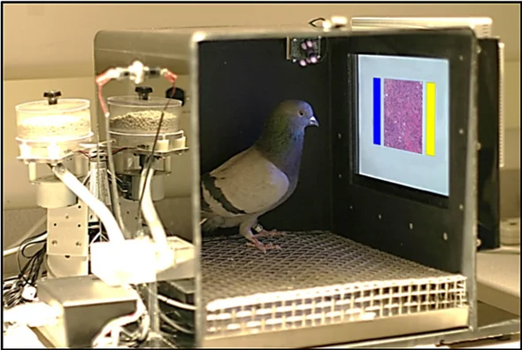
Bootstrapping/Bagging DQN
Train a collection of nets on different bootstrap samples from memory
Probability of action is taken in proportion to number of networks that recommend action
The power of a group of weak learners is best exemplified by how pigeons can diagnose cancer!
https://www.scientificamerican.com/article/using-pigeons-to-diagnose-cancer/

