Slide 1
Spell checking using
Deep Learning Approach
0856706 Susan Ku
0856156 Huong Vu

Slide 2
Outlines
Motivation
Deep Learning Introduction
Data & Data preprocessing
Background Theory & Framework
Experimental results

Slide 3
Motivation
Motivation
Not everyone can be a spelling bee
Misspelling or typo happens all the time due to different reasons
Problem statement:
Spelling corrections for a set English words

Slide 4
What is deep learning?
Artificial Intelligence
Ability of a machine to imitate intelligent human behavior
Machine Learning
Application of AI that allows a system to automatically learn and improve from experience
Deep Learning
Application of Machine Learning that uses complex algorithms and deep neural nets to train a model

Slide 5
Why do we need deep learning?
Process huge amount of data
Perform complex algorithm
To achieve the best results with large amount of data
Feature extraction

Slide 6


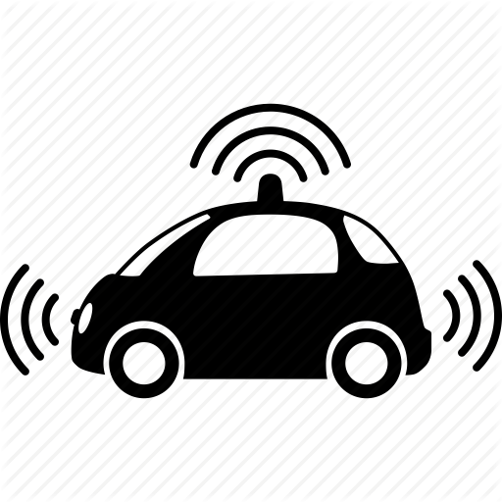
Some applications of deep learning
Cancer detection
Robot navigation
Autonomous driving cars

Slide 7

Some applications of deep learning
Machine translation

Slide 8

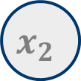

Neural networks
Input 1
w₁
Input 2
Neuron
Y
w₂
Output
w_{n}
Input n

Slide 9


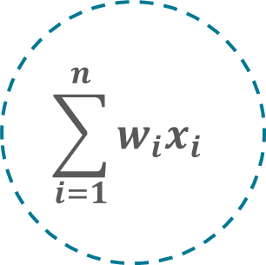

Neural networks
bias
w₁
w₂
Y
w_{n}
Transfer function
Activation function

Slide 10
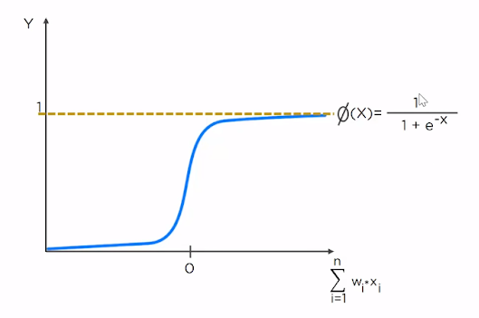

Activation function
Sigmoid function
ReLU function

Slide 11
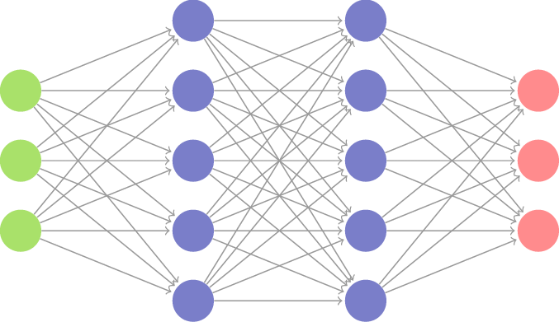
Neural networks
Input layer
Hidden layer
Output layer

Slide 12


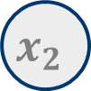
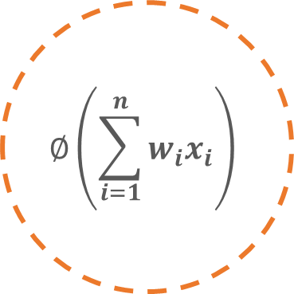


Working with Neural networks
Forward-propagation
Forward-propagation to get the predictions
Comparing actual and predicted output the get the cost function
Actual
Output
w₁
comparing actual & prediction
w₂
bias
Model
Output
w_{n}

Slide 13
Working with Neural networks
Back-propagation
Back-propagation to minimize the cost function using gradient-descent method
Actual
Output
w₁
w₂
bias
Model
Output
w_{n}

Slide 14
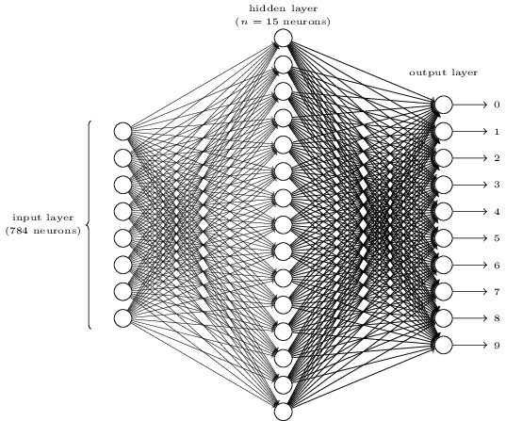
Neural networks recap
Hidden layer
Output layer
Input layer

Slide 15
Dataset
Contains 39,199 misspellings of 8,508 English words
Collected from a collection of corpora of misspellings: birkbeck, aspell, Wikipedia
Divided into training and testing

Slide 16
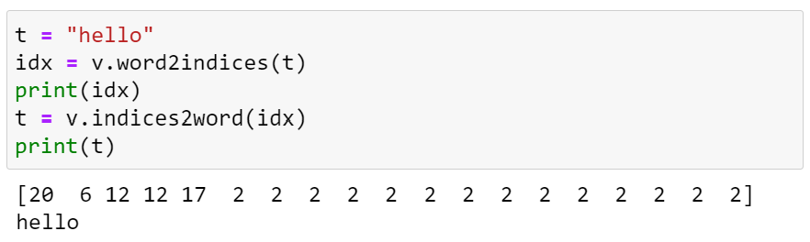

Data preprocessing
Embedding in encoder : convert word into indices
Each word can be regarded as a vector
Assign a number (indices) to all characters in the alphabet
Use special token for smooth operation of the neural networks
- <SOS> : <start of string> & <EOS>: <end of string>
- <unk>: <unknown> & <pad>: <padding>
Embedding in decoder: Convert indices back to word

Slide 17
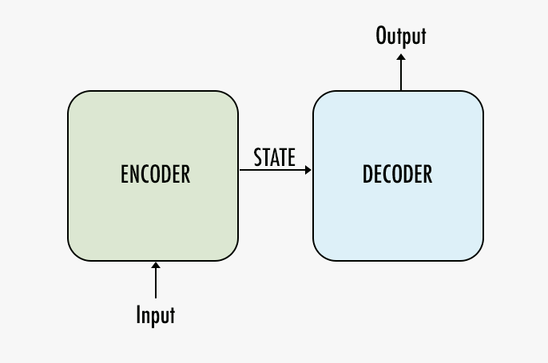
Background Theory
Sequence-to-sequence Model (seq2seq)
Introduced by Google in 2014
Use cases
- Google Translate, voice-enabled device, online chatbot, video caption
(fixed length)
(ex: “今天你在做甚麼?”, 7 words in Chinese)
(fixed length)
(ex: “What are you doing today?”, 5 words in English)

Slide 18
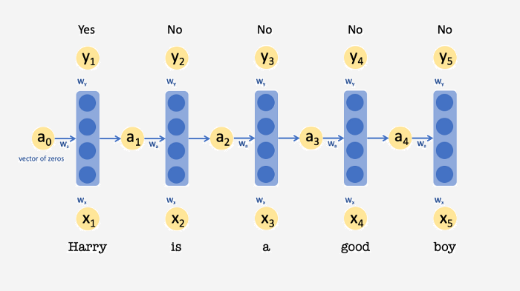
Background Theory
Recurrent Neural Network (RNN)
Neural network with memory
Used to deal with sequential data, like text classification
Output Layer
store
Hidden Layer
Input Layer

Slide 19


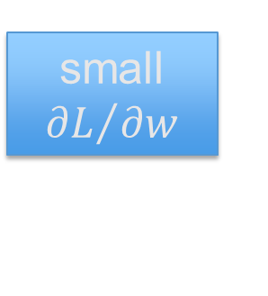


Background Theory
Vanishing Gradient Problem in RNN
The gradient will be vanishing small, which may stop neural network from further training
Toy Example
weight is updated proportional to the partial derivative of the error function
=w⁹⁹⁹
Output Layer
y¹
y²
y³
y¹⁰⁰⁰
1
1
1
1
Hidden Layer
……
Activation function
w
w
w
1
1
1
1
Input Layer
1
0
0
0
* source: NTU Professor HYLee

Slide 20
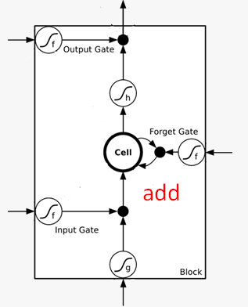
Background Theory
Long Short-Term Memory (LSTM)
To overcome vanishing gradient problem in RNN
- “gate” to regulate the flow of information (throw away or keep)
- Memory and input are added
signal control the output gate
signal control the forget gate
signal control the input gate

Slide 21
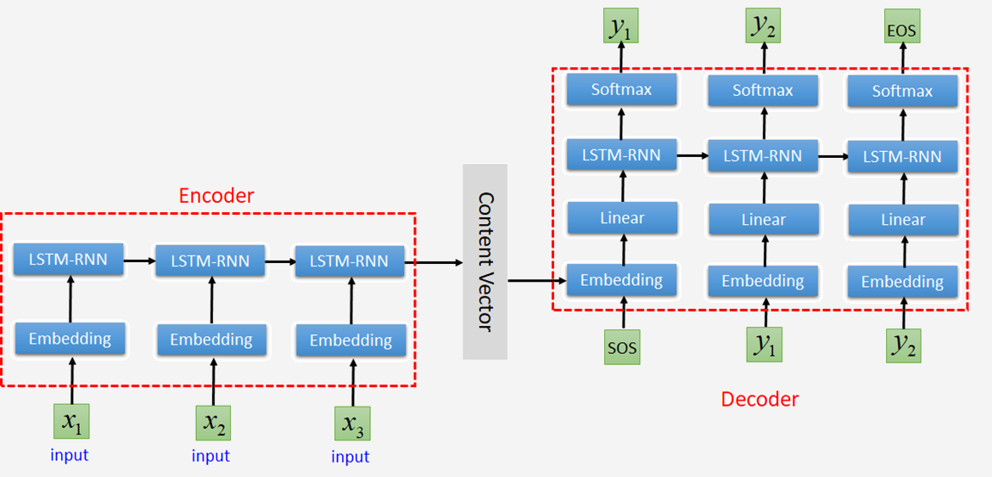
Our Framework
<SOS>: start of a sequence
<EOS>: end of a sequence

Slide 22
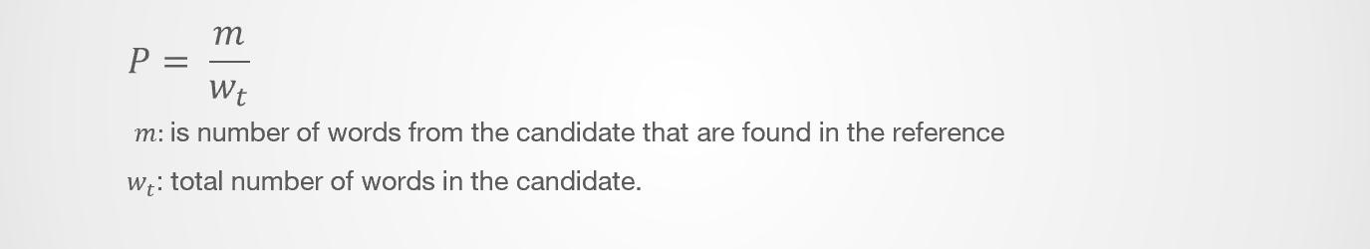
Experimental Results
Accuracy measurement: BLEU-4 score
For comparing a candidate translation of text to reference translation

Slide 23
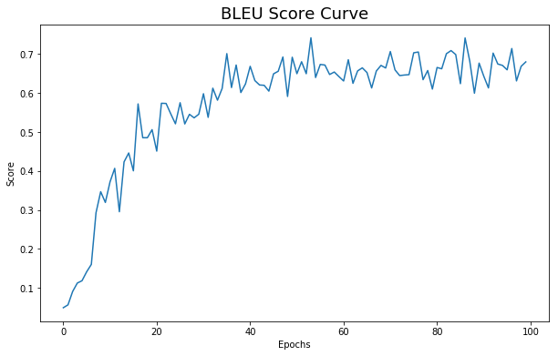
Experimental Results
Current Result:
average BLEU ≈70%
Hyperparameters: hidden layer=256; learning rate=0.1; teacher forcing = 1,0; batch size = 32

Slide 24
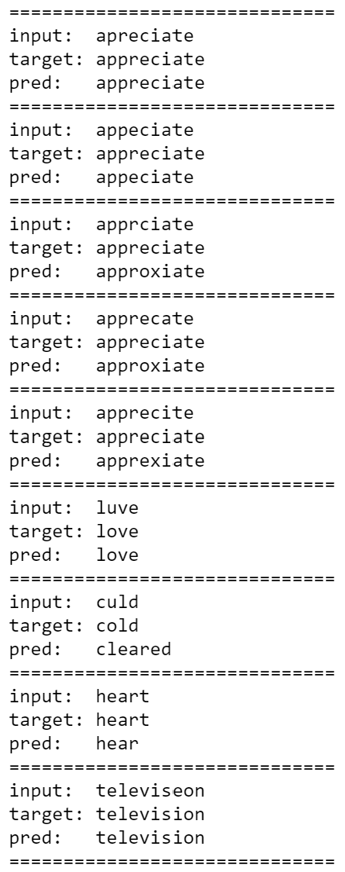
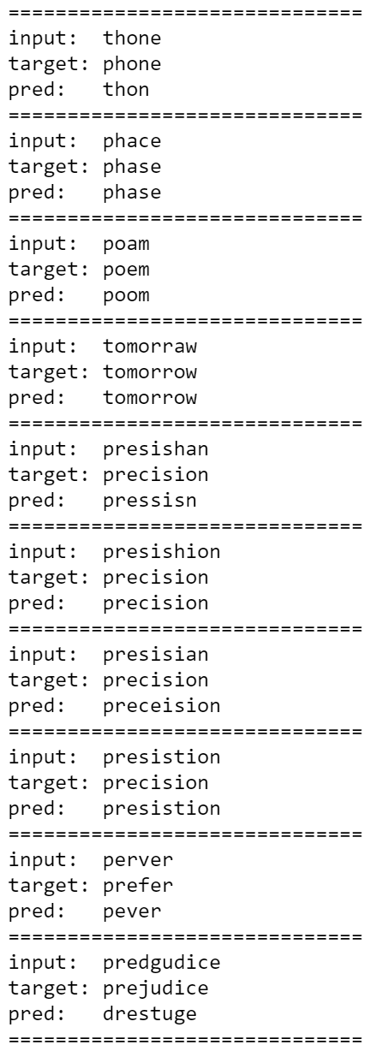
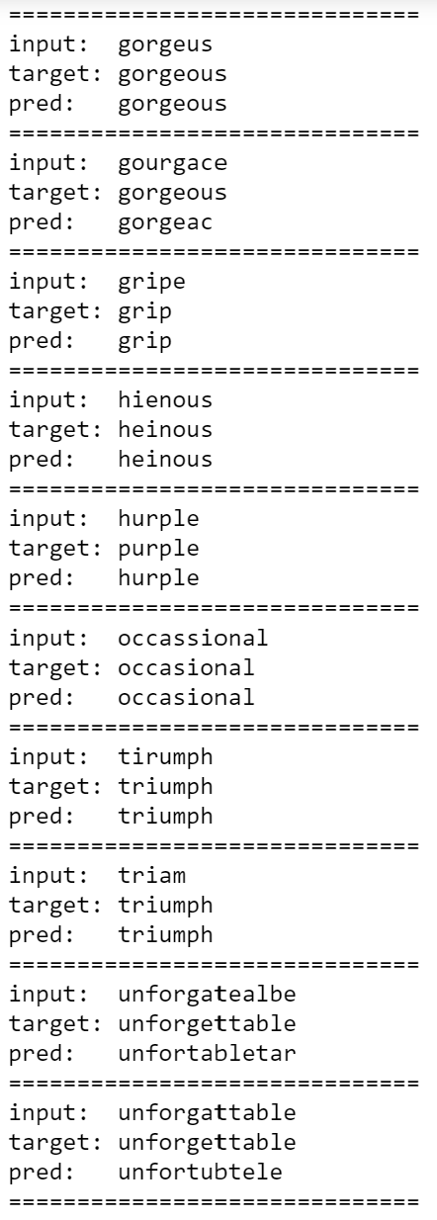
Experimental Results

