Slide 1
Web Crawling and Mapping U-bike Station
0852623 Andreas Rony Wijaya

Slide 2
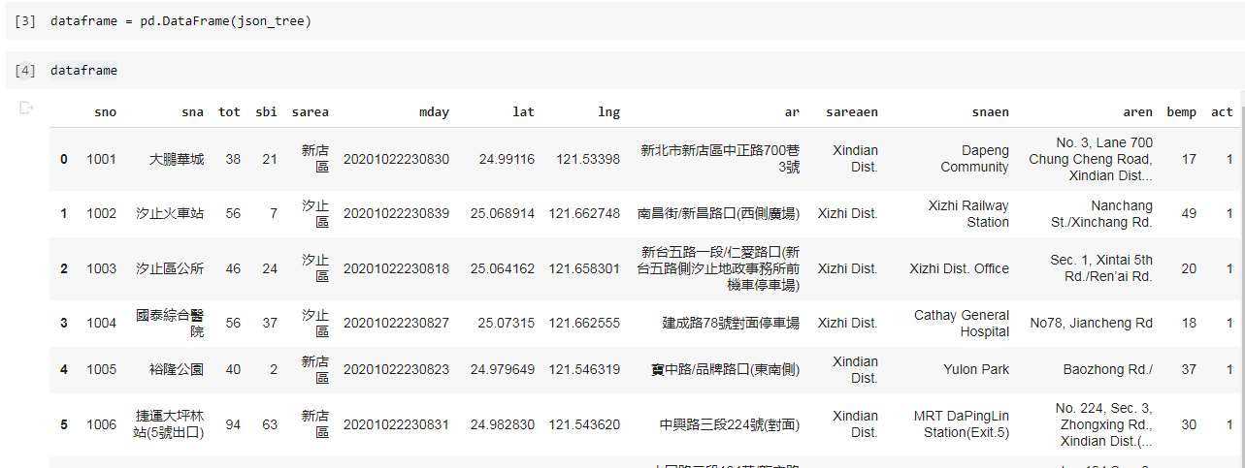
Web Crawling (for Ubike)
Reading JSON data online

Slide 3
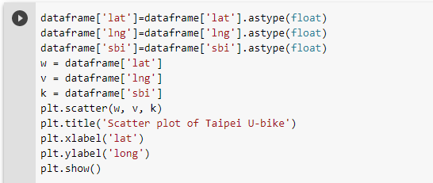
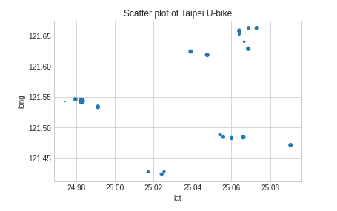
Scatter Plot
Scatter Plot of Longitude and Latitude with Size

Slide 4
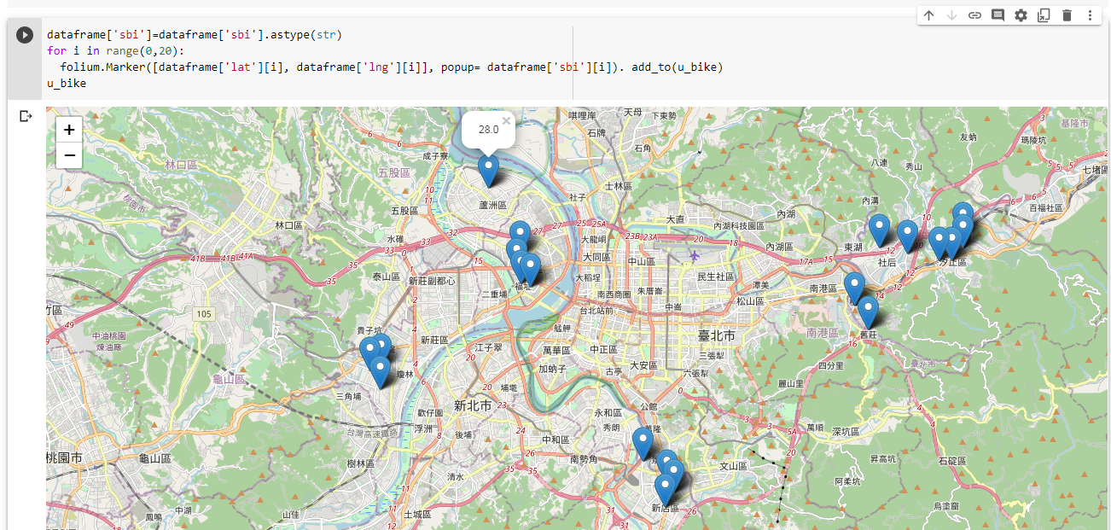
Mapping of U-bike Station
The map of u-bike location with the information about the number of u-bike left in this station

