Slide 1
Web Crawling for Japanese News
0852623 Andreas Rony Wijaya

Slide 2
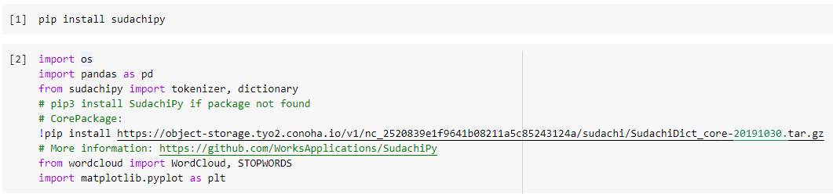
Python codes for Japanese news

Slide 3
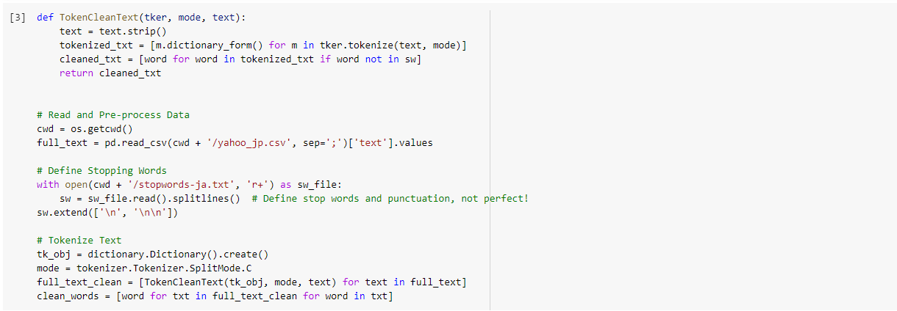
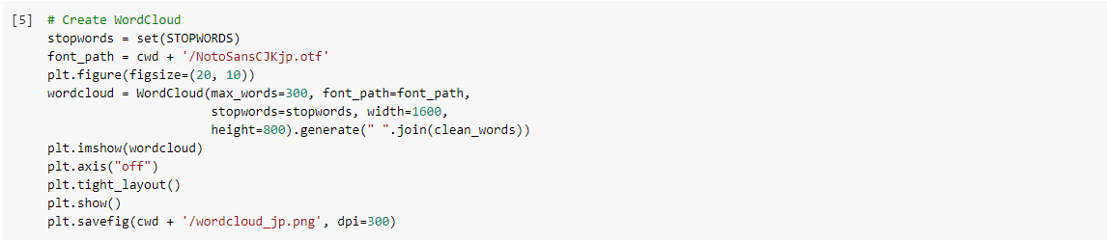
Python codes for Japanese news

Slide 4

Result: Wordcloud for Japanese News

