Slide 1
LDA Analysis on Abstract
00852623 Andreas Rony Wijaya

Slide 2
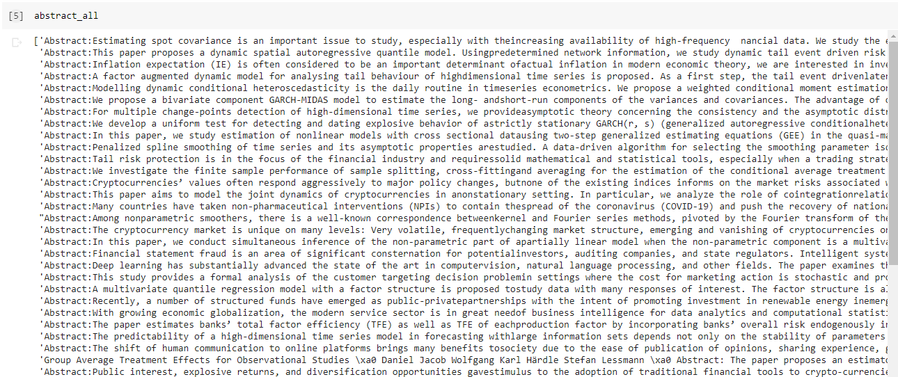
All Abstract Crawled

Slide 3
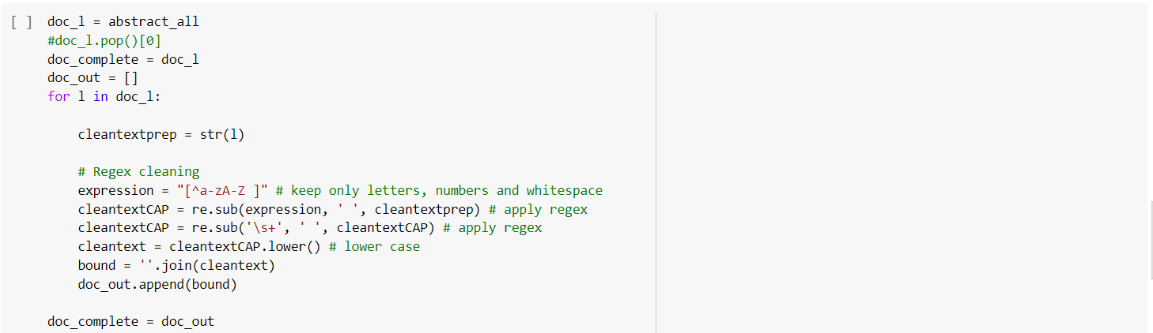
LDA Analysis
Text cleaning: keeping only useful information, transforming text to lower case.

Slide 4
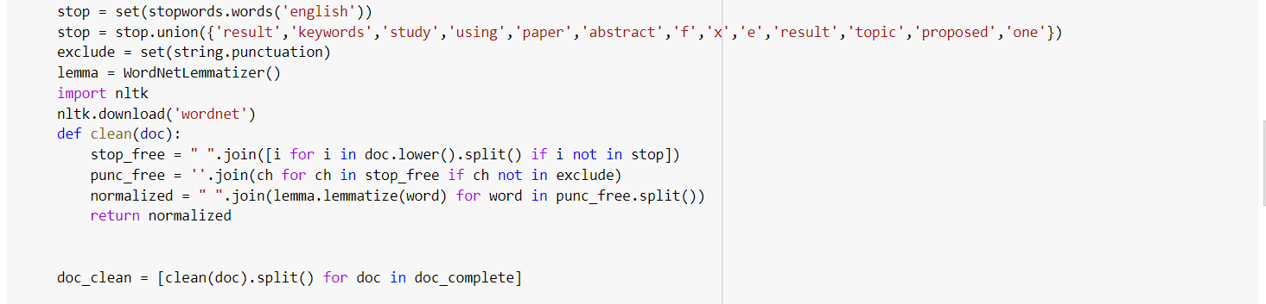
LDA Analysis
Text cleaning: removing stop words and lemmatisation of words (for words with same meaning).

Slide 5
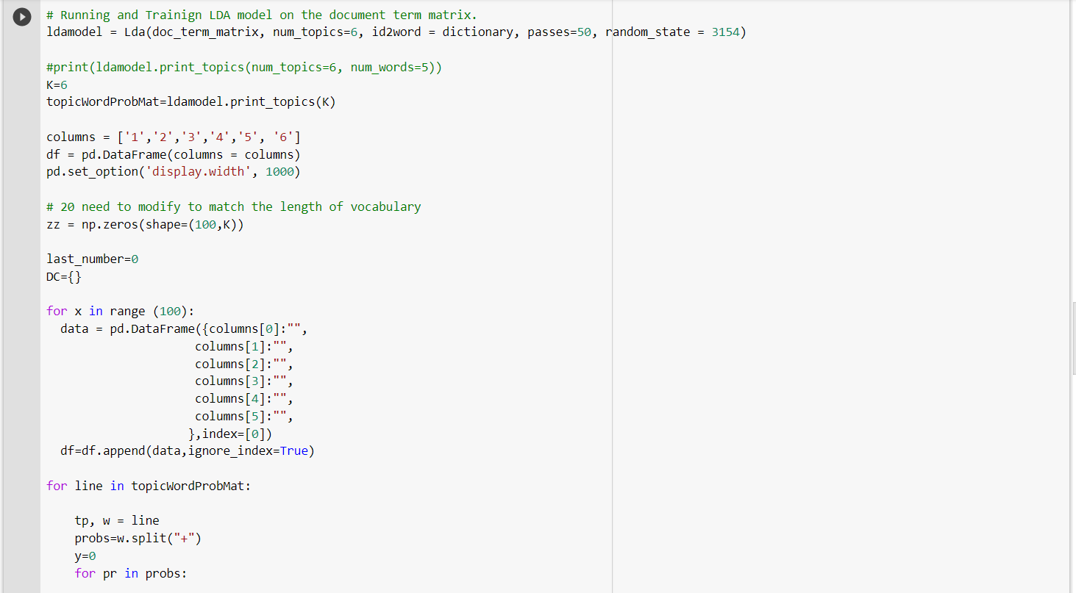
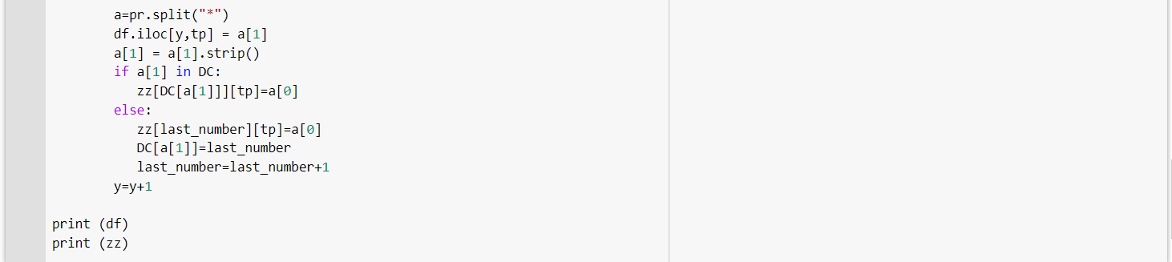
LDA Analysis
Performing LDA with 6 topics of abstract

Slide 6

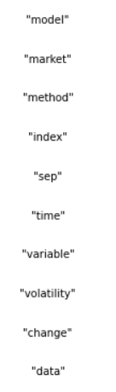
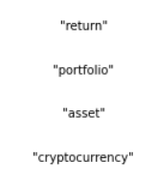
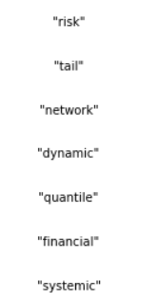
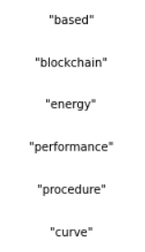
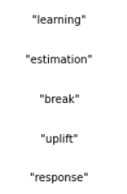
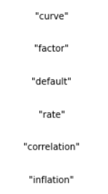
Results: LDA with 6 topics of abstract

