Slide 1
The probability to be outside the upper cutoff point
0852623 Andreas Rony Wijaya

Slide 2
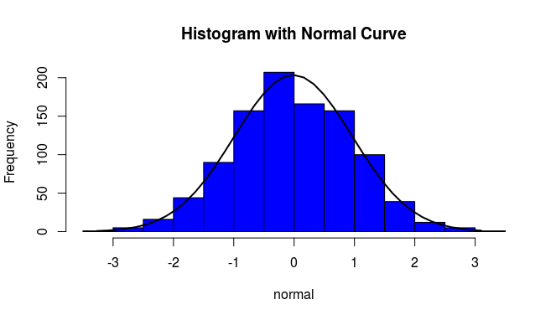
Generate Random Number from Standard Normal
R code
#Generate random number from normal distribution
set.seed(1357)
n=1000
normal = rnorm(n)
#histogram and its density
h <- hist(normal, breaks=10, col="blue",
main="Histogram with Normal Curve")
xfit <- seq(min(normal), max(normal), length = 40)
yfit <- dnorm(xfit, mean = mean(normal),
sd = sd(normal))
yfit <- yfit * diff(h$mids[1:2]) * length(normal)
lines(xfit, yfit, col = "black", lwd = 2)

Slide 3
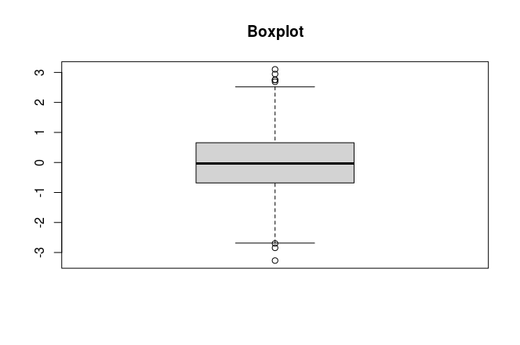
Upper Cut Off Point
# 25% quantile
q25 <- as.numeric(quantile(normal, probs =0.25))
# 75% quantile
q75 <- as.numeric(quantile(normal, probs =0.75))
#upper cut off point
w = q75 + 1.5 *(q75-q25)
cat("The cut off point is: ", w)
The cut off point is: 2.665273
#Boxplot of the data
boxplot(normal, main="Boxplot")

Slide 4
Probability of a “normal (distribution)” to be outside the upper cutoff point
# CDF with x=w
phi<- pnorm(w, mean = 0, sd = 1)
# Calculate the probability of a “normal (distribution)” to be outside the upper cutoff point
p = 2*(1-phi)
cat("The probability of a “normal (distribution)” to be outside the upper cutoff point: ", p)
The probability of a “normal (distribution)” to be outside the upper cutoff point: 0.007692584

