Slide 1

Unit 1
Microsoft Philanthropies TEALS Program
AP CS A

Slide 2
Introduction to AP CS
[ 1.01 ] [ Today’s Date ] [ Instructor Name ]
Notes:
Things to go over in 1.01:
Why are you taking the class, why AP computer science?
Class expectations, syllabus, and icebreakers.
Setup Eclipse or jGrasp, explain class requirements, notebooks, etc.

Slide 3
In Your Notebook:
What is your name? Do you prefer to be called by your nickname?
What is your grade?
Why are you taking this class?
Do you have any previous programming experience?
If so, what computer languages do you know?
What projects have you worked on?
Notes:
Note: You can modify this activity to index cards if you want to collect this info.

Slide 4
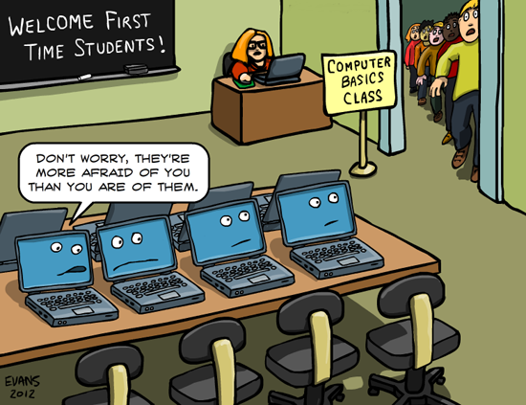
So why computer science?
CS isn’t just for programmers
CS fun
There jobs available in CS
CS pays well

Slide 5
How many computers do you interact with in a day?
Notes:
Example:
Phone/iPad/laptop
Gaming console
but also…
Car
GPS navigation
Smart speaker/personal assistant
Programmable appliances
Cash registers
Smart TV
Roomba
Key fobs

Slide 6
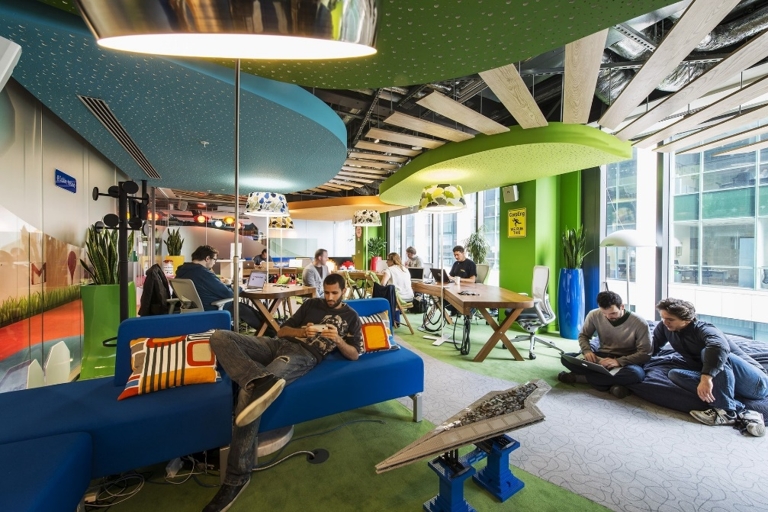
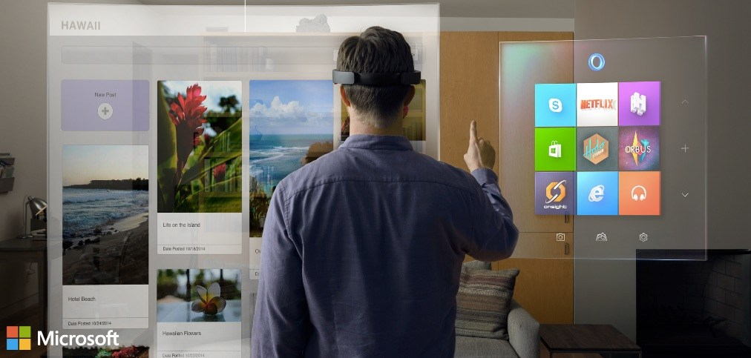
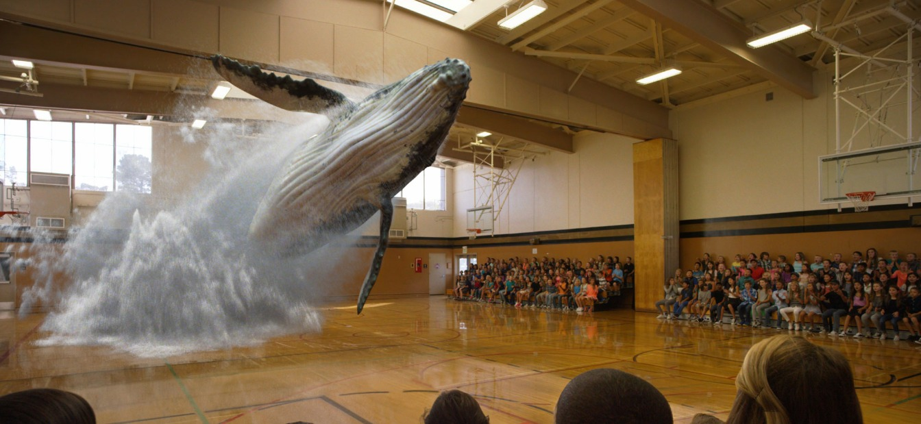
Is computer science fun?
Problem solving
Building something
Notes:
Seek volunteer input:
What is fun about their job?
What is the culture like?
What drives you at work?

Slide 7
Are there jobs available?
YES!
Bureau of Labor Statistics Handbook 2018 – 2028
Computer and Information Technology jobs
12% year over year growth.
546,000 new jobs.
2014 Business Insider Article 12 Fast-Growing Jobs in 2014
Role | Rank
Software Developer | 1st
Web Developer | 6th
Database Administrator | 8th

Slide 8
Does it pay well?
Source: Link
Career | Mean Hourly | Mean Annual
National Average | $23 | $46k
Software Engineer | $63 | $126k
Data Scientist | $67 | $134k

Slide 9

AP Computer Science A
This Class :
1st semester of a CS college course
Prepares you for the AP CS A test in May
Uses the Eclipse IDE to program in Java

Slide 10
Importance of taking good notes(edit)
Reuse code from class examples, previous assignments, demos
Turn in notebooks for periodic checks
Notes:
Instruct students on how take good notes

Slide 11
Classroom specific information (edit)
Get set up on Eclipse
Explain the file turn in system specific to your class
Explain the plug/un-plug procedures
Hand out syllabus (possibly bring it home/get it signed for homework?)
Go over
class expectations
Academic Honesty Statement
What do they need to bring to class for tomorrow?

Slide 12
Algorithms and Computational Thinking
[ 1.02 ] [ Today’s Date ] [ Instructor Name ]
Notes:
Things to go over in 1.02:
Peanut Butter and Jelly Activity
History
Coding without computers
Debugging
Some vocabulary and algorithms

Slide 13
 Warmup exercise – 7 minutes
As a class, create a list of:
Things that are “computers”
Tasks that can be accomplished by a computer
Come to the front of the class (in silence) and add a new entry to each list (include your name)
Be original!
Things that are “computers”: | Tasks that can be accomplished by a computer:
Cell phones (Mr. Nicholson) … | Filing taxes (Mr. Nicholson) …

Slide 14
Basic Computing Concepts
Students will be able to define the following terms
computer
computer science
program
algorithm
binary number
compiler

Slide 15
What is a computer?
A machine that manipulates data and executes lists of instructions known as “programs”
The same computer can perform many different tasks (depending on what program is running)
A computer can be built that is capable of running programs that don’t even exist yet
Made of hardware and software
Hardware: Physical components, e.g. CPU, memory, hard disk
Software: Collection of programs, e.g. Windows, Microsoft Office, Facebook
Program: A list of instructions to be carried out by a computer.

Slide 16
What is Computer Science?
Not programming
We’ll study programming because it is a good way of explaining the approach that Computer Scientists take to solve problems
A person does not really understand something until after teaching it to someone else, or…
A person does not really understand something until after teaching it to a computer, i.e. expressing it as an algorithm.

Slide 17
 Making cakes
Notes:
Ask a student to explain how to make a cake; write it down on the board as an algorithm; refactor, fix bugs, make improvements, etc. as a class

Slide 18
Programming
Computer programs are also stored as zeroes and ones
“Machine language”
We don’t write programs in zeroes and ones! (Anymore.)
We have some mechanisms to simplify this
We write text in programming languages (e.g. Java, C++, Python)
A special program called a compiler turns this text into machine language
Sometimes this is hidden from you
Compiler: A program that translates a program written in one language into an equivalent program in another language.

Slide 19
The process of programming
Yes
Use editor to
Start
create
/
edit source
Compile
Error
?
No
Execute program
End
files
Notes:
Has anyone/everyone seen a flow-chart before?

Slide 20
 Creating an algorithm
Think of an every day task (e.g. baking a cake) and write an algorithm for it
Does your algorithm use any “loops” or “conditionals”
Share your algorithm with a friend? Is it sufficient for them to perform the task? Can they identify any “bugs” in your algorithm?

Slide 21
Discussion:
How did you debug your algorithm?

Slide 22
Homework
Read chapter 1 section 2 (1.2) for class tomorrow. (p.10-23)
Many of our class examples involve Pokémon; if you don’t know much about the game, we advise that you read up on your Pokéknowledge at http://www.pokemon.com
A lot of our examples also draw from the Pokemon games; if you want to up your knowledge on the game’s mechanics, rules, underlying formulae and characters visit http://bulbapedia.bubagarden.net

Slide 23
Strings and Console Output
[ 1.03 ] [ Today’s Date ] [ Instructor Name ]
Notes:
Things to go over in 1.03:
About JAVA
About Eclipse
First Program
Print vs Println
Escape Sequences
Strings
Little ASCII

Slide 24

Brief History of Java
Originally released in 1995 by Sun Microsystems (now part of Oracle)
Designed for programs on “embedded devices”, specifically TV’s
These features also happened to make Java programs ideal for the internet, which was then in its infancy

Slide 25
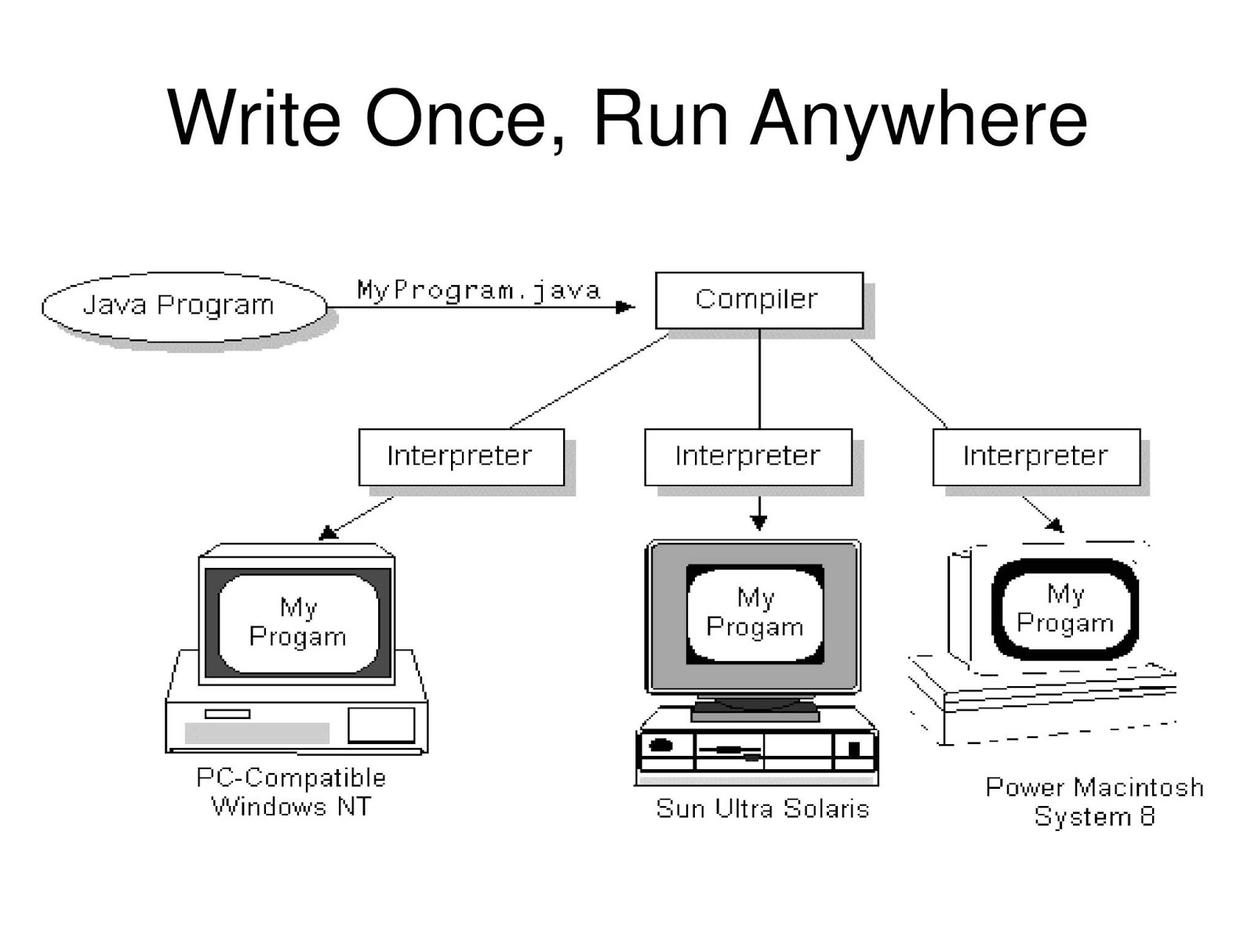
Key Characteristics of Java
Write-once, run anywhere
Automatic memory management
Object-oriented

Slide 26
Eclipse

Slide 27
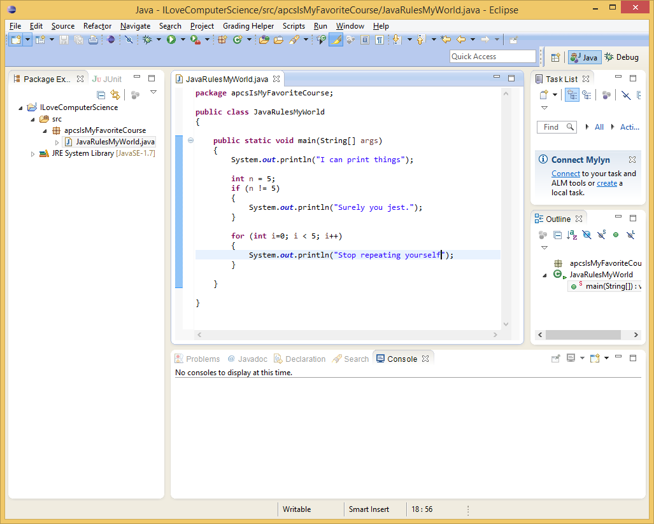
Eclipse: An Integrated Development Environment (IDE)
Code
Window
Package
Explorer
Console
Window

Slide 28
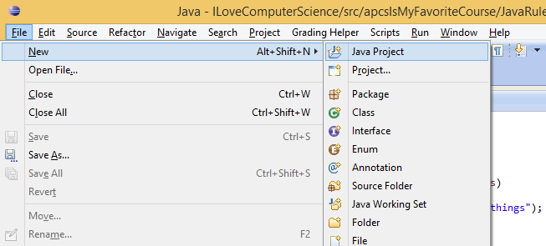
Your first project: Hello World!
File, New, Java Project
(then fill out the dialog, give it a name, etc.)

Slide 29
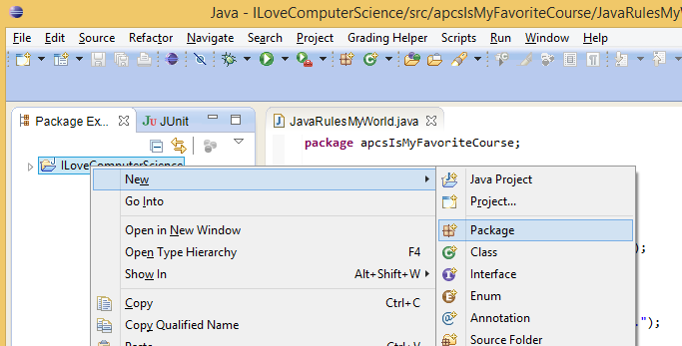
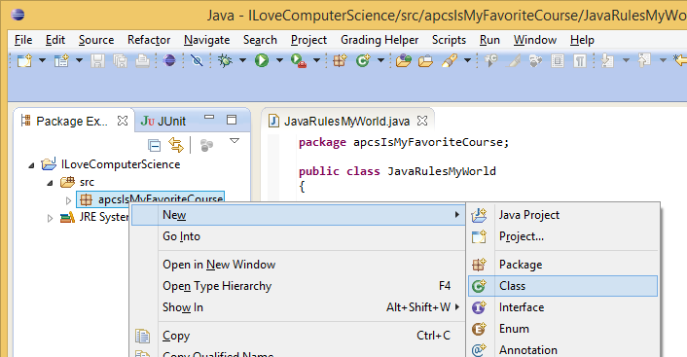
Continuing with Hello World!
2) Right-click, New, Package
(right-click on the java project.
then fill out the dialog, give it a name, etc.)
3) Right-click, New, Class
(right-click on the package.
then fill out the dialog, give it a name, etc.)

Slide 30
The code for Hello World!
public class HelloWorld
{
public static void main(String[] args){
System.out.println(“Hello World!”);
}
}
Type the highlighted code inside of the class as shown above.
Possible sources of error.
Don’t forget the semicolon ( ; ) after the statement!
Be consistent with your use of capital and lowercase letters!
Be sure to use the correct characters—note that Java treats parentheses, square brackets, and curly braces differently! ( ) { } [ ]

Slide 31
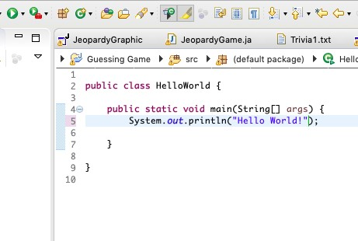
Running Hello World!
To run your program, click on the green arrow key a shown to the left.
Your program should print "Hello World!" in the console (bottom frame of Eclipse)

Slide 32
VS Code

Slide 33
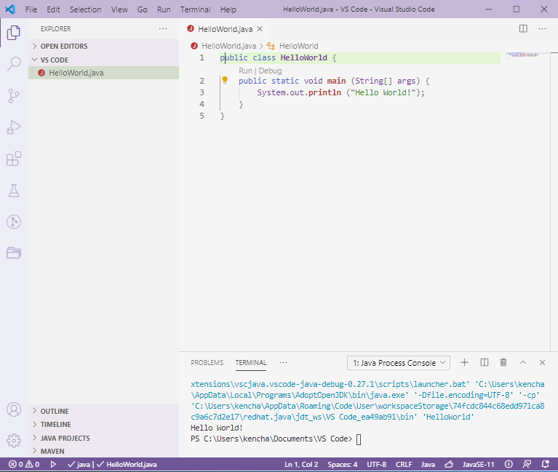
VS Code: Code Editor
Code
Window
File Explorer
Console
Window

Slide 34
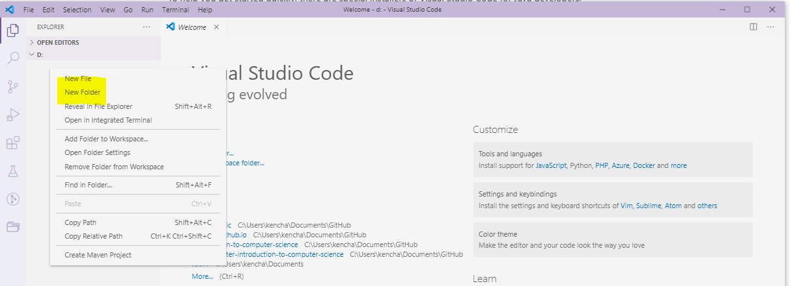
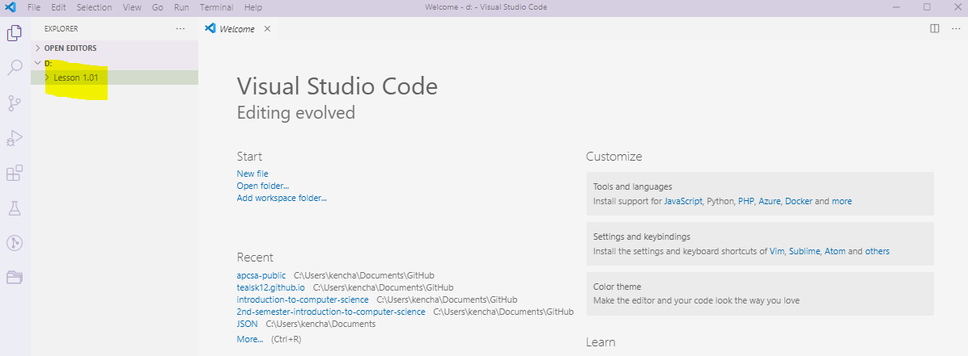
Create New Folder
2) Right-click, New Folder
3) Enter Folder Name

Slide 35
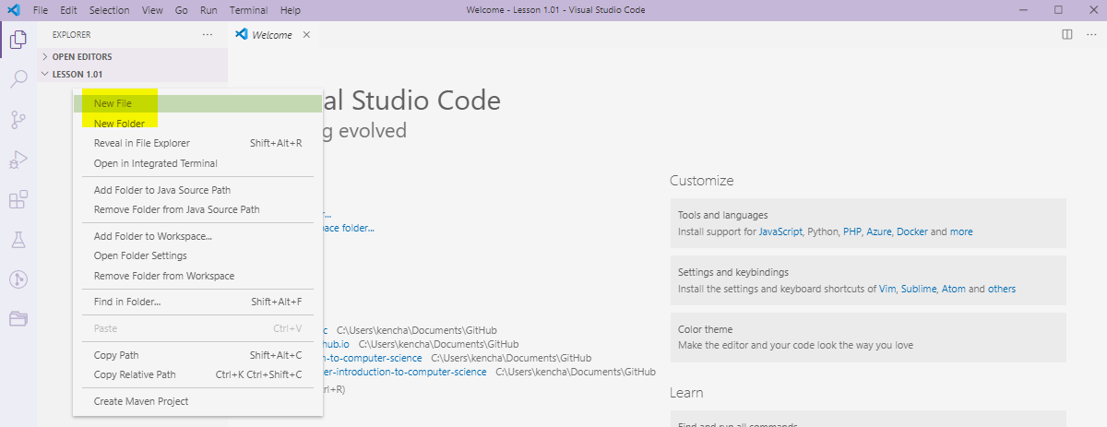
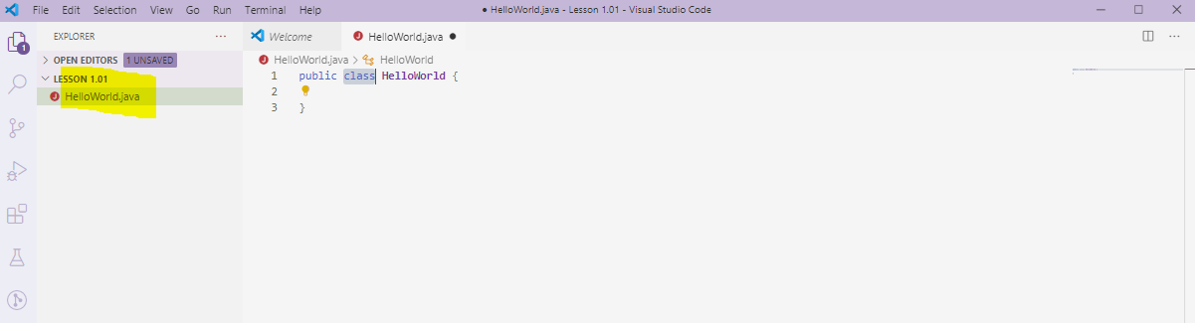
Create New File
2) Right-click under Folder, New File
3) Enter Filename: HelloWorld.java

Slide 36
The code for Hello World!
public class HelloWorld
{
public static void main(String[] args){
System.out.println(“Hello World!”);
}
}
Type the highlighted code inside of the class as shown above.
Possible sources of error.
Don’t forget the semicolon ( ; ) after the statement!
Be consistent with your use of capital and lowercase letters!
Be sure to use the correct characters—note that Java treats parentheses, square brackets, and curly braces differently! ( ) { } [ ]

Slide 37
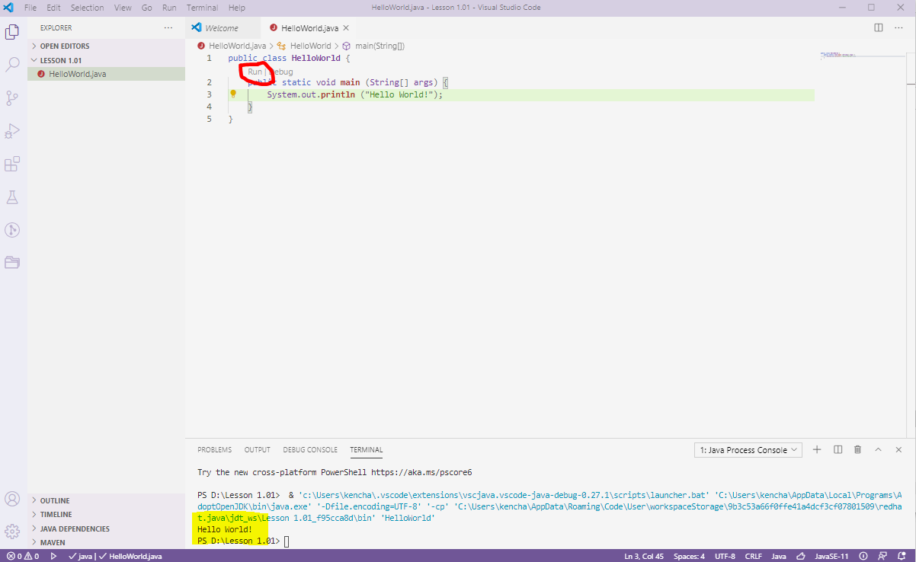
Running Hello World!
To run your program, click on the run icon
Your program should print "Hello World!" in the console (bottom frame)

Slide 38
What is a string?
A sequence of characters is called a string.
"cat" "Abraham Lincoln" "The quick brown fox jumps over the lazy dog"
Strings in Java are enclosed in double-quotes.
Identify the string in the code below
public class HelloWorld
{
public static void main(String[] args){
System.out.println(“Hello World!”);
}
}

Slide 39
Add another statement to your program
A statement is
public class HelloWorld
{
public static void main(String[] args){
System.out.println(“Hello World!”);
System.out.println("Welcome to CS");
}
}

Slide 40
println vs print
Replace: System.out.println(“”); with: System.out.print(“”);
What happened? What is the difference between print() and println()?

Slide 41
Working with escape sequences (featuring "\n")
Insert "\n" into the strings as shown below.
public class HelloWorld
{
public static void main(String[] args){
System.out.print(“Hello\n World!”);
System.out.print("\nWelcome to CS");
}
}
What does the "\n" escape sequence do?

Slide 42
Escape Sequences
Escape sequences are combinations of the backslash (\) and another character.
When embedded in a literal print statement, they send a special message to the compiler
Common escape sequences:
\n – new line
\” – quotation mark
\t – tab
\\ – backslash

Slide 43
Challenge: Text Pikachu
Write a program that outputs the following:
Pikachu welcomes you to the world of Pokemon!
(\__/)
(o^.^)
z(_(“)(“)

Slide 44

Homework
Read 1.3 in your textbook. (p.24-28)
Complete exercises 1 – 5 for chapter 1 (p.54-55)
Remember your syllabus if you haven’t turned it in already

Slide 45
Common Errors and Comments
[ 1.04 ] [ Today’s Date ] [ Instructor Name ]
Notes:
Things to go over in 1.04:
Common Errors (for what we know so far)
Types
Identifiers
Documentation
Style
Comments

Slide 46
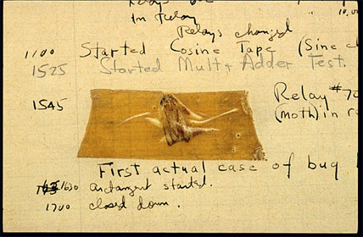
History of Bugs
Origin of (computer) bugs
September 9, 1947
Captain Grace Hopper

Slide 47


Syntax Errors
Error message
Program does not run
Bad grammar in Java
Misspelled words
Incorrect case
Missing semicolons
Java does not understand.
E.g.:
System.out.pruntln("");
system.out.println("");
public static main(String[] args) {
Notes:
Be sure to note that as students get started, they will primarily be making syntax errors. As they get better at programming, they will make fewer syntax errors (but will always make some).
Volunteers can share if they have ever written a program that ran perfectly the first time they tried it.

Slide 48
Runtime Errors
Program syntax is correct, but program asks computer to do something impossible or not allowed.
Program runs but ends with an error.
E.g.
int n = reader.nextInt();
int x = 100 / n;
// Error when n == 0
Error message after stopping
Program stops
Notes:
Explain that students will not make too many runtime errors as they get started, but will make more as they work with more complicated

Slide 49
Logical Errors (bugs)
Program does not do what was intended.
Can be hard to find.
No Error message
Program runs
E.g.
public static boolean isEven(int n){
return n % 2 == 1;
}
Notes:
Good opportunity for volunteers to share how much of their debugging time is spent on the different kinds of errors.

Slide 50
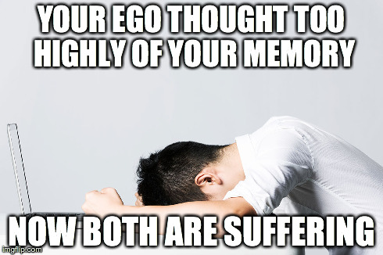
Preventing Errors: Documentation
Documentation refers to elements of the code that help a reader understand
Comments are messages that are ignored when your code is compiled
Single line comments: // this is a single-line comment
Multi-line (or C-style) comments: /* this is a multi-line comment */
Describe behavior of large portions of code.
Explain complicated lines of code.
Comment out lines of code to deactivate while debugging.
Notes:
Explain that the person most likely to read code is the person who wrote it.

Slide 51

Preventing Errors: Identifiers
Identifiers are the names of classes, variables, and functions.
Identifiers are single words.
Classes start with Capital Letters. MyClass, Student
Variables and functions should use camelCase. userInput, birthDate
Good names can make the code easier to understand and easier to debug.
Good: userAge, month, doubleNumber(int n)
Bad: aaa, bbb, ccc, thing(), reallyImportantVariableThatIUseLaterInTheProgram

Slide 52
Preventing Errors: More readability tips
Readable code is easier to work on debug.
Use consistent spacing and indentation.
Use line breaks to make long lines more readable.
Use complete sentences and proper spelling/grammar in comments.

Slide 53

Fixing errors: Common Mistakes to Check For
File name matches class name
Keywords and identifiers are speled correctly
Keywords and identifiers are caPitaliZed correctly
All statements end in a semicolon;
Packages are included.
Strings are enclosed in “quotation marks”
There are no extra, punctuation marks.
All {open-braces are paired with closed-braces

Slide 54
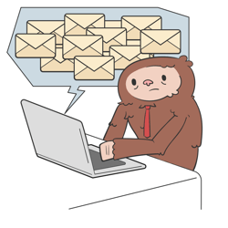
Fixing errors: Error messages
Ignore the parts you don’t understand
Look for the line number
Look at that line in the code
Look at the line above that line
Copy and paste the error message into a search engine

Slide 55
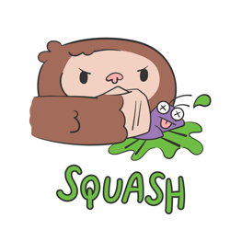
Fixing Errors: Debugging
Find where the bad output is coming from and trace backwards.
Add print statements to ensure variables are the values you think they are.
Debug lines of code to deactivate them.
If the error persists, that line is good
If the error goes away (or you get a new error), the error is in that line
If you get a different (but not new) error you will need to find another way to test.

Slide 56

Finding Errors: Testing
Test a variety of likely values
High numbers
Low numbers
Zero
Negative numbers
Right answers
Wrong answers
Test unlikely values
Letters when there should be numbers
Numbers when there should be letters
No value
What it would look like if a cat walked across the keyboard.
Notes:
This slide is optional.
You will spend more time talking about testing later when there is more code to test, but this could be a good preview.

Slide 57
Worksheet 1.4

Slide 58
Homework
Read chapter 1 section 4 (1.4) (p. 28-40)
Complete chapter 1 exercises 6 – 9 (p. 55)

Slide 59
Static Methods and Method Calls
[ 1.05 ] [ Today’s Date ] [ Instructor Name ]
Notes:
Things to go over in 1.05:
Method information and breakdown.
How to
Vocabulary
Examples

Slide 60
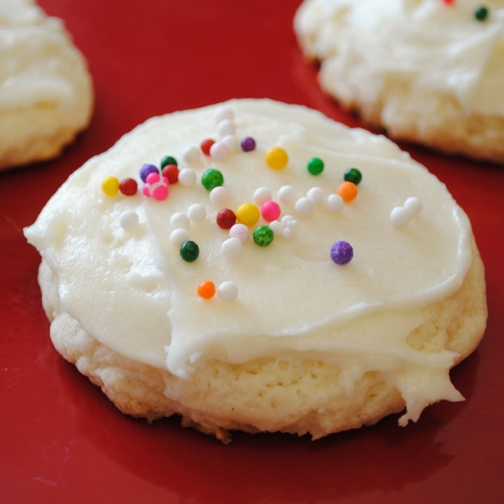
Algorithms
Algorithm: A list of steps for solving a problem.
Example Algorithm: bakeSugarCookies()
Mix the dry ingredients.
Cream the butter and sugar.
Beat in the eggs.
Stir in the dry ingredients.
Set the oven temperature.
Set the timer.
Place the cookies into the oven.
Allow the cookies to bake.
Spread the frosting and sprinkles onto the cookies

Slide 61
Problems with Algorithms
Lack of structure: Many tiny steps; tough to remember each step
Redundancy: Consider making a double batch
…
Stir in the dry ingredients
Set the oven temperature
Set the timer
Place the first batch of cookies into the oven
Allow the cookies to bake
Set the oven temperature
Set the timer
Place the second batch of cookies into the oven
Allow the cookies to bake
….

Slide 62
Removing Redundancy
A well-structured algorithm can describe repeated tasks with less redundancy
Make the cookie batter.
Mix in the dry ingredients.
…
Bake the cookies (first batch)
Set the oven temperature.
Set the timer.
…
2a. Bake the cookies (second batch)
Decorate the cookies.
…
By grouping steps and calling the groups, we can eliminate redundancy.

Slide 63
Structure Diagram
Allows you to divide and conquer
Many batches of cookies
Make a batch of cookies
Make the batter
Bake the cookies
Decorate the cookies
System.out.println("Mix the dry ingredients.");
System.out.println("Cream the butter and sugar.");
System.out.println("Beat in the eggs.");
System.out.println("Stir in the dry ingredients.");
…
…

Slide 64
+-------+
| |
| |
+-------+
+-------+
| |
| |
+-------+
+-------+
| |
| |
+-------+
Create a structure diagram for this set of stacked boxes:

Slide 65
Methods
method: a named group of statements
Procedural decomposition: dividing a problem into methods
Writing a method is like adding a new command to Java

Slide 66
static Methods
static keyword: access modifier
static method: methods that can be called with creating an object
Non static methods: will be covered in a future lesson on object oriented programming concepts

Slide 67
Using static Methods
Define / Declare the method
Call (or run) the method
*Insider Tip* The main() method always runs first

Slide 68
Defining and Declaring a static Method
Give the method a name so it can be executed:
Syntax:
public static void name(){
statement;
statement;
…
statement;
}
Give the method a name so it can be executed:
Example:
public static void makeBatter() {
System.out.println(“Mix the dry ingredients.”);
System.out.println(“Cream the butter/sugar.”);
System.out.println(“Beat in the eggs.”);
System.out.println(“Stir in dry ingredients.”)
}

Slide 69
Calling static Methods
Executes the method’s code
Syntax : <name>()
Output:
Mix the dry ingredients.
Cream the butter/sugar
Beat in the eggs
Stir in dry ingredients
Example:
makeBatter();
public static void makeBatter() {
System.out.println(“Mix the dry ingredients.”);
System.out.println(“Cream the butter/sugar.”);
System.out.println(“Beat in the eggs.”);
System.out.println(“Stir in dry ingredients.”)
}
This whole block of code is called every time makeBatter() is called.

Slide 70
// This program displays a delicious recipe for baking batches of cookies.
public static void main(String[] args)
{
// Step 1: Make the cake batter.
System.out.println("Mix the dry ingredients.");
System.out.println("Cream the butter and sugar.");
System.out.println("Beat in the eggs.");
System.out.println("Stir in the dry ingredients.");
// Step 2a: Bake cookies (first batch).
System.out.println("Set the oven temperature.");
System.out.println("Set the timer.");
System.out.println("Place a batch of cookies into the oven.");
System.out.println("Allow the cookies to bake.");
// Step 2b: Bake cookies (second batch).
System.out.println("Set the oven temperature.");
System.out.println("Set the timer.");
System.out.println("Place a batch of cookies into the oven.");
System.out.println("Allow the cookies to bake.");
// Step 3: Decorate the cookies.
System.out.println("Mix ingredients for frosting.");
System.out.println("Spread frosting and sprinkles.");
}

Slide 71
// This program displays a delicious recipe for baking batches cookies with less redundant code
public class BakeCookies3
{
public static void main(String[] args)
{
makeBatter();
bake(); // 1st batch
bake(); // 2nd batch
decorate();
}
// Step 1: Make the cake batter.
public static void makeBatter()
{
System.out.println("Mix the dry ingredients.");
System.out.println("Cream the butter and sugar.");
System.out.println("Beat in the eggs.");
System.out.println("Stir in the dry ingredients.");
}
// Step 2: Bake a batch of cookies.
public static void bake()
{
System.out.println("Set the oven temperature.");
System.out.println("Set the timer.");
System.out.println("Place batch into oven.");
System.out.println("Allow the cookies to bake.");
}
// Step 3: Decorate the cookies.
public static void decorate()
{
System.out.println("Mix ingredients for frosting.");
System.out.println("Spread frosting and sprinkles.");
}
}
This affords you a lot
of new capabilities.

Slide 72
Practice Problems
Complete the following practice questions:
Self-Check 1.22: Tricky
Self-Check 1.23: Strange
Self-Check 1.26: Confusing
Self-Check 1.29: LotsOfErrors-errors

Slide 73
Homework
Read chapter 1 section 5 (1.5) (p. 40-46)
Do chapter 1 exercises 11, 12, 14, and 16. (p. 56-58)

Slide 74
Static Methods and Method Calls
[ 1.06 ] [ Today’s Date ] [ Instructor Name ]
Notes:
Things to go over in 1.06:
Method inside method.
Control Flow
Practice It
Can use the optional challenges in the lesson plan; some students may struggle here, make sure that they’re all caught up.

Slide 75
public class MethodsExample
{
public static void main(String[] args)
{
message1();
message2();
System.out.println("Done with main.");
}
public static void message1()
{
System.out.println("This is message1.");
}
public static void message2()
{
System.out.println("This is message2.");
message1();
System.out.println("Done with message2.");
}
}
We can put methods inside methods!
How do you think this program runs?
What is the output of this program?

Slide 76
public class MethodsExample
{
public static void main(String[] args)
{
message1();
message2();
System.out.println("Done with main.");
}
public static void message1()
{
System.out.println("This is message1.");
}
public static void message2()
{
System.out.println("This is message2.");
message1();
System.out.println("Done with message2.");
}
}
Control Flow:
What do you think the output of this program is?
In this case, the program outputs:
This is message1.
This is message2.
This is message1.
Done with message2.
Done with main.

Slide 77
Review Exercises
Write a program that prints your name in the following forms:
FirstName LastName
FirstName MiddleName LastName
LastName, FirstName
LastName, FirstName MiddleName
Rewrite the above program using static void methods

Slide 78
Challenge
*****
*****
* *
*
* *
*****
*****
* *
*
* *
*****
*****
*
*
*
*****
*****
* *
*
* *
There’s a 10 minute time limit.
Write a Java program called StarFigures that generates the following output
You MUST include a structure diagram or your answer will be disqualified
A correct answer will use static methods to show structure and eliminate redundancy in your solution

Slide 79
Practice Problems
If you speed through and finish early, here are some problems for you to try:
Complete Strange 2, Strange 3, Complicated 2 and Complicated 3 Practice
Work on sample test questions with outputs that can be written using method calls. Make sure to include an answer key to your sample!

Slide 80
Homework
No reading tonight!
Complete an outline for chapter 1
Please complete programming project 1.1 and 1.3

Slide 81
Programming Project
[ 1.07 ] [ Today’s Date ] [ Instructor Name ]

Slide 82
Programming Project 2: Similar Letters
Should be able to print similar letters to three people of your choice
Each letter should have one paragraph in common with each other letter
Your main program should only have three method calls
TIPS: Try to isolate repeated tasks into methods. Include comments in with your code so others can easily understand what your code is supposed to do

Slide 83
Programming Project 5: The House that Jack Built
Write a program that produces as output the words of the song,
“The House that Jack Built”
Reference page 60 of your textbook for the full lyrics
Use methods for each verse and repeated text

Slide 84
If you finish early, work on Programming Project 4

Slide 85
Homework
All students must turn in notes for each day of class (including days missed due to absence)
Notes must be fully completed, adding daily summaries if needed
Students may use the book to supplement their notes if needed

Slide 86
Finding and Fixing Errors
[ 1.08 ] [ Today’s Date ] [ Instructor Name ]
Notes:
Things to go over in 1.08:
Touch base on error checking flow/diagram.
Go over common errors.
Go over style guide.

Slide 87
Today’s plan:
Error check and resubmit all chapter 1 assignments
Study for the test by:
Reviewing all of the blue, self-check pages at the end of Chapter 1
Re-reading sections as needed to complete the self-check problems
Submit 5 questions for review in class tomorrow

Slide 88
Homework Regrade/Resubmit
You all have the opportunity to get full credit on your homework grades by correcting them now, in class
Use your error checking algorithm, and if you need help just ask!

Slide 89
Caveat: Style
In order to get your full credit, you’ll need to restyle your code
In programming style is necessary
We’ll touch on a few major style guidelines

Slide 90
Style:
Class Names
MyProgram, CritterMain
Method/Variable Names
greatMethod1(), String firstName, int countOfX
Use header, method, field, and inside-method commenting
Method commenting: //Prints an introduction to programming style
Inside-method commenting: //This variable is used to count your steps
We’ll introduce more commenting and style as we move along!

Slide 91
Style:
Formatting:
Keep your lines under 100 characters of length, preferably 80 characters
Redundancy:
We touched on this previously, but redundant code is bad style
*For advanced coders: Do not use break, break-like, or continue statements in your code! Also no empty return statements!

Slide 92
Style:
UW Commenting Guide:
http://courses.cs.washington.edu/courses/cse142/11au/handouts/comment-guide-eric-arendt.pdf
UW Style Guide:
http://courses.cs.washington.edu/courses/cse143/13sp/handouts/style-guide.pdf

Slide 93
Lab
Error check and resubmit all chapter 1 assignments
Study for the test by:
Reviewing all of the blue, self-check pages at the end of Chapter 1
Re-reading sections as needed to complete the self-check problems
Submit 5 questions for review in class tomorrow

Slide 94
Homework
Begin reviewing chapter one for the Unit Test
Submit any questions you have for review

Slide 95
Review
[ 1.09 ] [ Today’s Date ] [ Instructor Name ]

Slide 96
Review Questions
Use submitted review questions to review for the test
Assemble the questions into categories to go over
Answer individual questions, or make slides for topics you think students need to go over

