Slide 1
Test Review & Reteach
[ 4.00 ] [ Today’s Date ] [ Instructor Name ]

Slide 2
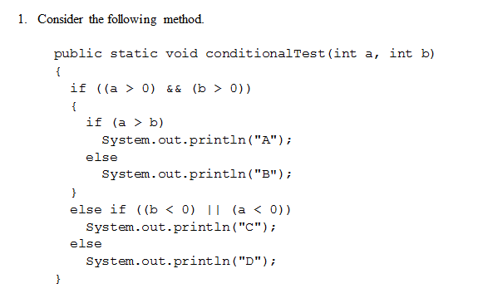
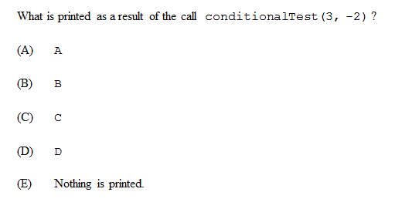

Slide 3
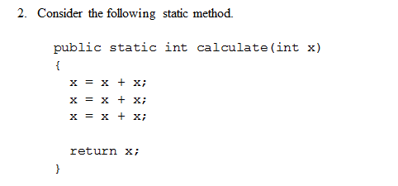
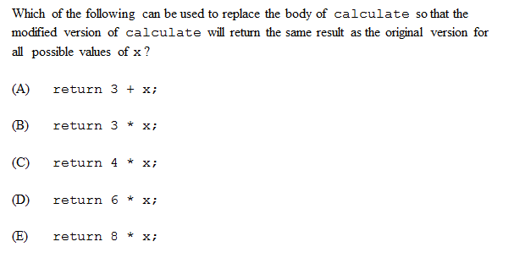

Slide 4
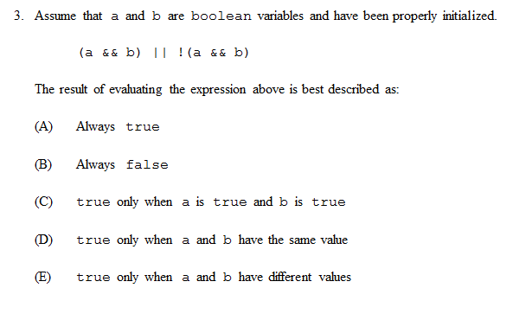

Slide 5
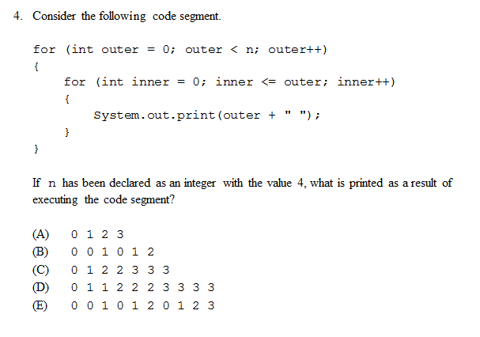

Slide 6
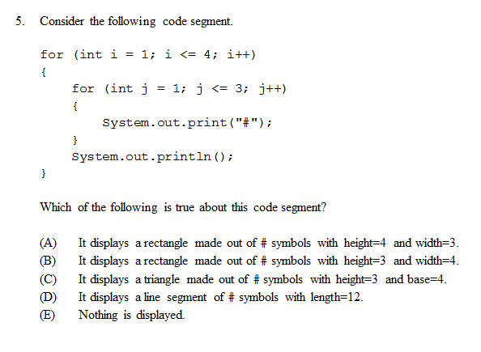

Slide 7
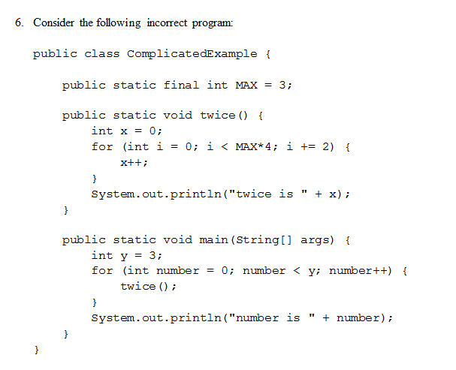
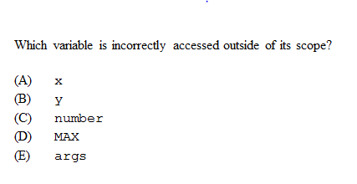

Slide 8
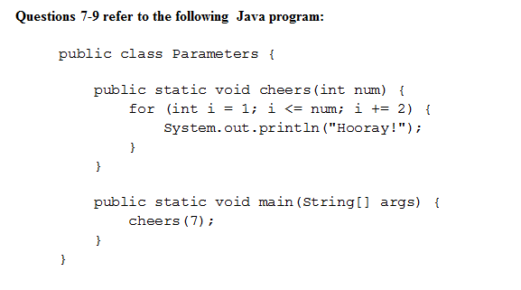
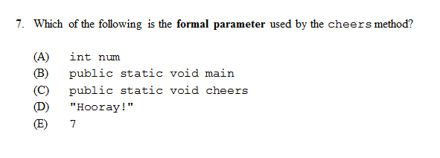
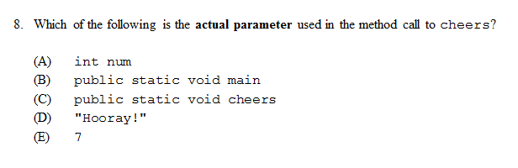
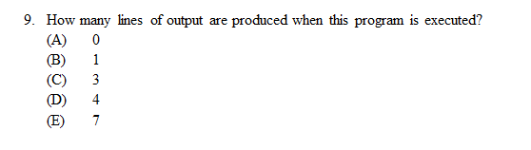

Slide 9
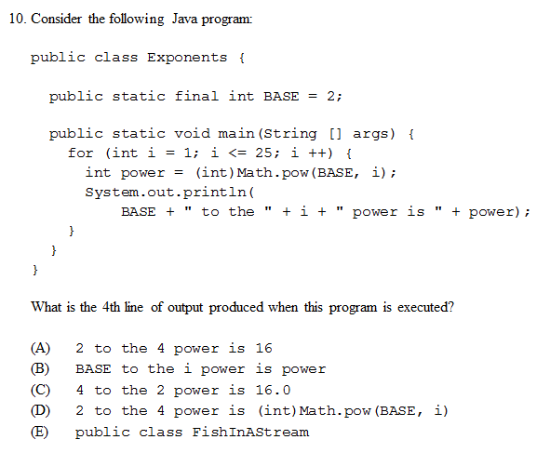

Slide 10
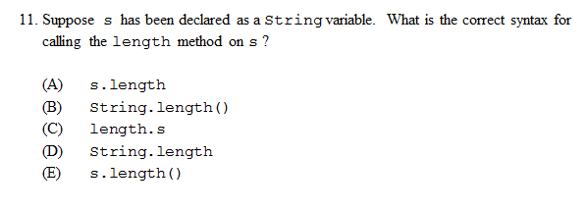

Slide 11
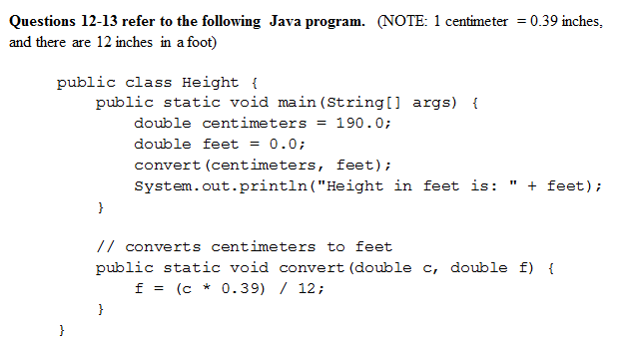
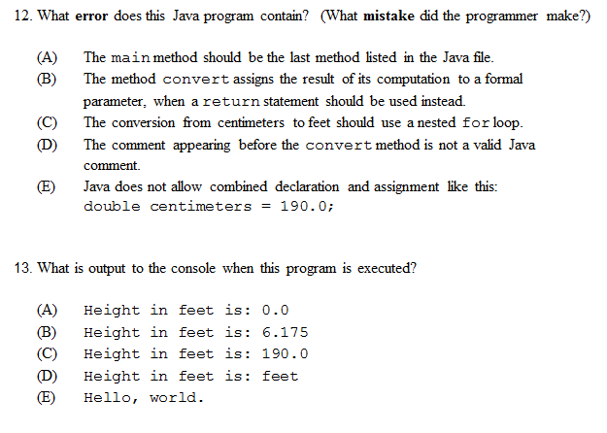

Slide 12
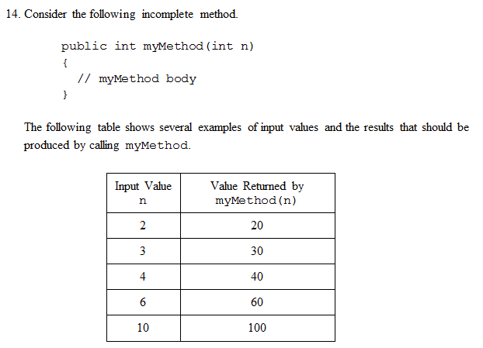
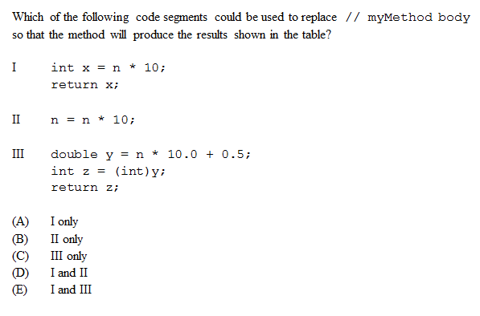

Slide 13
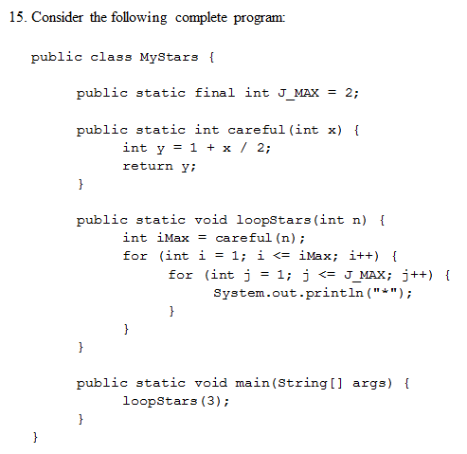
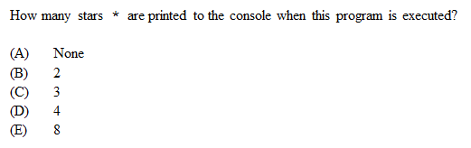

Slide 14
Homework
Read HW 6.1
Correct any incorrect test answers by re-answering on a separate sheet of paper:
To get back credit, you must justify your new answers.
Staple new answer sheet to the old test and return it tomorrow.

Slide 15
Array Basics
[ 4.01 ] [ Today’s Date ] [ Instructor Name ]

Slide 16
Students Will Be Able To…
Understand the arrays basics:
Define Array
Create an Array
Initialize an Array
Iterate over the elements in an Array

Slide 17

How would you write the following program:
How many days’ temperatures? 7
Day 1’s high temp: 45
Day 2’s high temp: 44
Day 3’s high temp: 39
Day 4’s high temp: 48
Day 5’s high temp: 37
Day 6’s high temp: 46
Day 7’s high temp: 53
Average temp = 44.6
4 days were above average.

Slide 18
How would you write the following program:
How many days’ temperatures? 7
Day 1’s high temp: 45
Day 2’s high temp: 44
Day 3’s high temp: 39
Day 4’s high temp: 48
Day 5’s high temp: 37
Day 6’s high temp: 46
Day 7’s high temp: 53
Average temp = 44.6
4 days were above average.

Slide 19
public static void main(String[] args) {
Scanner scanner = new Scanner(System.in);
System.out.println(“How many days?”);
int days = scanner.nextInt();
double sum = 0.0;
for (int day = 0; day < days; day++) {
sum += scanner.nextDouble();
}
System.out.println(“Average: “ + sum/days);
}
How do you calculate the days with temperatures above average?

Slide 20
public static void main(String[] args) {
Scanner scanner = new Scanner(System.in);
System.out.println(“How many days?”);
int days = scanner.nextInt();
double sum = 0.0;
for (int day = 0; day < days; day++) {
sum += scanner.nextDouble();
}
System.out.println(“Average: “ + sum/days);
}
How do you calculate the days with temperatures above average?
You would need to store the temperature for every day.

Slide 21
Define Array
Array: An array is a fixed-size list of items of a particular type.
It is zero-indexed, just like a String.
It is an object, not a primitive type, so it has to be constructed before it can be used:
int[] myArray = new int[20];
When a new array is constructed, all of the items are automatically initialized to zero (or a zero-equivalent value, like false or null).

Slide 22
Array Declaration
<element type>[ ] <name> = new <element type>[<length>]
Example: int[] myArray = new int[10];
In addition to using new, you can provide an array initializer much like initializing a String to a string literal:
index | 0 | 1 | 2 | 3 | 4 | 5 | 6 | 7 | 8 | 9
value | 0 | 0 | 0 | 0 | 0 | 0 | 0 | 0 | 0 | 0
String myString = "hello!";
int[] myArray = {8, 42, 13, 77, 8, 16};
// myArray has 6 elements, just like doing:
// new int[6]
Notes:
Ask the class what they notice about the last number and compare it to the length. Should also touch on how length can be any integer expression.

Slide 23
Array Usage
Since an array has a fixed size, Java provides a way to find out its length. This is almost the same as getting the length of a String, with one important difference.
What’s the difference?
You don’t put parentheses after the “.length” when getting the length of an array:
String myString = "hello!";
int[] myArray = {8, 42, 13, 77, 8, 16};
int strLen = myString.length(); // evaluates to 6
int arrLen = myArray.length; // evaluates to 6

Slide 24
Array Usage
To reference a specific element in the array, provide the index (remember it’s zero-based!) in square brackets after the array variable.
This is like charAt() on a String:
String myString = "hello!";
int[] myArray = {8, 42, 13, 77, 8, 16};
char c = myString.charAt(1); // c gets 'e'
int n = myArray[1]; // n gets 42

Slide 25
Arrays of other types
double[] results = new double [5];
results[2] = 3.4;
results[4] = -0.5;
boolean[] tests = new boolean[6];
tests[3] = true;
index | 0 | 1 | 2 | 3 | 4
value | 0.0 | 0.0 | 3.4 | 0.0 | -0.5
index | 0 | 1 | 2 | 3 | 4 | 5
value | false | false | false | true | false | false

Slide 26
Out-of-bounds
Legal indexes: between 0 and the array's length - 1.
Example:
int[] data = new int[10];
System.out.println(data[0]);
System.out.println(data[9]);
System.out.println(data[-1]);
System.out.println(data[10]);
index | 0 | 1 | 2 | 3 | 4 | 5 | 6 | 7 | 8 | 9
value | 0 | 0 | 0 | 0 | 0 | 0 | 0 | 0 | 0 | 0
Okay
Okay
Exception!
Exception!

Slide 27
Arrays and Scanners
Scanner input = new Scanner(System.in);
int[] numbers = new int[8];
for (int i = 0; i < 8; i++) {
numbers[i] = input.nextInt();
}

Slide 28
Arrays and for loops (Typical pattern)
int[] numbers = new int[8];
for (int i = 0; i < 8; i++) {
numbers[i] = i * 2;
}
For loop starts at 0
Condition is “< array length”

Slide 29
Arrays and for loops
int[] numbers = new int[8];
for (int i = 0; i < 8; i++) {
numbers[i] = i * 2;
}
What does the array look like after this?

Slide 30
Arrays and for loops
int[] numbers = new int[8];
for (int i = 0; i < 8; i++) {
numbers[i] = i * 2;
}
index | 0 | 1 | 2 | 3 | 4 | 5 | 6 | 7
value | 0 | 2 | 4 | 6 | 8 | 10 | 12 | 14

Slide 31
 Activity
Self-check 4
Write code that stores all odd numbers between -6 and 38 into an array using a loop. Make the array’s size exactly large enough to store the numbers.
Then, try generalizing your code so that it will work for any minimum and maximum values not just -6 and 38.
Assignment
Read chapter 7, section 7.1
Finish classroom activity.
Self-check: 4, 5, 6 (page 505)

Slide 32
Worksheet

Slide 33
For-Each Loop & Arrays Class
[ 4.02 ] [ Today’s Date ] [ Instructor Name ]

Slide 34
Traditional loop:
int [] fallTemperatures = {55, 50, 59, 69, 48, 30, 48};
for(int i = 0; i < fallTemperature.length; i++) {
if(fallTemperatures[i] > 32) {
above++;
}
}

Slide 35
For-each Loop
If you want to access each element in the array without changing the values (to summarize or count them), you can access them using a for-each loop

Slide 36
Easy access with a for-each loop:
for (<type> <name> :<array>) {
<statement>;
<statement>;
…
}
<type> is the type of data in the array
<name> is the temp name of the items in the array
<array> Name of the array you are looping through

Slide 37
For-each loop
So to check for how many temperatures were above 32 degrees a For-each loop would be a good fit
int [] fallTemperatures = {55, 50, 59, 69, 48, 30, 48};
for(int i : fallTemperatures){
if(i > 32){
above++;
}
}

Slide 38
Worksheet

Slide 39
Homework
Read HW 7.2 up to “Reversing an Array”
Complete self-check questions #12 – 14

Slide 40
Printing, Searching, and Testing for Equality
[ 4.03 ] [ Today’s Date ] [ Instructor Name ]

Slide 41
Mini Lessons:
Printing an Array
Searching & Replacing
Testing for Equality
Reversing an Array
String Transversal Algorithms

Slide 42
Homework
Day 1: Complete self-check questions #15 – 17 and exercise 3
Day 2: Read HW 7.3 and complete self-check questions #19 – 21

Slide 43
Reference Semantics
[ 4.04 ] [ Today’s Date ] [ Instructor Name ]

Slide 44
Worksheet

Slide 45
Review

Slide 46
Homework
Read BJP 7.3--7.4 (up to “Command-Line Arguments”)
Complete chapter 7 exercises #9 and 10

Slide 47
Shifting Values & Arrays of Objects
[ 4.05 ] [ Today’s Date ] [ Instructor Name ]

Slide 48
metroCardRides
int[] metroCardRides = {5, 4, 3, 2, 1};
How would you reorganize this array (within your code) so that the 5 moves from the first element to the last element?
*You cannot reinitialize the array.

Slide 49
Store the first value in the array.
int first = metroCardRides[0];
How do we assign each value in the array to the next value in the array?
Hint: Try using a for loop to cycle through!

Slide 50
Cycle through the array:
for (int j = 0; j < metroCardRides.length – 1; j++){
metroCardRides[j] = metroCardRides[j + 1];
}
What additional code do we need to add to finish our array?
Hint: Our array is currently:
4 | 3 | 2 | 1 | 1

Slide 51
Good job:
public static void firstToLast(int[] metroCardRides) {
int first = metroCardRides[0];
for (int j = 0; j < metroCardRides.length – 1; j++) {
metroCardRides[j] = metroCardRides[j + 1];
}
metroCardRides[metroCardRides.length – 1] = first;
}
How can we do the opposite? Move the last element to the front?

Slide 52
The opposite:
public static void firstToLastRight(int [] metroCardRides){
int last = metroCardRides[metroCardRides.length – 1];
for (int j = metroCardRides.length – 1; j >= 1; j++){
metroCardRides[j] = metroCardRides[j – 1];
}
metroCardRides[0] = last;
}

Slide 53
Practice

Slide 54
Self-Check
a. Self-Check 7.22: arrayCodeTracing3
b. Self-Check 7.23: arrayCodeTracing4
c. Self-Check 7.25: arrayMystery2
d. Self-Check 7.26: arrayMystery3
e. Self-Check 7.30: isPalindrome

Slide 55
Homework
Read HW 7.4 “Nested Arrays” and HW 7.5 “Rectangle Two-Dimensional Arrays
Complete chapter 7 self-check questions #27 – 29 and exercise #4.

Slide 56
Nested Loop Algorithms & Rectangular Arrays
[ 4.06 ] [ Today’s Date ] [ Instructor Name ]

Slide 57
Two-dimensional arrays:
turkey | ham | roast beef | turkey
turkey | ham | roast beef | turkey
ham | turkey | roast beef | chicken
roast beef | roast beef | turkey | roast beef

Slide 58
Write a loop that outputs all inversions:
4 | 3 | 2 | 1
E.g. (4, 3), (4, 2), (4, 1), (3, 2) …
Notes:
An inversion is any instance of a smaller number following a larger number in the array.

Slide 59
Final code:
for(int i = 0; i < data.length - 1; i++) {
for(int j = i + 1; j < data.length; j++){
if (data [i] > data[j]) {
System.out.println(“(“ + data[i] +”, “ + data[j] + “)”);
}
}
}

Slide 60
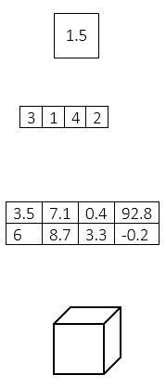
Array data representation:
double
double[]
double[][]
double[][][]

Slide 61
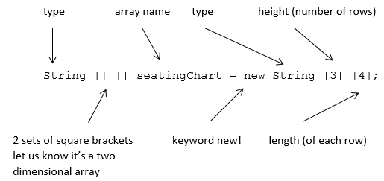
Constructing a double array:

Slide 62
Initializing double arrays:
// Simple 4x4 multiplication table
int[][] multiplicationTable = {
{1,2,3,4},
{2,4,6,8},
{3,6,9,12},
{4,8,12,16}
};

Slide 63
Passing double arrays as parameters:
public static void print(double[][] grid) {
for(int i = 0; i < grid.length; i++) {
for(int j = 0; j < grid[i].length; j++) {
System.out.print(grid[i][j] + “ “);
}
System.out.println();
}
}

Slide 64
Homework
Read HW 10.1 up to “Adding to and Removing from an ArrayList.”
Complete chapter 10 self-check problems #1 – 6.

Slide 65
ArrayList
[ 4.07 ] [ Today’s Date ] [ Instructor Name ]

Slide 66
Instantiating (Creating) an ArrayList
ArrayList<String> spongebob;
// spongebob reference can point to an ArrayList of type String
spongebob = new ArrayList<String>();
// create an ArrayList of type String
// point spongebob to this new (empty) ArrayList.
// Or do everything in a single step . . .
ArrayList<String> spongebob = new ArrayList<String>();
Notes:
The following line of code constructs an empty list:
ArrayList<String> spongebob = new ArrayList<String>();
spongebob.size() returns 0

Slide 67
The ArrayList
spongebob.add(“Patrick Star”);
spongebob.add(“Squidward Tentacles”);
spongebob.add(“Mr. Krabs”);
spongebob.add(“Pikachu”);
spongebob.add(“Sandy Cheeks”);
Predict the output for
System.out.println("Cast of Spongebob includes: " + spongebob);

Slide 68
ArrayList methods: remove() and add()
spongebob.remove(3); //Pikachu is stored at index 3
spongebob.add(3, “Plankton”);

Slide 69
ArrayList methods: set() and clear()
System.out.println(spongebob.get(3));
System.out.println(spongebob.size());
spongebob.set(3, “Plankton”);
spongebob.clear();

Slide 70
Iterating Through an ArrayList
int sum = 0;
for(int = 0; i < spongebob.size(); i++;) {
String s = spongebob.get(i);
sum += s.length();
}
System.out.println("Total of lengths = " + sum);

Slide 71
Grudgeball

Slide 72
Homework
Outline Chapter 7 and 10.1 “ArrayList”
Complete 10.1 self-check questions #3 – 6 and exercise 3

Slide 73
Finding and Fixing Errors
[ 4.08 ] [ Today’s Date ] [ Instructor Name ]
Notes:
This unit is mostly done either on practice it or the board. Feel free to edit this slide deck as you see fit!

Slide 74
Today’s plan:
Error check and resubmit all chapter 7 and 10.1 assignments.
Study for the test by:
Reviewing all of the blue, self-check pages at the end of Chapter 7 and 10.1.
Re-reading sections as needed to complete the self-check problems.
Submit 5 questions for review in class tomorrow.

Slide 75
Homework Regrade/Resubmit
You all have the opportunity to get full credit on your homework grades by correcting them now, in class.
Use your error checking algorithm, and if you need help just ask!
Make sure to check for issues with scope!

Slide 76
Homework
Begin reviewing chapters 7 and 10.1 for the Unit Test.
Submit 5 questions you have for review tomorrow.

Slide 77
Magpie Chatbot
[ 4.09 ] [ Today’s Date ] [ Instructor Name ]
Notes:
This unit is mostly done either on practice it or the board. Feel free to edit this slide deck as you see fit!

Slide 78
Empty Powerpoint
If necessary, make your own slides to cover topic students struggle with during the Magpie Chatbot lab.

Slide 79
Review
[ 4.10 ] [ Today’s Date ] [ Instructor Name ]

Slide 80
What’s on the test?

Slide 81
Worksheet

Slide 82
Review Topics
Make a list of review topics that you feel you need to go over for the test tomorrow.
For each topic, follow up by reviewing the textbook, self-check problems, and the appropriate Practice problems.

Slide 83
Good Luck!

