Slide 1

RANSAC:
An Historical Perspective
Bob Bolles & Marty Fischler
bolles@ai.sri.com, fischler@ai.sri.com
SRI International
333 Ravenswood Avenue
Menlo Park, CA 94025
(650) 859-4620, (650) 859-5106
June 18, 2006

Slide 2
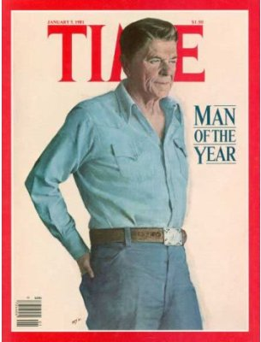
“Thank you” to the Organizers for Setting up this Meeting
We’re surprised that it’s been 25 years!
Marty sends his regards.
We’ve continued to be users of RANSAC, but we haven’t kept up with the evolution of all the enhanced versions – we’ll learn a lot from this workshop.
January 15, 1981

Slide 3
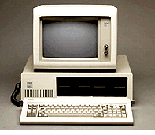
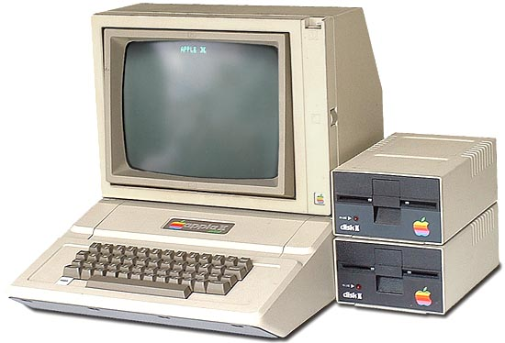
Outline
What was Computer Vision in 1981?
Didn’t the photogrammetry community already know everything about external camera calibration?
What were the goals of the original paper?
Which result had the most impact?
Why did we publish it in the Communications of the ACM?
Why did RANSAC catch on?
What do we use RANSAC for now?
How do we know if we’ve computed the correct result?
IBM announced the first PC in 1981
Model 5150, 4.77MHz, Intel 8088
Apple II-Plus, 1981
Max of 64 Kbytes of RAM

Slide 4
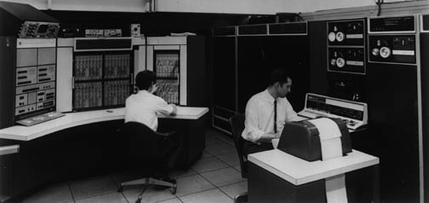
Computer Vision in 1981
(One of several loosely related communities)
Photogrammetry
  Well-established, many textbooks
  Film-based analysis
  Many practical applications
Neural Networks
  Inspired by the fact that the human brain can learn to recognize patterns
  Treated all inputs (speech, vision, auditory, … ) the same
  Excitement in the 60s, but ramped down after Minsky’s book
Industrial Robotics
  Machine Intelligence Corp, founded 1978 (based largely on binary blob analysis)
  SRI Industrial Affiliates Program
Medical Imaging
  Image enhancement of tomographic images
  Visions of automatic classification
Missile Guidance
  Correlation-based matching for estimating altitude for terrain-following missiles
1978 Timeshared
PDP-10
KS-10, 20MHz

Slide 5
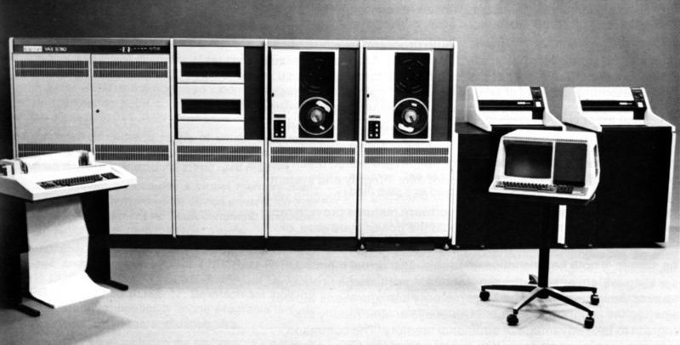
Computer Vision in 1981
Focused on classification and recognition
Science-based (hadn’t gotten to applications yet)
Initially focused largely on artificial worlds (e.g., “the blocks world”)
Images were hard to come by – you got a few and analyzed them to death
In the 70s, Marr’s biologically-inspired work was quite influential
3-D range sensing was almost viewed as cheating
Research was driven by sponsor’s interests
  DARPA, initially wide open; late 70’s started focusing on geometric recovery
  NSF, initially wide open; late 70’s started sponsoring industrial robotics
1978 Timeshared
VAX-11/780
Speed defined
to be 1 MIPS

Slide 6
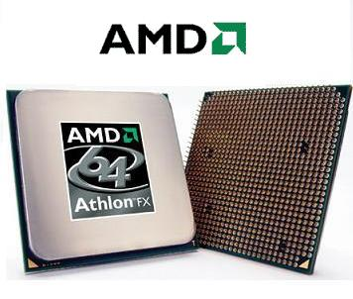
Computer Vision in 1981 (continued)
Often there was no evaluation of results except that they looked good (e.g., detected edges and segmentations) -- Marty says that it was a “beauty contest,” not a scientific evaluation
This lack of evaluation was especially misleading because people viewing the results would often “link things up” and make interpretations without realizing it, making the results look better than they were
Techniques would make “ugly mistakes” that people would never make
Hough transform techniques had been used for “voting” and then fitting, but they focused on line fitting until Ballard generalized them
2006 Dual Core
AMD Athlon FX-60
22,150 MIPS

Slide 7
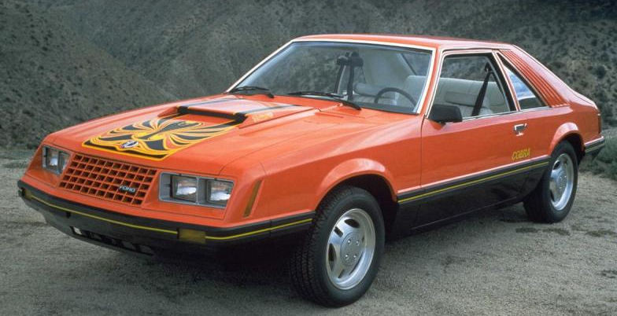
Statistics – Another Community
By 1981 statisticians had been interested in “robust statistics” for handling outliers (gross errors) for awhile
Peter J. Huber had published papers on robust techniques in statistical journals in the 60s and 70s, which we didn’t know about until later
He published a book “Robust Statistics” in 1981, about the same time as our paper
1981 Mustang

Slide 8
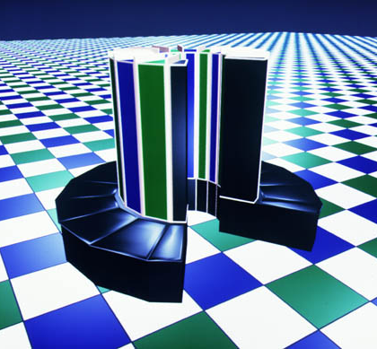
Didn’t the Photogrammetry Community Already
Know Everything about External Camera Calibration?
No, because they approached the problem differently. They were geared toward interactive selection of ground control point (GCP) matches so they didn’t have to deal with many gross errors.
As a result, they focused on “averaging” techniques to produce the best estimate from a moderate number of GCPs.
In addition, they weren’t concerned about the minimum number of correspondences required or the ambiguities associated with 3 to 5 correspondences because they typically worked with a few more than the minimum (eg, 10).
Cray-2, 1985, 1.6 gigaflops

Slide 9
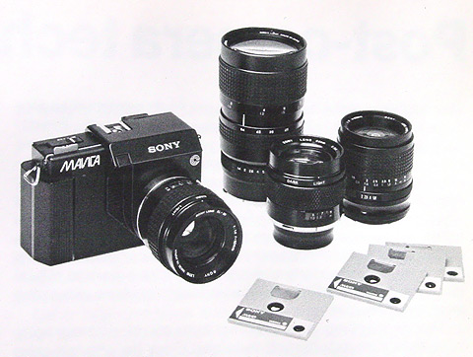
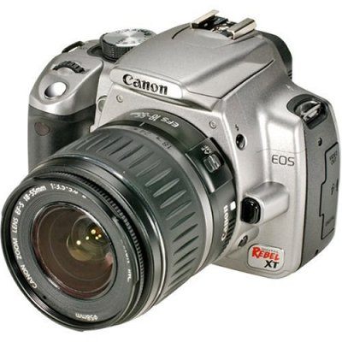
Goals of the RANSAC Paper
Develop techniques to interpret images in terms of a predefined set of models
Develop techniques to deal with gross errors in model fitting
Develop effective techniques for computing the external camera parameters from an image, assuming the internal parameters are known (ie, solve the “Location Determination Problem” (LDP))
Answer some unknown questions about the geometry of the Perspective-n-Point (PnP) problem
1981, Sony introduced the first “still video camera” -- Mavica with a 570x490 CCD
2005, Canon Rebel XT with
3456x2304 CMOS sensor

Slide 10
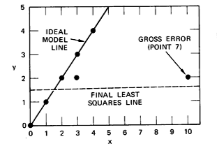
Approach
We approached the fitting problem in the opposite way from most previous techniques. Instead of averaging all the measurements and then trying to throw out bad ones, we used the smallest number of measurements to compute a model’s unknown parameters and then evaluated the instantiated model by counting the number of consistent samples.

Slide 11
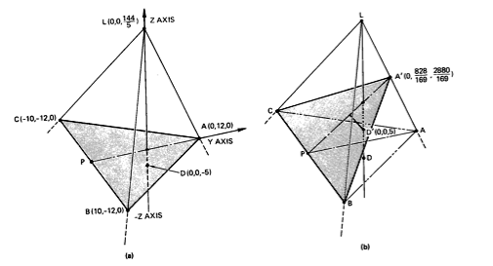
Results
Existence proofs of multiple solutions for the P3P, P4P, and P5P problems
An algorithm for solving the general P3P
An algorithm for solving the planar P4P problem
An automatic gross-error filtering technique (RANSAC)

Slide 12

Which contribution has had the most impact?
Opened in 1981

Slide 13
Which contribution has had the most impact?
The “Google” Metric
Search terms Matches
RANSAC “Computer Vision” 44,800
RANSAC (“PnP” or P3P or 187
P4P or P5P or P6P)
Opened in 1981

Slide 14
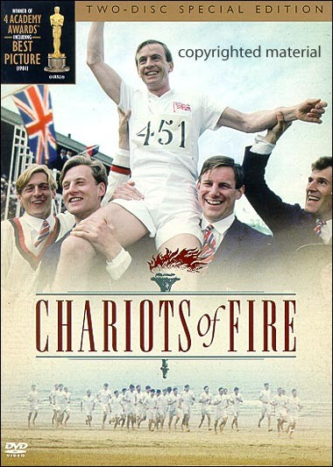
Why Publish in the
Communications of the ACM?
We wanted to reach a broad audience because we thought they’d be interested in the model fitting problem
Journals at the time
  CG&IP - Computer Graphics and Image Processing
  IEEE PAMI started in 1979
  Communications of the ACM
IJCV didn’t start for another 6 years
Conferences at the time
  PRIP
  IJCPR (now ICPR)
  DARPA IU Workshops
CVPR started in 1983
Opened in 1981

Slide 15
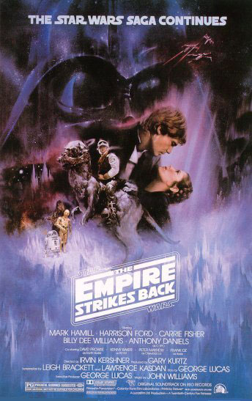
Why Did RANSAC Catch On?
It’s easy to understand and it’s effective
It helps solve a common problem (i.e., filter out gross errors introduced by automatic techniques)
The number of trials to “guarantee” a high level of success (e.g., 99.99 probability) is surprisingly small
The dramatic increase in computation speed made it possible to do a large number of trials (100s or 1000s)
The algorithm can stop as soon as a good match is computed (unlike Hough techniques that typically compute a large number of examples and then identify matches)
Opened in 1980

Slide 16
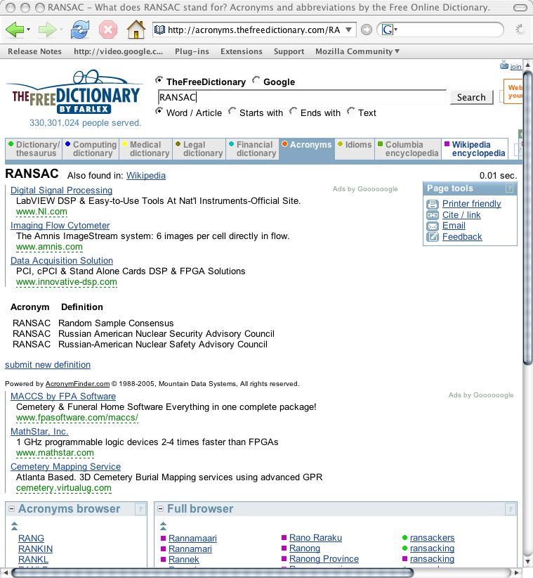
The Acronym “RANSAC”

Slide 17

The Acronym “RANSAC” (continued)

Slide 18
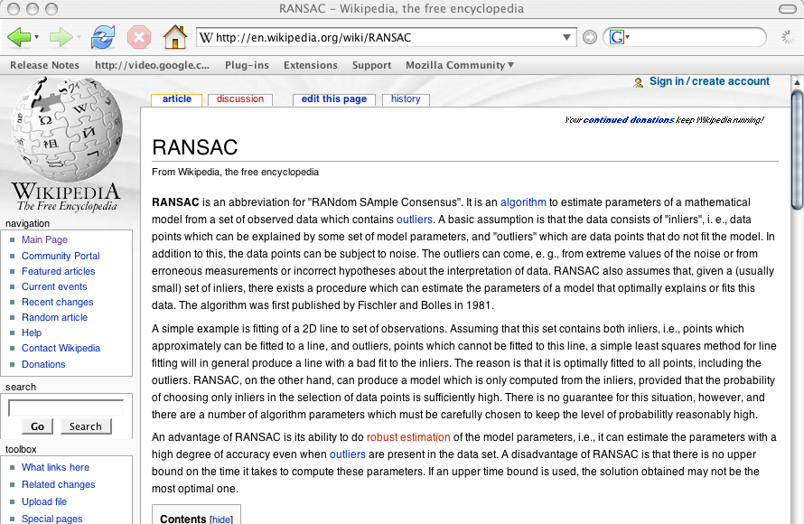
RANSAC in Wikipedia

Slide 19
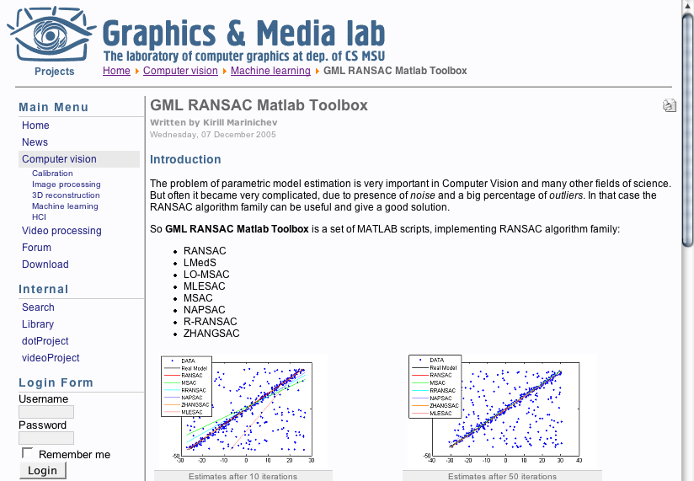
RANSAC Toolbox in Matlab

Slide 20
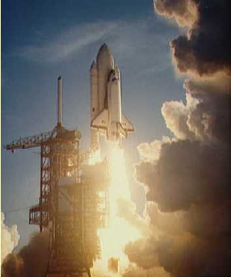
Some of Our Current Applications of RANSAC
DARPA’s Learning Applied to Ground Robots (LAGR) Program
  Estimating the local ground plane in front of the robot, given stereo disparities
  Estimating the 6-dof motion of the robot over time, given stereo sequences
Detection of moving objects from a moving vehicle
  Identifying scene regions that aren’t moving consistently with a rigid world
1981, First Space Shuttle launch

Slide 21
LAGR Videos
(Handheld Video)
After learning the appearance of a bark path at SRI, the robot used it to follow a similar path through a eucalyptus grove at Stanford

Slide 22
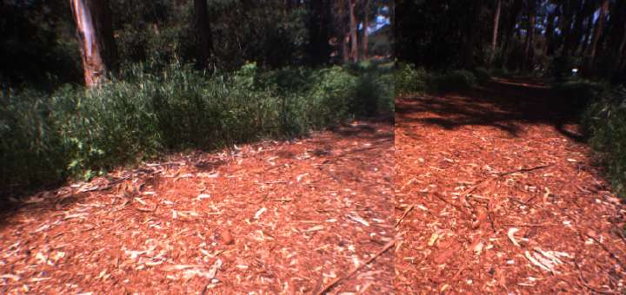
LAGR Videos
(Camera View)
A simple montage created from the two left cameras from the two Bumblebee stereo sensors on the robot

Slide 23
LAGR Videos
(Intepretated View)
RANSAC is used to fit a ground plane to stereo measurements

Slide 24
LAGR Videos
(Map Construction)
RANSAC is used to estimate the 6-dof incremental robot motion over time

Slide 25
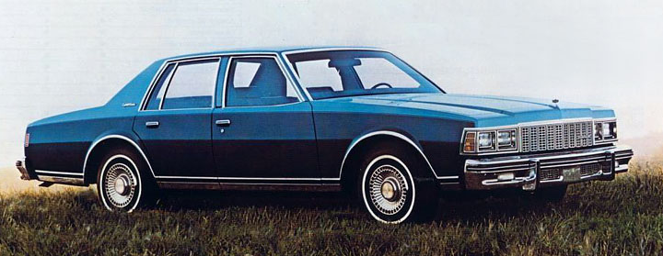
How can we tell when we have the correct answer?
This is still an open question!
The computer vision community has made significant advances, but there are still no “requirements” to describe
  When an algorithm is applicable and when it isn’t
  What results to expect
  Confidence measures associated with the results
All this (and more) is necessary for someone to use an algorithm within a practical system
1981 Chevrolet Caprice

Slide 26
Thank you again
I’m look forward to a good meeting

Slide 27
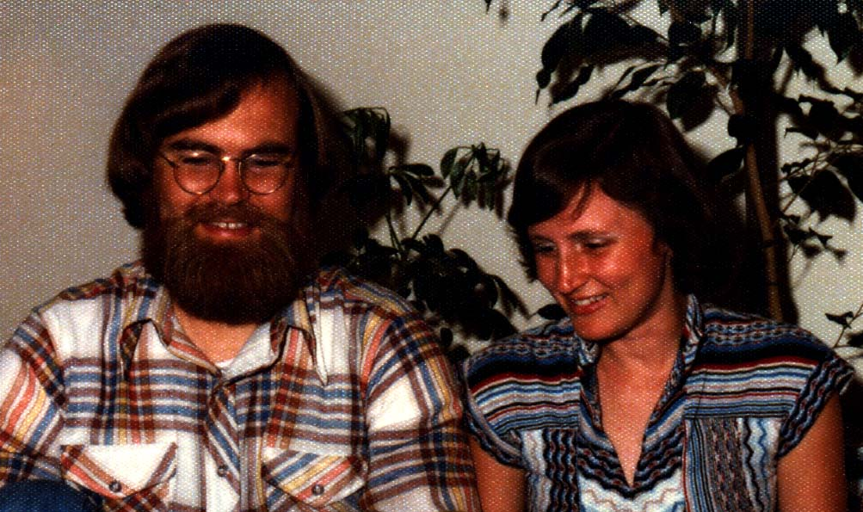
Thank you again
I’m look forward to a good meeting
Bob & Jomary Bolles, 1978

