Slide 1
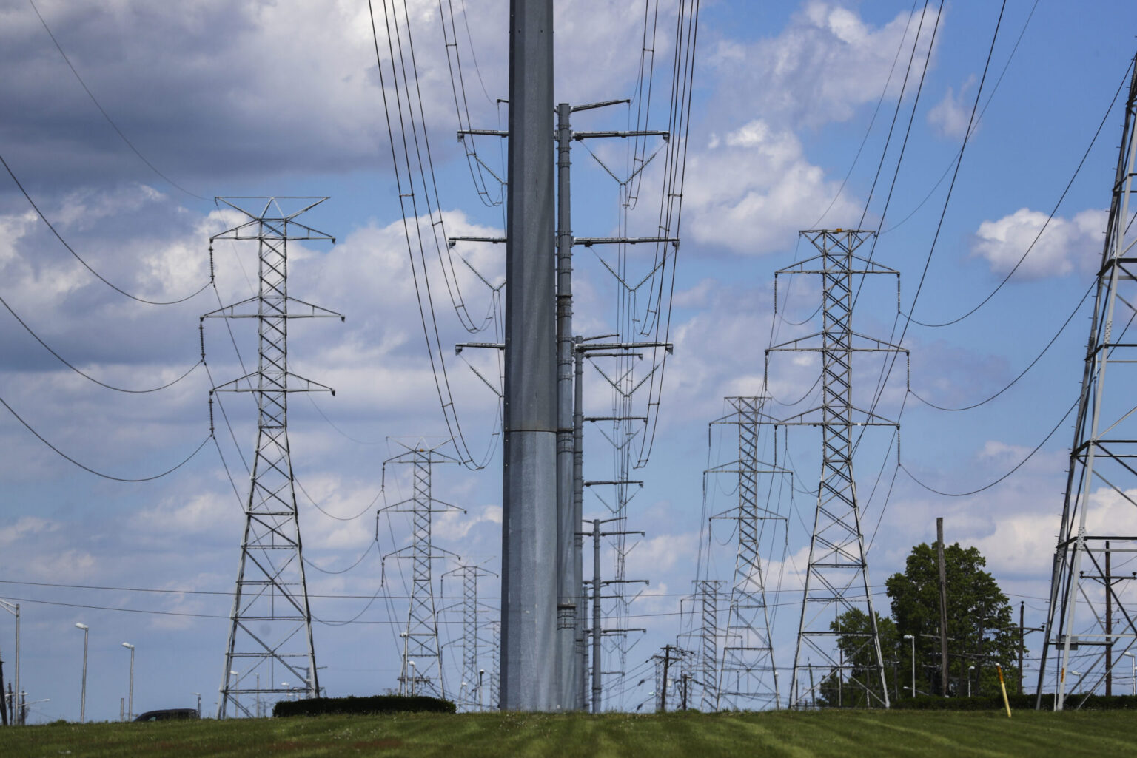

The Problem:
• Power systems are difficult to visualize
• Software and equations alone aren't enough
• Existing hardware is expensive or inaccessible
Notes:
Every year, thousands of engineering students learn power systems through equations and software—but never truly see how the grid behaves. Existing teaching tools are either too abstract, too expensive, or inaccessible.

Slide 2
Notes:
We introduce to you, Mpower Boards.

Slide 3
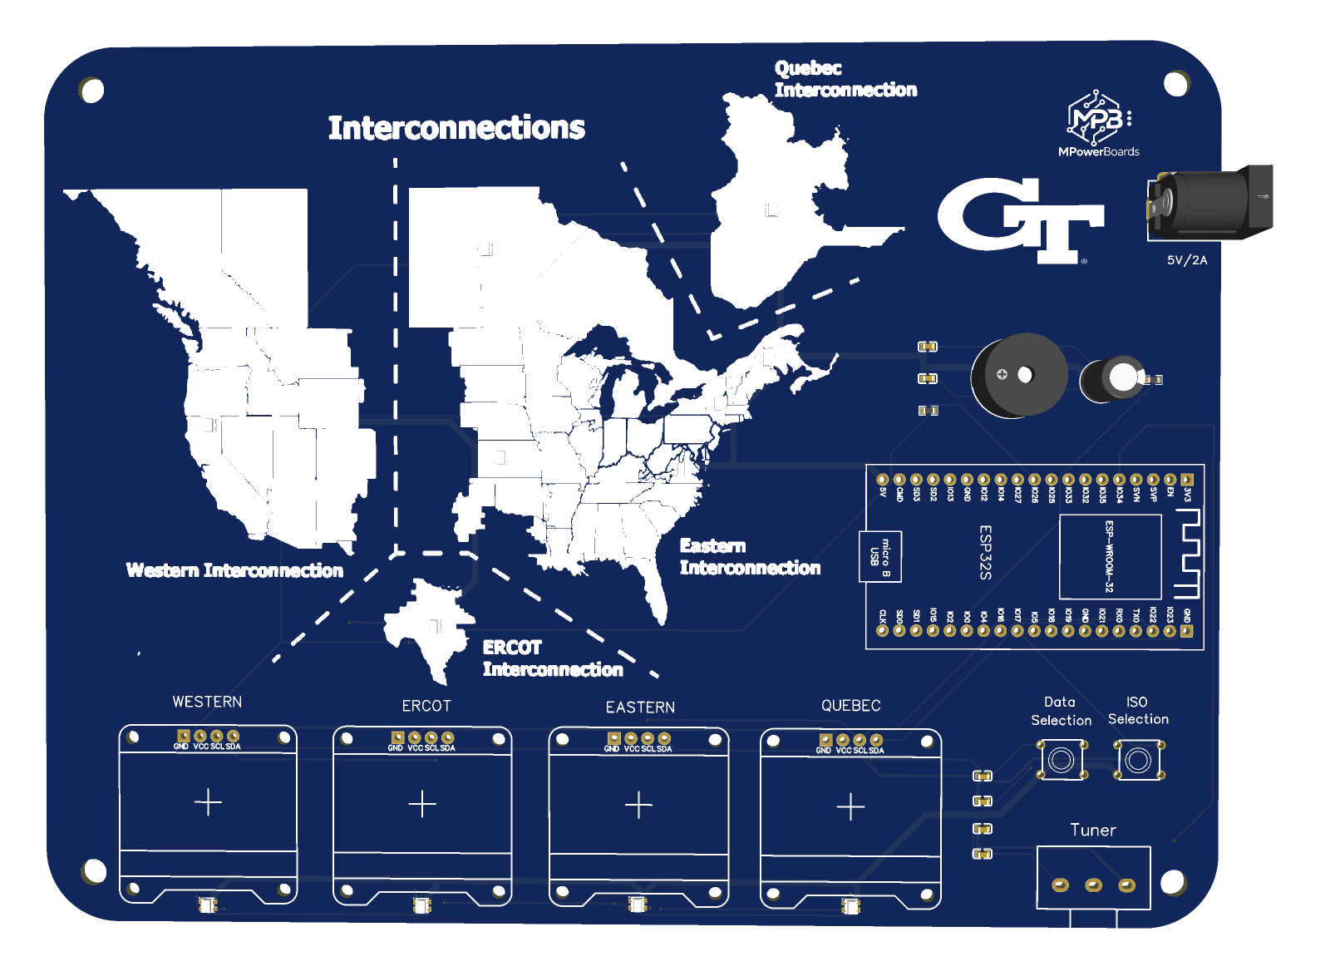
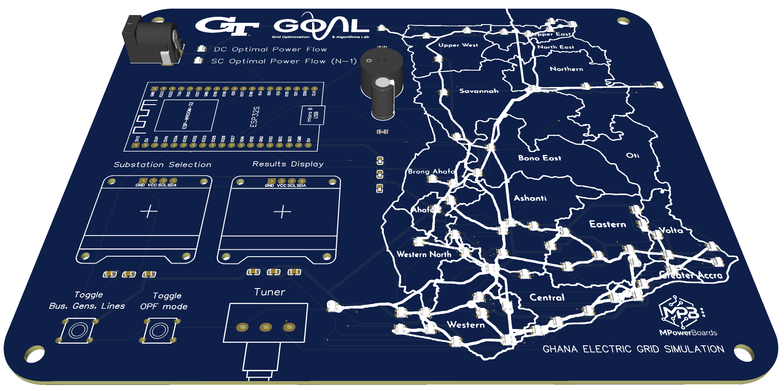
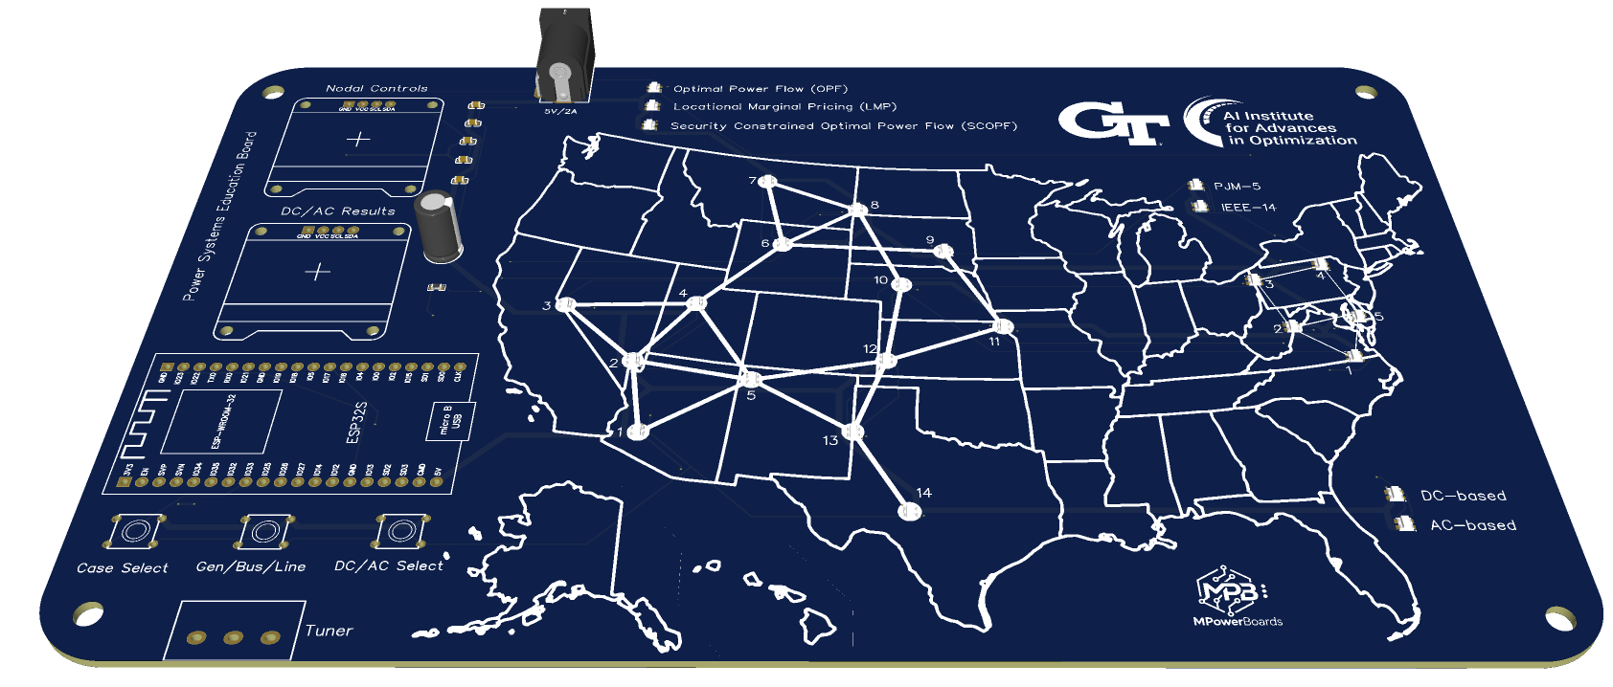
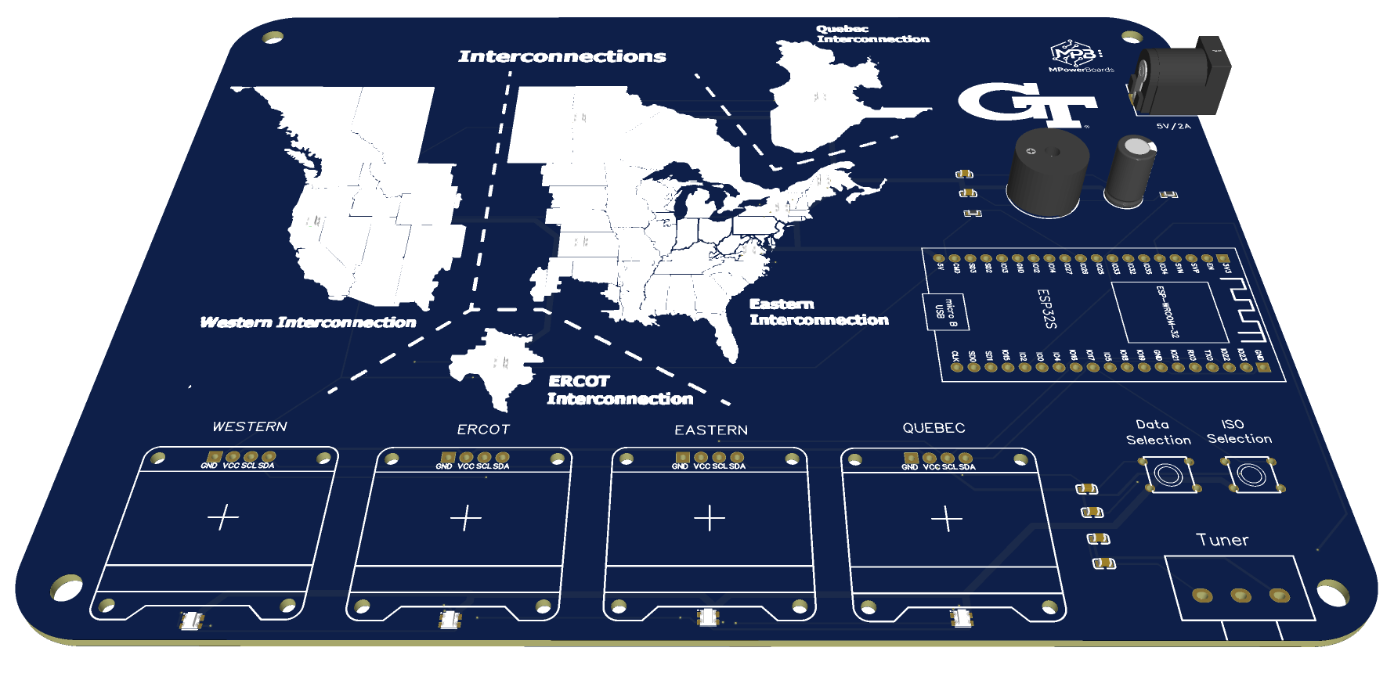
MPowerBoards:
Interactive Physical Visualization
• Real-time simulations
• Embedded electronics
• Modeling complex power systems concepts
Notes:
MPowerBoards transforms real power-grid simulations into interactive physical boards using LEDs, embedded electronics, and real-time visualization. Students don't just calculate power flow—they watch it happen.
We've developed three flagship products for classrooms, education, and research, allowing users to explore everything from basic concepts to real grid operations.

Slide 4
• Working prototypes
• Classroom demos
• Georgia Tech faculty
• AI for Power Systems Institute
15+ Undergraduate/ Highschool students
10+ K-12 Teachers and Students
8+ Professors and PhD researchers
Notes:
We've already built working prototypes and are collaborating with Georgia Tech faculty and the AI Institute to bring MPowerBoards into classrooms and outreach.

Slide 5




Michael A. Boateng
Audrey H. Vu
Ifeanyi D. Sorokwu
Betelihem K. Ashebo
MPowerBoards
Revolutionizing Power Grid Education and Research
Notes:
Our mission is to make power systems education visual, interactive, and accessible. We'd love to connect with educators, researchers, and investors.

