Slide 1



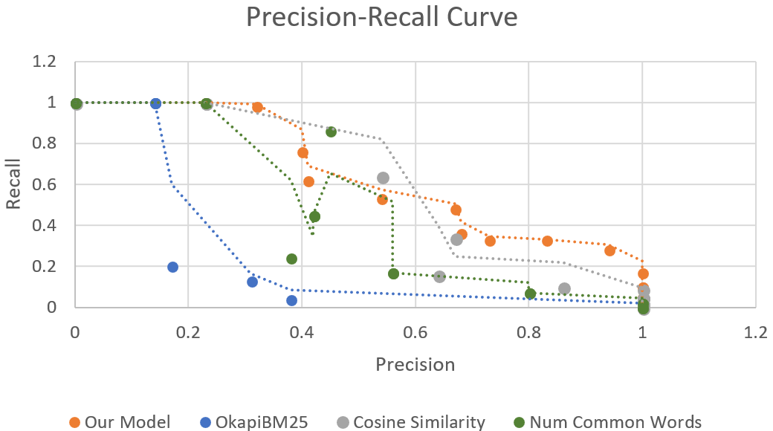


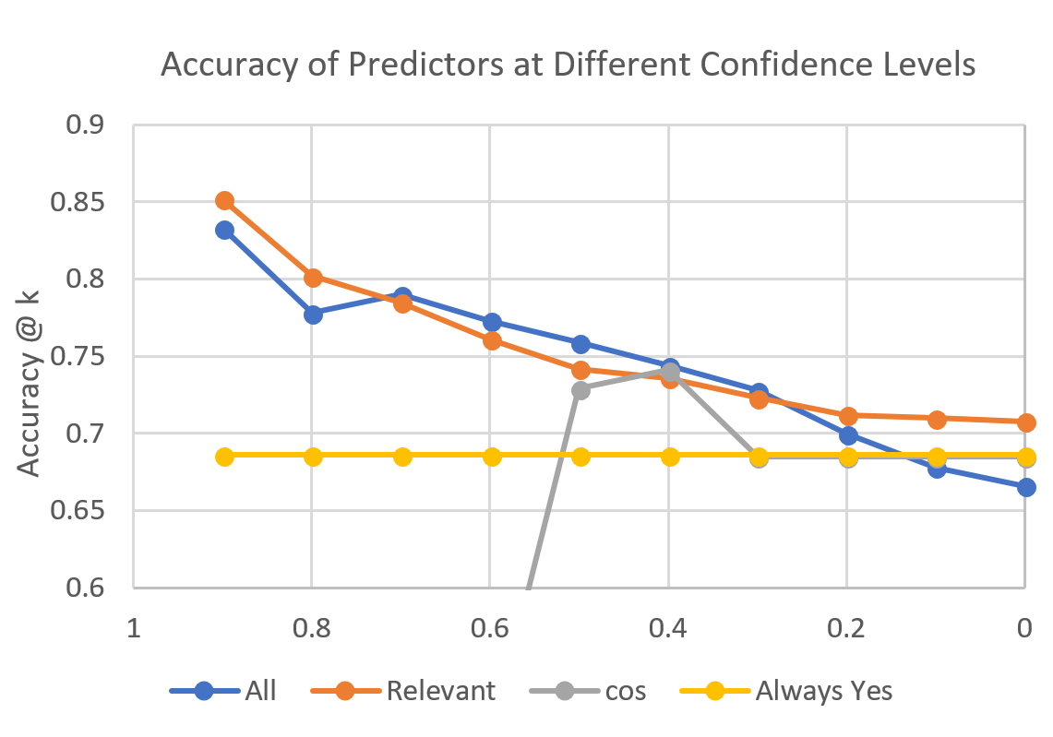
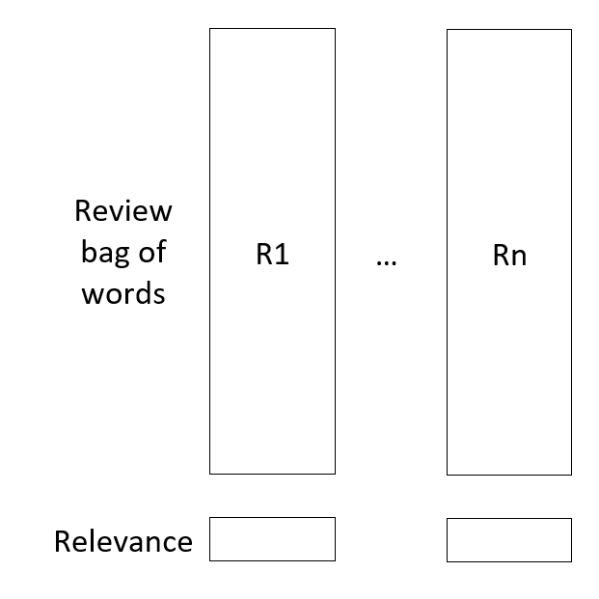


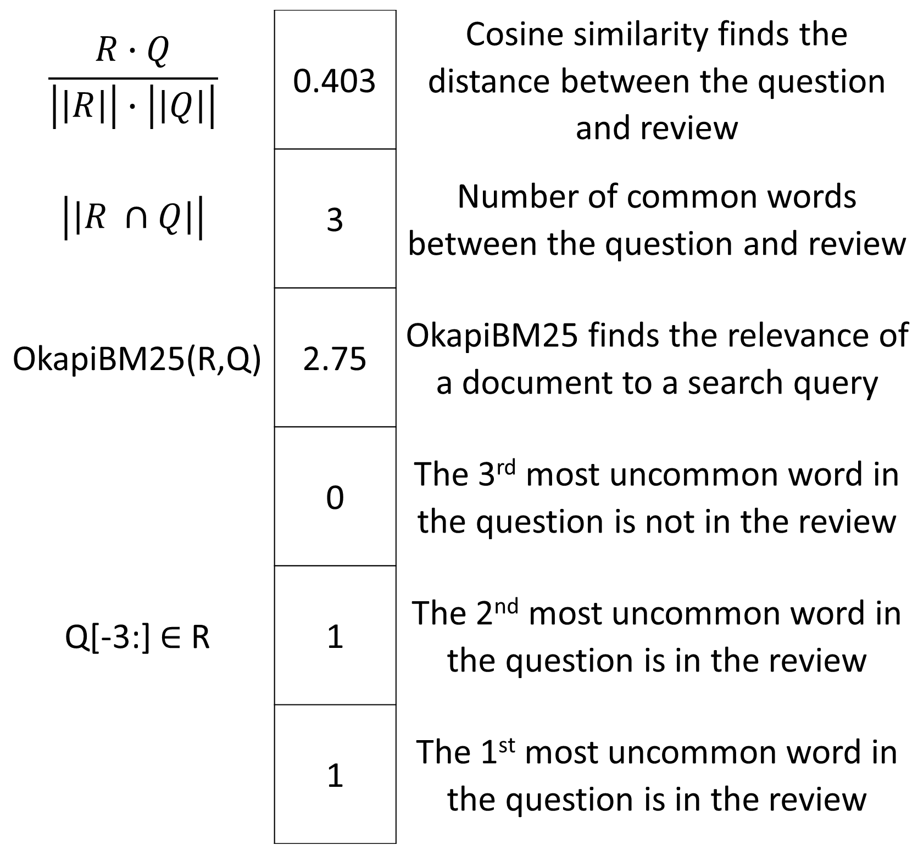
Answering Amazon product queries using relevant reviews
Mikhail Boulgakov, Silvia Jinrong Gong, Lavanya Satyan
Advised by Prof. Julian McAuley
Results - Relevance
Motivation & Background
We tested 4 different relevance functions: our model, OkapiBM25 (used by search engines), cosine similarity between question and review, and number of common words between question and review. The respective areas under the curve (a measure of a relevance function’s performance) are .64, .20, .59, and .45. Our model outperformed all the other functions for this task.
We tested 4 different models: our model trained on all reviews, our model trained only on relevant reviews, cosine similarity between review and question, and always predicting yes. For the 50% most confident predictions, we got 74.5% accuracy, which is better than Moqa performed for this category (73%).
Our model is currently only able to answer binary questions. In the future, we also want to be able to answer open ended questions.
It is important for sellers on Amazon to quickly answer users’ questions. Our goal is to automatically answer a user’s yes/no question about an Amazon product using the information contained in the reviews for that product.
The longer a user waits to get a question answered, the less likely they are to purchase a particular product.
We aim to build upon Moqa¹, a framework that predicts the answer to a question using a bilinear regression between a bag of words representation of a review and a question.
Model
Y/N Question
Relevance Predicts how relevant a review is to a question using logistic regression.
Y/N Question
Voting Predicts the answer to the Yes / No question using logistic regression.
Review 1
Review & Relevance Score 1
Y/N
…
…
Review n
Review & Relevance Score n
Asks a question
Example Question: Does the router attachment work with the DeWalt Dw625 router?
Purchased
Relevance
Voting
Break question and review into words and discard the stop words
Example:
Example relevant review: I used this attachment with the DeWalt Dw625 and it was great.
R = { used, attachment, dewalt, dw625, great }
Q = { router, attachment, work, dewalt, dw625 }
Featurization:
Take a dictionary of the 200 most common words, ignore stop words, and check how many times each word is contained in the question and in the reviews
Example:
Bag of words representation
does – stopword
the – stopword
router – word
attachment word
work – word
with – stopword
the – stopword
DeWalt – not common
Dw625 – not common
router – second time
Weighted average of reviews
We use the relevance scores as the weights
Cosine similarity between question (Q) and
weighted reviews (R_{W})
Not Purchased
∙ ∙ ∙
item | 0
work | 1
broom | 0
∙ ∙ ∙
clean | 0
attachment | 1
play | 0
∙ ∙ ∙
red | 0
router | 2
never | 0
∙ ∙ ∙
Results - Voting
Problem Statement
$$\frac{R∙Q}{\left|\left|R\right|\right|∙\left|\left|Q\right|\right|}$$ | 0.403 | Cosine similarity finds the distance between the question and review
$$\left|\left|R ∩Q\right|\right|$$ | 3 | Number of common words between the question and review
OkapiBM25(R,Q) | 2.75 | OkapiBM25 finds the relevance of a document to a search query
Q[-3:] ∈ R | 0 | The 3rd most uncommon word in the question is not in the review
 | 1 | The 2nd most uncommon word in the question is in the review
 | 1 | The 1st most uncommon word in the question is in the review
We aim to improve the accuracy of the predicted answers by improving the measurement of the relevance of a review to the question. Improving the relevance helps us to determine which reviews contain the most useful and correct information, which allows us to answer the question as accurately as possible.
Our data came from the Tools and Home Improvement category of Amazon².
To train relevance, we created a dataset of 760 hand labelled question-review pairs labelled as relevant or irrelevant.
To train voting, we used a dataset with 8280 questions labeled with yes/no answers and 148540 reviews.
Q
Dataset/Input
R_{w}
Output:
I used this router attachment with the DeWalt Dw625 and it was great | 0.93
I like how portable it is | 0.1
The router does indeed work | 0.46
Future Work
Julian McAuley and Alex Yang. 2016. Addressing Complex and Subjective Product-Related Queries with Customer Reviews.
http://jmcauley.ucsd.edu/data/amazon/qa/
$$\frac{RW∙Q}{ |\left|RW∙Q\right||}$$
We would like to acknowledge Aditi Mavalankar, Mengting Wan, and Prof. Alvarado. This material is based upon work supported by the National Science Foundation under Grant No. CNS-1339335.

