Slide 1
Predicting Recipe Site Traffic
Jun Cai
Feb. 20, 2024

Slide 2
Introduction
Data validation & Exploratory Analysis
Metric for the Business to Monitor
Model Development & Evaluation
Conclusion

Slide 3
Introduction
Tasty Bytes helps people to find recipes to use up the limited supplies they had at home. Currently, the Product team choose their favourite recipes from a selection and display them on the home page. They have noticed that traffic to the rest of the website goes up by as much as 40% if a popular recipe is picked. More traffic means more subscriptions, so this is important to the company. But they don’t know how to decide if a recipe will be popular.
The Product team seek the Data Science team's help to choose which recipes should be displayed on the home page. They would like to know if it is possible to:
predict which recipes will lead to high traffic;
correctly predict high traffic recipes 80% of the time.

Slide 4

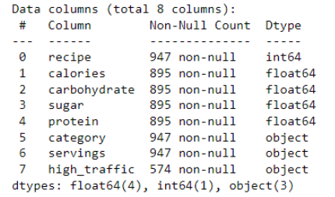
Data validation & Exploratory Analysis
Dataset
Dataframe info
recipe_site_traffic_
2212.csv
dataframe

Slide 5
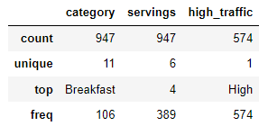
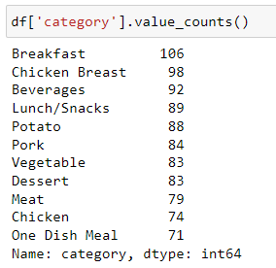
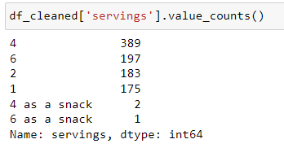
Further EDA shows:
invalid
invalid

Slide 6
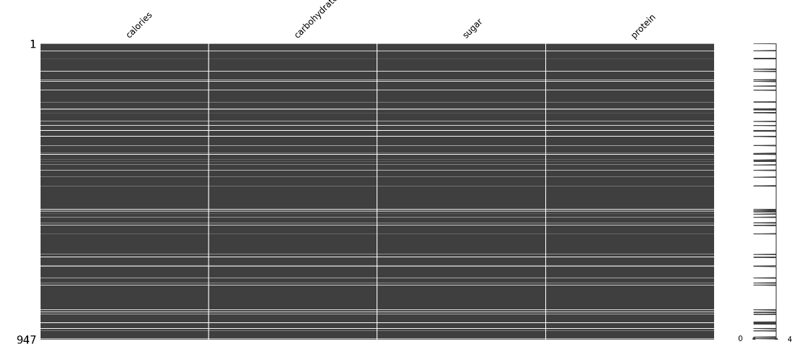

Missing data visualization:
Missing values against high_traffic values
So, we cannot simply drop the records with missing values.

Slide 7
Data Cleaning
"category" column: "Chicken Breast" is merged with the category value "Chicken"
"servings" column: Two non-numeric values, "4 as a snack" and "6 as a snack", are converted to numeric values by removing the string " as a snack“.
For each numeric column, the category-wise medians are used to impute the missing values for each category, respectively.
The missing values in the target column "high_traffic" are imputed as "Low".

Slide 8
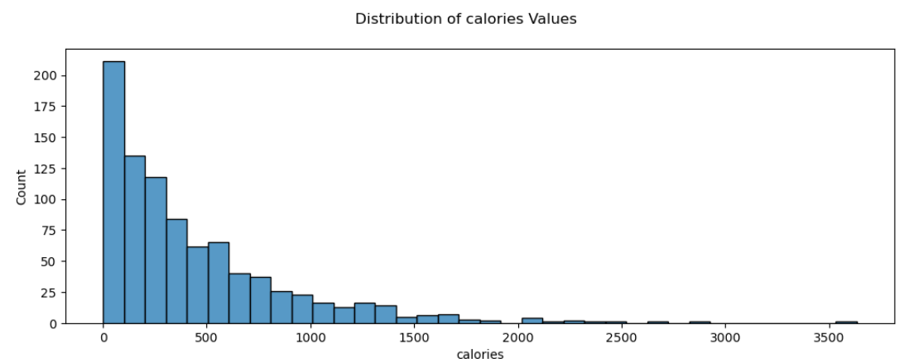
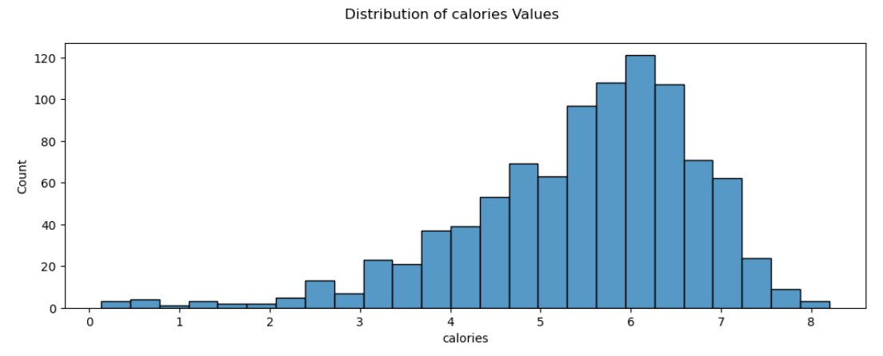
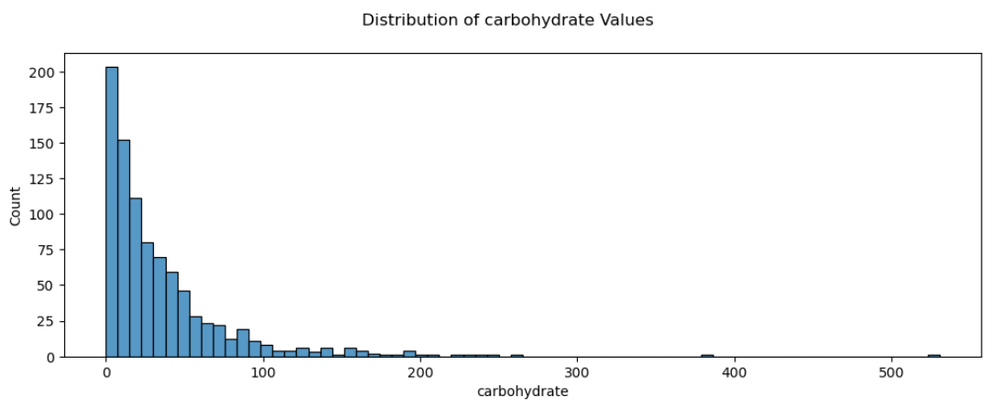
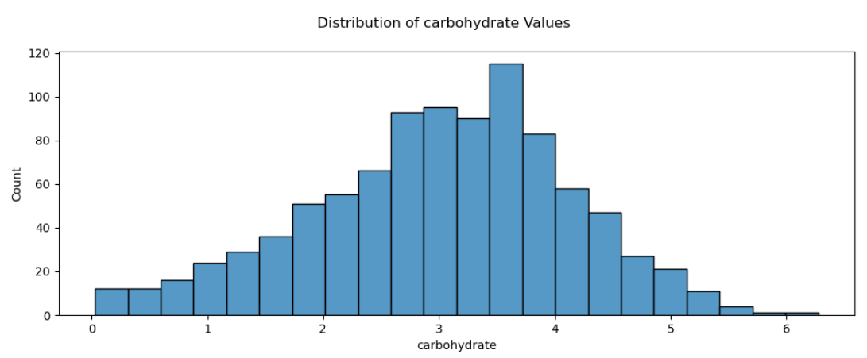
The distribution of the numeric columns are all right skewed". Log-transformation is used to handle the skewness. For example,
log-transformation

Slide 9
Metric for the Business to Monitor
Business Objective
"predict which recipes will be popular 80% of the time and minimize the chance of showing unpopular recipes"
Predictive Modeling:
Classification
Metric to Monitor:
Precision
original value
60.61%

Slide 10
Model Development & Evaluation
Model Development
K-Nearest Neighbors
DecisionTree
Logistic
Regression
Ensemble Model
SVM
ExtraTrees
One-hot dummy features are created for "category" and "servings" columns.
Grid search is performed to find best hyperparameters for each model.

Slide 11
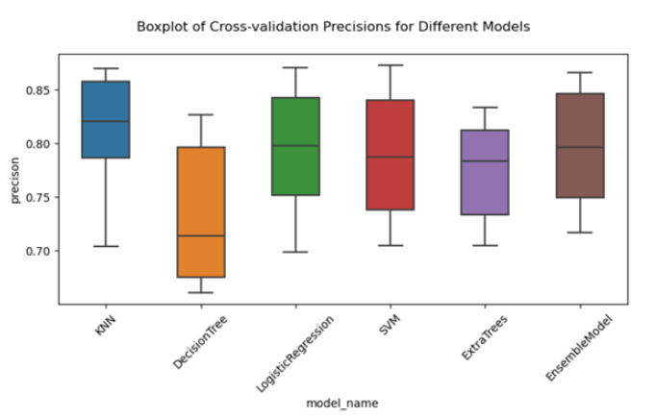
Model Quality Evaluation
10-fold cross validation has been performed to evaluate the model precision.
Comparisons show that using log-transformed numeric features does not introduce model quality improvement.

Slide 12
Conclusion
By using K-Nearest Neighbors modeling mechanism and without using the log-transformed numeric features, we can build up a classification model with the best cross-validation results of precision:
the median of cross validation precisions is greater than 0.82.
the 95% confidence interval of classification precision is [0.71, 0.87].
We can conclude that it is promising for us to build models to correctly predict which recipes will be popular at about 80% of the time.
We recommend the Product team to deploy such a classification model to make the prediction.

