Slide 1

Pre-service Teachers
Pre-service Administrators
Teachers
Principals and Assistant Principals
Central Office Staff
Superintendents
View instruments, tools and validation reports on
the NC Professional Teaching Standards website: www.ncptsc.org

Slide 2
Alignment
NC State Board of Education Mission and Goals
Standards for Superintendents, Principals/Assistant Principals, and Teachers
Evaluation Instruments for Superintendents, Instructional Central Office Staff, Principals/Assistant Principals, and Teachers
21st Century Skills and Knowledge
Research from the Teacher Working Conditions Survey
Professional Development Plans
School Improvement Planning Template
Standards for Mentoring Programs and Mentors
Program Approval for Schools of Education: Teacher, MSA, and EDD
Online software for recording of Principal and Teacher Evaluation Instrument

Slide 3
NC Standards for Teachers
Standard 1: Teachers demonstrate leadership
Standard 2: Teachers establish a respectful environment for a diverse population of students
Standard 3: Teachers know the content they teach
Standard 4: Teachers facilitate learning for their students
Standard 5: Teachers reflect on their practice

Slide 4
NC Professional Educator Evaluation Systems
Their purpose is to support and promote effective leadership, quality teaching, and student learning.
The design is a growth model to improve instruction and enhance professional practice.
The evaluation instruments are based on the Framework for 21st Century Learning and the Standards.

Slide 5
NC Professional Educator Evaluation Systems (continued)
They are flexible enough to be fair to teachers and school executives of varying levels of experience and in school settings.
The rubrics are formative in nature based on a rating scale from “developing” through “distinguished.”
Multiple data sources, artifacts, and evidence are used in assessing educator performance.
They provide the basis for performance goals and professional development activities.

Slide 6
Components of the
Teacher Evaluation Process
The Process
Training
Orientation
Self-assessment
Pre-observation Conference
Observation
Post-observation Conference
Summary Evaluation and Scoring the Form
Professional Development Plans
Notes:
Time: 9:35 – 9:45 am (10 minutes for Slides 20-21)
The 21st Century Framework and the State Board Mission of producing students ready for the 21st Century have led to the creation of standards for the Superintendent, Principals and Teachers. McREL has been hired to develop new evaluation systems for each of these roles.
The new evaluation process has several primary goals. First and foremost this tool should serve as a guide for the principal to reflect upon and improve their effectiveness as a school leader. Because the evaluation tool is aligned to the Executive Standards, principals have an opportunity to clearly assess their performance in several areas that are the real activities in which they engage as principals.
The new evaluation tool is also designed to help a district focus on their primary goals and objectives during the Principal evaluation process. This will allow districts to ensure that Principal’s across the district are all working toward a common vision.

Slide 7
The teacher evaluation process will:
Serve as a measurement of performance for individual teachers.
Serve as a guide for teachers as they reflect upon and improve their effectiveness.
Serve as the basis for instructional improvement.
Focus the goals and objectives of schools and districts as they support, monitor, and evaluate their teachers.

Slide 8
Guide professional development programs.
Serve as tool in developing coaching and mentoring programs.
Enhance the implementation of the approved curriculum.
Inform higher education programs as they develop the content requirements for higher education programs.

Slide 9
Standard 1: Teachers Demonstrate Leadership a. Teachers lead in their classrooms. Teachers demonstrate leadership by taking responsibility for the progress of all students to ensure that they graduate from high school, are globally competitive for work and postsecondary education, and are prepared for life in the 21st century. Teachers communicate this vision to their students. Using a variety of data sources, they organize, plan and set goals that meet the needs of the individual student and the class. Teachers use various types of assessment data during the school year to evaluate student progress and to make adjustments to the teaching and learning process. They establish a safe, orderly environment, and create a culture that empowers students to collaborate and become lifelong learners.
Developing | Proficient | Accomplished | Distinguished | Not Demonstrated (Comment Required)
Understands how they contribute to students graduating from high school. Uses data to understand the skills and abilities of students | . . . and Takes responsibility for the progress of students to ensure that they graduate from high school. Provides evidence of data-driven instruction throughout all classroom activities Establishes a safe and orderly classroom. | . . . and Communicates to students the vision of being prepared for life in the 21st century. Evaluates student progress using a variety of assessment data. Creates a classroom culture that empowers students to collaborate. | . . . and Encourages students to take responsibility for their own learning. Uses classroom assessment data to inform program planning. Empowers and encourages students to create and maintain a safe and supportive school and community environment.
Notes:
Detailed rubric, tied to standards describing effective practice

Slide 10
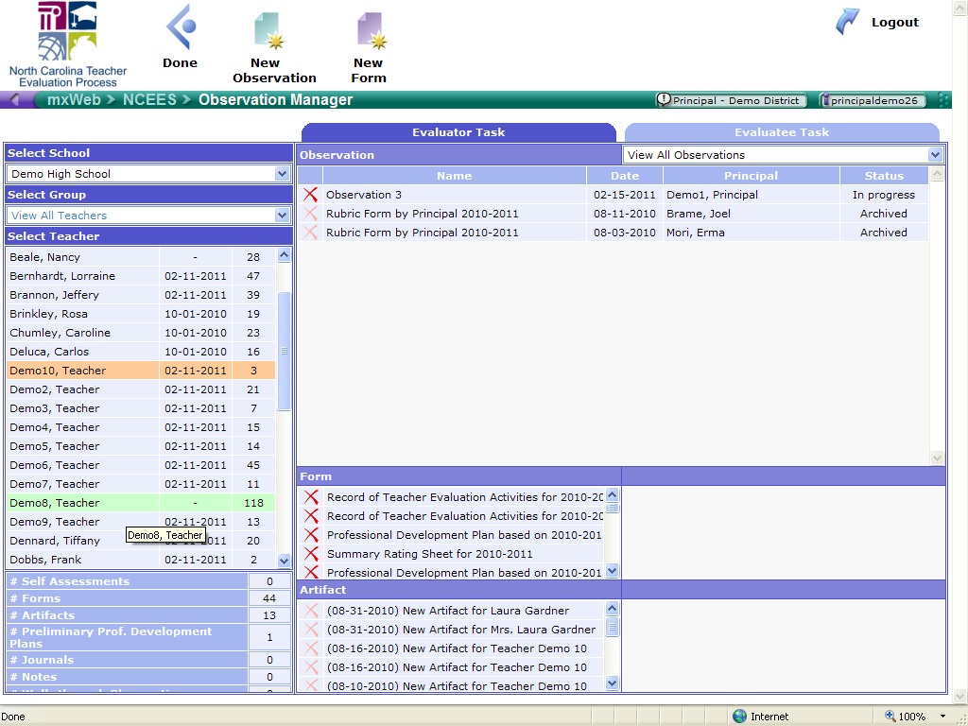

Slide 11
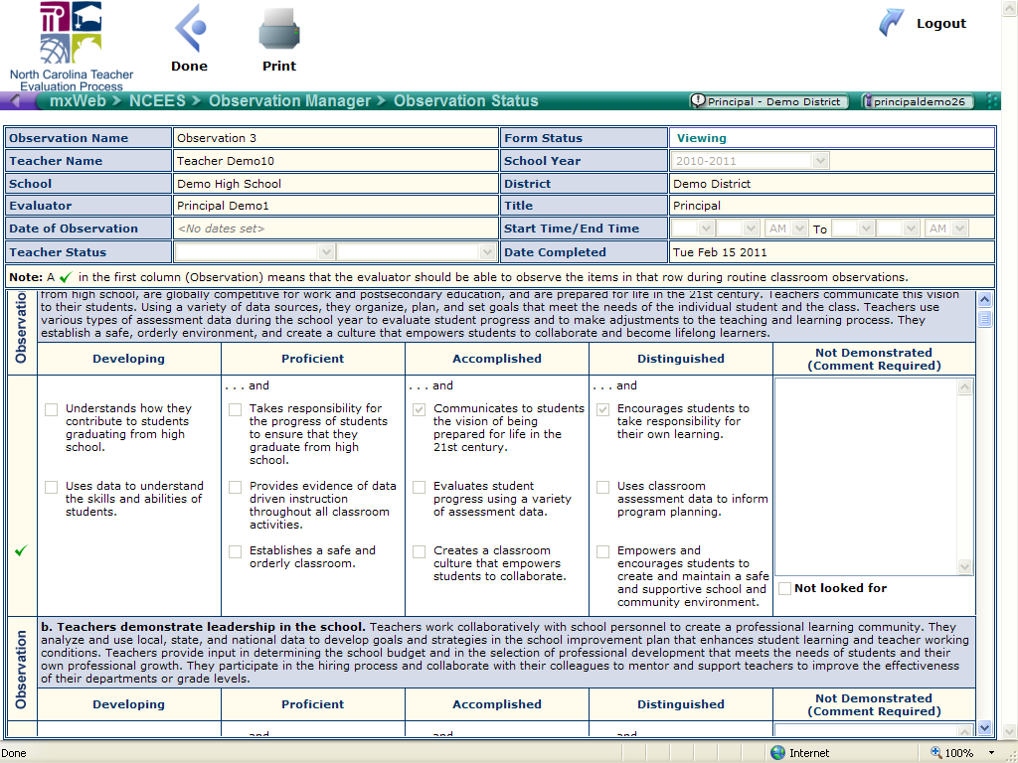

Slide 12
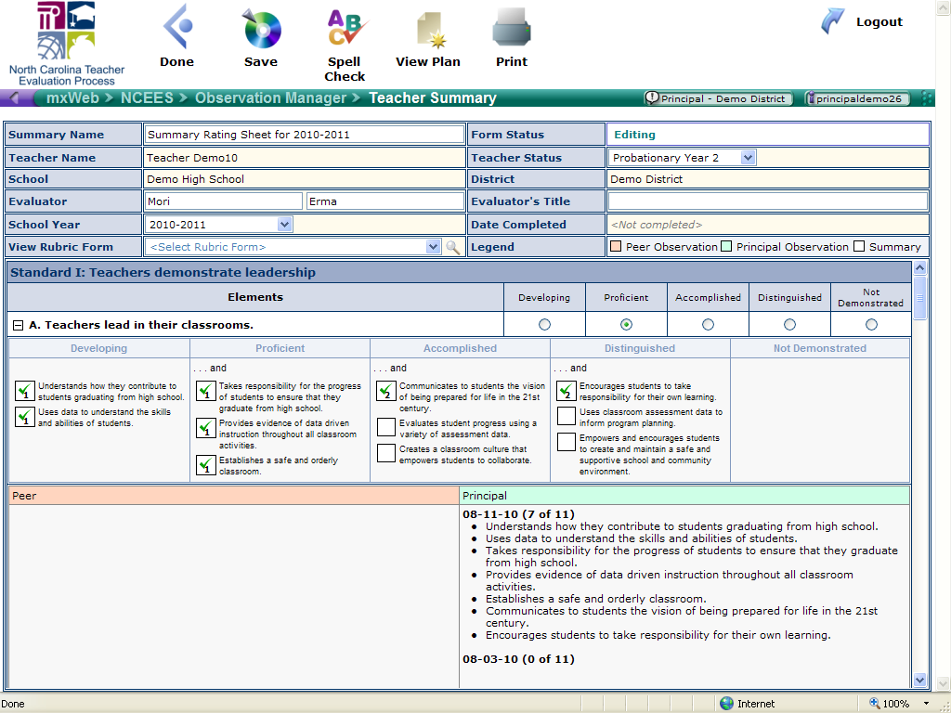

Slide 13
