Slide 1

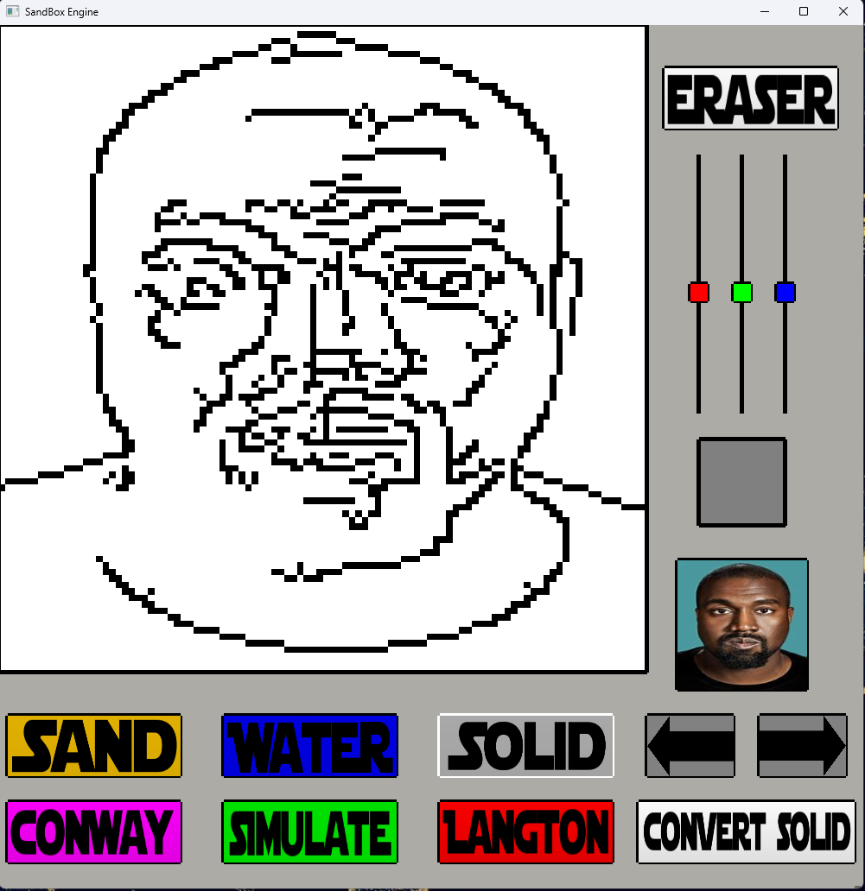
BURRITO, The TACO Clone: An Analysis of Compiler Schedules and Optimizations
A CS 4323 Lab Project, Designed with guidance from Dr. Richard Veras
https://github.com/MichaelCrabb/lab2_taco
Andrew Gallant, Harivansh Luchmun, Hugo Atayde, Luis Guillen Arcos, Michael Crabb, Nick Louque
Introduction
1. Overview
2. The Operations
This project implements Burrito, a clone of the Tensor Algebra Compiler, to explore modular compiler construction principles. By independently defining computations through seven operation being reduction, scaling, pointwise, transposition, outer product, matrix-vector mult, and matrix-matrix mult, and applying schedule transformations such as splitting, interchange, and unrolling, we record how execution strategies impact computational efficiency. This is important because it demonstrates how simple changes in the way a compiler organizes and traverses through work can significantly shift bottlenecks and lead to performance improvements.
Burrito takes seven .operation files: reduction, scaling, pointwise, transpose, outer product, matrix-vector, and matrix-matrix multiplication, and uses Python generators to produce both baseline and scheduled C code. We evaluate these by compiling and running each version, collecting performance metrics like execution time, throughput, memory usage, and bottlenecks. Optimizing these operations is essential, as each impacts key performance areas: reductions minimize overhead, scaling and pointwise boost throughput via vectorization, transposes improve memory bandwidth, and matrix operations benefit from better memory reuse and compute efficiency.
Reduction creates a single for loop node with an assign node containing an accumulation expression (e.g., acc = acc + A[i]). Scaling uses a for loop node with an assign node that multiplies each array element by a constant (e.g., A[i] = A[i] * c). Pointwise has a for loop with assign nodes performing binary operations (add, mul, etc.) across multiple arrays. Transpose uses two nested for loop nodes where the indices are swapped in the access expression (B[j][i] = A[i][j]). Outer product has nested for loops with a mul expression between elements of two vectors stored into a matrix. Matrix-vector multiplication uses nested for loops with an inner accumulate node summing products of matrix rows and vector elements. Matrix-matrix multiplication uses three nested for loops with an assign node that performs a mul and add chain (C[i][j] += A[i][k] * B[k][j]).
3. Transformations and Schedules
4. Performance Analysis
5. Summary
Reduction introduces loop-carried dependencies, limiting throughput and increasing nanoseconds; scaling and pointwise are parallel and increase flop with GB_per_s, but their performance is limited by bytes moved per iteration; transpose alters memory access patterns, increasing bytes and decreases GB_per_s; outer product increases both bytes and nanoseconds; matrix-vector multiplication increases nanoseconds and lowers throughput; matrix-matrix multiplication, increasing flop and which gives improved throughput.
splitting reduces nanoseconds and reducing per-iteration bytes, interchange increases GB_per_s, and unrolling improves throughput and increases the number of operations per cycle.
Each of the seven operations in Burrito stressed different performance metrics. Transpose, scaling, pointwise, and outer product were most affected by memory usage (bytes, GB_per_s). Reduction and matrix-vector multiplication were limited by execution time (nanoseconds) and low throughput due to dependencies or poor reuse. Matrix-matrix multiplication impacted flop and throughput. These differences highlight how operation types change specific bottlenecks and guide where compiler optimizations matter most.
Transpose
Impacted most through bytes and GB_per_s
Reduction
Impacted most through throughput and nanoseconds
Scaling
Impacted most through bytes and GB_per_s
Pointwise
Impacted most through bytes and GB_per_s
Outer Product
Impacted most through bytes and GB_per_s
Matrix-Vector Multiplication
Impacted most through bytes and nanoseconds
Matrix-Matrix Multiplication
Impacted most through flop and throughput

