Slide 1
Hibernate
By Michael Crump

Slide 2
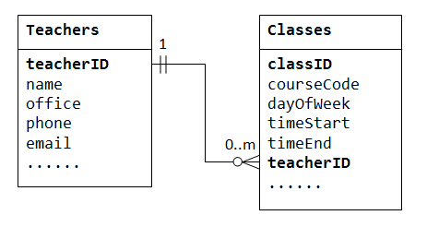

Background
When you use a relational database within an app, the results of a query have to be converted from database records to things the app can understand each time a query is done. And then the app’s data types and structures have to be changed to SQL for each insertion or update. This kind of code is bug prone and when done poorly, slows data transfer. Hibernate takes care of these problems for you.
Hibernate is an open source persistent framework created by Gavin King in 2001. It is a powerful, high performance Object-Relational Persistence and Query service for any Java Application.

Slide 3
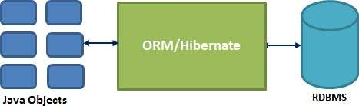
What is Hibernate?
Hibernate is an Object-Relational Mapping (ORM) solution for JAVA.
Hibernate maps Java classes to database tables and from Java data types to SQL data types and relieves the developer from 95% of common data persistence related programming tasks.
Hibernate sits between traditional Java objects and the database server to handle all the work in persisting those objects based on the appropriate O/R mechanisms and patterns.

Slide 4
Advantages of Hibernate
Hibernate takes care of mapping Java classes to database tables using XML files and without writing any line of code.
Provides simple APIs for storing and retrieving Java objects directly to and from the database.
If there is a change in the database or in any table, then you need to change the XML file properties only.
Abstracts away the unfamiliar SQL types and provides a way to work around familiar Java Objects.
Hibernate does not require an application server to operate.
Manipulates Complex associations of objects of your database.
Minimizes database access with smart fetching strategies.
Provides simple querying of data.

Slide 5
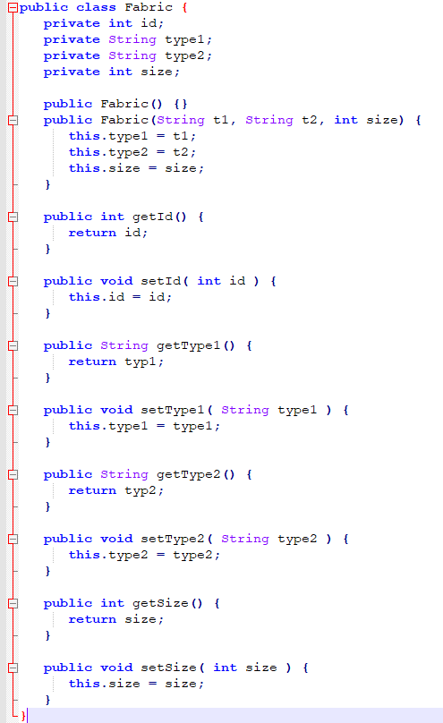
Hibernate Code Example
Step 1: Create a POJO (Plain Old Java Object)
My Mother-In-Law is opening an online quilting business. Among other things, this business will sell fabric. I’ll start by creating a Fabric object that has a few different attributes.

Slide 6
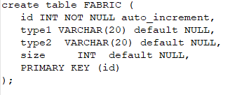
Hibernate Code Example (cont.)
Step 2: Create a Database Table
There would be one table corresponding to each object you are willing to provide persistence.

Slide 7
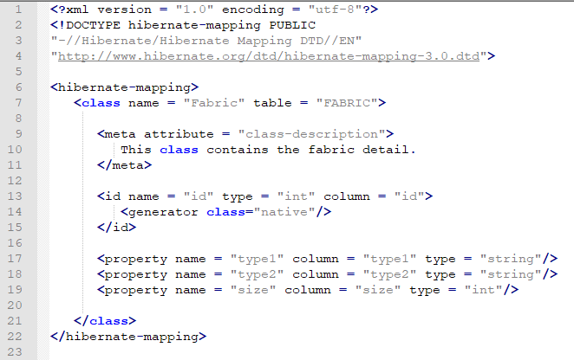
Hibernate Code Example (cont.)
Step 3: Create a Mapping Configuration File
This step is to create a mapping file that instructs Hibernate how to map the defined class or classes to the database tables.

Slide 8
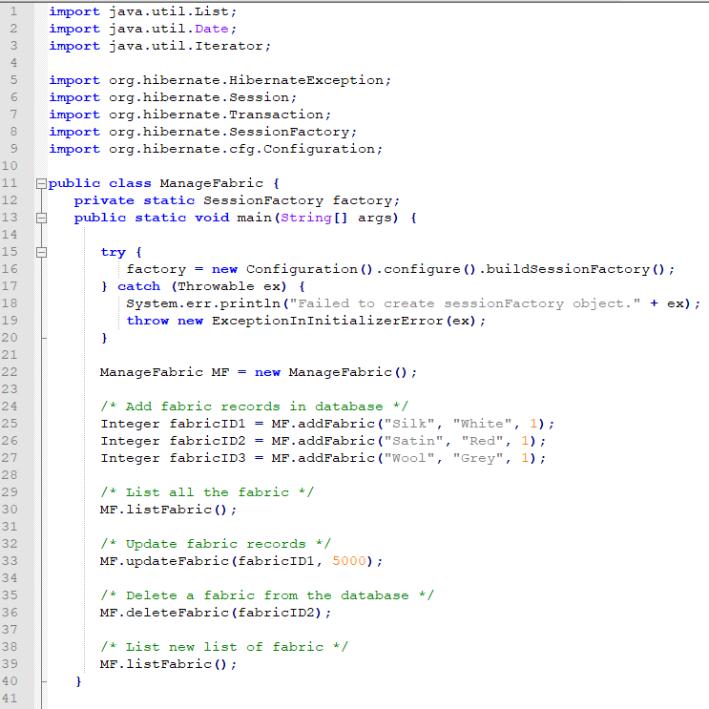
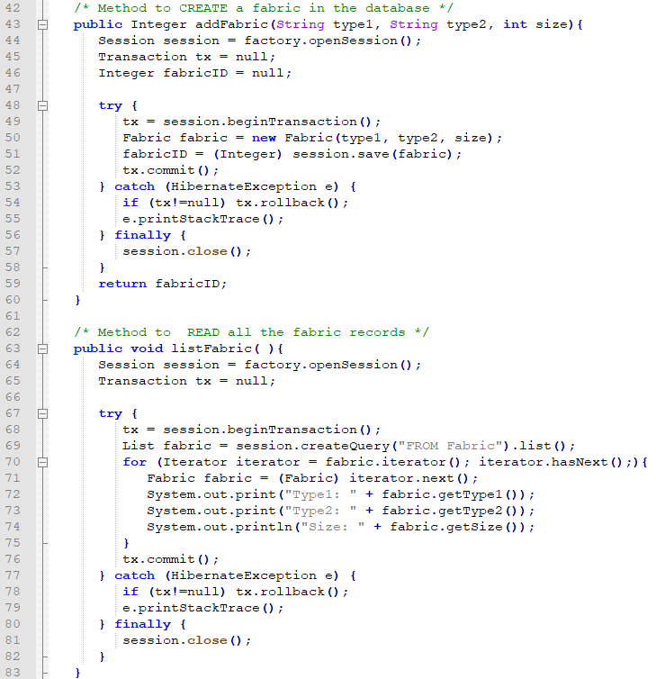
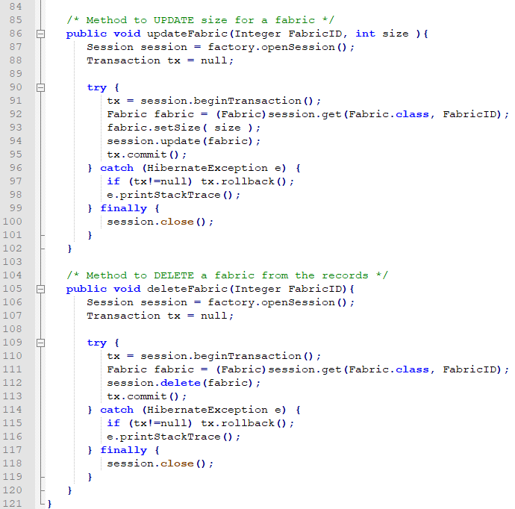
Hibernate Code Example (cont.)
Step 4: Create Application Class
Finally, we create our application class with the main() method to run the application. We could use this application to save, update, or delete Fabric records.

Slide 9
Conclusion
Hibernate can be a large topic to comprehend, but it will ultimately save you time and make your code much more modular in the long run. The more you use features like Hibernate, the more you will come to appreciate the relationships that exist between applications and databases.

Slide 10
References
https://www.tutorialspoint.com/hibernate/hibernate_overview.htm
Doing More With Java, Android and Tomcat Edition, Lee S. Barney

