Slide 1
AWS Intro Bootcamp
May 12, 2018

Slide 2
Agenda
Introductions
AWS signup
IAM (Identity Access Management)
EC2 (Elastic Compute)
VPC (Virtual Private Cloud) / Networking
Lunch (?)
Set up a simple web server
Load balancing
Bootstrapping
Autoscaling
CloudFormation

Slide 3
AWS signup
https://aws.amazon.com/

Slide 4
IAM
IAM is used to manage access to AWS services
Users – An entity that represents a person or service that interacts with AWS. Consists of a name and credentials.
Groups – A collection of users
Roles – Similar to user. An identity that can be consumable by anyone (users, services, apps that don’t normally access your AWS account). Useful if you don’t want to create a new user for every entity that connects to your account (iPhone app)
Policies – A JSON document that defines permissions
Best practice – Keep a tight leash on your permissions. Be pessimistic and think the worst of people and how they might abuse the system.

Slide 5
AWS infrastructure
Regions – A separate geographic area that is completely independent and isolated from other regions.
Examples: us-east-1 (Virginia), us-west-1 (California), ap-northeast-1 (Tokyo)
Not all features or services are available in every region
Availability Zones – A set of isolated locations that make up a region. At least two AZs in each region. AZs are connected through low-latency links. Represented by the region name and a letter identifier
Examples: us-east-1a, us-east-1b, us-east-1c

Slide 6
VPC
Virtual Private Cloud – A virtual network dedicated to your account that runs inside AWS where you will launch your EC2 instances, load balancers, etc
Isolated from other virtual networks in the cloud
VPCs span an entire region
VPCs are created with a range of IP addresses that are defined in a CIDR block (no bigger than a X.X.X.X/16)
You can have multiple VPCs in your account, and they can be peered (so they can talk to each other), but the CIDR ranges on the VPCs must not overlap (Plan ahead)

Slide 7
CIDR (Classless Inter-Domain Routing)
A way to allocate or describe a range of IPs
Notation (IPV4): <IP Address>/<suffix> EG: 32.51.120.0/22
The suffix is a number from 0-32 that defines how many bits of the IP address are “locked”
00100000.00110011.011110**.********
The above CIDR would give us a range that contains 2^(32-22) addresses = 1024 addresses
32.51.120.0/22 is equivalent to 32.51.123.48/22. To avoid confusion, replace the wildcards with 0
00100000.00110011.01111011.00110000 => 00100000.00110011.01111000.00000000
0.0.0.0/0 = No locked bits = Any IP
128.32.250.42/32 = All locked bits = Only this exact IP

Slide 8
Subnets/Route tables/Internet Gateways/NAT
Subnet – A range of IP address within your VPC.
Subnets are limited to a single AZ within the same region as your VPC
Public subnets have a route to the internet gateway
Private subnets don’t have a route to the internet gateway. A NAT must be used to talk to the internet
Route Table – A set of rules (routes) that determine where to direct traffic
Each subnet must be associated with one and only one route table
Internet Gateway – Allows communication between instances in VPC and the internet
NAT (Network Address Translation) – Allows instances that aren’t publicly accessible the ability to send and receive internet traffic
Does not allow the internet to establish the connection, just allows instances in private subnets the ability to call out

Slide 9
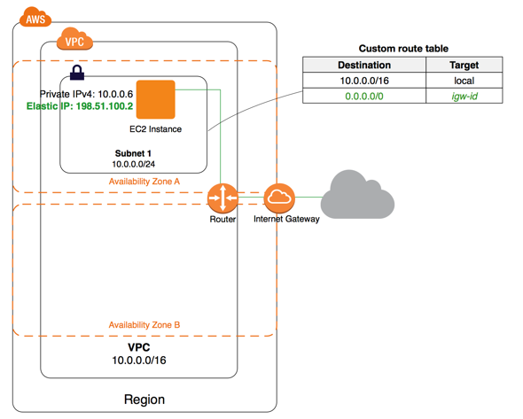

Slide 10
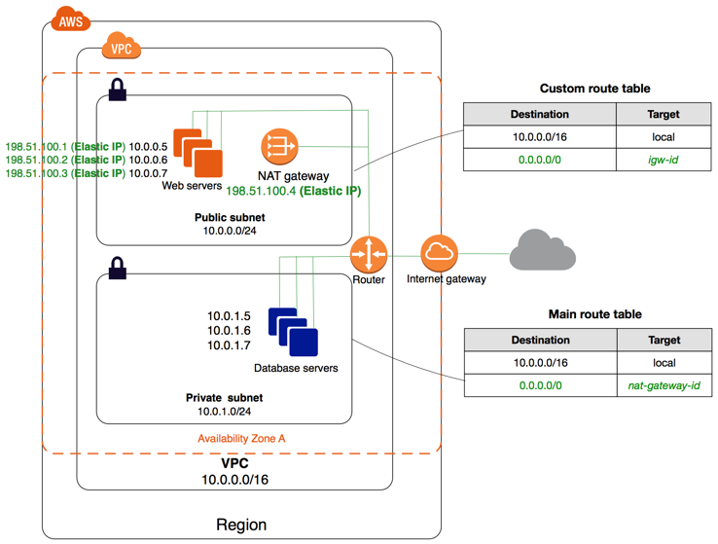

Slide 11
Adding a bastion host
EC2 instances in private subnets cannot be accessed directly from the internet
To access a private instance, you must connect from an EC2 instance in a public subnet
Hosts that are publicly accessible and used as entry points to access private hosts are called “bastion hosts”
Provides a single point that needs to be protected
Best practice is to have separate keys for your bastion and for your private hosts
Bestest practice is to never share the PEM files and manage the authorized keys on each host in order to be able to cut off access

Slide 12
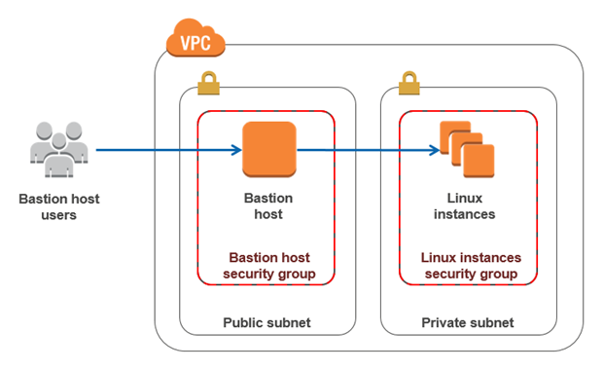

Slide 13
SSH
Use an ssh-agent to manage all your keys
Too many keys can be a problem
ssh-add will add keys to the agent
List keys stored in agent - ssh-add –l
Add key to agent – ssh-add <path to key>
Remove all keys from agent – ssh-add -D
Use aliases or functions to help manage your ssh commands
Don’t store PEM files on your bastion; don’t give attackers the ability to break into your system if they get past the first hurdle
ssh -o UserKnownHostsFile=/dev/null -o StrictHostKeyChecking=no -o "ProxyCommand ssh -W %h:%p ec2-user@<BASTION PUBLIC IP>" ec2-user@<HOST PRIVATE IP>

Slide 14
Security Groups vs NACLs
Security Groups – Firewall rules applied at an instance level
Supports ALLOW rules only (Does not support rules to exclude)
All rules evaluated first before deciding whether to allow traffic
Stateful – Return traffic is allowed regardless of the rules in place
NACL (Network Access Control List) – Firewall rules at the subnet level
Supports ALLOW and DENY rules
Rules processed in order
Stateless – Will not remember requests; return traffic must be explicitly allowed by rules

Slide 15
Load balancers
Load balancers are used to split traffic between registered hosts
ELB – Elastic Load Balancer (classic) – Routes traffic to certain EC2 instances and ports
ALB – Application Load Balancer – Capable of operating at the individual request level
Can route to more granular targets within the VPC (docker containers using dynamic ports)
Can route based on the content of the request itself (path based routing)

Slide 16
S3 (Simple Storage Service)
File/Object storage service
99.999999999% durable
Global service (bucket names must be unique)

Slide 17
AWS CLI
Python based command line tools to interact with AWS
Installed on all AWS base images
Useful in scripting or in determining EC2/IAM permissions

Slide 18
EC2 Userdata/Metadata
Userdata is an optional script or set of instructions that an EC2 instance will execute upon startup
Useful in bootstrapping an instance to get it ready in your system when it comes up
Metadata is data about the instance that is not known until runtime (EG which AZ the instance is in, public ip address, the instance id)
Useful when needing to set up start up scripts
Accessible by running curl on the instance:
curl http://169.254.169.254/latest/meta-data/

Slide 19
Autoscaling / Launch Configurations
Autoscaling groups – Monitors and responds to unhealthy machines or to an increase in traffic to scale up more instances
Describes “when” and “how” to launch new instances
Can monitor EC2 health or ELB (connectivity) health
You can also monitor your own application and manually set the state to “Unhealthy” as desired
Launch configuration – Describes the instances that will be provisioned when autoscaling kicks in, including AMI, instance type, IAM role, userdata, disks, security groups, etc
The definition of “what” to launch

Slide 20
Cloudformation
Cloudformation automates all the deployment and setup of the AWS resources in a repeatable manner
JSON or YML templates describe ”stacks” of AWS resources. These templates can (and should) be source controlled
AWS attempts to be as atomic as possible when creating or updating a stack
If there are any errors creating the stack, the entire stack will not come up
If there are any errors updating a stack, the stack will be rolled back to the initial state
Pro-tip: Group your resources and organize your stacks around life-cycle. Use multiple stacks, don’t put everything into one giant stack.

Slide 21
Questions? Suggestions?

