Slide 1
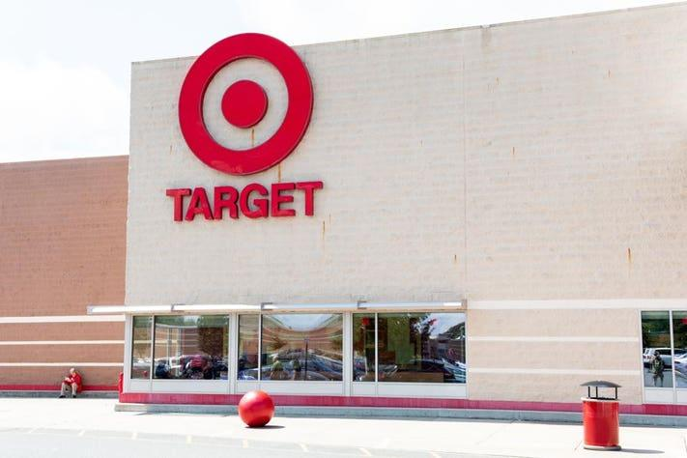
Target (the Dept. Store) Simmer
By Olivia Christie + Michael Schlueb + Katherine Keefe
Notes:
Remind me what parts to UML and Activity Diagram (give me the names of what’s what)

Slide 2
So Why Model Target (or any department store)? + Concepts
Target is a very organized & respectable company, and the reality of a store can be optimized very well in object oriented programming
The code is meant to act as a type of management terminal, allowing the user to access multiple aspects of the store.
We drew on several concepts from OOP to complete our code.
The main concepts were inheritance, with us using both abstract and concrete classes, and polymorphism, with us using downcasting and method overriding.

Slide 3
Each of our roles:
Michael:
The architect behind the code.
Abstraction for classes by asking:
What do we need for a department store?
Do we need more than one?
Katherine: Helped write the code and test cases for several classes.
Olivia: Diagram Maker and Consultant

Slide 4
UML Diagram
Product
Employee
Department
Checkout
Part
Manager
Full
Aisle
Seasonal
Common Behavior
Customer Behavior
Notes:
UML by Olivia? (Will also do activity)
Clear up that because of

Slide 5
Activity Diagram: employeeNum method
Is total less than the amount of employees provided?
Initialize
Total number variable
No
Yes
Update Total by 1

