Slide 1
Eli Lilly Student Case Study
SV-351
Michael Barrett
Cody Bostic
Neven Frazee
11/12/13

Slide 2
Company
Financial
Competition
Valuation
Challenges

Slide 3
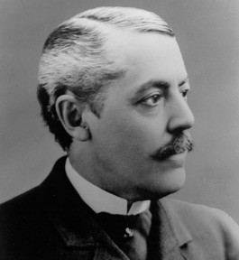
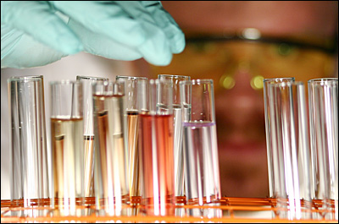
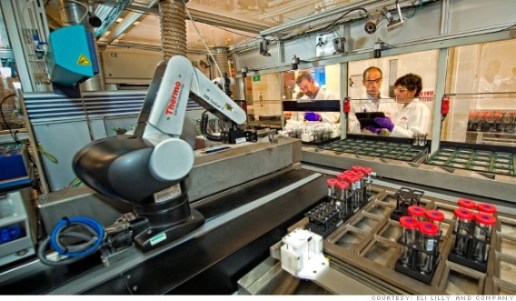
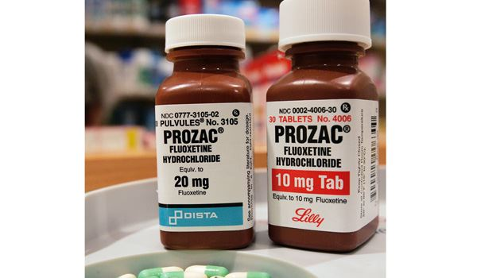

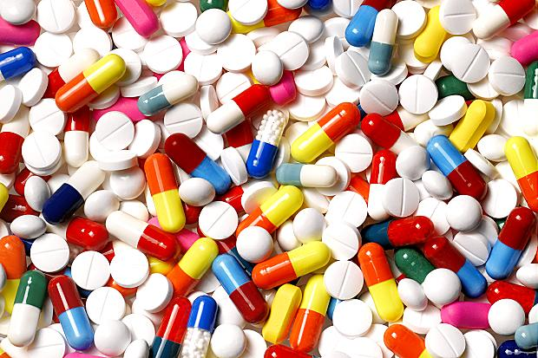
Lilly : World’s Tenth Largest Pharmaceutical Company
Founded in 1876 by Colonel Eli Lilly
Headquarters in Indianapolis, Indiana
Ticker Symbol: LLY (NYSE)
President, Chairman & C.E.O : John C. Lechleiter
Employees: 38,000 (worldwide)
“ Lilly makes medicines to help people live longer, healthier and more active lives. ”
Company
Financial
Competition
Challenges
Valuation

Slide 4
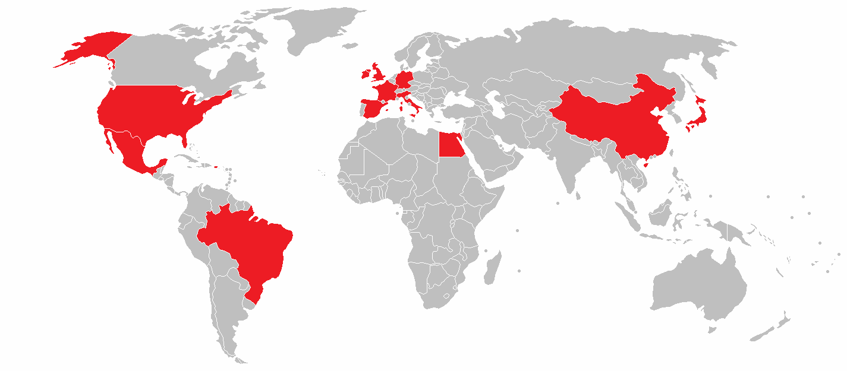
Global Impact
R&D Facilities in 8 Countries
Manufacturing Plants in 13 Countries
Conducting Clinical Research in Over 55 Countries
Company
Financial
Competition
Challenges
Valuation
Notes:
Describe Picture

Slide 5
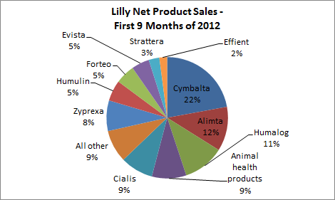
Markets
Diabetes: Insulin
Men's Health: Erectile Dysfunction
Neuroscience: Alzheimer’s
Company
Financial
Competition
Challenges
Valuation
Notes:
ADD PICS
Two main categories: Human (focus) and Animal Protein Products
Bone, Muscle, Joint, Cardiovascular, Diabetes, Endocrine (depression shit), Mens health (Cialis), NeuroScience, Oncology (cancer)

Slide 6
Company
Financial
Competition
Valuation
Challenges

Slide 7
Financial Stuff
Company
Financial
Competition
Challenges
Valuation
Notes:
Pie Charts of : revenue By segment, revenue by geography

Slide 8
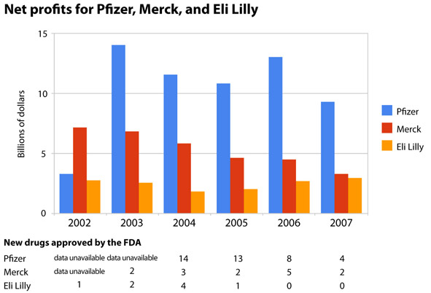
Net Income
Company
Financial
Competition
Challenges
Valuation
Notes:
Change picture

Slide 9
Dividends per share
Company
Financial
Competition
Challenges
Valuation
Notes:
Pie Charts of : revenue By segment, revenue by geography

Slide 10
Table of Volitility, and other things like in sample
Company
Financial
Competition
Challenges
Valuation
Notes:
Pie Charts of : revenue By segment, revenue by geography

Slide 11
Company
Financial
Competition
Valuation
Challenges

Slide 12
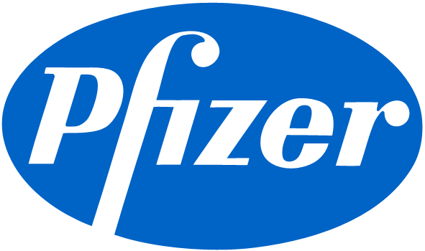
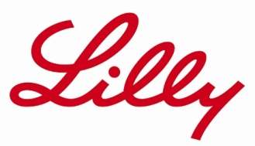

Company
Financial
Competition
Challenges
Valuation
Notes:
Add other competitors and picture of china?
In the middle compared in anualized volitility (21%) to other companies
Lily 21%
Merck 25%
Pfizer 20%
Lowest amount of annualized returns 4.7%, Merck 6.8%, Pfizer 5.6%

Slide 13
A
Company
Financial
Competition
Challenges
Valuation
Notes:
In the middle compared in anualized volitility (21%) to other companies
Lily 21%
Merck 25%
Pfizer 20%
Lowest amount of annualized returns 4.7%, Merck 6.8%, Pfizer 5.6%

Slide 14
Lilly, Merck and Pfizer : Factors of Return on Equity
Company
Financial
Competition
Challenges
Valuation
Notes:
High asset turnover and financial leverage
Disribe characterstics in each graph that makes up ROE
(change of ownership in 2008-2009)

Slide 15
Company
Financial
Competition
Valuation
Challenges

Slide 16

Regulations, wholesale, patent expirations
Porters Five Forces
Company
Financial
Competition
Challenges
Valuation
Notes:
Wholesale: amerisource bergen cooperation, cardinal health inc, mckesson corp.

Slide 17
Company
Financial
Competition
Valuation
Challenges

Slide 18
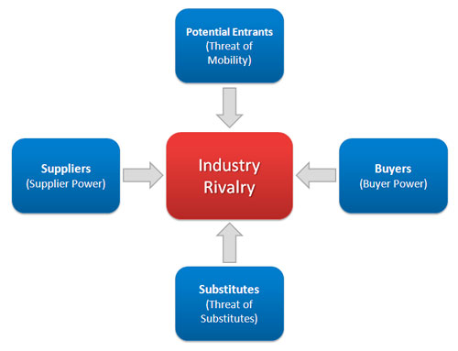
Porter’s 5 Forces on Eli Lilly and Company

Slide 19

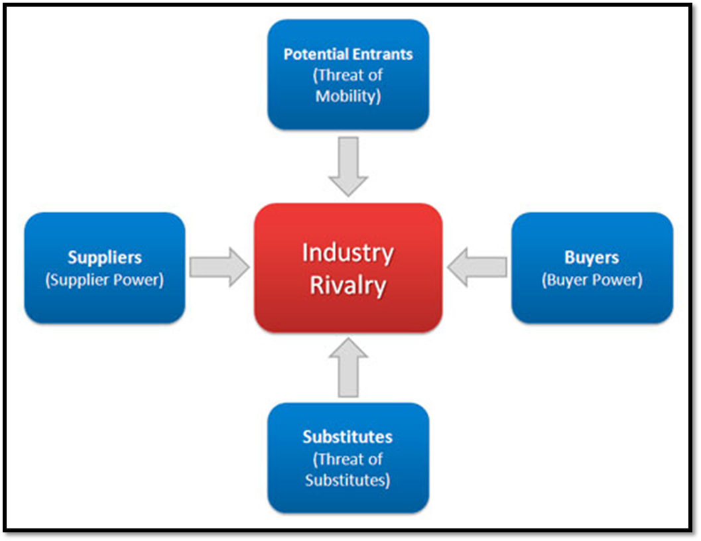
Potential Entrants
Threat Level: Low
It is difficult to create a new drug without proper, highly specialized resources
However, when a patent runs out on a drug, anyone can start to produce a generic version

Slide 20
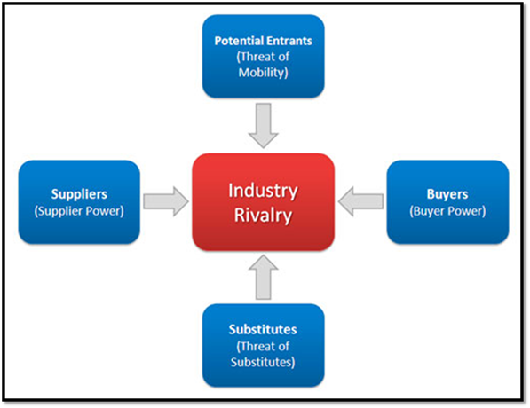
Substitutes
Threat Level: Low
There are not many substitutes for pharmaceutical medicine

Slide 21
Supplier Power
Influence Level: High
Workers are not unionized
Raw materials can be bought from a variety of suppliers

Slide 22
Buyer Power
Influence Level: High
There are 3 major pharmaceutical wholesale companies which buy most drugs from companies like Lilly, Merk, and Phizer

Slide 23
Industry Rivalry
Intensity Level: High
The pharmaceutical industry is ranked #2 for advertising spending
In a 2009, the industry spent $95 Billion in Research and Development
Notes:
The auto industry is ranked #1

Slide 24
Value the company
Company
Financial
Competition
Challenges
Valuation

Slide 25
Thank you.
Questions
Company
Financial
Competition
Challenges
Valuation

