Slide 1
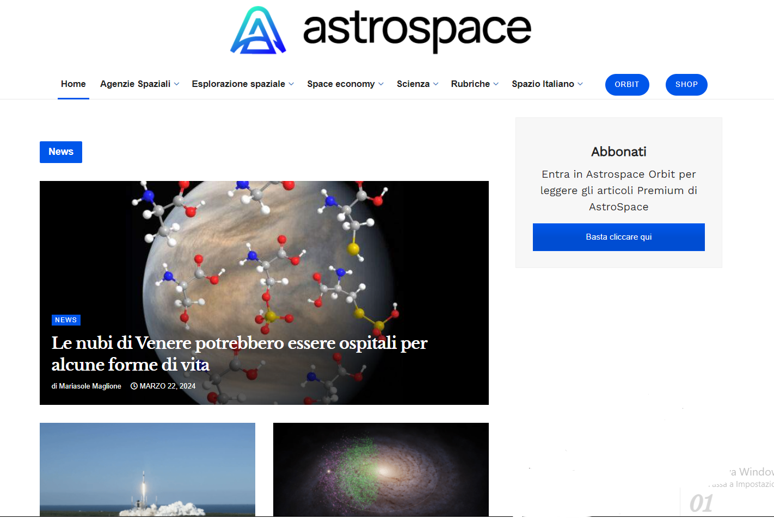
https://www.astrospace.it/

