Slide 1

Sample Data Analyst Report
By Michael Dixon

Slide 2
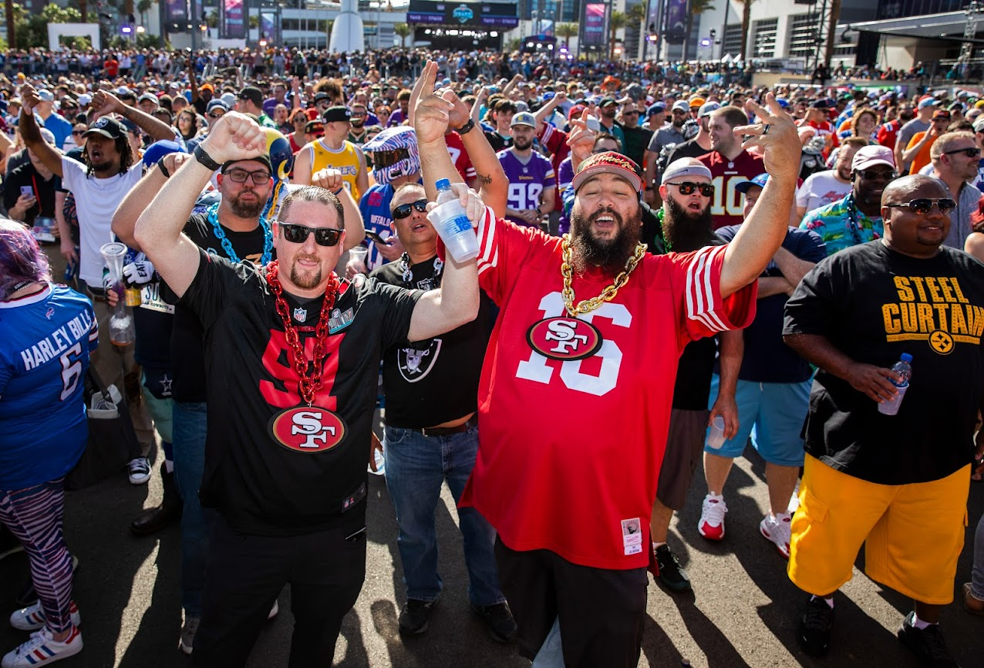
The Task:
Given hypothetical data of an NFL team.
The goal laid out to the data analytics team was to find trends about our season ticket holders to better understand how likely they would be to renew their tickets.
We also wanted to model these trends to make predictions about future renewals.

Slide 3

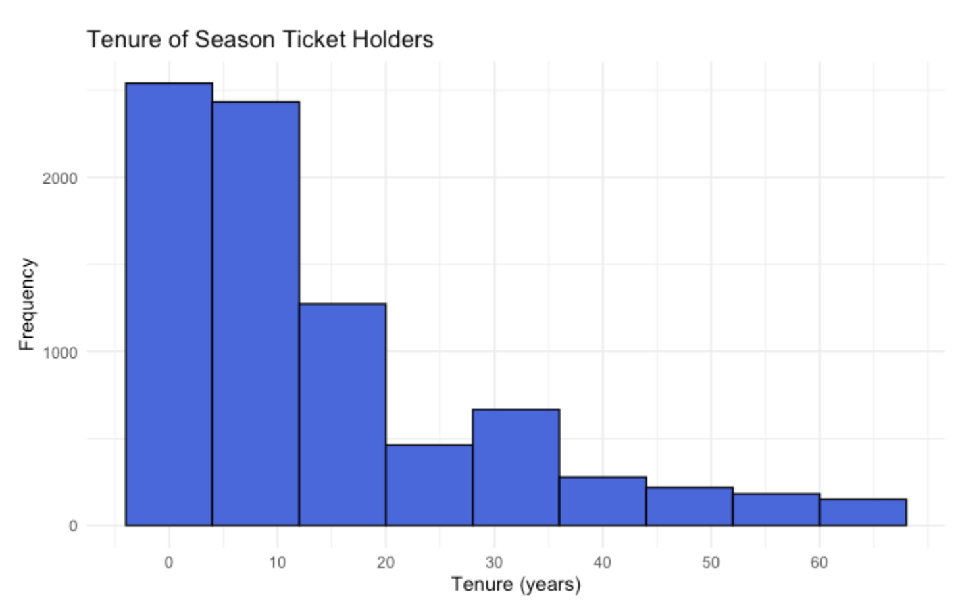
Exploratory Data Analysis:
Generally, acquiring new customers can be five times more expensive than maintain existing ones.
A histogram plot shows that most of the season ticket holders are relatively new (34% have held for less than 5 years, 57% have held for less than 10 years) .
It would be in the best interest of the team to understand why customers stop renewing and how to increase renewal rate.

Slide 4
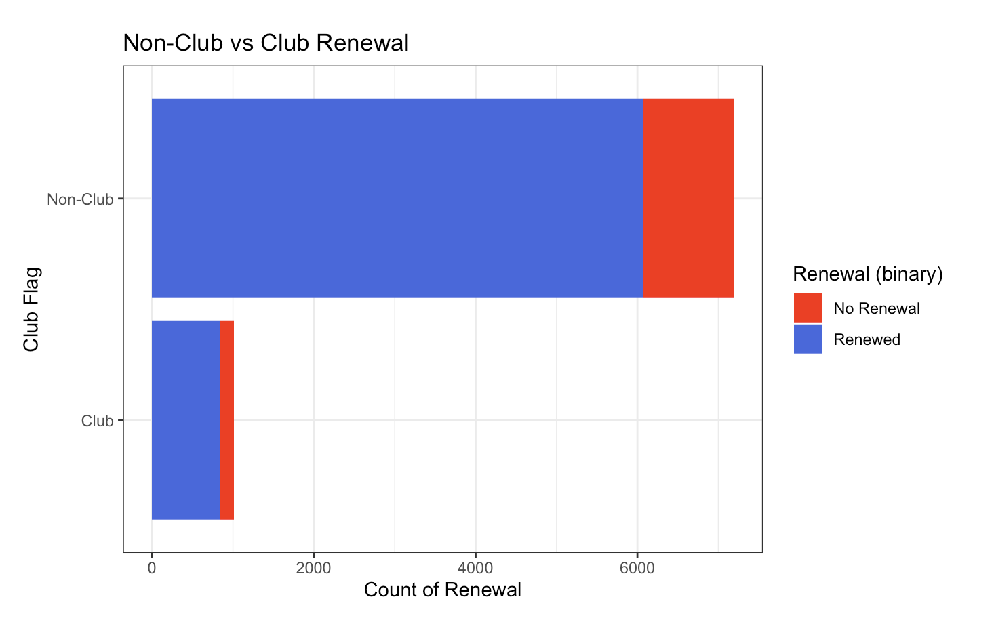
Impact of Perks:
The analytics team wanted to see if club tickets (and their associated benefits) would influence retention.
As shown in the plot, despite there being far fewer club tickets, a higher percentage of these ticket holders renewed for the next year.

Slide 5
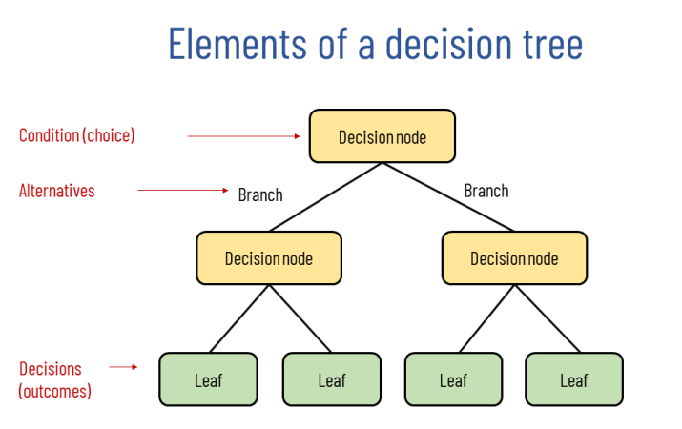
Models, Trees and Forests:
For my model, I applied a technique called “random forest modeling.”
To understand random forests, we must first understand decision trees.
Decision trees lay out one process for making a choice.
In the first step, a decision ‘node’ simply asks a question or forces a choice. For example, when you decide what to wear to work, the first question may be “is it snowing out?”
The two branches (yes or no) lead you to what to wear. If yes, a heavy coat. If no, a light jacket.
You continue down the tree, asking additional more specific questions, until your choice is made.
Decision trees have many strengths– they are easy to understand, can work on multiple kinds of prediction tasks and work well on unseen data (i.e., can predict well).

Slide 6
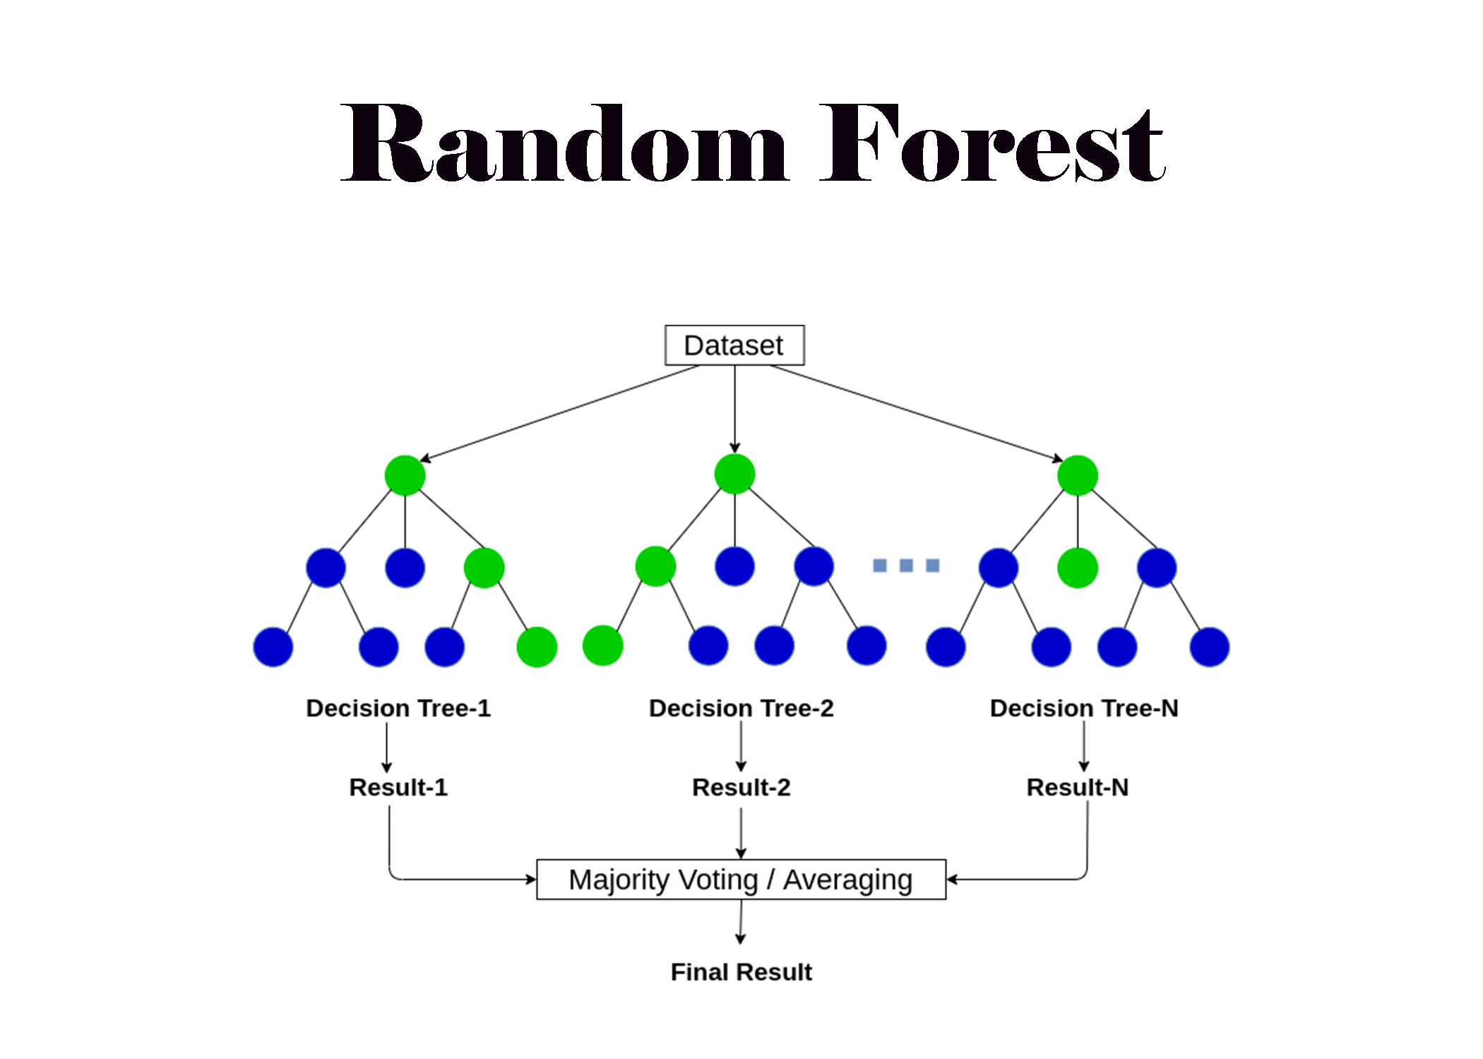
The Value of a Forest:
Now that we understand how to conceptualize decision trees, random forests are easy to understand.
Random forest models create more than one decision tree and then the results are weighed to get a final output.
This ensures the model is not over influenced by a single tree while allowing us the benefits of decision trees.
In short, random forests give us the interpretability of a decision tree while improving on its performance.

Slide 7
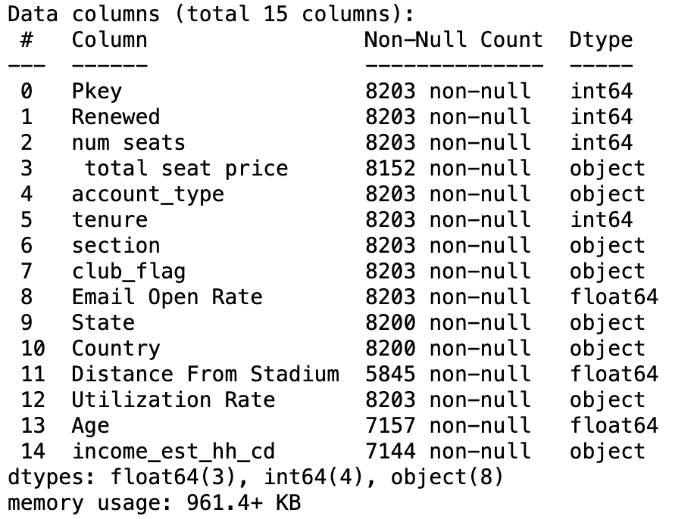
Applications to Season Ticket Holders
I created a random forest model for our data using the following features: number of seats sold, number of years the customer has owned their season tickets, account type (broker, personal, etc.), whether they were club or not and Utilization Rate (% of tickets used in the year).
I chose these features because they all seemed highly relevant to the model, and they had no data missing (reflected by the 8203 Non-Null count on the chart to the right).
Values that are present (not missing, or Non-Null) are important because I did not have to input any missing values nor remove any, which let me use all the relevant training data.
The more data I can use to train the model, the more robust the model is.

Slide 8
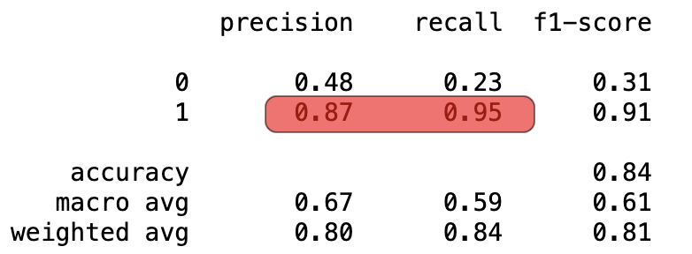
Results
I did not have a test set to validate my model results, so instead I created a validation set from a subset of my training data (in an 80%-20% training-validation split, common data science practice) to validate my model results.
The model produces an output of binary values – 0 or 1 – with 1 meaning we think the person will renew their tickets and 0 meaning we think they will not.
The accuracy achieved is good (84%, the third number down in the f-1 score column) but it is not the only measure we should look at.
Accuracy only considers how many total predictions the model predicted correctly. However, since far more customers renewed their tickets than didn’t (referred to as class imbalance), other factors should be considered.
For example, if 70% of the customers renewed their tickets, and the model simply predicted that 100% of the customers would renew, its accuracy would 70%, which would not indicate how well the model performed.
Better metrics are the precision, recall and F1-score. Precision of 0.87 for renewal (precision column, second value down) indicates that 87 percent of the people we predicted will renew did. Even better, recall of 0.95 (recall column, second value down) means that 95% of all the people who renew their season tickets were predicted to do so by the model.

Slide 9
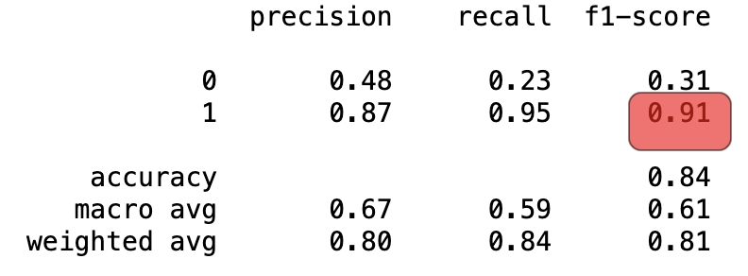
Further Results
Using these stats, we can understand our F-1 score, which averages precision and recall from the previous slide.
Usually F-1 scores between 0.8-0.9 are considered good while anything above 0.9 is excellent.
We say this because F-1 essentially averages how much Type I and Type II error there is in the model (false positive and false negative respectively).
A false positive occurs when the model predicted someone would renew and they didn’t, and a false negative occurs when the model predicted someone would not renew and they did.
Therefore, our F-1 score of 0.91 (f-1 score column, second value down) indicates that when we say someone will renew they usually will, and when we say someone won’t they usually won’t.

Slide 10
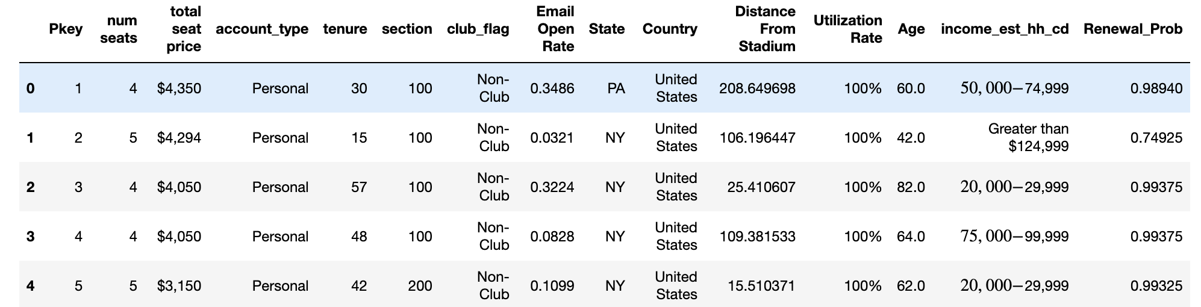
Final Results
Considering how well this model works, we then applied it to our test, but instead of binary outputs of 1 and 0 (renewal vs no renewal), we output the probability of renewal.
As seen above in our test set, we have the probability of some season ticket holders renewing their accounts on the far right.
For example, the season ticket holder in the second row, who purchased 5 seats costing $4294 for their personal account, has a 74.93% chance of renewing next year.

Slide 11
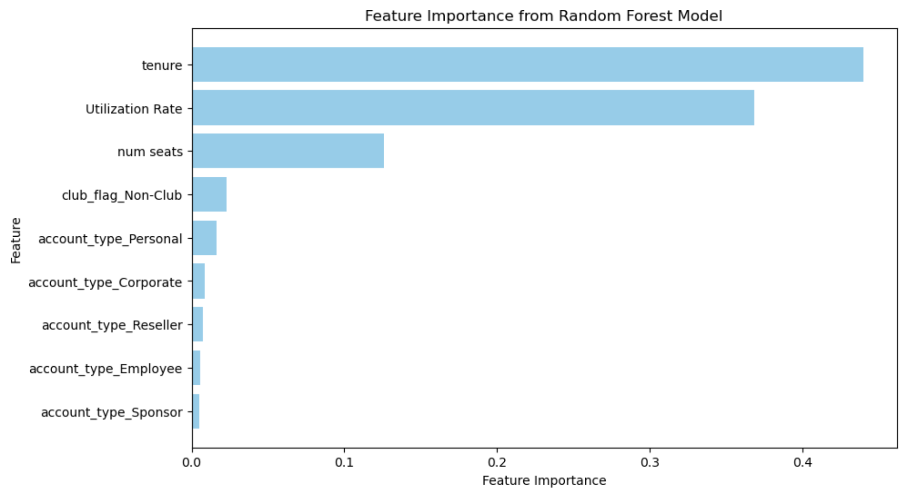
Feature Importance
This graph seeks to show how much of the model’s output is associated with each variable (feature).
Here, tenure and utilization rate are far and away the most important features to our model.

Slide 12
Next Steps
Overall, we can say the modeling appears to be a success and can use it for the upcoming fiscal year.
We should prioritize deals, sales or offers to people who currently have season tickets but have not held them for particularly long as it seems that as longevity increases, so does the probability the customer will renew the tickets.
Furthermore, we should pay close attention to utilization rate of ticket holders this year as that too will be highly associated with which customers most useful for us to target.

Slide 13
Presented by Michael Dixon Thank You for Reading

