Slide 1
SpectroLab EBME 360
Shine on, forever.
Spr 2019

Slide 2
Goals
Understand how important light is and how awesome it is to gather information about molecules.
Really understand how important light is.
Use MATLAB to interface with Arduino.
We have released the C++ code, and if you are interested, definitely reach out to a TA for more info. We have found that teaching Arduino on the fly is like pushing you out of an airplane without telling you where the ripcord is. But, if you prefer to struggle with C++ also let us know in the reviews below. Don’t forget to like and subscribe.

Slide 3
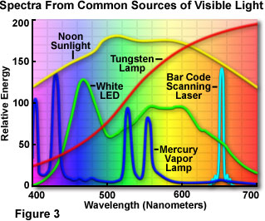
See the rainbow…
There is no white wavelength of light.
Rather, white is a combination of a lot of different light waves.
We want to break white light down to its different wavelengths and then use that to see how our solution behaves.

Slide 4
Putting the “Photon” Together
BOM
Laser Cut “Photon” Setup (What a clever name)
An extra bright LED (3.3 V from Arduino)
Select a resistor that limits the current to 20 mA
A photo resistor with amplification circuit (3.3 V from Arduino)
HEY! NOT 5 V! Use 3.3 V.
A stepper motor with a DVD “diffraction grating”
Stepper motor driver
Use the breadboard power regulator to get 5 V from the 9 V battery
2 Cuvettes
Arduino
Photon_speak.ino
A breadboard or two
A positive outlook on learning

Slide 5
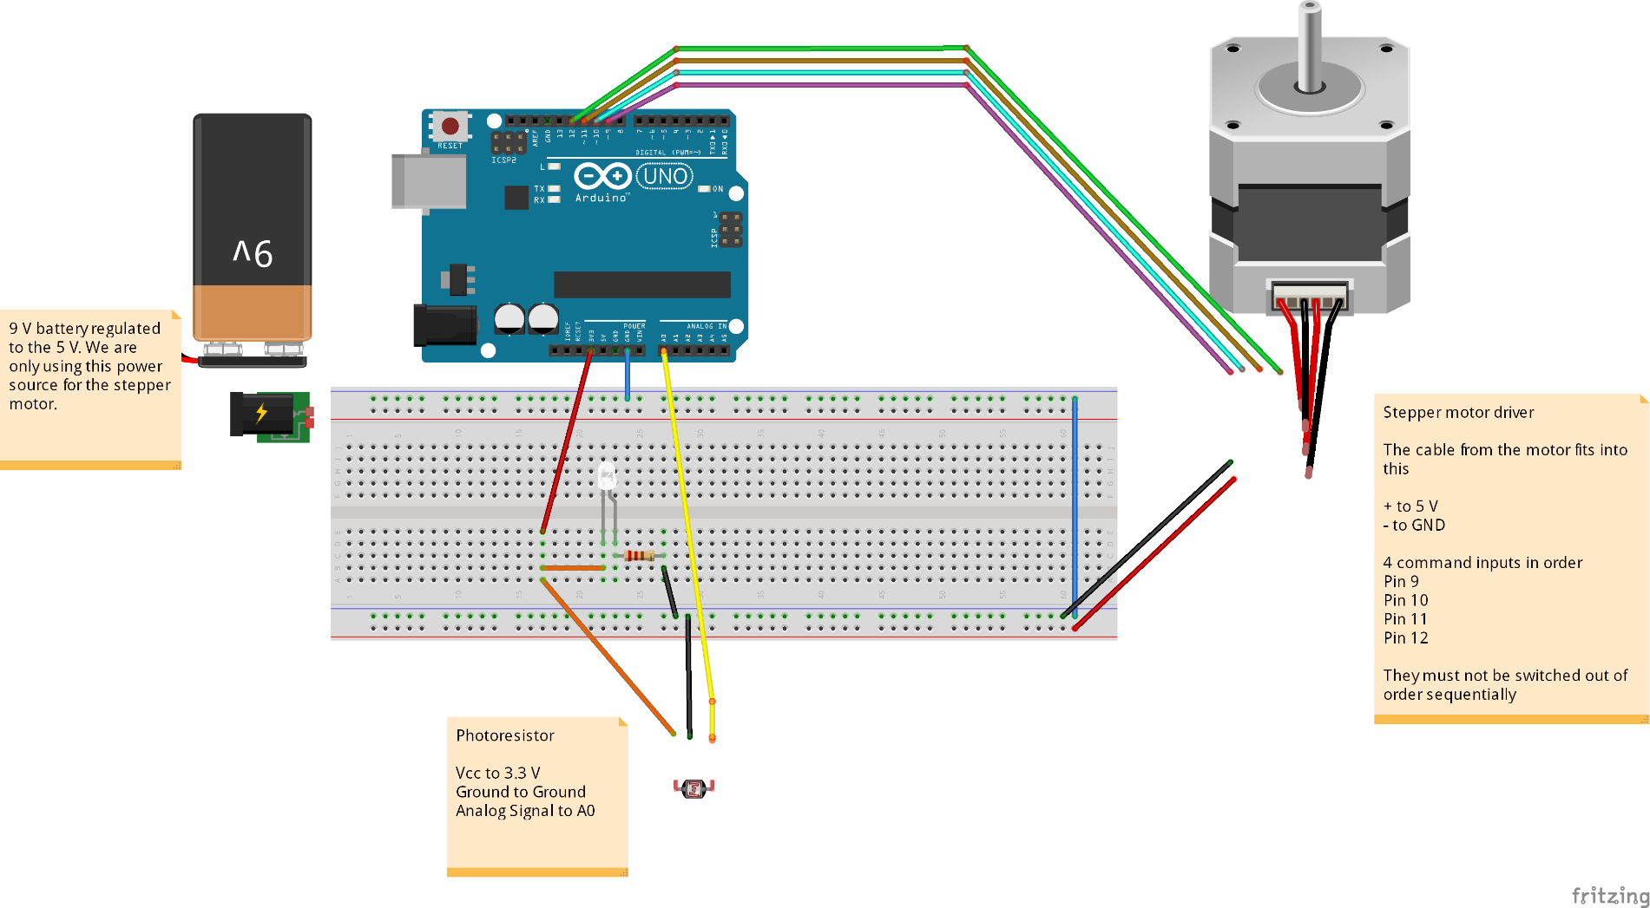
Circuit Diagram
Power Regulator fits right on breadboard. One side is 3.3 V and the other is 5 V. Use the 5 V rails for the stepper motor.
VCC
A0
GND

Slide 6
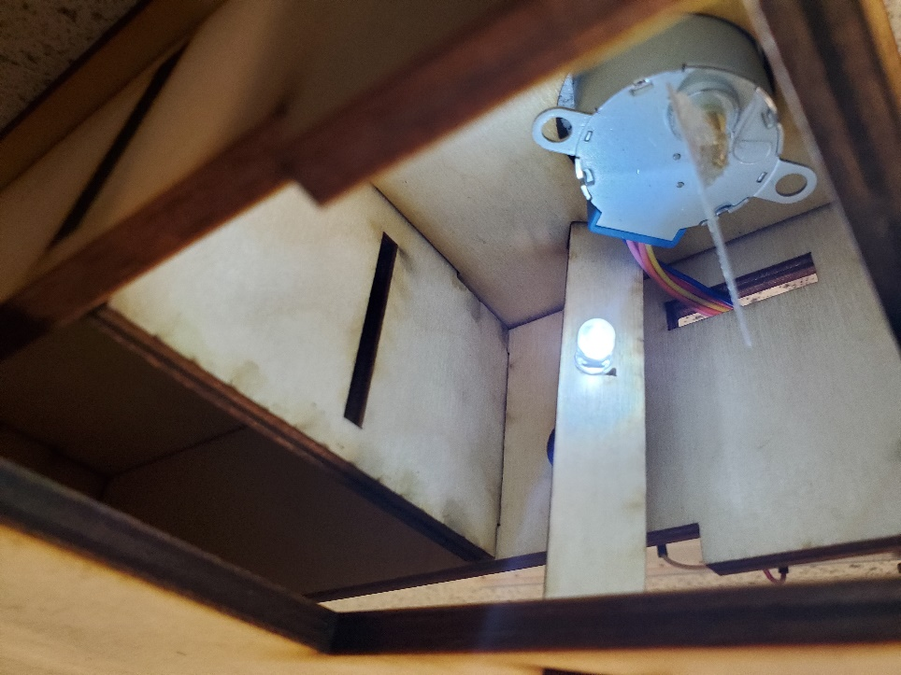
Actually Seeing the Rainbow
See Rainbow Here
Use the LED to shine light onto the DVD. Spin it around until you see the rainbow on the other side of the photon.

Slide 7
Measuring ROYGBIV
As we take steps with the stepper motor, we can isolate certain wavelengths that the detector sees. The setup can definitely do this.
The Spectrum Moves with the stepper motor.
Measure Here
And if you view this slide in presentation mode, the spectrum moves with a click

Slide 8
Using MATLAB to send and receive requests
We will treat our Arduino like an instrument. Some of you may have used ASCII commands to “talk” to oscilloscopes and function generators before. It is extremely useful and can automate data collection like CRAZY!
The C++ that you uploaded to your Arduino (photon_speak.ino) acts as a way to create an instrument.
Make sure you uploaded the code
Start Matlab alongside this powerpoint. Use the student skeleton file on canvas.
Open up a Serial Port using the following commands
ardy = serial(‘COMxy’, ‘BaudRate’, 115200)
fopen(ardy)
fscanf(ardy)
‘COM10’ will be different based on the port where your Arduino is. Use the tools tab on the Arduino IDE as an easy way to find your port.

Slide 9
Sending and Receiving
What we want to do is “speak” to the Arduino
Use the following commands to do that
fprintf(ardy, “*IDN?”)
fscanf(ardy)
If fscanf returns a quirky message, then you’ve succeeded.
IMPORTANT:
To close your instrument use the following sequence:
fclose(ardy)
delete(ardy)
clear ardy
You may forget to close your instrument. MATLAB makes it relatively easy to mend this mistake, so if you get an error opening your ardy through serial, use instrreset to start over.

Slide 10
Your Commands
You can send certain commands to the Arduino. Remember to always do an fscanf after an fprintf. If you’re clever, there is a function that combines the two, but if you’re just learning stick to the basics.
“*IDN?”
The Arduino will respond with its identity
“:STP:MOV N”
The Stepper Motor will move N amount of steps
“:STP:SET N”
N is 0 or 1 corresponding to CW and CCW rotation.
“:MEA?”
Return the output of the photoresistor.
Remember this is in bits (0-1023)

Slide 11
Gather the spectrum of spinach
Now you should write some code to explore the spectrum of chlorophyll
There’s a lot of tips in the Matlab code

