Slide 1
On The Spot Courier Service
Application System Interface

Slide 2
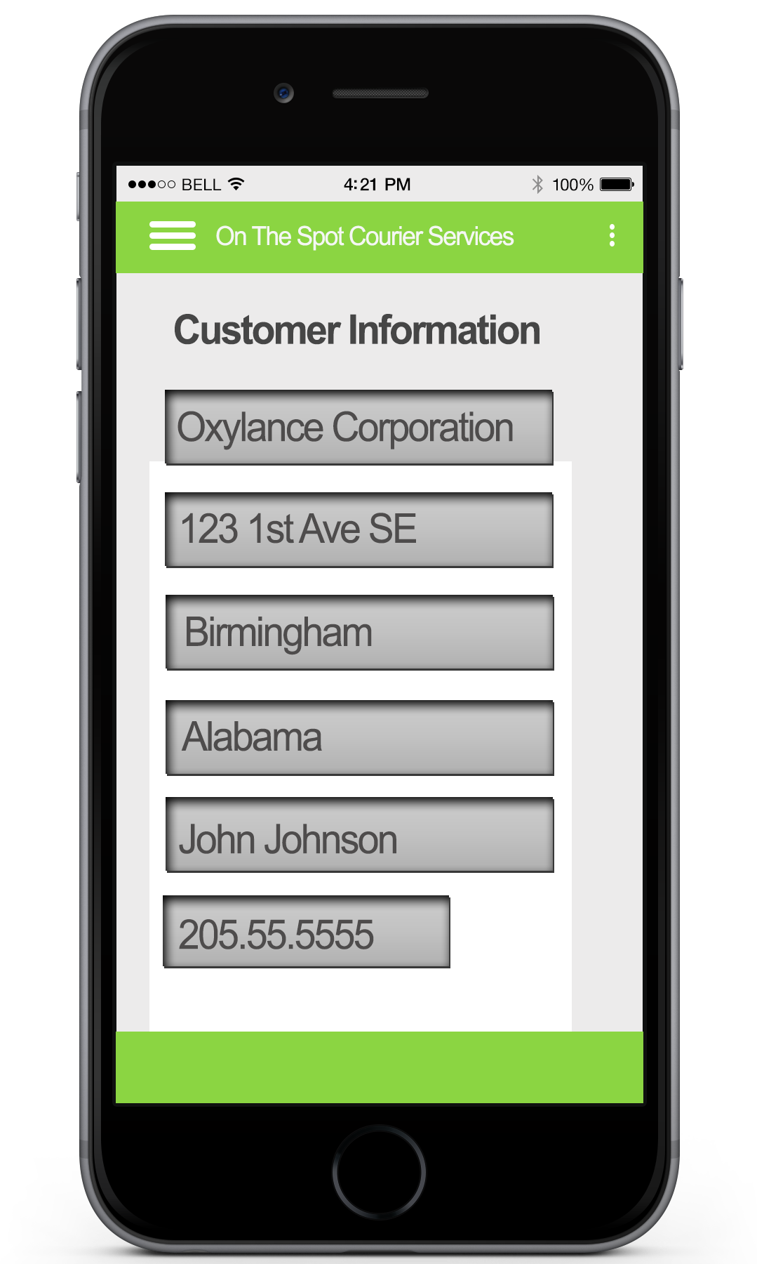
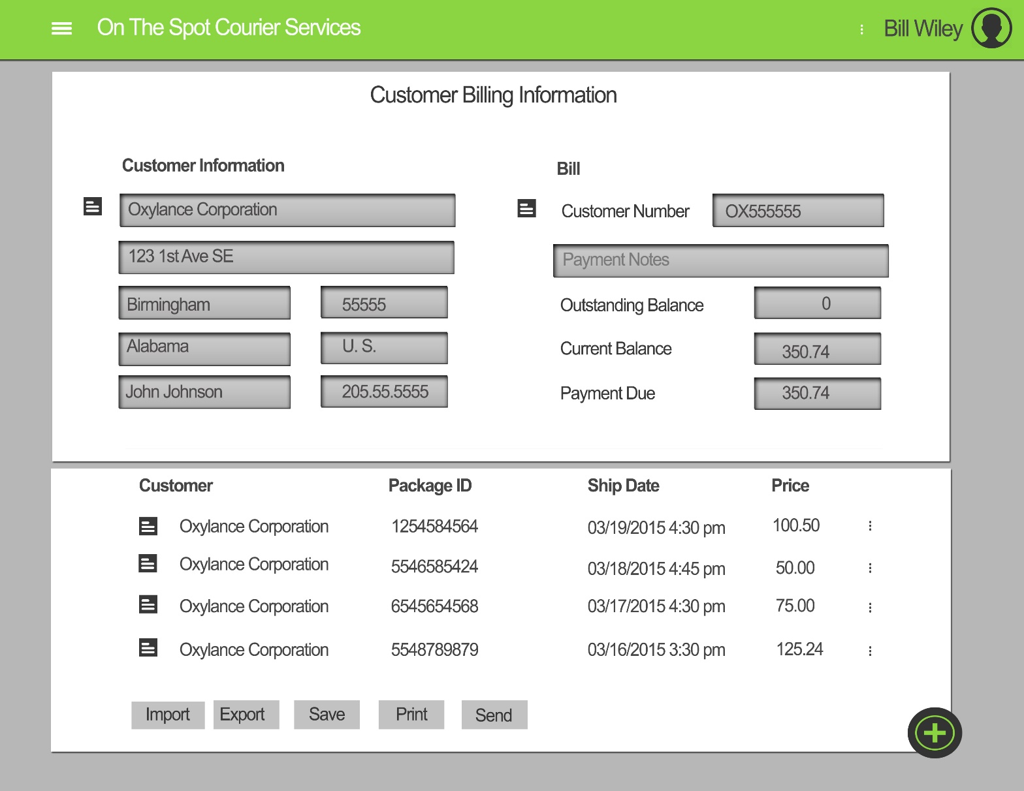
Responsive Application
The Web App has a responsive interface. This allows the application to adapt to the user’s screen size.
This means that the company only needs to have one application, Saving then money in software development.
Here is what the Application looks like on a desktop computer. As you can see, the application looks about the same, but you are able to fit more information on the screen at one time.

Slide 3
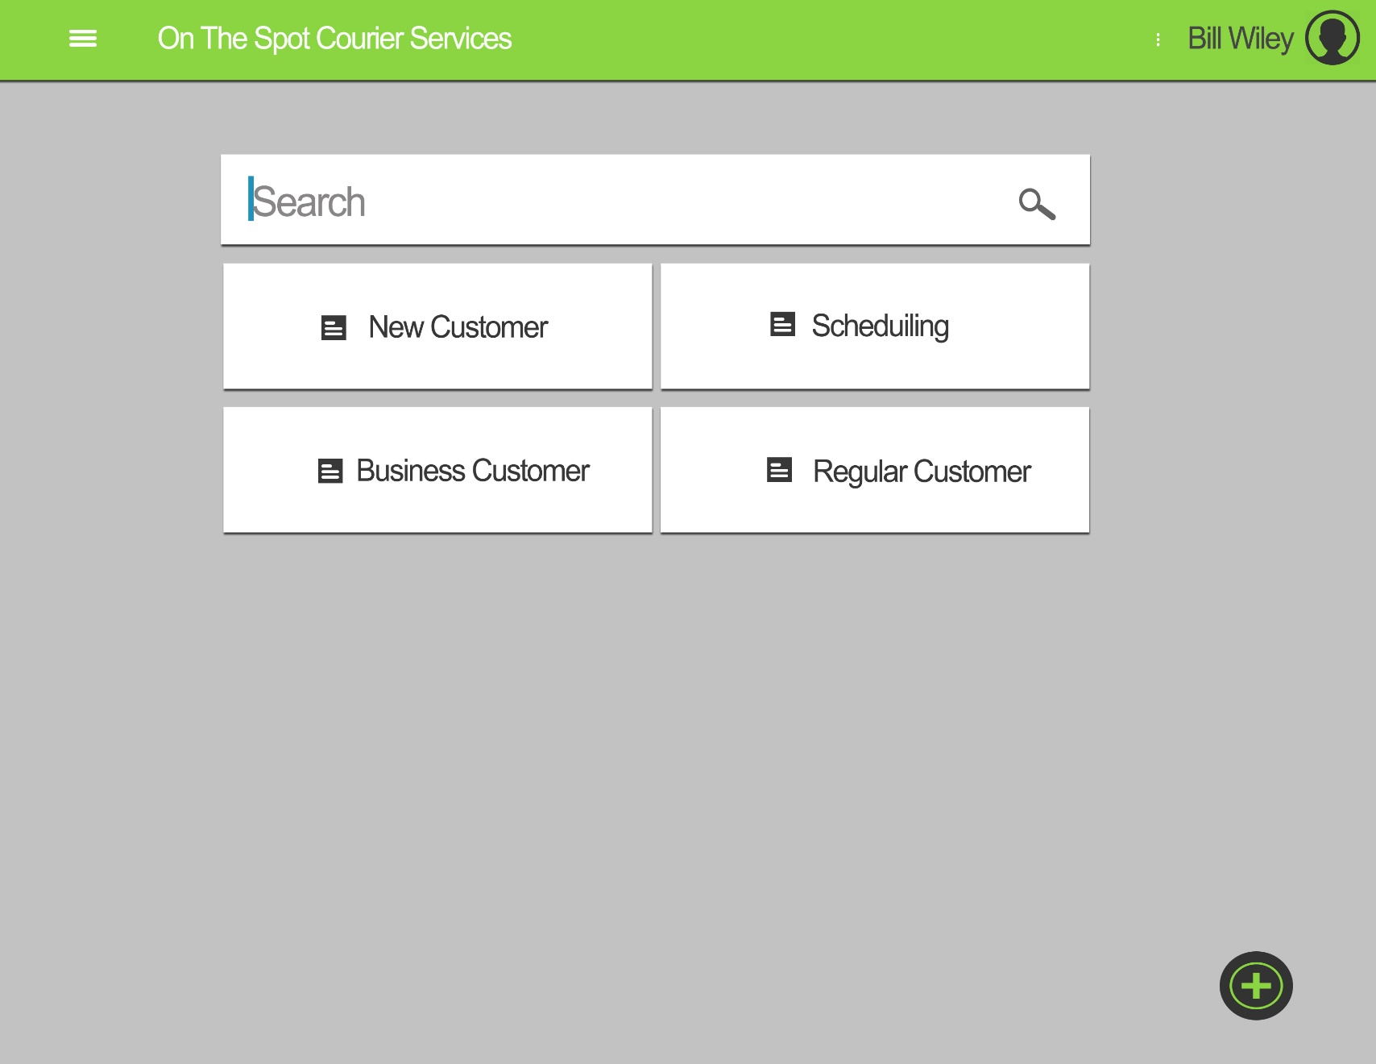
Bill’s Home Page
From Here Bill can:
Search for customers
Add a New Customer
See the Schedule
Look at the Business customer information
Look at the Regular customer information

Slide 4

Customer Billing
If we look in the top corner, we can see that Bill Wiley is logged in.
This is where Bill can see his customer’s billing information. He can make modifications or simply send the bill to the customer
Bill can import or export information from/to programs like Excel or Word

Slide 5
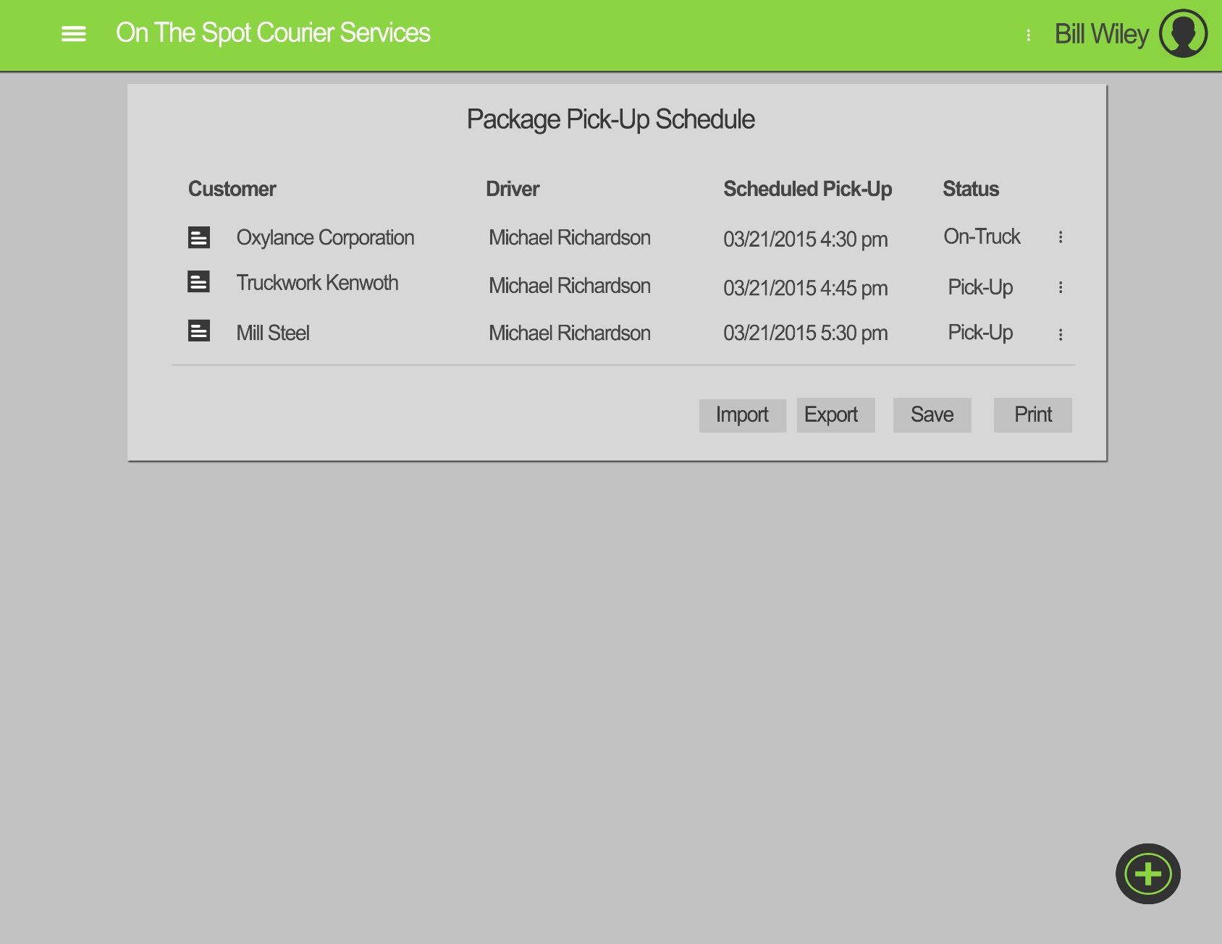
Pick-up Schedule
Here Bill can see the Pick-up Schedule
Under “status” he can see if a package has been picked up or not
By clicking on one of the listing he will have the option to quickly modify it.

Slide 6
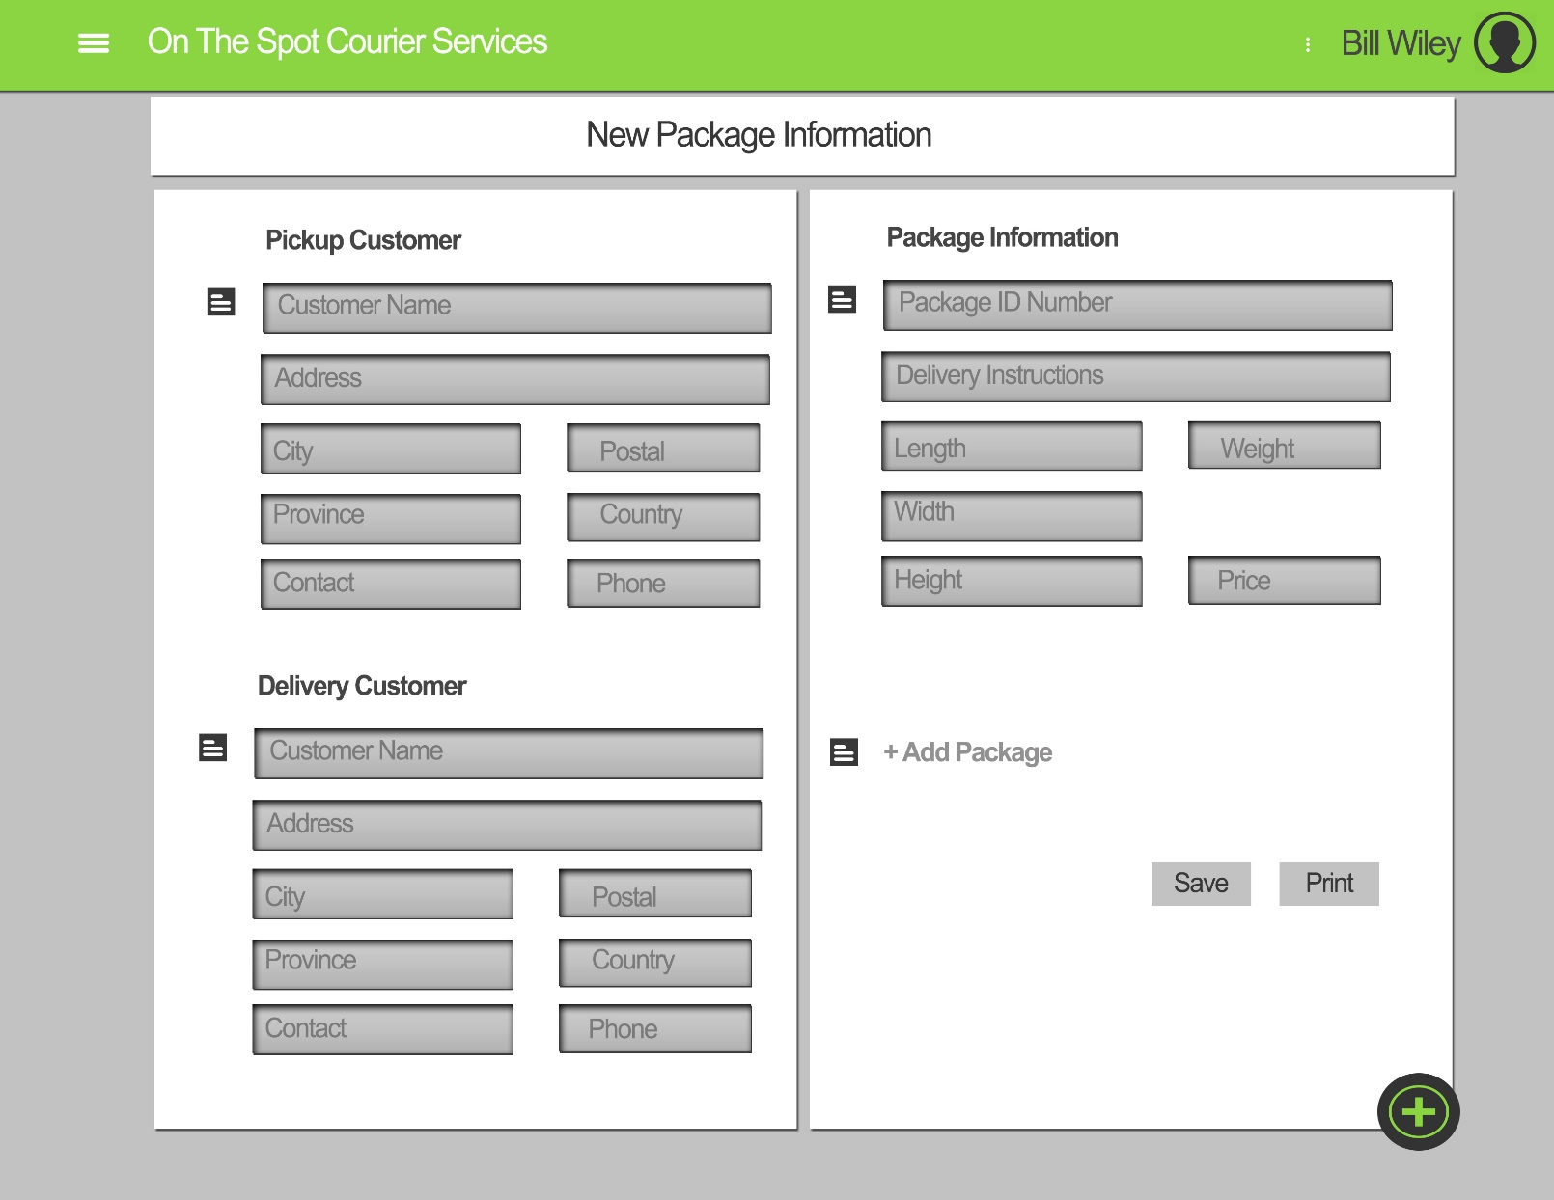
New Package
Here Bill can add a new Package
update package information
And Print Labels

Slide 7
Thank you for your time

