Slide 1
On The Spot Courier Services
Onthespotcourierservices.com

Slide 2
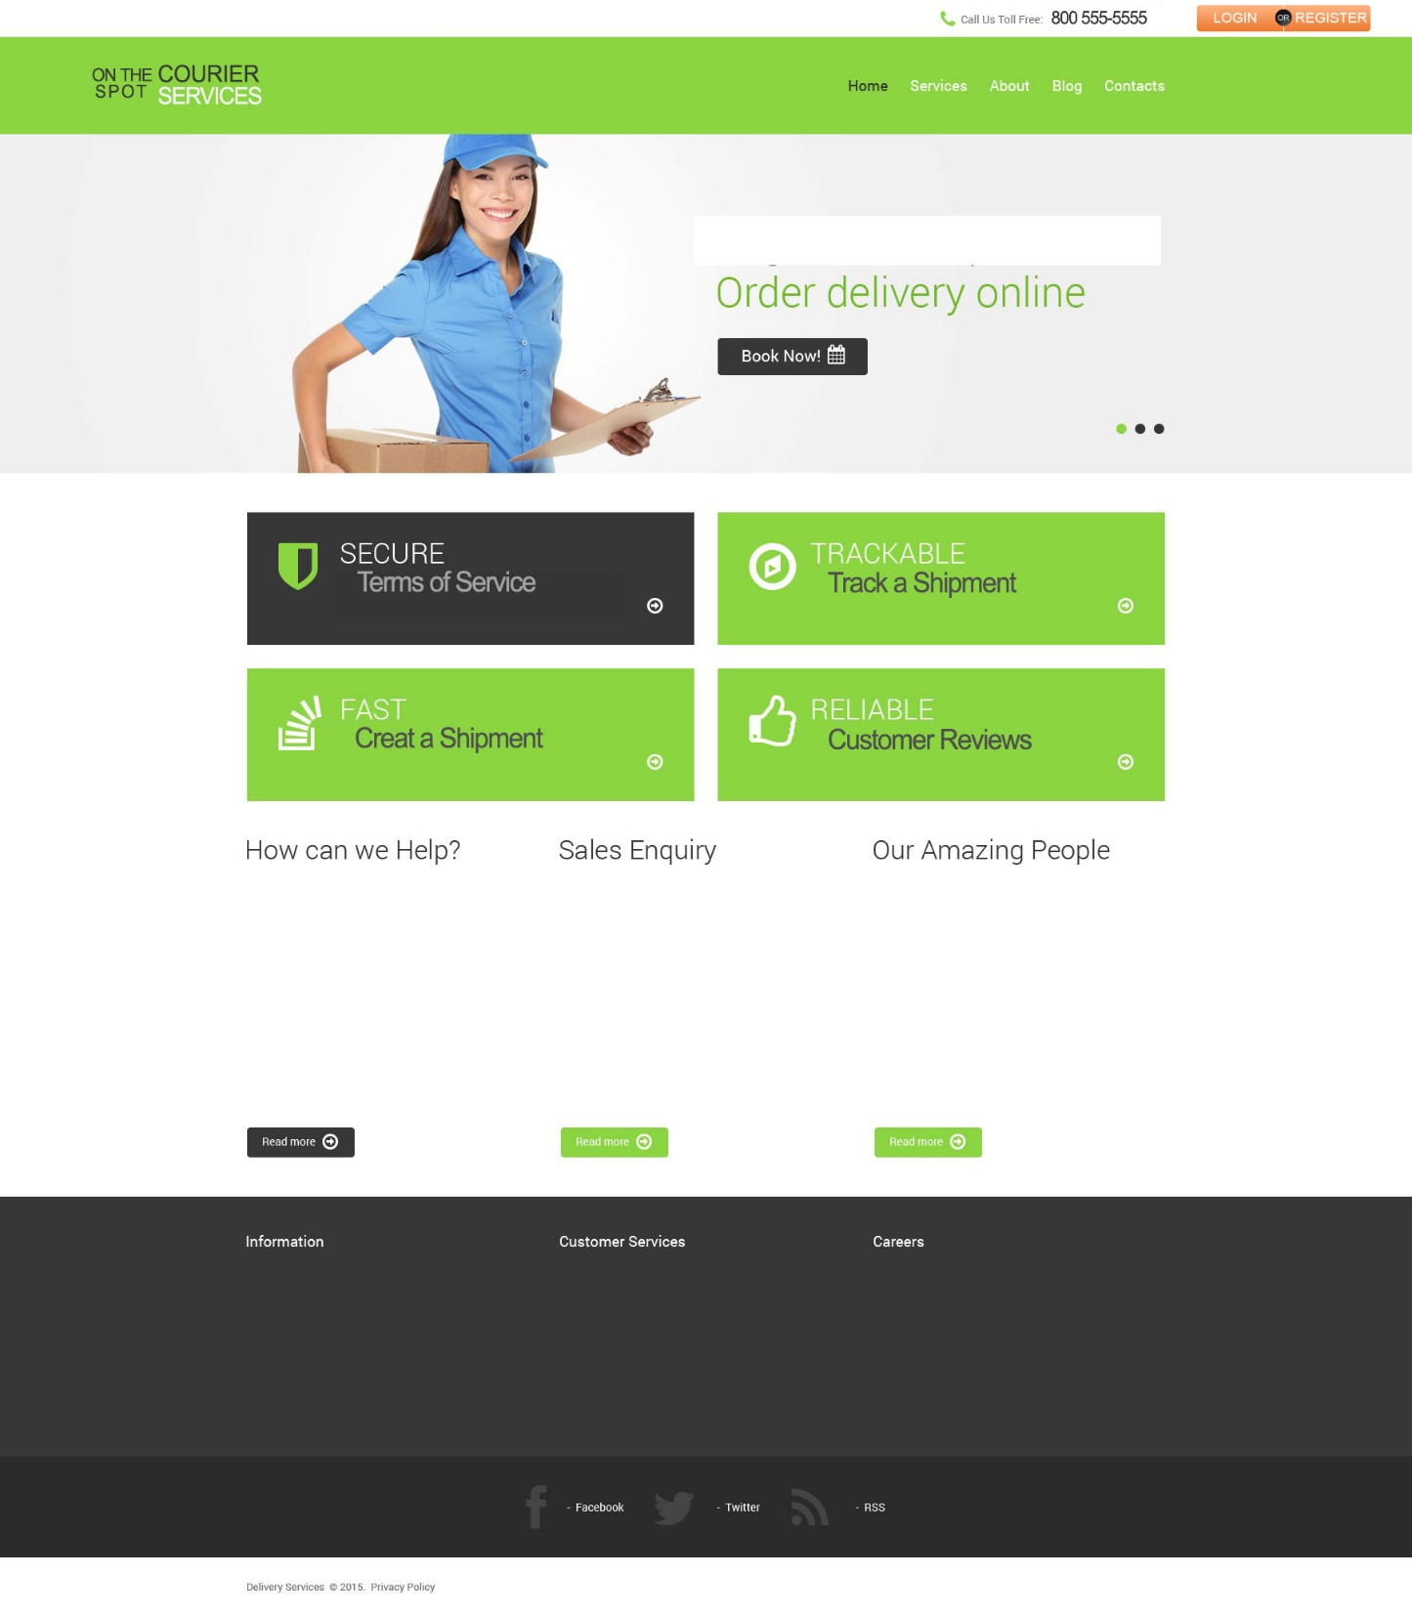

Slide 3
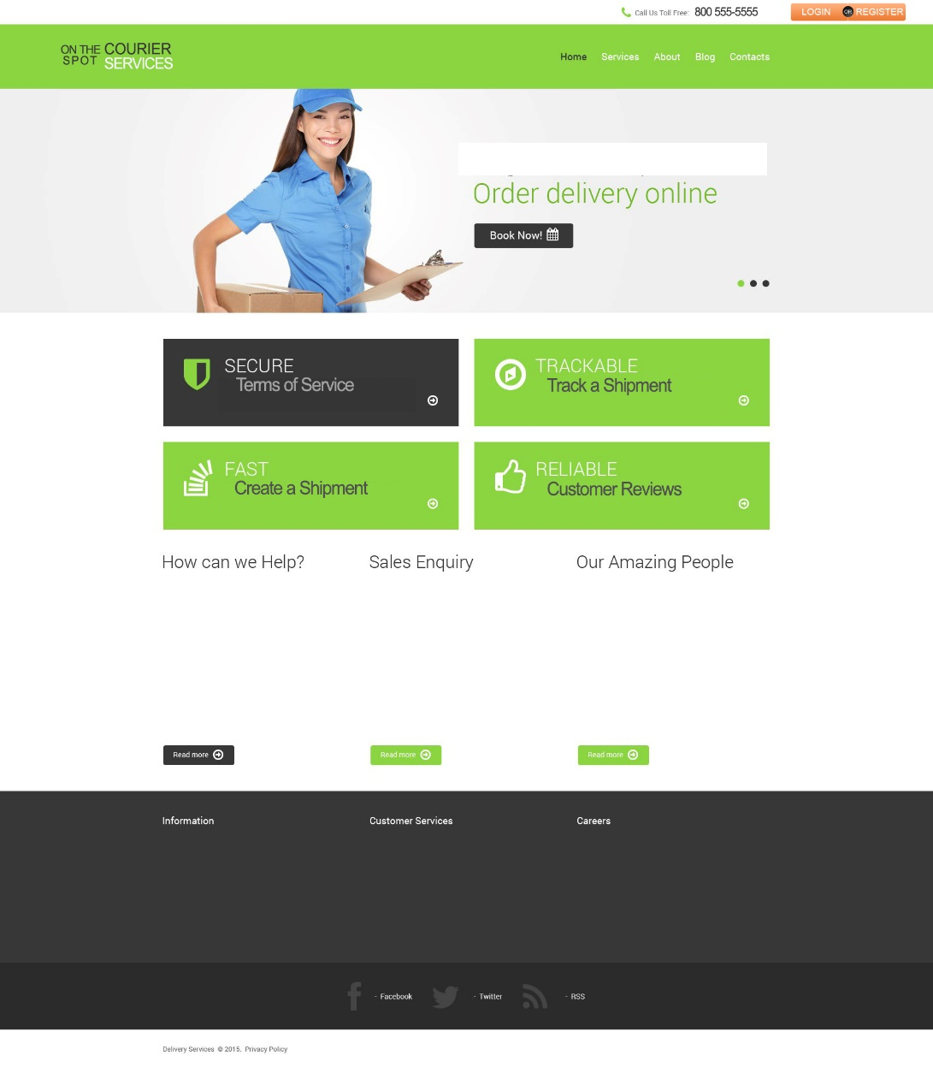
Home Page
From the home page the customer can:
Login or Register for a new account
Read the Terms of Service
Track a shipment
Create a shipment

Slide 4
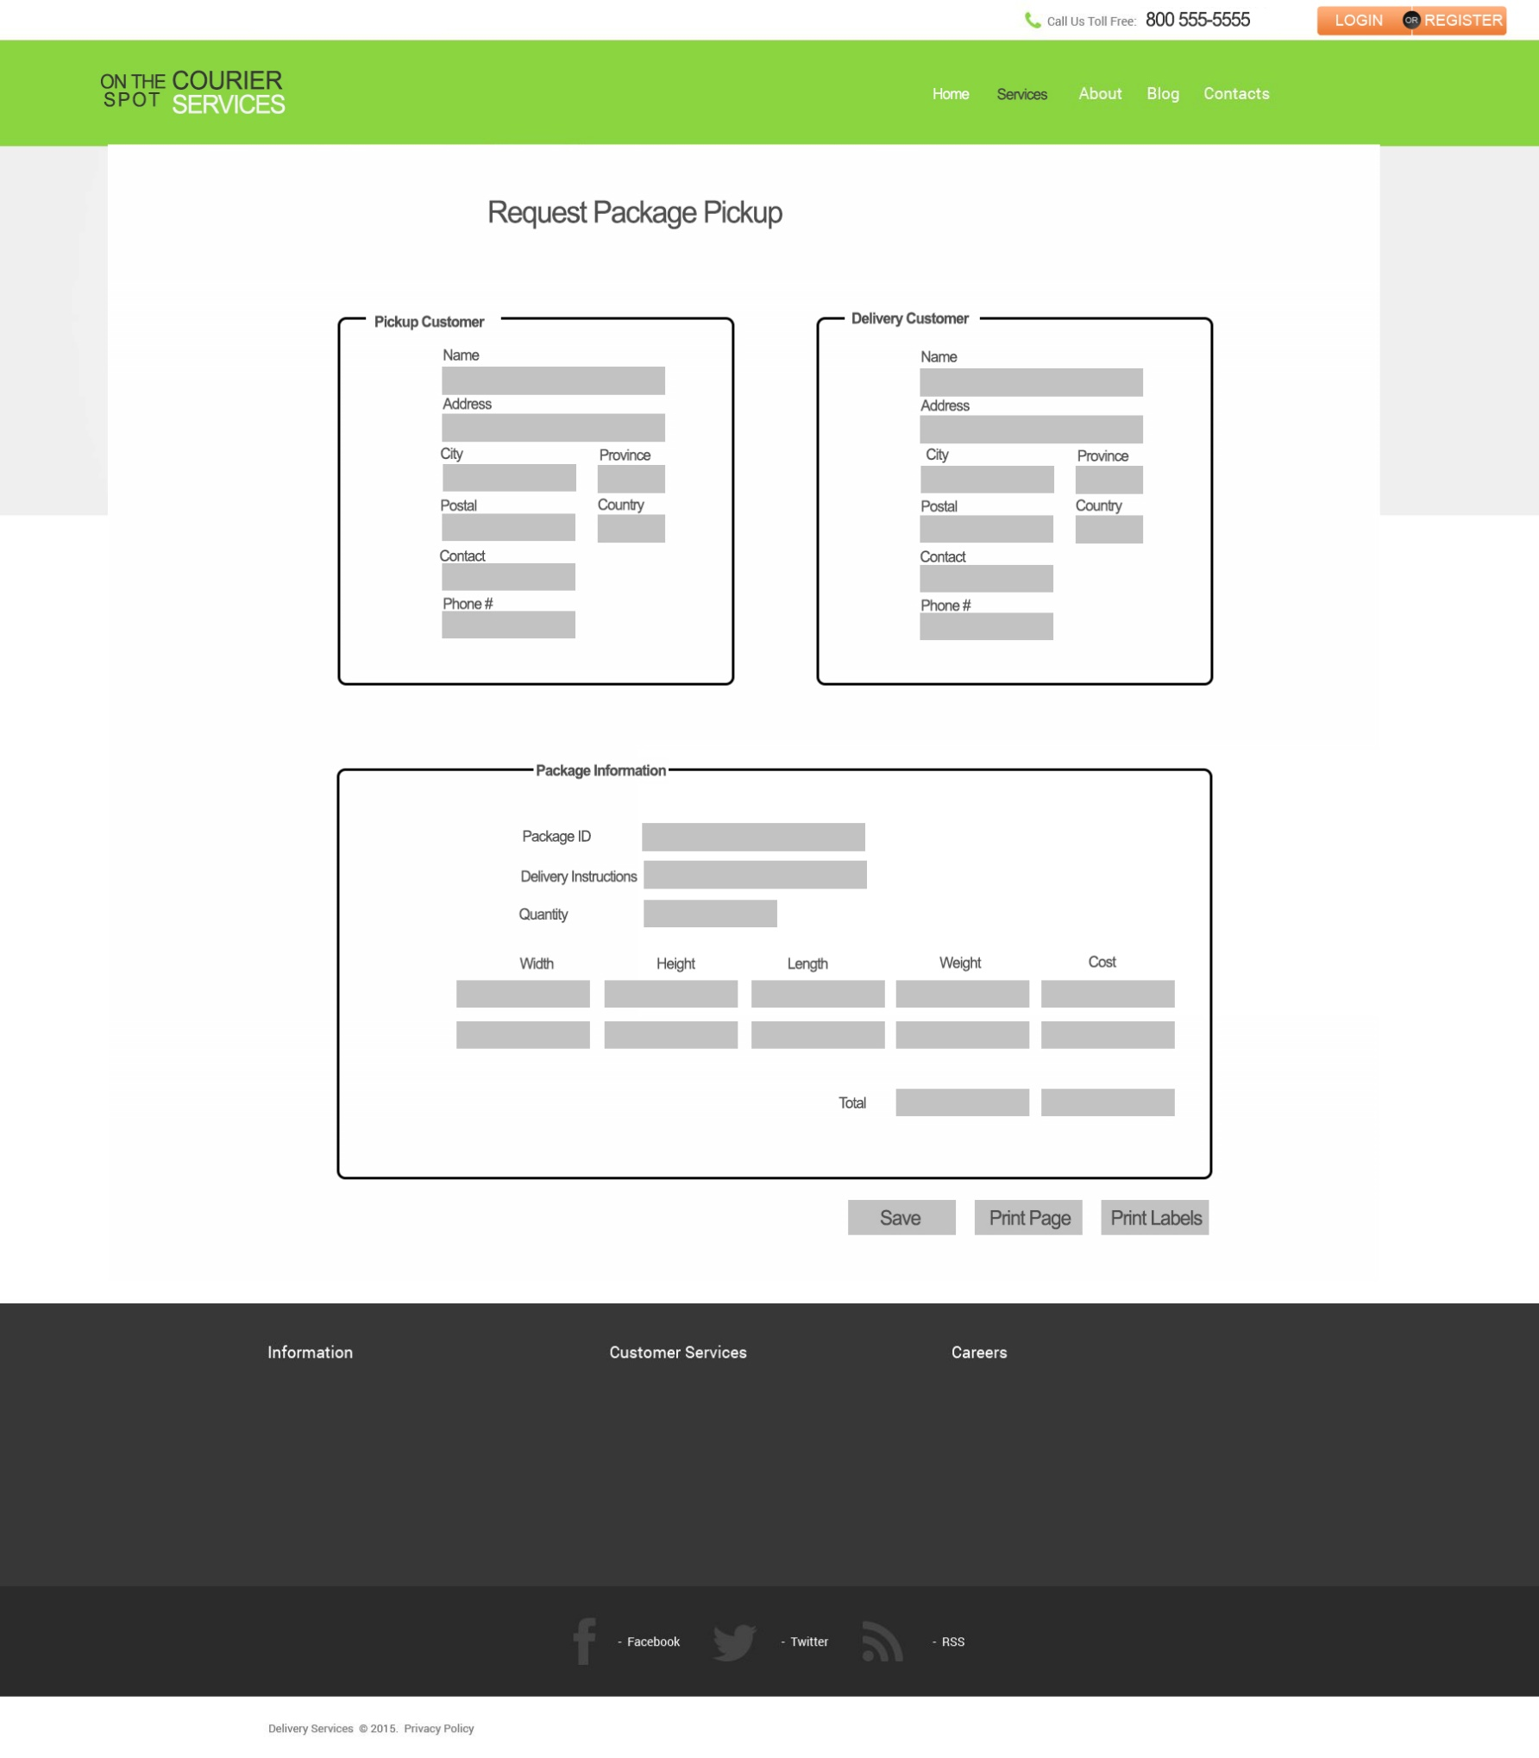
Request Package Page
The customer can request package pickup online
The customer can also print the labels needed for the packages
The website works hand & hand with the web app so the order will be processed quickly

Slide 5
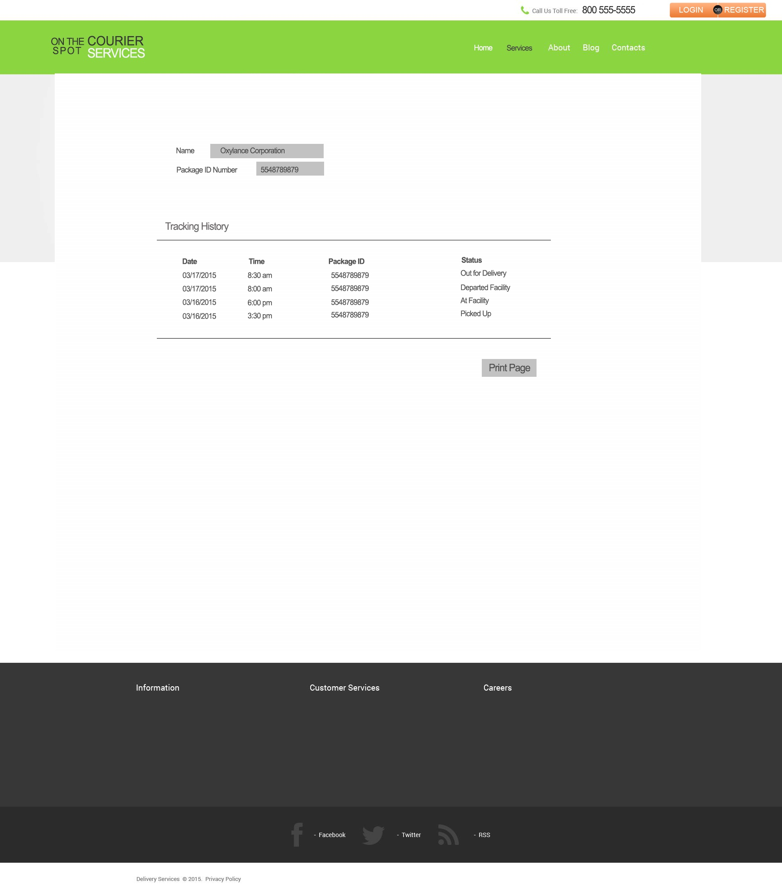
Tracking Page
On this page the customer can put in their package information and see the status of their package

Slide 6
Thank you for your time

