Slide 1
Project Walkthrough

Slide 2
Craft Payment - What is?
Craft payment is a payment gateway integrated with existing digital processes can connect a checkout system to a payment network.
It captures and transfers payments data from the customer to the acquirer.
It is primarily built on Mule ESB
For demonstration we integrate this api with an existing online shopping platform called craft online shopping.

Slide 3
Requirement
Java Installed Machine
Maven
Anypoint studio
Postman
Anypoint platform account
CloudHub account

Slide 4
Technologies We use
Mule ESB to build the api
Springboot to build the online shopping app
Mysql to store the data of the user
Salesforce to store the data of the customer

Slide 5
Mainly Used Mused Mule Connectors
HTTP Listener
Transform Message
SMTP
Mysql Connector => Select, insert, update
Salesforce Connector => Create, Query
Choice Router
API kit router
Raml => Since we follow design first approach

Slide 6
Step by Step - Walkthrough
Step 1: Download the war file of craft online shopping from github: https://github.com/MichaelETPHP/craft-shopping-WAR.git
And download the mule application for github: https://github.com/MichaelETPHP/craft-payment-API-sys.git
Step 2: Open CMD/terminal and run this command to run the online shopping app:
java -jar craft-shopping-v1.war
Import the mule application and run it with anypoint studio.

Slide 7
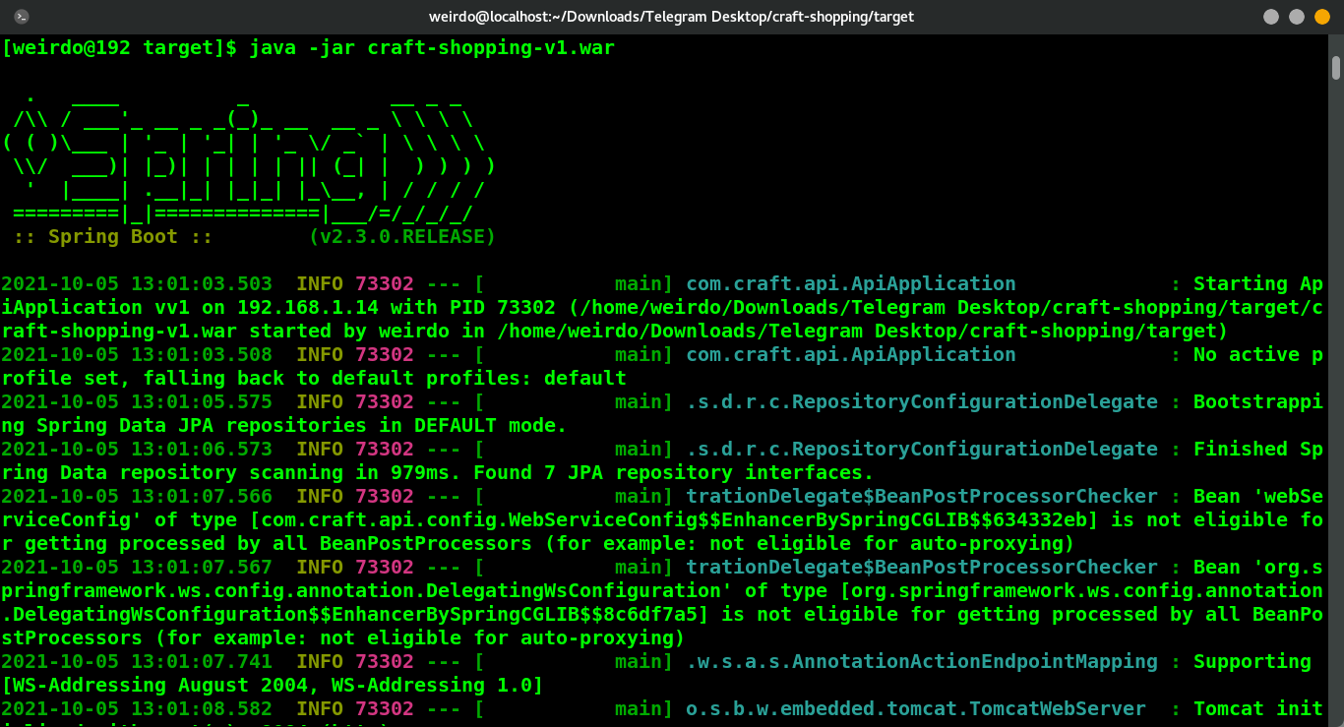
...Cont

Slide 8
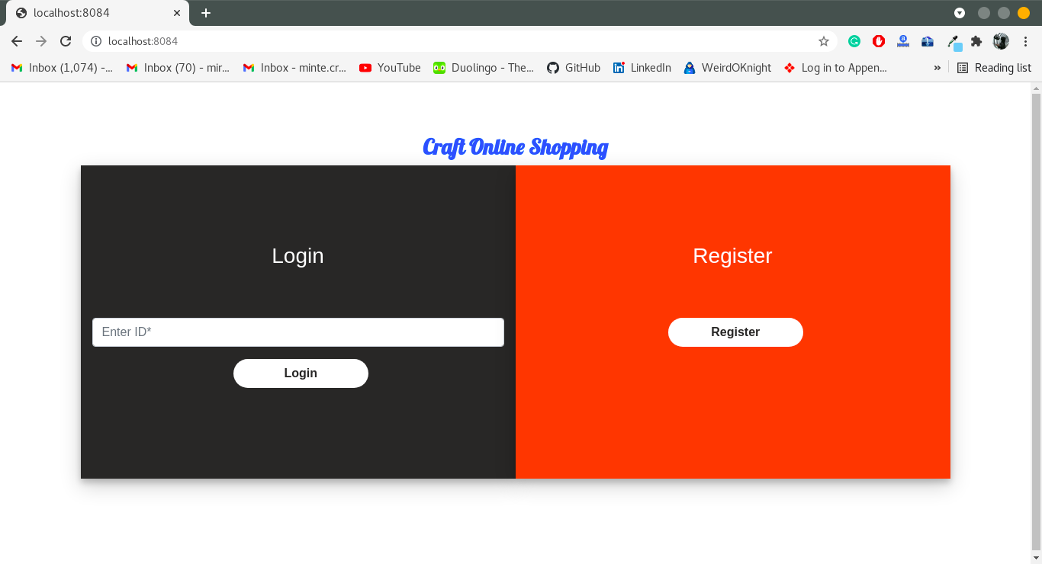
...Cont
Step 3: Open a browser and go to: http://localhost:8084

Slide 9
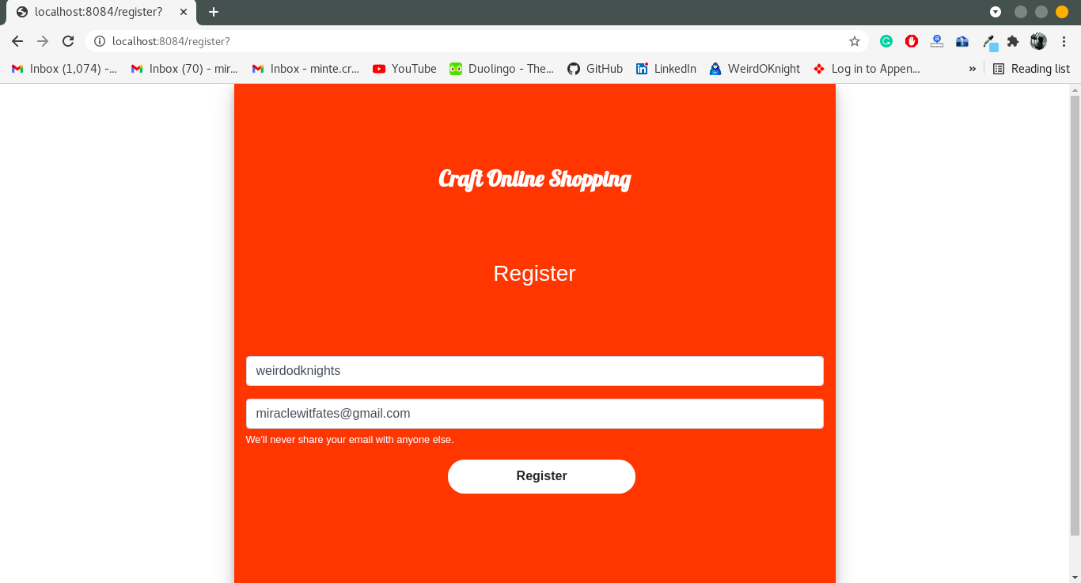
...Cont
Step 4: Click on register button and register with username and password.

Slide 10
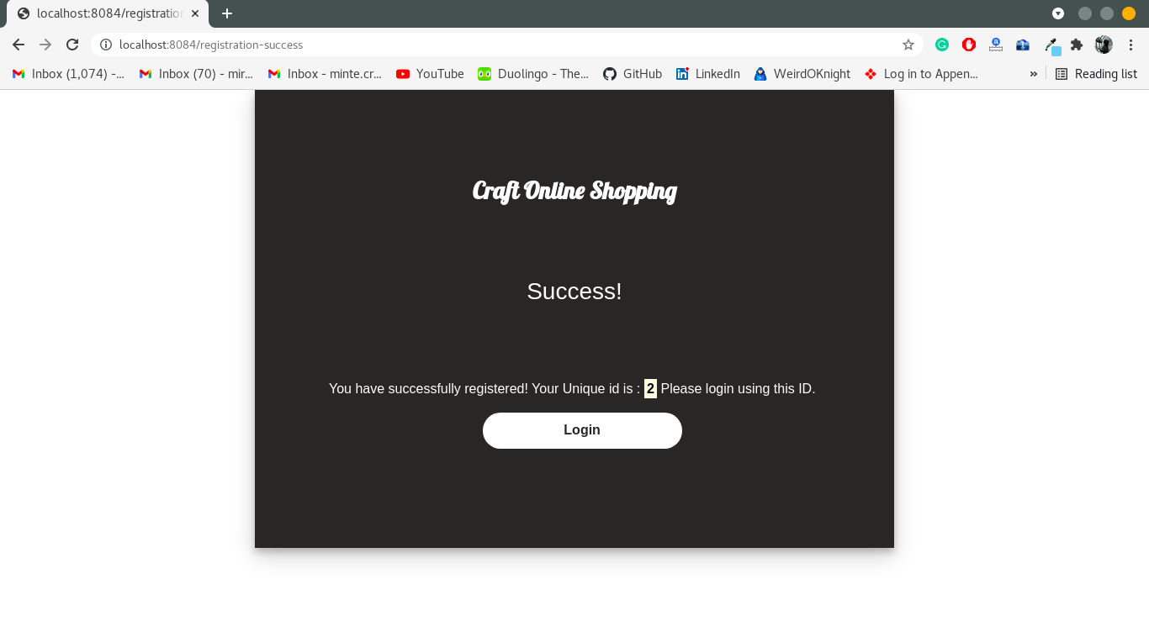
...Cont
Step 5: Get the id and login with that id

Slide 11
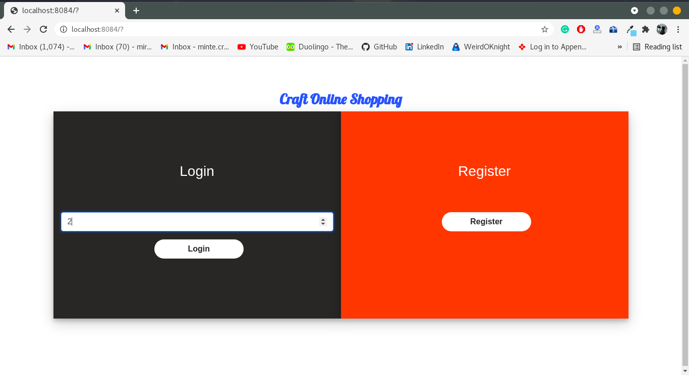
...Cont

Slide 12
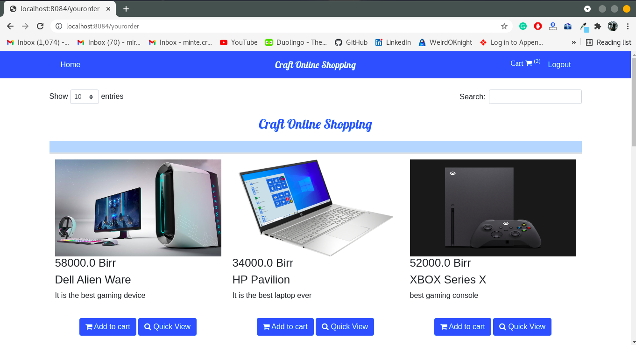
...Cont
Step 6: Add products to the cart

Slide 13
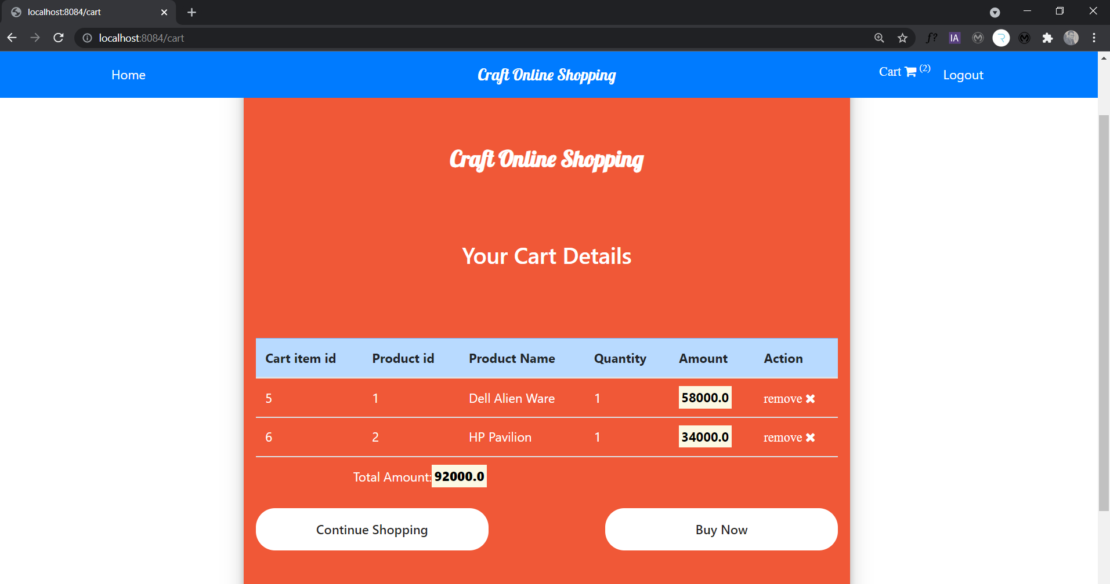
...Cont

Slide 14
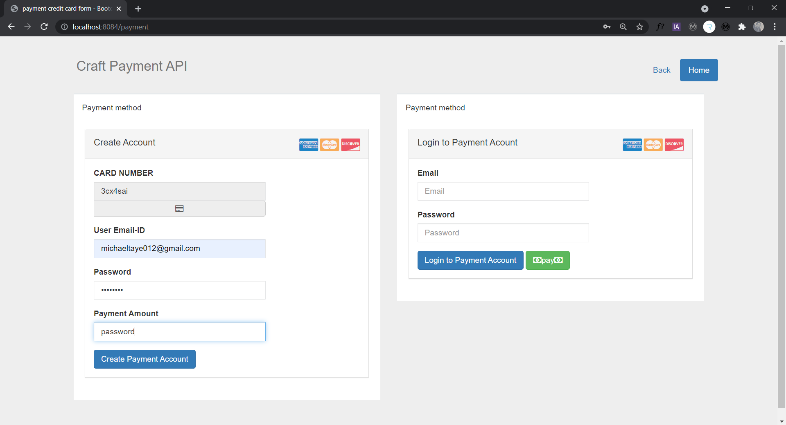
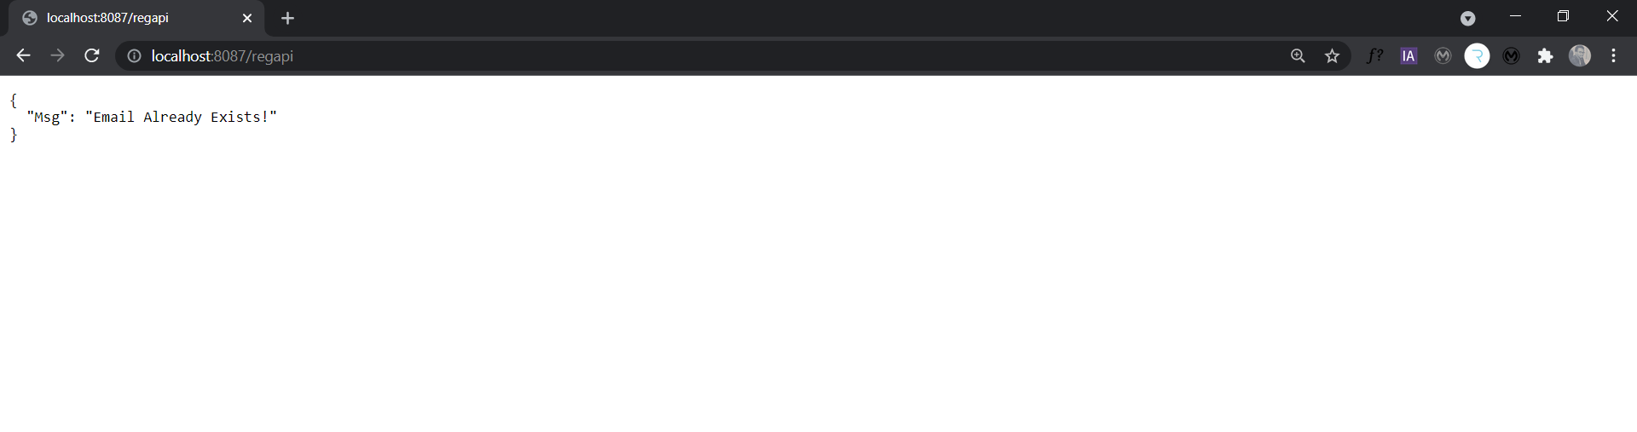
...Cont
Step 7: Click buy now and register in the payment api frontend

Slide 15
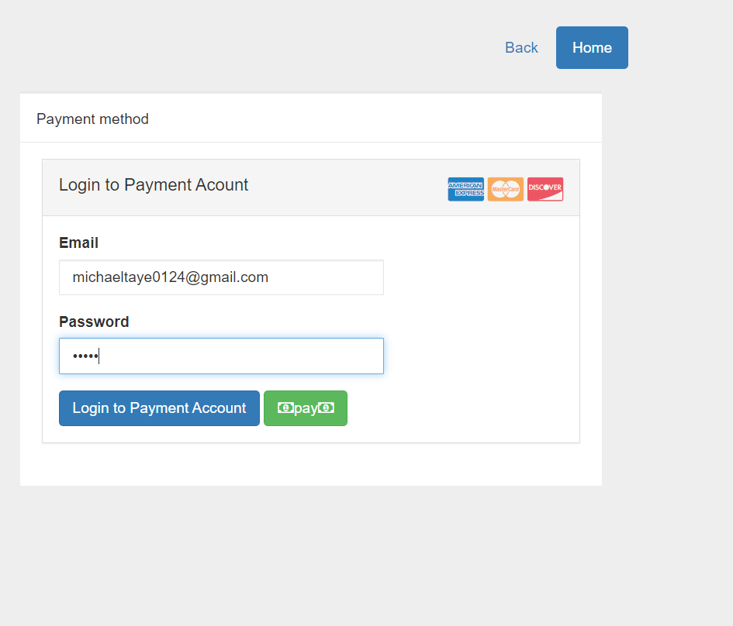
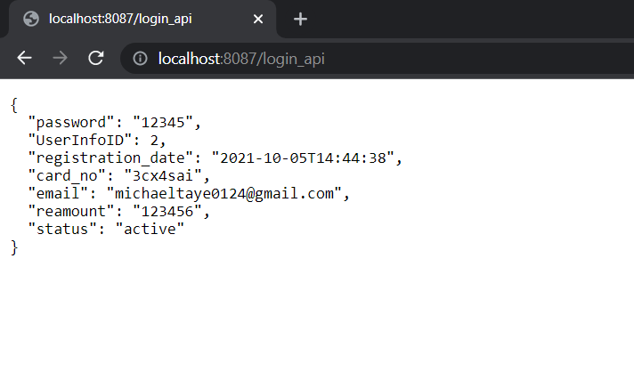
...Cont
Step 8: Login with his/her credentials

Slide 16
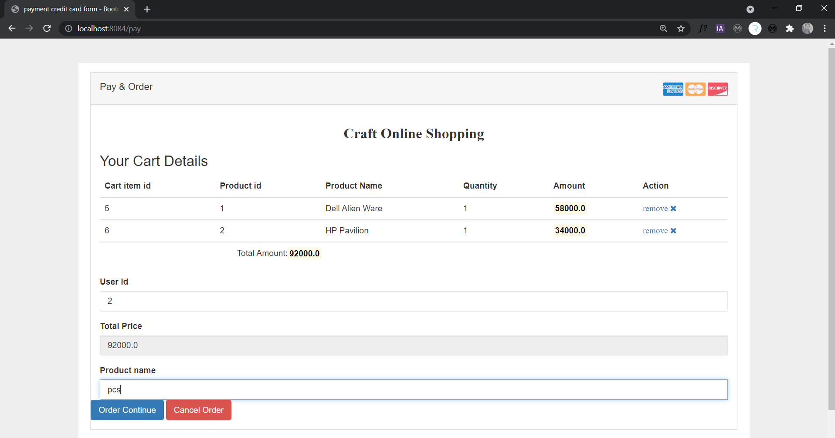
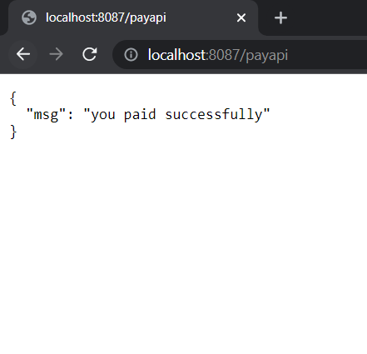
...Cont
Step 9: Take “UserInfoID”, click pay and place payment with that user id. Insert user id, and pname and click order continue

