Slide 1
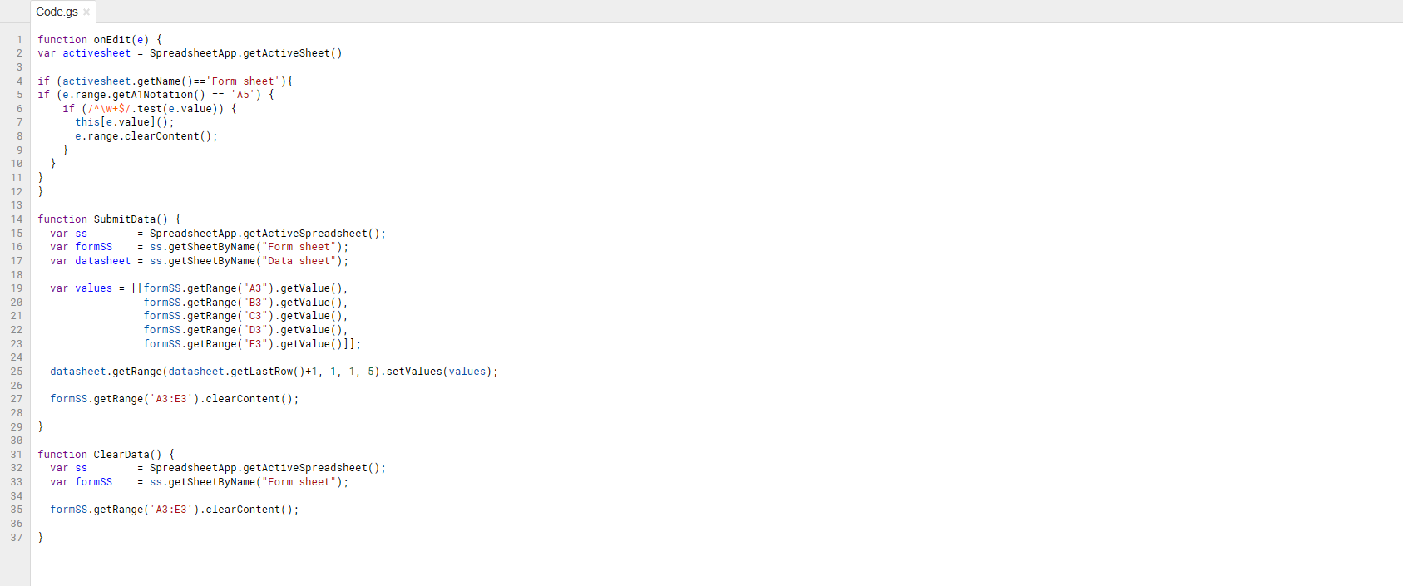
Change based on sheet name and cell location
Change based on number and location of data entry fields

