Slide 1

Web Scraping
By: Michael Emmert

Slide 2
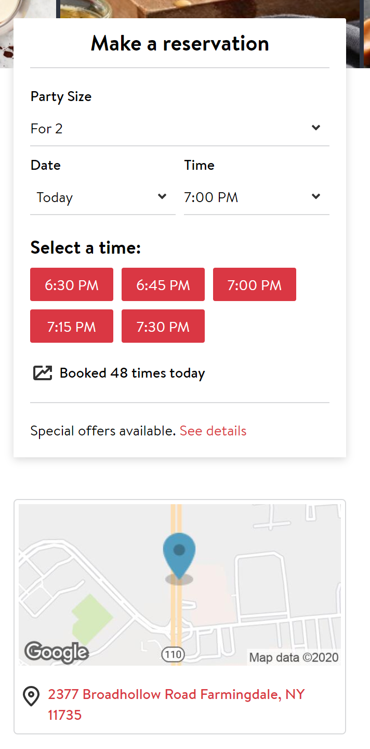
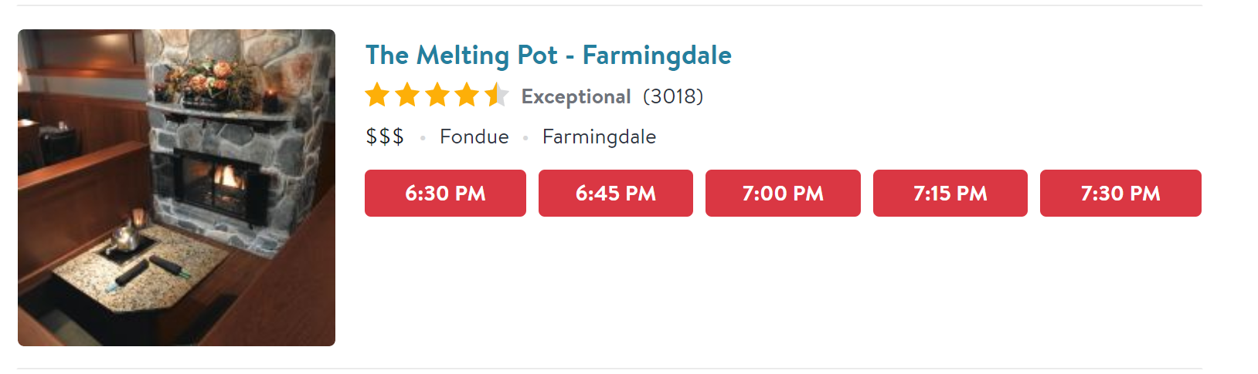
Area: long Island
Location: Farmingdale
Name: The Melting Pot – Farmingdale
Review Count: 3018
Rating: 4.5 out of 5
Cuisine: Fondue
Cost: $$$
Bookings: Booked 48 times today
Location on page: [3,0]
Promoted: True or False

Slide 3
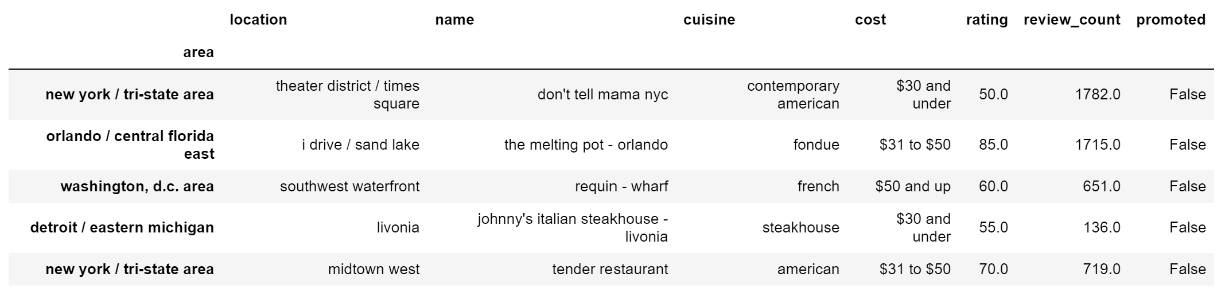
60 Areas
4095 Location
163,831 Restaurants
23,727 Restaurants
Removed all rows with less than 50 reviews

Slide 4
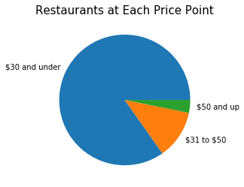
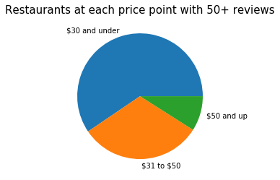

Slide 5
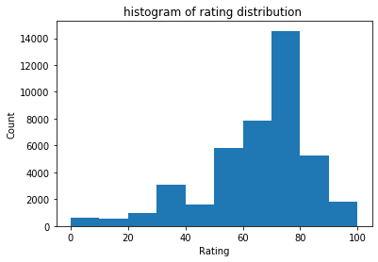
Aggregated Data
Only 8.32% of restaurants are given ratings below 4 out of 5 stars

Slide 6
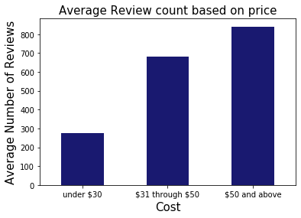

Slide 7
Objective:
Identify the location, price point and cuisine of the most likely to succeed restaurant amongst the four major cities in the United States
Rating is converted to % and used as a metric of how much a restraint is liked
Number of reviews will be used to indicate popularity
Restaurants are highly susceptible to risk so when considering investing in a restaurant it is important to look into standard deviation of rating and review count

Slide 8
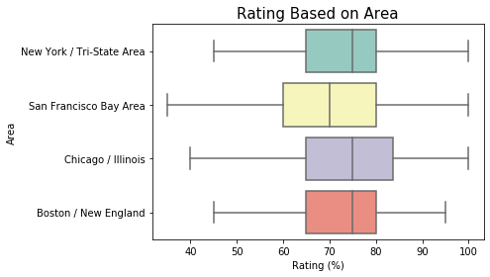
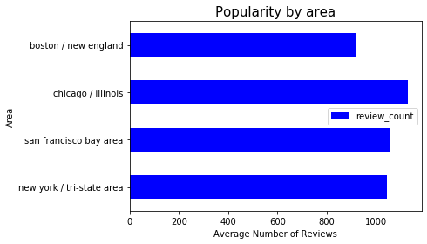
City?

Slide 9
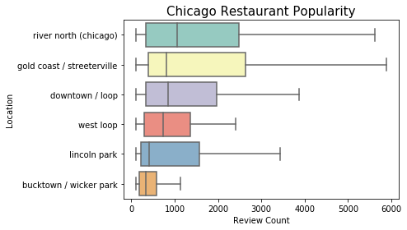
Neighborhood?

Slide 10
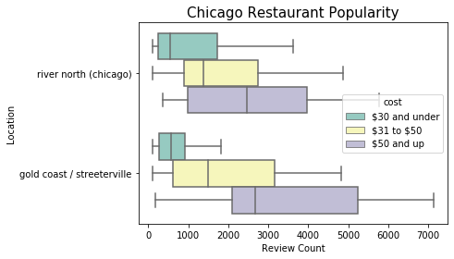
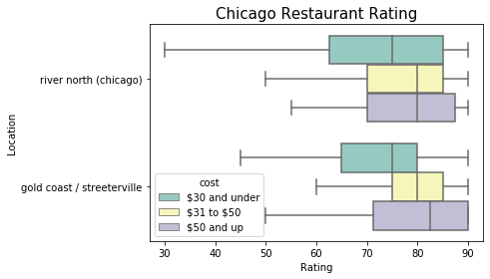

Slide 11
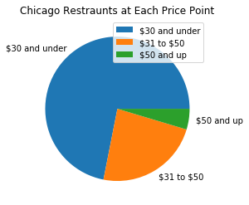

Slide 12
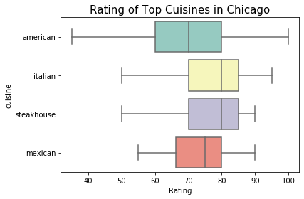
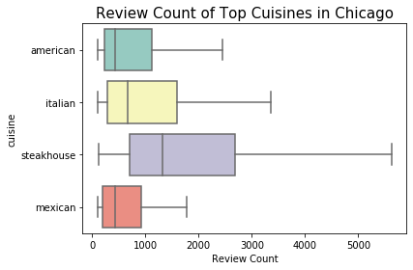
What food?

Slide 13
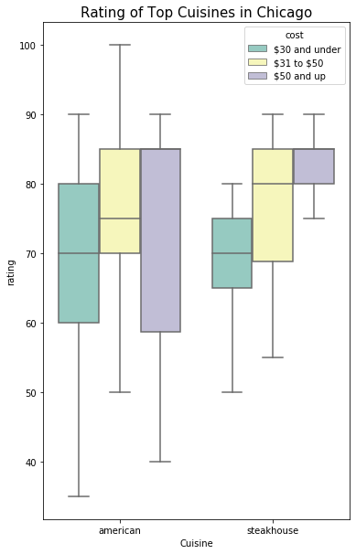
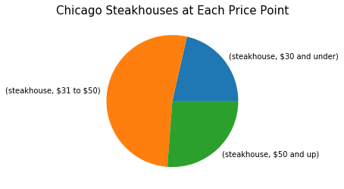

Slide 14
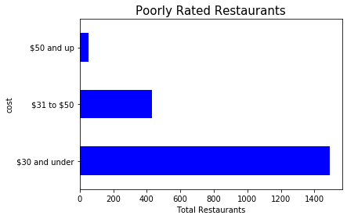
All restaurants below 4 stars

Slide 15
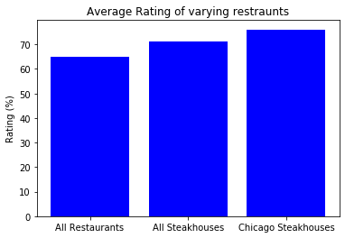
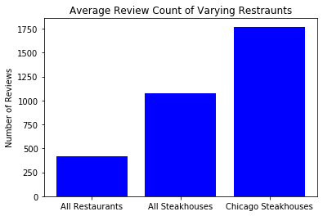
Steak Houses in Chicago have a higher success rate

Slide 16
Future Work
Collect Review data to identify words associated with positively reviewed restaurants
comparing restaurant ratings with menu items
Collect restaurant data over time to identify trends, assuming that restaurants that are removed from the website went out of business
Use regular expressions to identify chain restaurants by name and compare their success in varying locations
Identifying the impact of location on page on the number of online bookings for OpenTable
Identifying the impact of being promoted on the number of online bookings for OpenTable
Seeing the relationship between booking and average income of an area

