Slide 1
MSAI631-M92 · ARTIFICIAL INTELLIGENCE FOR HUMAN-COMPUTER INTERACTION
ResumeFit
A Conversational, ATS-Safe Resume Rewriter
Residency Group Project · Team
Kenneth Ohene Abrefa
Michael Eniolade
Jyothsna Aitipamula
Sailesh Krishna Kodeboyena
Suraj Raymond D'Souza
Naief Abdullah Shakil

Slide 2
THE PROBLEM
Most Resumes Aren't ATS-Safe
Inconsistent formatting
Tables, columns, and graphics that automated parsers can't read
Vague, unquantified bullets
“Responsible for sales” instead of a measurable result
No idea what “ATS-safe” means
Most job seekers have never seen the parser's side of it
Fixing it manually is tedious
And easy to get wrong without knowing the actual rules
ResumeFit
2

Slide 3
THE SOLUTION
One Conversation, Two AI Layers
1. Paste or upload a draft
Plain text, PDF, or DOCX — whatever you already have
2. Answer a few targeted questions
Only about what your resume is actually missing
3. Get an ATS-safe rewrite
Single column, standard headers, nothing invented
ResumeFit
3

Slide 4
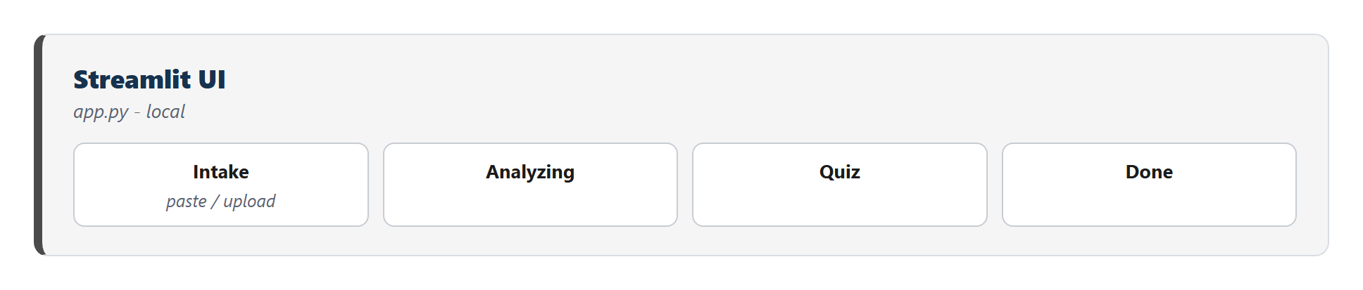
ARCHITECTURE
Five Stages, Two Processing Layers
Intake → Analyzing → Quiz → Rewriting → Done
Traditional layer: local Python, zero API calls
AI-as-a-service layer: two distinct OpenAI calls
Every stage degrades gracefully, never a dead end
ResumeFit
4

Slide 5
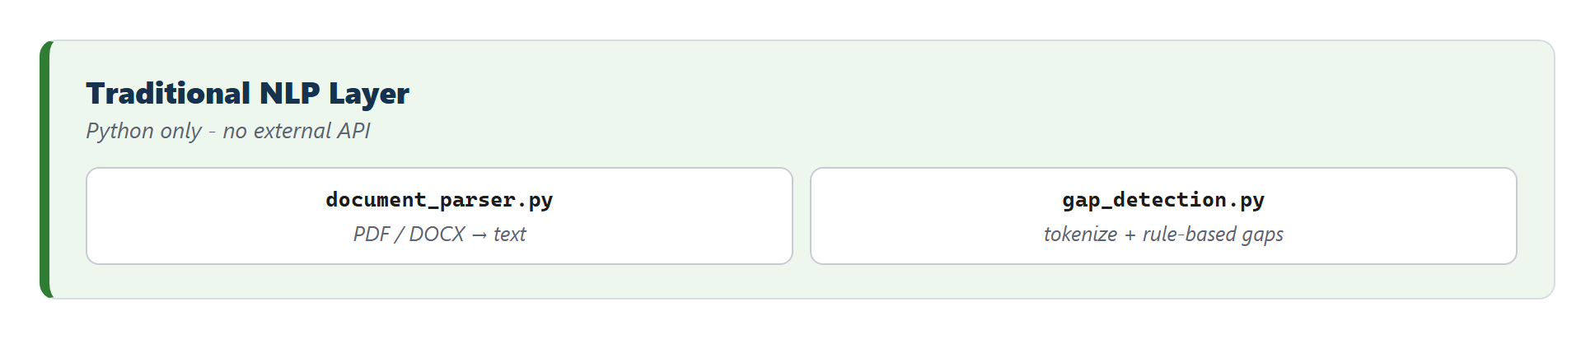
LAYER 1 · TRADITIONAL CHATBOT
Rule-Based Gap Detection, Entirely Local
Missing or inconsistent dates
Vague job titles (“Team Member”)
Bullets with no quantified result
ResumeFit
5

Slide 6
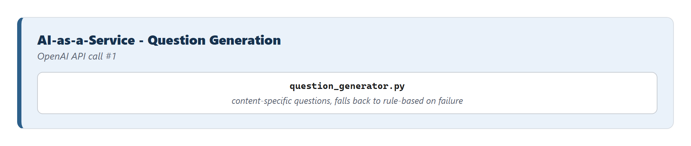
LAYER 2 · AI-AS-A-SERVICE
Content-Specific Questions via OpenAI
Reads what THIS resume actually says
Never repeats the rule-based questions
Falls back to rule-based-only if the API fails
ResumeFit
6

Slide 7
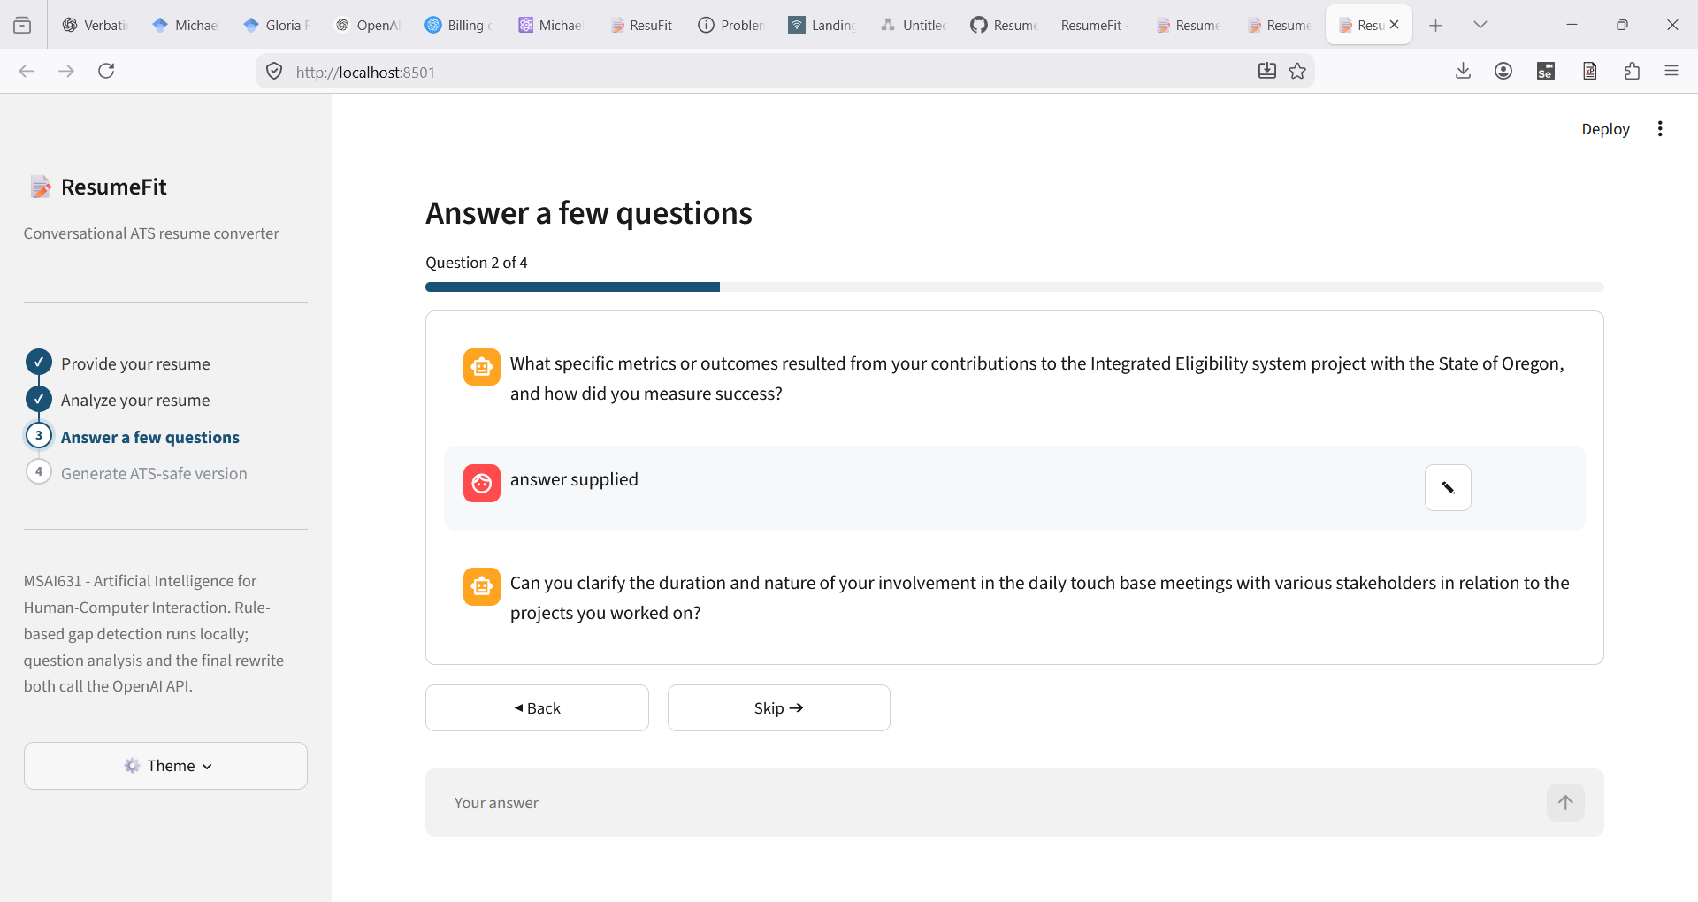
INTERACTION DESIGN
Back, Skip, and Inline Editing
Real running app — mid-quiz, question 2 of 4
ResumeFit
7

Slide 8
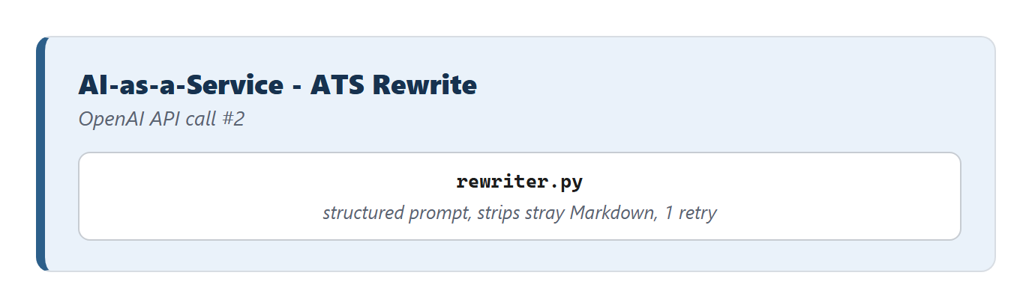
LAYER 2 · AI-AS-A-SERVICE
The Rewrite: Structured Prompt, One Retry
Single column, standard section headers
Never invents employers, titles, or dates
One automatic retry before falling back
ResumeFit
8

Slide 9
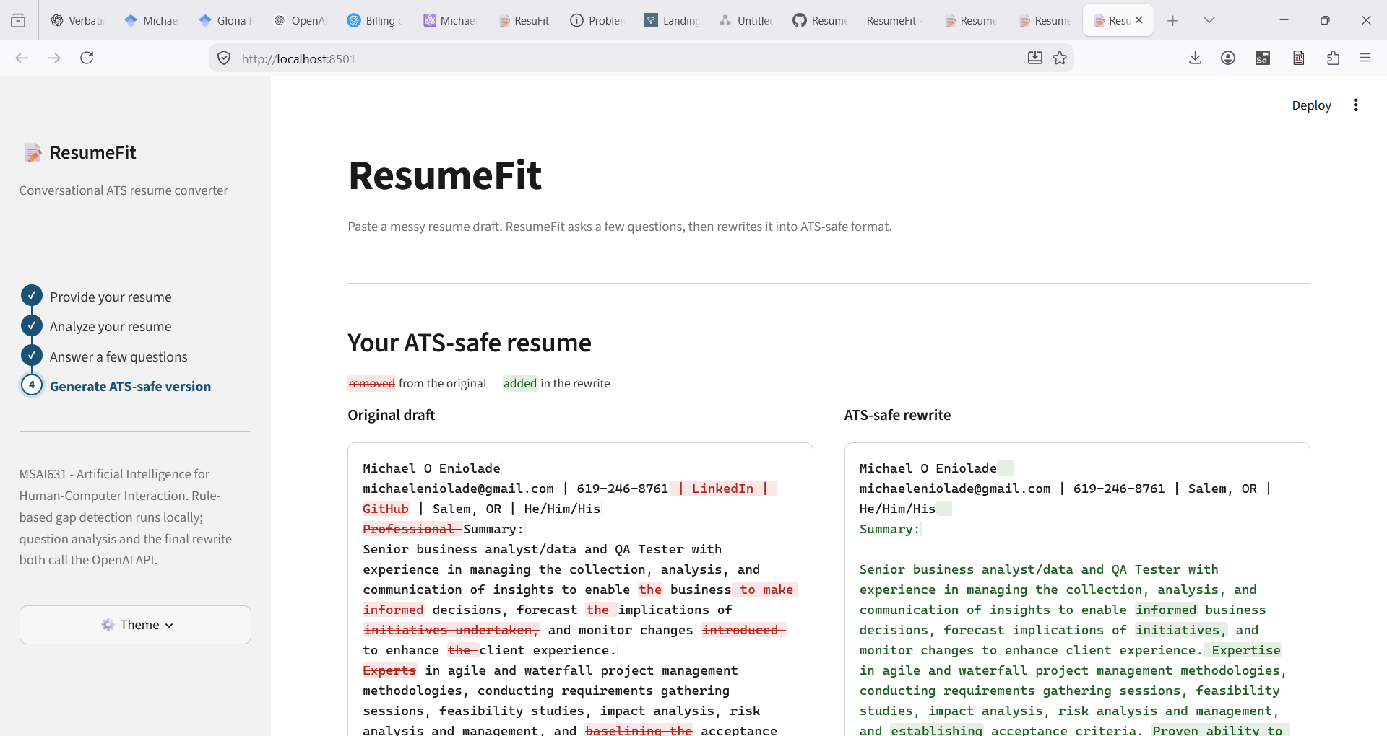
THE RESULT
See Exactly What Changed
Word-level diff — removed in red, added in green
ResumeFit
9

Slide 10
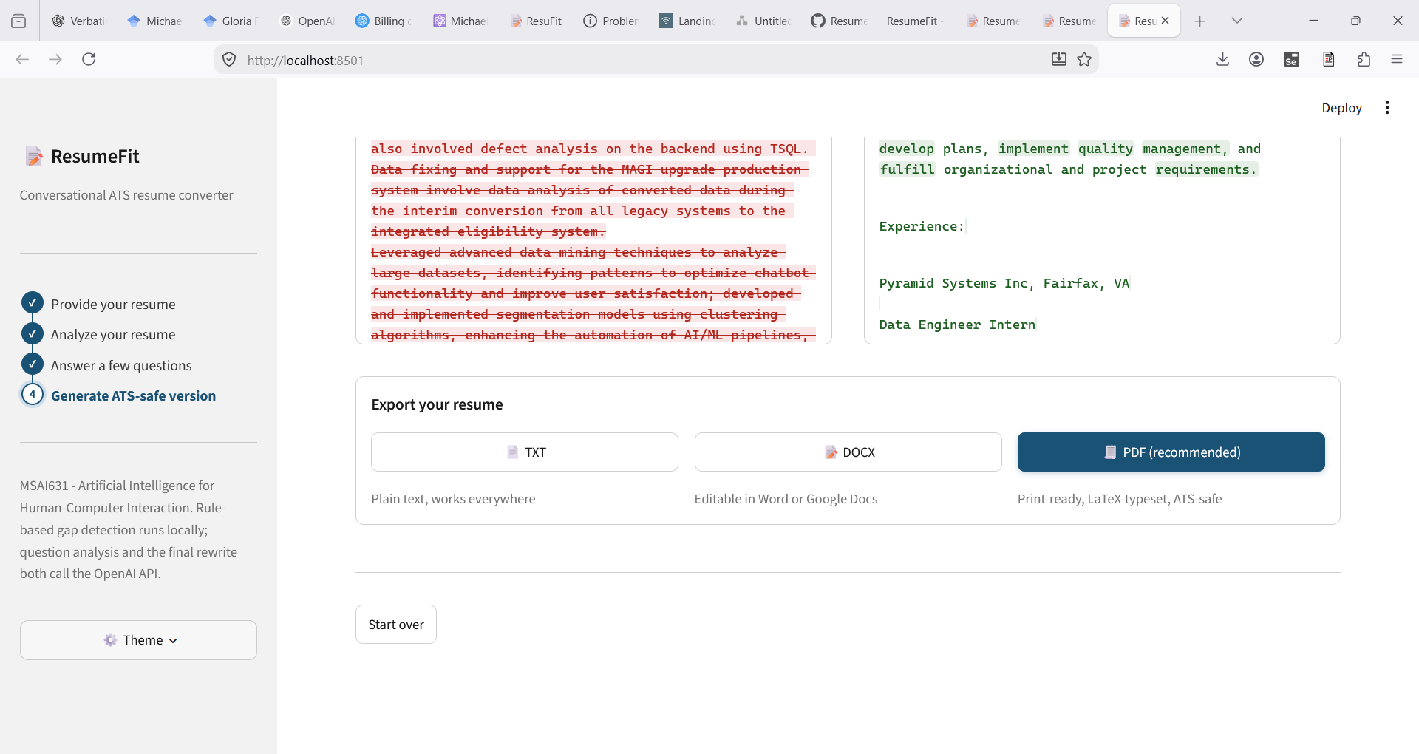
THE OUTPUT
TXT, DOCX, and a LaTeX-Typeset PDF
PDF compiled locally via pdflatex — single-column, ATS-safe by construction
ResumeFit
10

Slide 11
ACCESSIBILITY & ETHICS
Two Sides of the Same Design Choice
ATS-safe = screen-reader-safe
Never invents experience
One constraint satisfies both requirements at once
Skipped answers stay unresolved, not guessed
Fallback is always labeled
Nothing persists beyond the session
A cached response never silently poses as live
No database, no external storage of resume content
ResumeFit
12

Slide 12
Thank You
Questions?
github.com/MichaelEnny/ResumeFit · MSAI631-M92 Residency

