Slide 1
MSAI631-M92 · ARTIFICIAL INTELLIGENCE FOR HUMAN-COMPUTER INTERACTION
ResumeFit
A Conversational, ATS-Safe Resume Rewriter
Residency Group Project · Team
Kenneth Ohene Abrefa
Michael Eniolade
Jyothsna Aitipamula
Sailesh Krishna Kodeboyena
Suraj Raymond D'Souza
Naief Abdullah Shakil

Slide 2
THE PROBLEM
Most Resumes Aren't ATS-Safe
Inconsistent formatting
Tables, columns, and graphics that automated parsers can't read
Vague, unquantified bullets
“Responsible for sales” instead of a measurable result
No idea what “ATS-safe” means
Most job seekers have never seen the parser's side of it
Fixing it manually is tedious
And easy to get wrong without knowing the actual rules
ResumeFit
2

Slide 3
THE SOLUTION
One Conversation, Two AI Layers
1. Paste or upload a draft
Plain text, PDF, or DOCX — whatever you already have
2. Answer a few targeted questions
Only about what your resume is actually missing
3. Get an ATS-safe rewrite
Single column, standard headers, nothing invented
ResumeFit
3

Slide 4
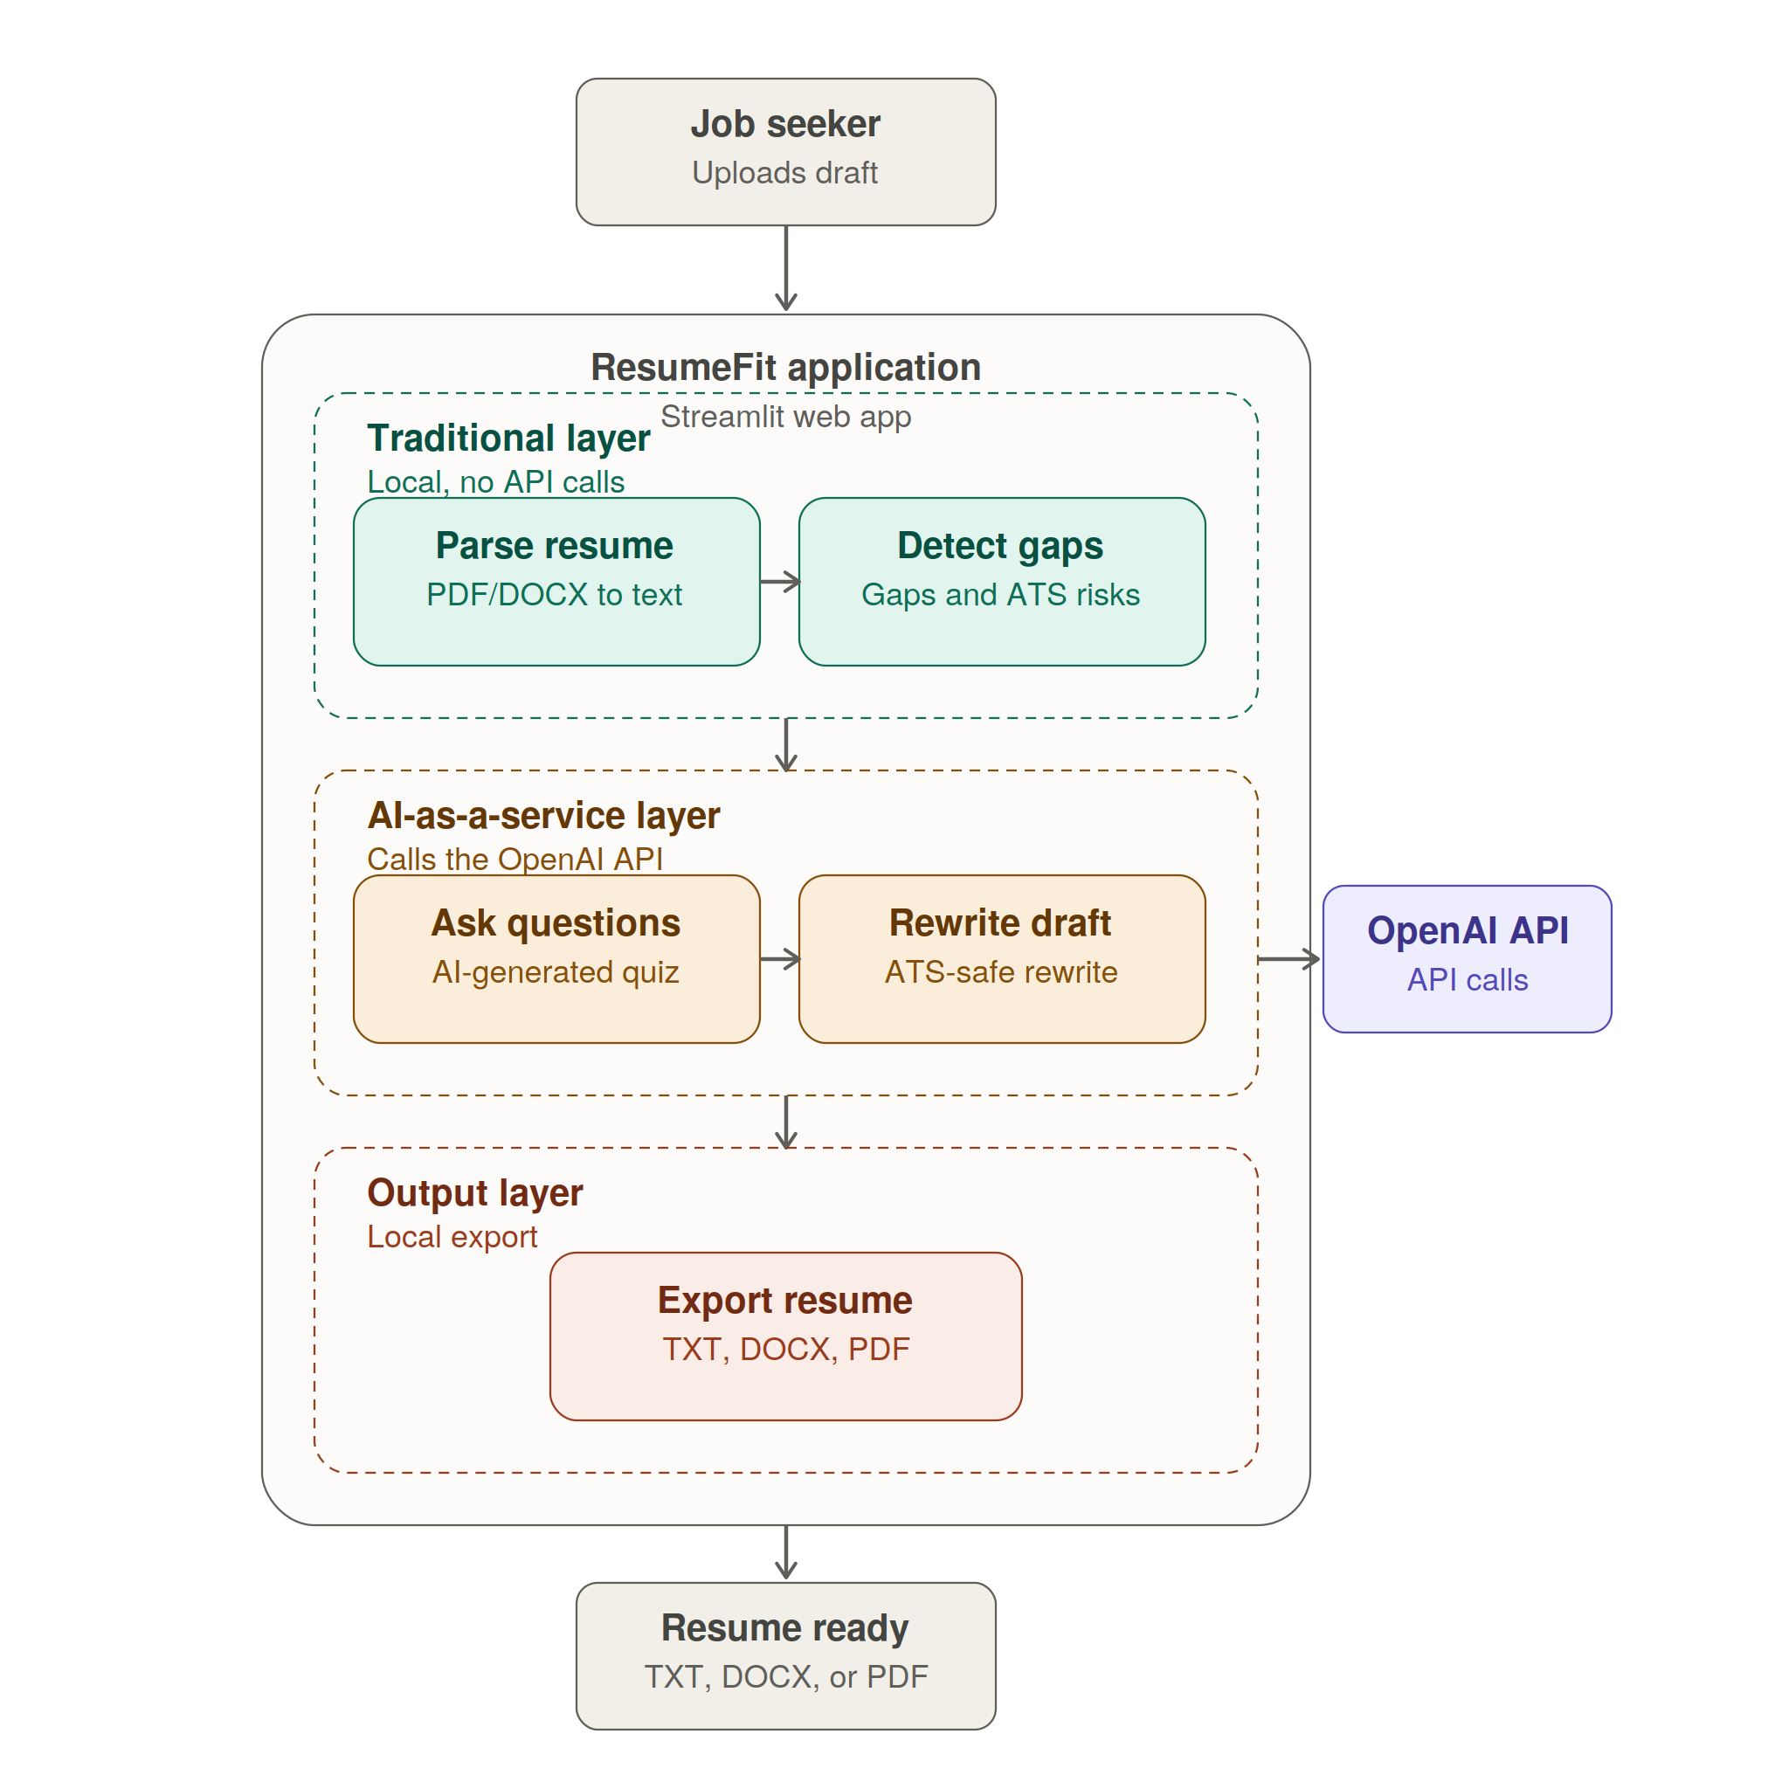
ARCHITECTURE
High-Level Design Diagram
Job seeker uploads a resume draft to start
Traditional layer: local Python, zero API calls
AI-as-a-service layer: two distinct OpenAI calls
Output layer: TXT, DOCX, and PDF export
ResumeFit
5

Slide 5
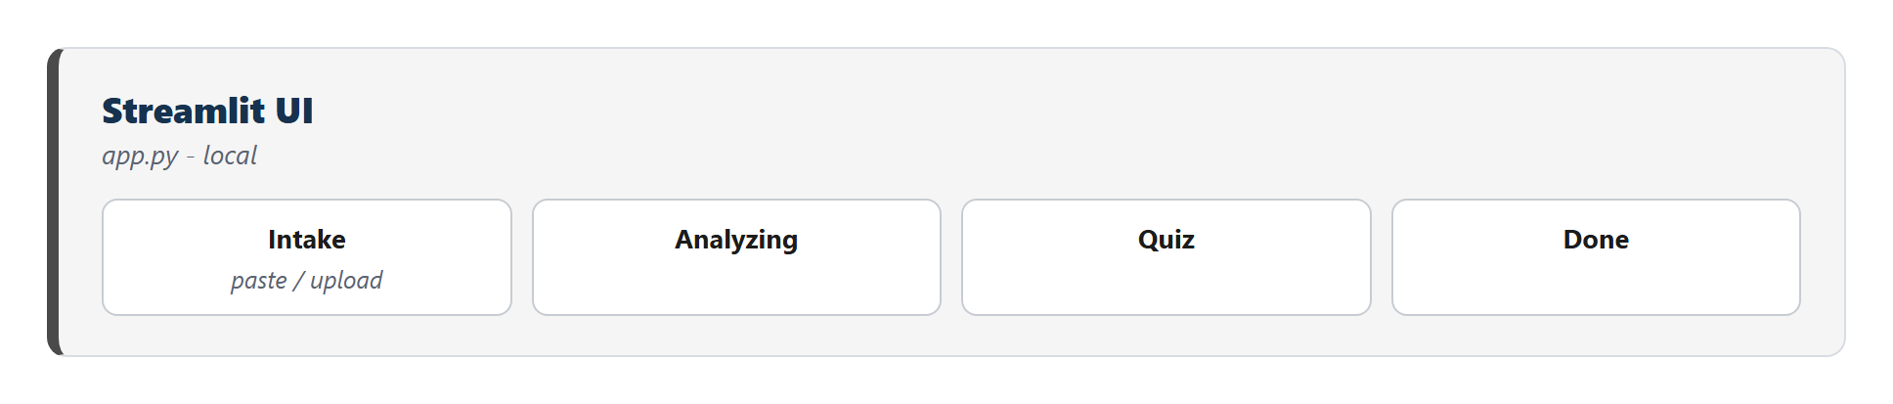
ARCHITECTURE
Five Stages, Two Processing Layers
Intake → Analyzing → Quiz → Rewriting → Done
Traditional layer: local Python, zero API calls
AI-as-a-service layer: two distinct OpenAI calls
Every stage degrades gracefully, never a dead end
ResumeFit
4

Slide 6
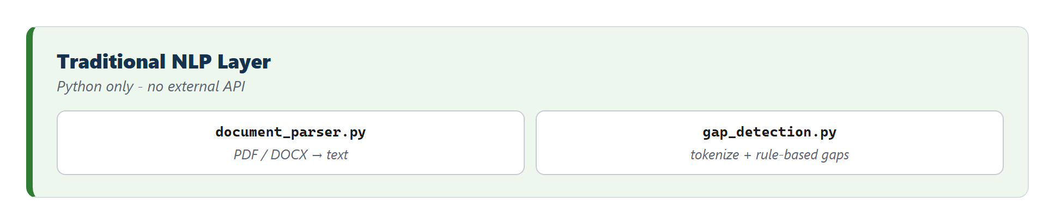
LAYER 1 · TRADITIONAL CHATBOT
Rule-Based Gap Detection, Entirely Local
Missing or inconsistent dates
Vague job titles (“Team Member”)
Bullets with no quantified result
ResumeFit
5

Slide 7
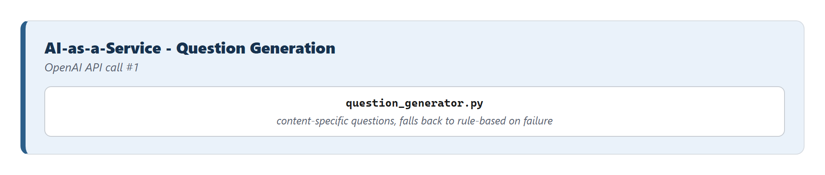
LAYER 2 · AI-AS-A-SERVICE
Content-Specific Questions via OpenAI
Reads what THIS resume actually says
Never repeats the rule-based questions
Falls back to rule-based-only if the API fails
ResumeFit
6

Slide 8
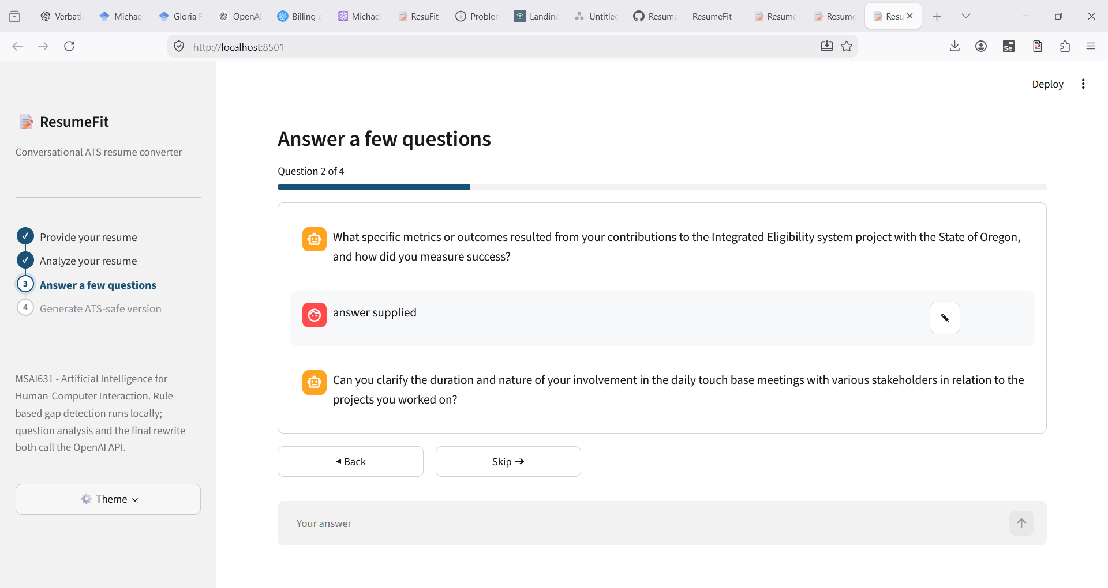
INTERACTION DESIGN
Back, Skip, and Inline Editing
Real running app — mid-quiz, question 2 of 4
ResumeFit
7

Slide 9
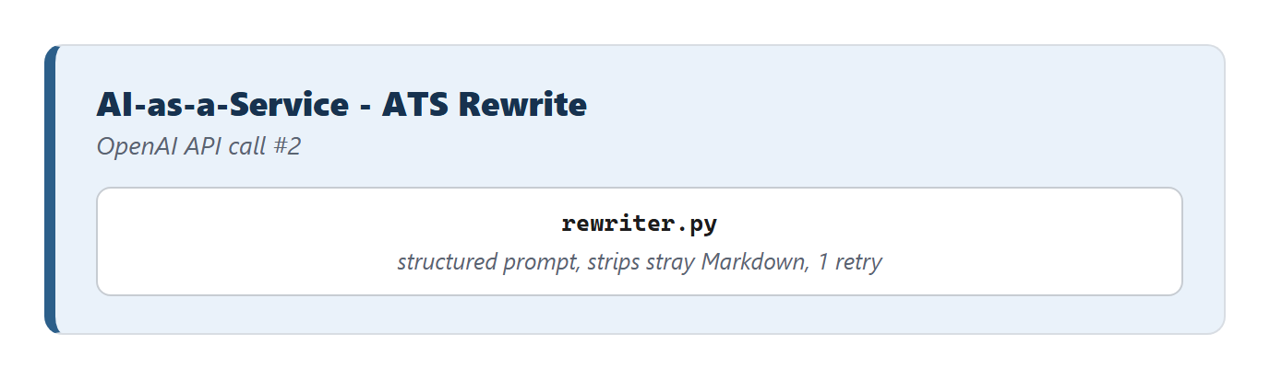
LAYER 2 · AI-AS-A-SERVICE
The Rewrite: Structured Prompt, One Retry
Single column, standard section headers
Never invents employers, titles, or dates
One automatic retry before falling back
ResumeFit
8

Slide 10
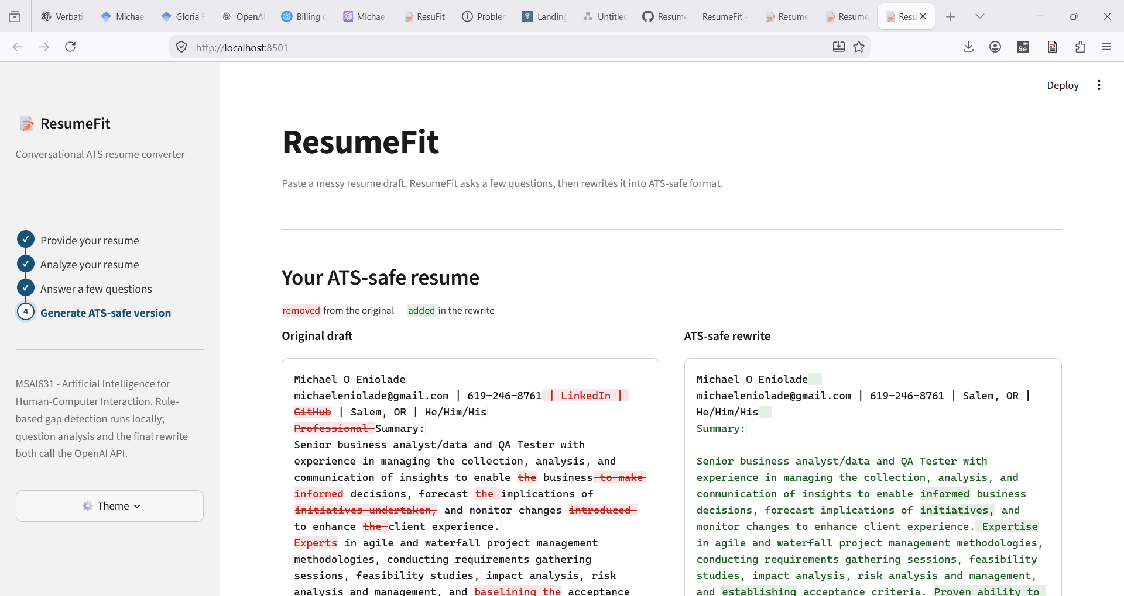
THE RESULT
See Exactly What Changed
Word-level diff — removed in red, added in green
ResumeFit
9

Slide 11
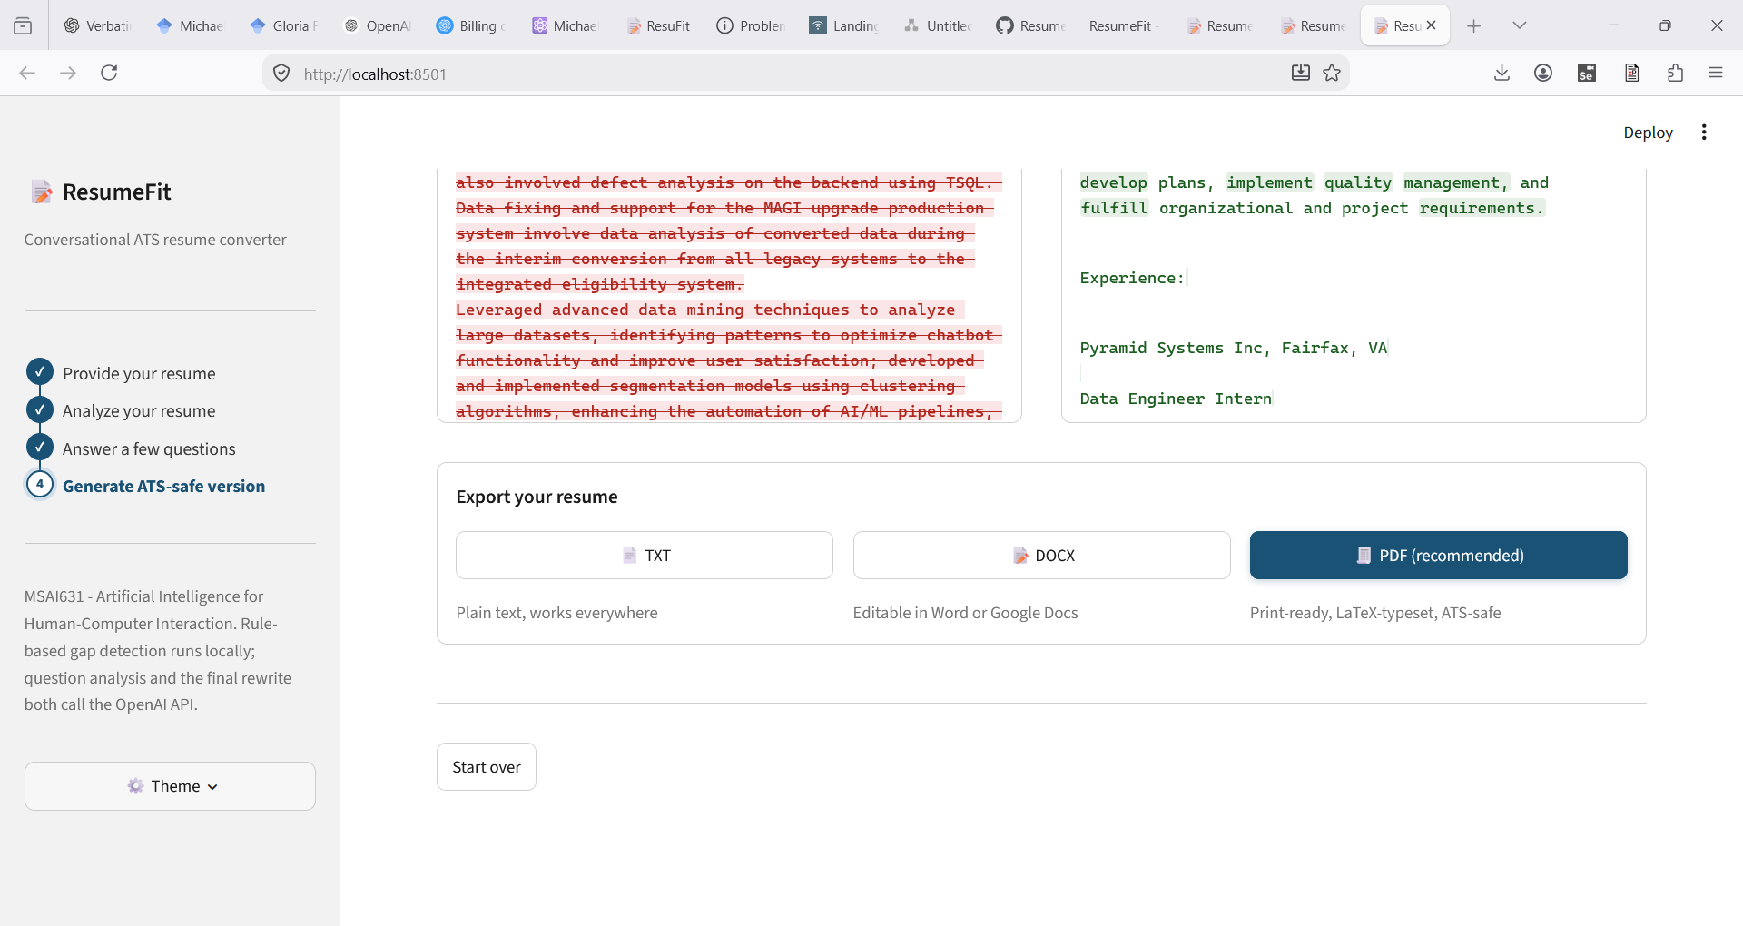
THE OUTPUT
TXT, DOCX, and a LaTeX-Typeset PDF
PDF compiled locally via pdflatex — single-column, ATS-safe by construction
ResumeFit
10

Slide 12
ACCESSIBILITY & ETHICS
Two Sides of the Same Design Choice
ATS-safe = screen-reader-safe
Never invents experience
One constraint satisfies both requirements at once
Skipped answers stay unresolved, not guessed
Fallback is always labeled
Nothing persists beyond the session
A cached response never silently poses as live
No database, no external storage of resume content
ResumeFit
12

Slide 13
FUTURE ENHANCEMENTS
Taking ResumeFit to the Next Level
Target Job Description Matching
Local PII Stripping
Identify keyword gaps against specific job postings
Sanitize before Cloud AI prompt
Re-inject it before final resume generation
A/B Phrasing Selection
Cover Letter Generation
Metric-led vs. action-led generated resume
Leverage gathered data to generate a matching cover letter
ResumeFit
12

Slide 14
Thank You
Questions?
github.com/MichaelEnny/ResumeFit · MSAI631-M92 Residency

