Slide 1
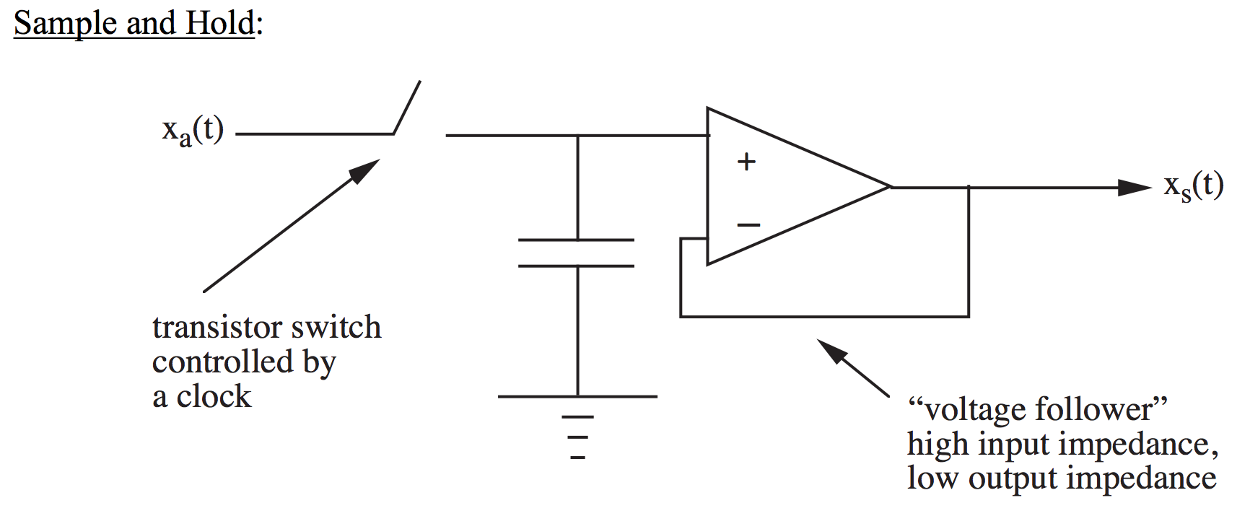
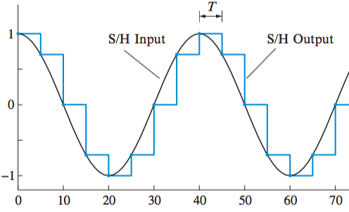
A/D and D/A circuits
A/D consists of a Sample and Hold (S/H) followed by a Quantizer
x_{c}(t)
Let’s look at two popular types of quantizer
*adapted from course notes by D.C. Munson, Jr.

Slide 2
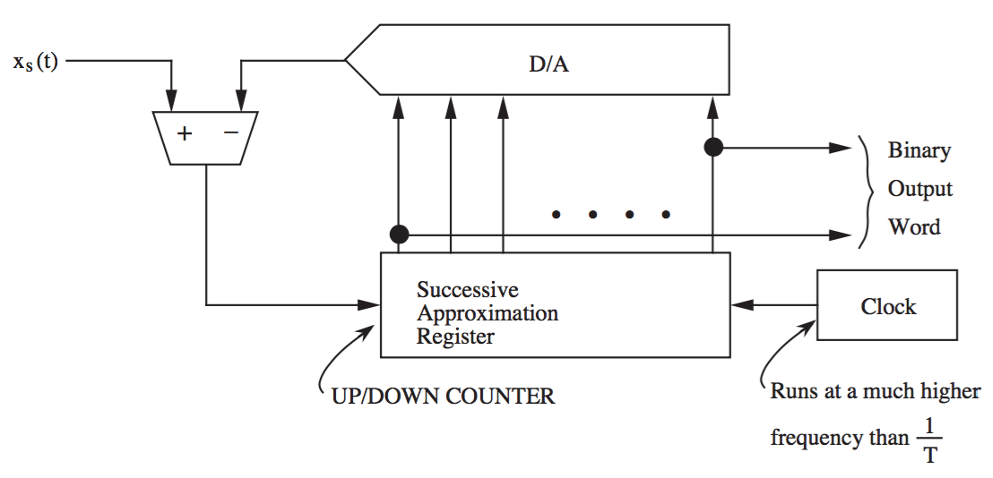
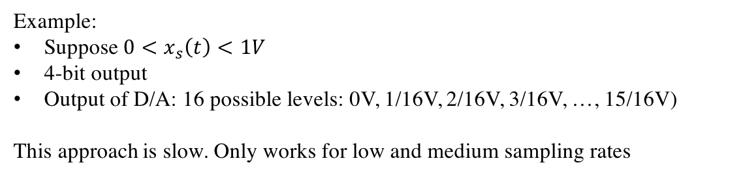
Successive Approximation A/D
<
0.1
>
0.3
0
2/16
3/16
4/16
5/16
1/16
output from S/H
comparator
0
0
digital output
x[n]
1
1
0
0
1
0
1
Example:
Suppose $0<x_{s}\left(t\right)<1V$
4-bit output
Output of D/A: 16 possible levels: 0V, 1/16V, 2/16V, 3/16V, …, 15/16V)
This approach is slow. Only works for low and medium sampling rates
*adapted from course notes by D.C. Munson, Jr.

Slide 3
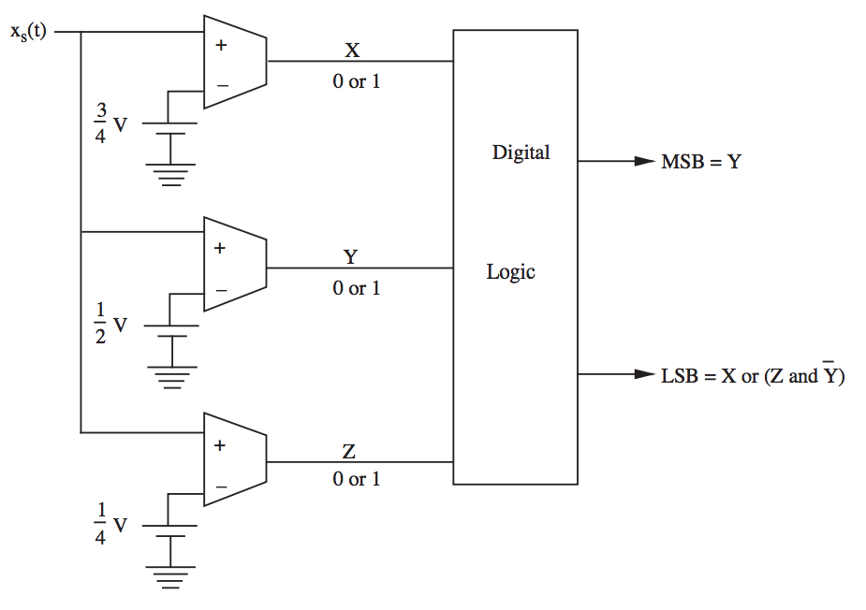
Flash A/D
example of 2-bit quantizer
0.7V
0.3V
output from S/H
0
0
1
1
0
1
0
1
Can handle high sampling rates
Uses $2^{N}−1$ comparators for N-bit output
*adapted from course notes by D.C. Munson, Jr.

Slide 4
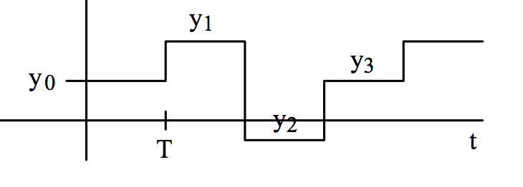



D/A converter
As we saw, D/A consists of Zero Order Hold followed by analog compensator filter
$$\overline{y_{c}}\left(t\right)$$
$$y[n]$$
ZOH
F(Ω)
$$y_{c}\left(t\right)$$
ZOH output
Zero Order Hold can be implemented with a resistor ladder
*adapted from course notes by D.C. Munson, Jr.

Slide 5
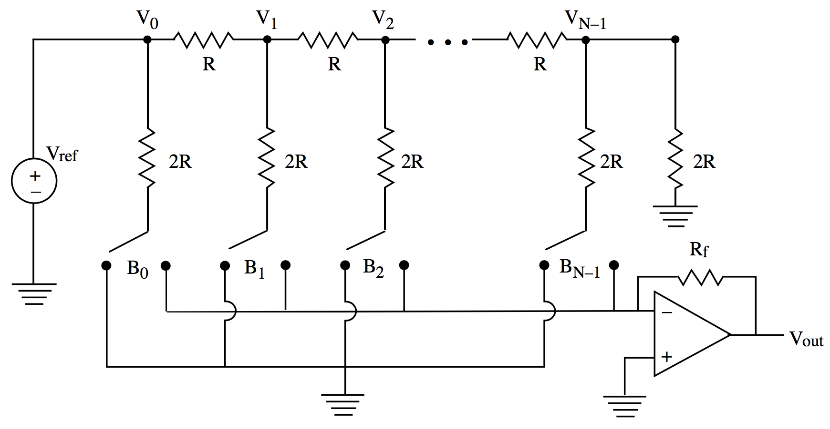
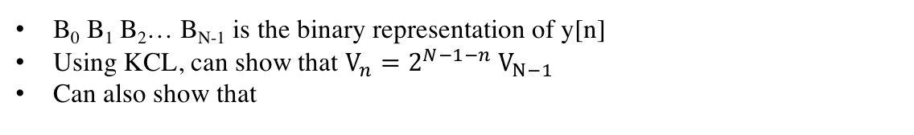




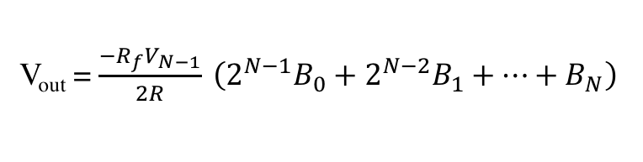
Zero Order Hold (resistor ladder)
$1$ V
$0.5$ V
$0.25$ V
$2^{−(N−1)}$ V
B₀ B₁ B₂… B_{N-1} is the binary representation of y[n]
Using KCL, can show that $V_{n}={2^{N−1−n} V}_{N−1}$
Can also show that
V_{out} = ${\frac{−R_{f}V_{N−1}}{2R}}_{ }\left(2^{N−1}B_{0}+2^{N−2}B_{1}+…+B_{N}\right)$
y[n]
*adapted from course notes by D.C. Munson, Jr.

