Slide 1
IoT Smart Gateway Demo
October 18, 2017
Red Hat Public Sector DemoJam
Michael Fitzurka, Middleware SA
Rick Stewart, Middleware & OpenShift SSP
Kingsmill Resort, Williamsburg, VA

Slide 2



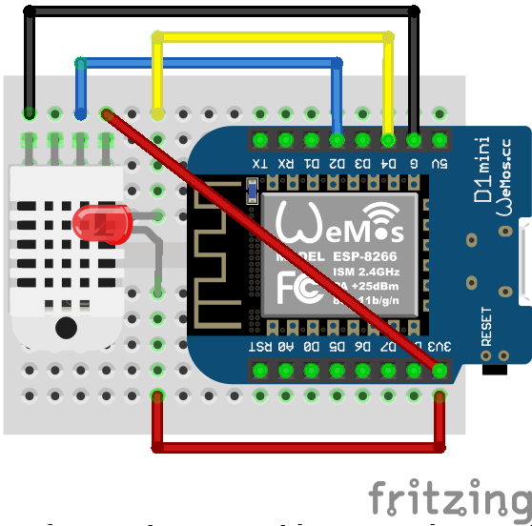














IoT Smart Gateway Demo
Datacenter
Smart Gateway
Edge Device
Red Hat
JBoss
BPMS
Red Hat
JBoss
Data Grid
BRMS
Decision
Server
Fuse
Integration
Services
Red Hat
JBoss
A-MQ
Red Hat
JBoss
BRMS
Red Hat
JBoss
Fuse
Microcode
AM2302
LED
Red Hat Enterprise Linux / CDK
ESP8266

Slide 3
IoT Smart Gateway Demo
Datacenter
Smart Gateway
Edge Device
Red Hat
JBoss
BPMS
Red Hat
JBoss
Data Grid
BRMS
Decision
Server
Fuse
Integration
Services
Red Hat
JBoss
A-MQ
Red Hat
JBoss
BRMS
Red Hat
JBoss
Fuse
Microcode
AM2302
LED
Red Hat Enterprise Linux / CDK
ESP8266

Slide 4


IoT Smart Gateway Demo
T, ϕ, V
32˚C, #71
1 message / second for each
MQTT
Datacenter
Smart Gateway
Edge Device
Red Hat
JBoss
BPMS
Red Hat
JBoss
Data Grid
BRMS
Decision
Server
Fuse
Integration
Services
Red Hat
JBoss
A-MQ
Red Hat
JBoss
BRMS
Red Hat
JBoss
Fuse
Microcode
AM2302
LED
Red Hat Enterprise Linux / CDK
ESP8266

Slide 5
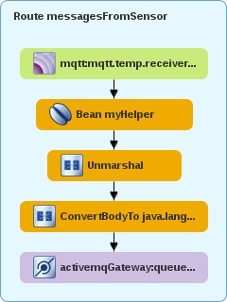

IoT Smart Gateway Demo
32˚C, #71
<dataSet>
<deviceType>Temperature</deviceType>
<payload>32</payload>
<count>71</count>
<timestamp>DateTime</timestamp>
</dataSet>
Datacenter
Smart Gateway
Edge Device
Red Hat
JBoss
BPMS
Red Hat
JBoss
Data Grid
BRMS
Decision
Server
Fuse
Integration
Services
Red Hat
JBoss
A-MQ
Red Hat
JBoss
BRMS
Red Hat
JBoss
Fuse
Microcode
AM2302
LED
Red Hat Enterprise Linux / CDK
ESP8266

Slide 6


IoT Smart Gateway Demo
XML
Yes,
Same
Don’t Send
T_{i}= T_{(i-1)}?
Average: <T₁, … T₁₀₀>
No,
Different
J
M
S
Send
Datacenter
Smart Gateway
Edge Device
Red Hat
JBoss
BPMS
Red Hat
JBoss
Data Grid
BRMS
Decision
Server
Fuse
Integration
Services
Red Hat
JBoss
A-MQ
Red Hat
JBoss
BRMS
Red Hat
JBoss
Fuse
Microcode
AM2302
LED
Red Hat Enterprise Linux / CDK
ESP8266

Slide 7
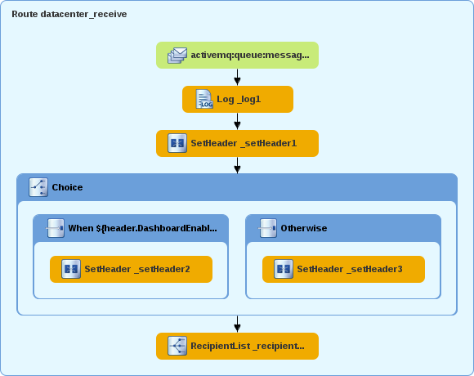
IoT Smart Gateway Demo
J
M
S
Datacenter
Smart Gateway
Edge Device
Red Hat
JBoss
BPMS
Red Hat
JBoss
Data Grid
BRMS
Decision
Server
Fuse
Integration
Services
Red Hat
JBoss
A-MQ
Red Hat
JBoss
BRMS
Red Hat
JBoss
Fuse
Microcode
AM2302
LED
Red Hat Enterprise Linux / CDK
ESP8266

Slide 8
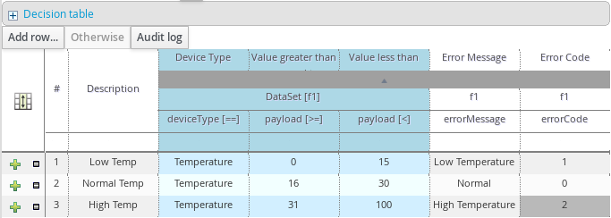




IoT Smart Gateway Demo
32˚C >= 31˚C
Error #2
Turn on LED
MQTT
Datacenter
Smart Gateway
Edge Device
Red Hat
JBoss
BPMS
Red Hat
JBoss
Data Grid
BRMS
Decision
Server
Fuse
Integration
Services
Red Hat
JBoss
A-MQ
Red Hat
JBoss
BRMS
Red Hat
JBoss
Fuse
Microcode
AM2302
LED
Red Hat Enterprise Linux / CDK
ESP8266

Slide 9
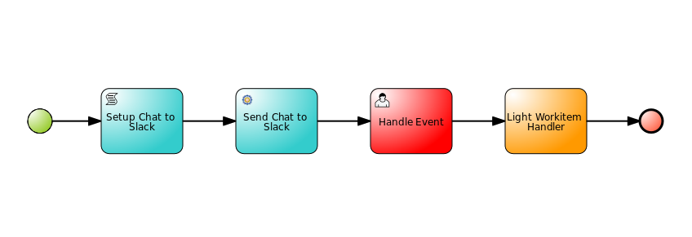
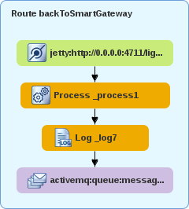

IoT Smart Gateway Demo
Error #2
Turn on LED
Datacenter
Smart Gateway
Edge Device
Red Hat
JBoss
BPMS
Red Hat
JBoss
Data Grid
BRMS
Decision
Server
Fuse
Integration
Services
Red Hat
JBoss
A-MQ
Red Hat
JBoss
BRMS
Red Hat
JBoss
Fuse
Microcode
AM2302
LED
Red Hat Enterprise Linux / CDK
ESP8266

Slide 10

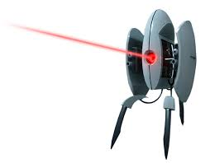

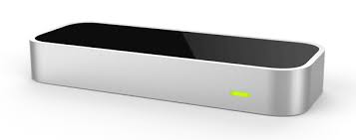

IoT Smart Gateway Demo
Datacenter
Smart Gateway
Edge Device
Red Hat
JBoss
BPMS
Red Hat
JBoss
Data Grid
BRMS
Decision
Server
Fuse
Integration
Services
Red Hat
JBoss
A-MQ
Red Hat
JBoss
BRMS
Red Hat
JBoss
Fuse
Microcode
AM2302
LED
Red Hat Enterprise Linux / CDK
ESP8266

Slide 11
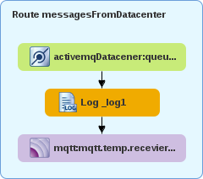
IoT Smart Gateway Demo
Turn off LED
Datacenter
Smart Gateway
Edge Device
Red Hat
JBoss
BPMS
Red Hat
JBoss
Data Grid
BRMS
Decision
Server
Fuse
Integration
Services
Red Hat
JBoss
A-MQ
Red Hat
JBoss
BRMS
Red Hat
JBoss
Fuse
Microcode
AM2302
LED
Red Hat Enterprise Linux / CDK
ESP8266

Slide 12
IoT Smart Gateway Demo
Datacenter
Smart Gateway
Edge Device
Red Hat
JBoss
BPMS
Red Hat
JBoss
Data Grid
BRMS
Decision
Server
Fuse
Integration
Services
Red Hat
JBoss
A-MQ
Red Hat
JBoss
BRMS
Red Hat
JBoss
Fuse
Microcode
AM2302
LED
Red Hat Enterprise Linux / CDK
ESP8266

Slide 13
IoT Smart Gateway Demo
Datacenter
Smart Gateway
Edge Device
Red Hat
JBoss
BPMS
Red Hat
JBoss
Data Grid
BRMS
Decision
Server
Fuse
Integration
Services
Red Hat
JBoss
A-MQ
Red Hat
JBoss
BRMS
Red Hat
JBoss
Fuse
Microcode
AM2302
LED
Red Hat Enterprise Linux / CDK
ESP8266

Slide 14


Thank You!

