Slide 1

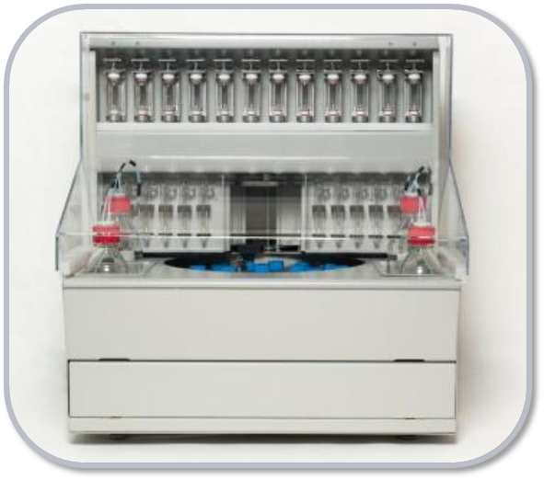
DISCOVERY-12
New High-Quality, Cost-Efficient, Fully
Automated Multiple Peptide Synthesizer
with Pre-activation

Slide 2
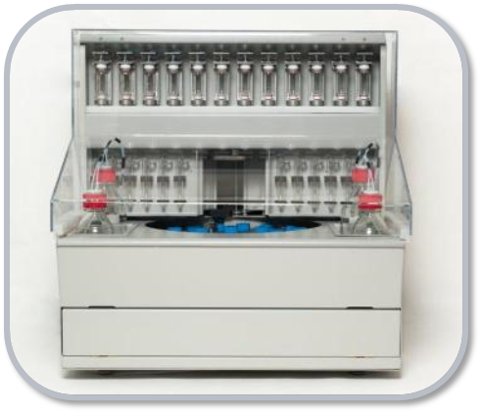
DISCOVERY-12
The unique design prevents any precipitation, clogged lines, and overfills so typical of other instruments.
The use of stock solutions of AA's eliminates the need for pre-fill cartridges or barcoding.

Slide 3
WHAT DOES IT DO?
Produces high quality peptides on any scale from 0.05 to 1.0 mmoles per reactor.
Utilizes common coupling reagents such as HBTU, HATU, PyBOP, DIC/HOBt, and bulk AA solutions with up to 0.5 mmol concentration.

Slide 4
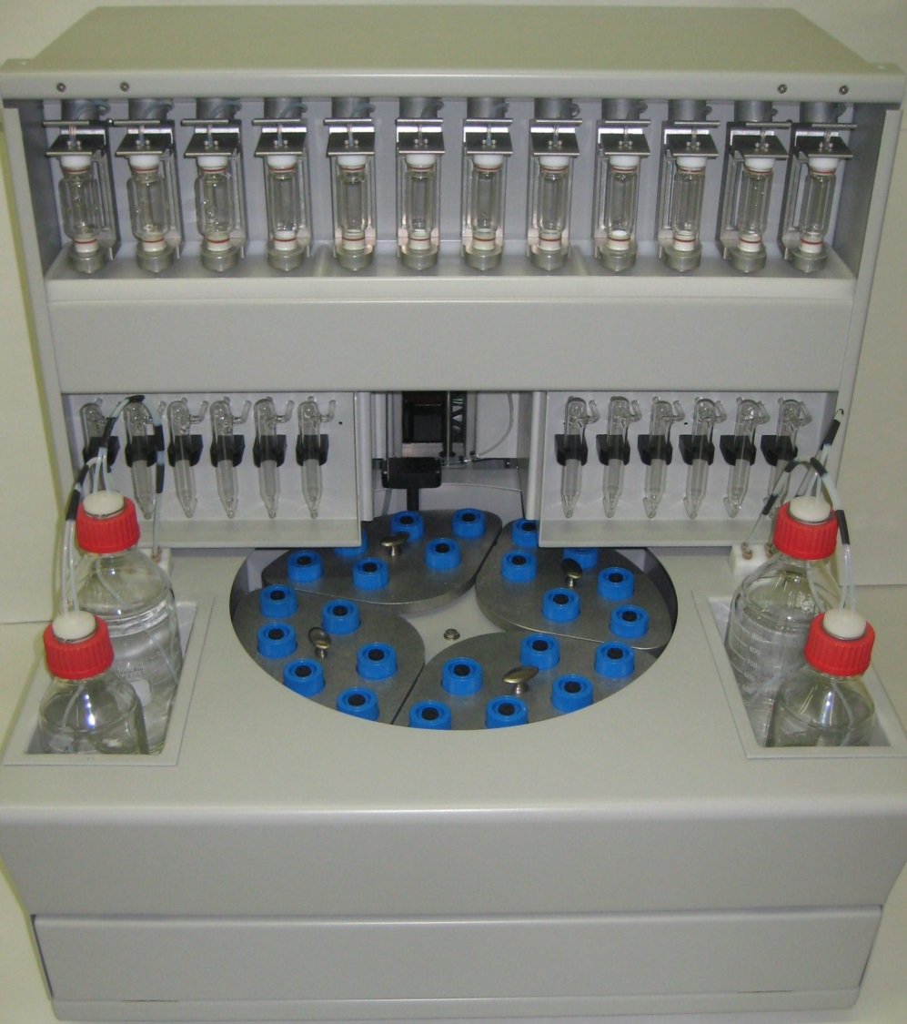
DISCOVERY-12

Slide 5
DISCOVERY-12
The patent pending unique liquid measuring device results in accurate and quick delivery every time. There is no need to hassle with calibration based on pressure, time, or set volume.
Performs any Fmoc chemistry with or without pre-activation.

Slide 6

DISCOVERY-12
Each reaction vessel has a dedicated pre-activation vessel for more efficient coupling.
Compact tabletop design with ventilated hood.
Windows 8 based software guarantees users a quick and easy experience every time.

Slide 7
DISCOVERY-12
Gentle but efficient nitrogen mixing thoroughly mixes resin and reagents while preserving the integrity of the resin beads in intervals of different delays.

Slide 8
DISCOVERY-12
Flexibility in sequence selection allows users to effortlessly import sequences from USB, select standard protocols, develop custom protocols, assign protocols to sequences, and sequences to reaction vessels.

Slide 9
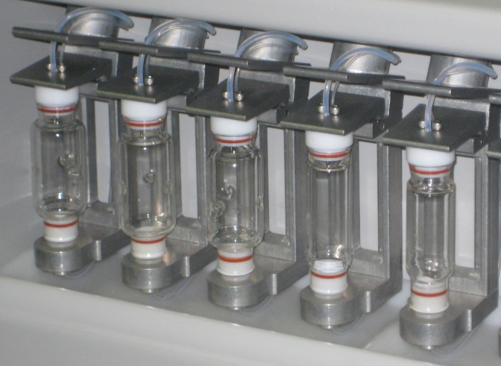
DISCOVERY-12
Utilizes 30, 60, or 100 ml glass reactors with removable filters.
Each reactor can run independently with different scales and protocols.
Ability to add and remove sequences without interrupting instrument operations.

Slide 10
INSTRUMENT SPECIFICATIONS
REACTION VESSELS | 30 ml, 60 ml, or 100 ml, glass
PRE-ACTIVATION VESSELS | 20 ml
REAGENTS / SOLVENTS | 6 – 500 ml to 5 gallons
AMINO ACID CONTAINERS | 24 – 175 ml
WASTE CONTAINER | 1 – 20 L
MIXING | Adjustable nitrogen bubbling
INSTRUMENT CONTROL | Windows base MS
POWER | 100V / 60Hz to 240V / 50Hz
DIMENSIONS | W 29 Inches (73cm), D 28 Inches (71cm), H 31 Inches (78cm)
WEIGHT | 150 lbs.
TEMPERATURE | Ambient

Slide 11
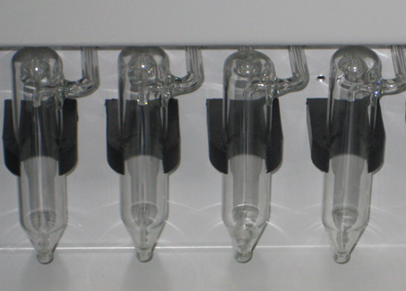
DISCOVERY-12
Each reaction vessel has
a dedicated pre-activation
vessel for more efficient
coupling
Performs resin de-protection and wash while delivering the amino acids and activation reagents to the pre-activation vessels.
With uniquely designed glassware, it utilizes the least amount of solvents to wash the line and pre-activation vessels after delivering the activated amino acid to the reactors.

Slide 12
OUR COMMITMENT
Peptide Machines Inc. is a well established company located in San Diego, California. We manufacture and sell multiple peptide synthesizers. Our instruments are designed by engineers and peptide chemists with a significant amount of experience in peptide synthesis.
At Peptide Machines Inc. we are committed to providing you with highest level of customer satisfaction. Our commitment to you does not end when you receive your instrument. We provide our customers with:
Two days of on-site training with installation,
12-month warranty and service contract options, and
Access to experienced peptide chemists to help with instrument application and peptide chemistry.

Slide 13
FOR MORE INFORMATION
Contact Peptide Machines, Inc.
Tel: 858-909-0971
Toll Free: 888-608-6351
Fax: 858-657-9440
Email: sales@peptidemachines.com
Website: peptidemachines.com

