Slide 1

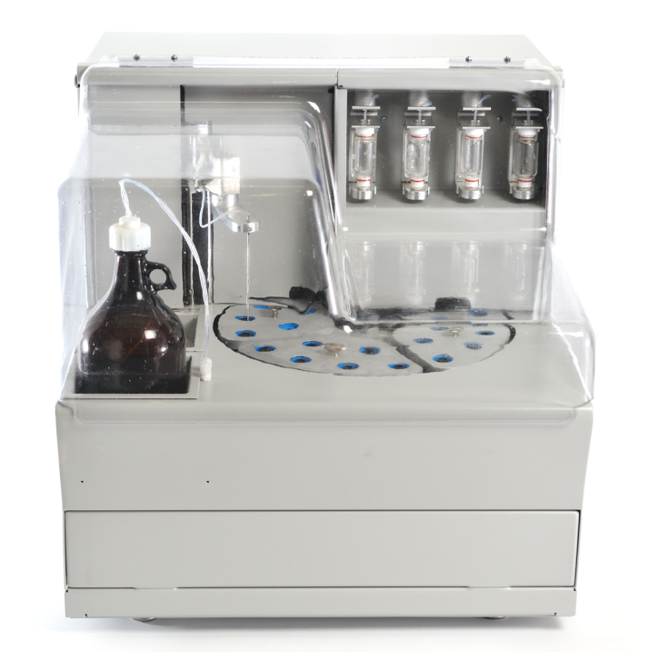
DISCOVERY-4
New High-Quality, Cost-Efficient, Fully
Automated Multiple Peptide Synthesizer
with Pre-activation

Slide 2
WHAT IS IT?
Automated, patented 4-reactor peptide synthesizer that offers users the ability to produce multiple peptides simultaneously.
Compact tabletop model with fully ventilated hood.

Slide 3
WHAT DOES IT DO?
Produces high quality peptides on any scale from 0.05 to 3.0 mmoles per reactor.
Utilizes common coupling reagents such as HBTU, HATU, PyBOP, DIC/HOBt, and bulk AA solutions with up to 0.5 mmol concentration.

Slide 4
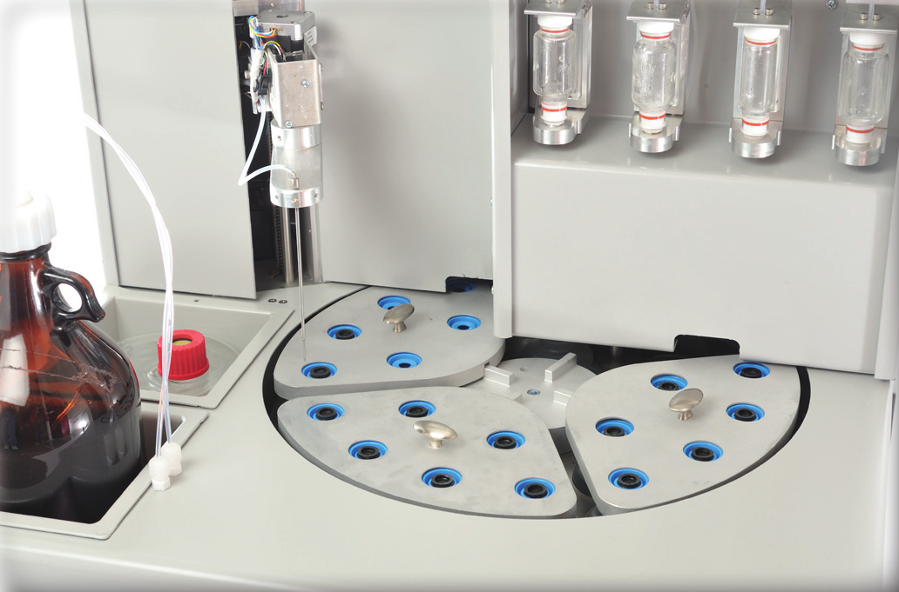
DISCOVERY-4

Slide 5
DISCOVERY-4
Each reaction vessel has a dedicated pre-activation vessel for more efficient coupling.
No waste of any liquids, amino acids, solvents, or reagents by priming or any other method.
Use two to three times less solvent comparing to other synthesizers on the market.
Due to pre-activation, consistently produces uniform, high quality peptides from reactor to reactor and run to run even in single couple mode.

Slide 6

DISCOVERY-4
All reagents and solvents are delivered from the top of the reaction vessels.
Gentle but efficient nitrogen mixing thoroughly mixes resin and reagents while preserving the integrity of the resin beads in intervals of different delays.

Slide 7
DISCOVERY-4
The patent pending unique liquid measuring device results in accurate and quick delivery every time. There is no need to hassle with calibration based on pressure, time, or set volume.

Slide 8
DISCOVERY-4
Flexibility in sequence selection allows users to effortlessly import sequences from USB, select standard protocols, develop custom protocols, assign protocols to sequences, and sequences to reaction vessels.

Slide 9
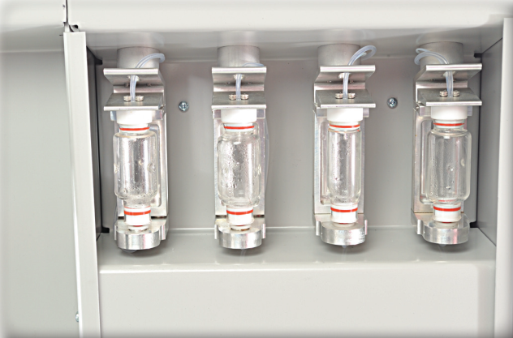
DISCOVERY-4
Utilizes 30, 60, or 100 ml glass reactors with removable filters.
Each reactor can run independently with different scales and protocols.
Non-stop operation with reaction vessels that can function independently, and the ability to add and remove sequences without interrupting instrument operations add to the ease of use.

Slide 10

DISCOVERY-4

Slide 11
INSTRUMENT SPECIFICATIONS
REACTION VESSELS | 30 ml, 60 ml, or 100 ml, glass
PRE-ACTIVATION VESSELS | 50 ml
REAGENTS / SOLVENTS | 2 x 1 L, 1 x 2 L
AMINO ACID CONTAINERS | 24 – 175 ml
WASTE CONTAINER | 1 – 20 L
MIXING | Adjustable nitrogen bubbling
INSTRUMENT CONTROL | Windows base MS
POWER | 100V / 60Hz to 240V / 50Hz
DIMENSIONS | W 26 Inches (66 cm), D 28 Inches (71 cm), H 27 Inches (68 cm)
WEIGHT | 100 lbs.
TEMPERATURE | Ambient

Slide 12
OUR COMMITMENT
Peptide Machines Inc. is a well established company located in San Diego, California. We manufacture and sell multiple peptide synthesizers. Our instruments are designed by engineers and peptide chemists with a significant amount of experience in peptide synthesis.
At Peptide Machines Inc. we are committed to providing you with highest level of customer satisfaction. Our commitment to you does not end when you receive your instrument. We provide our customers with:
Two days of on-site training with installation,
12-month warranty and service contract options, and
Access to experienced peptide chemists to help with instrument application and peptide chemistry.

Slide 13
FOR MORE INFORMATION
Contact Peptide Machines, Inc.
Tel: 858-909-0971
Toll Free: 888-608-6351
Fax: 858-657-9440
Email: sales@peptidemachines.com
Website: peptidemachines.com

