Slide 1
Learning To Protect Communications With Generative Adversarial Neural Networks
Michael Guarino
Marist College MSCS 630

Slide 2
What is Machine Learning?
Machine learning is an application of artificial intelligence (AI) that provides systems the ability to automatically learn and improve from experience without being explicitly programmed.
Machine learning focuses on the development of computer programs that can access data and use it learn for themselves.
Deep Learning is a subset of machine learning specifically focused on neural networks (very loosely inspired by the brain).

Slide 3
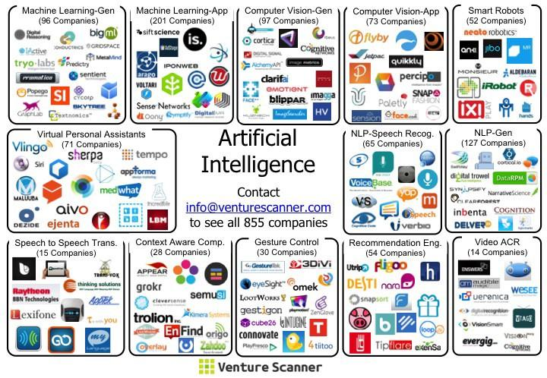
So what can we do with that?

Slide 4
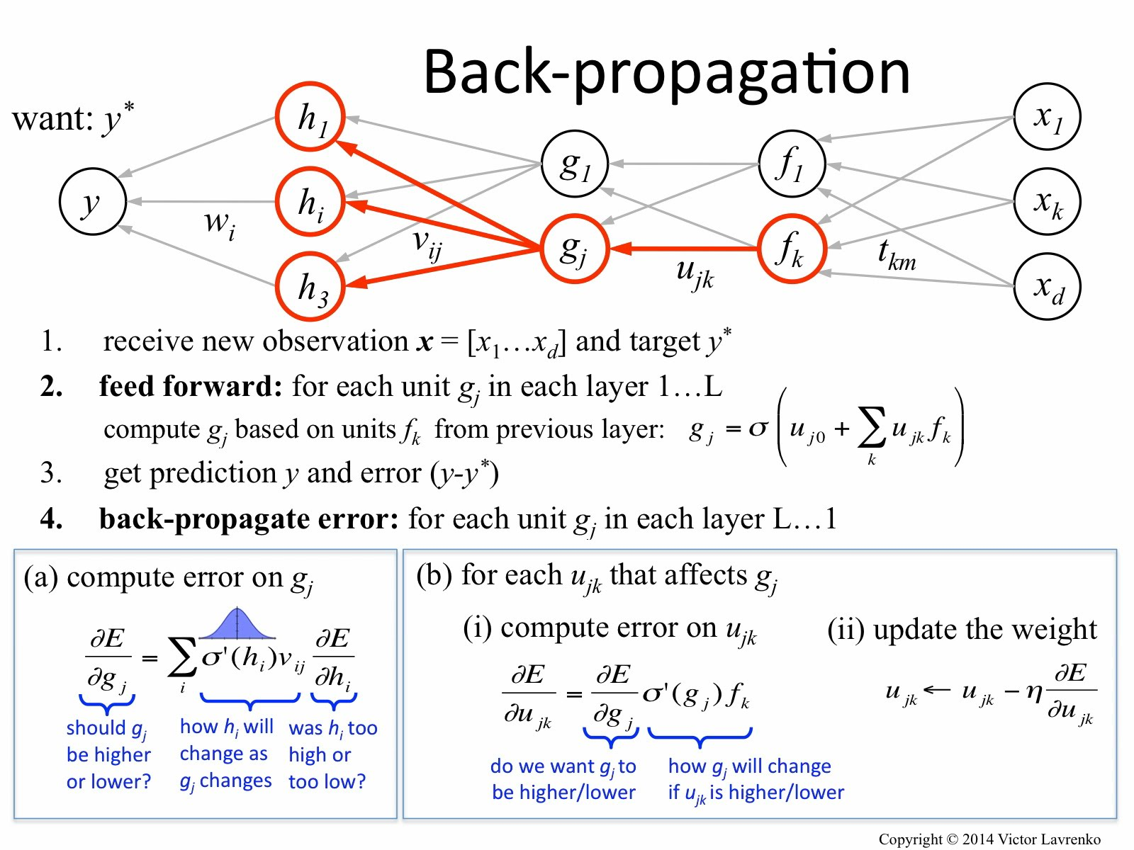
How do neural networks learn?

Slide 5
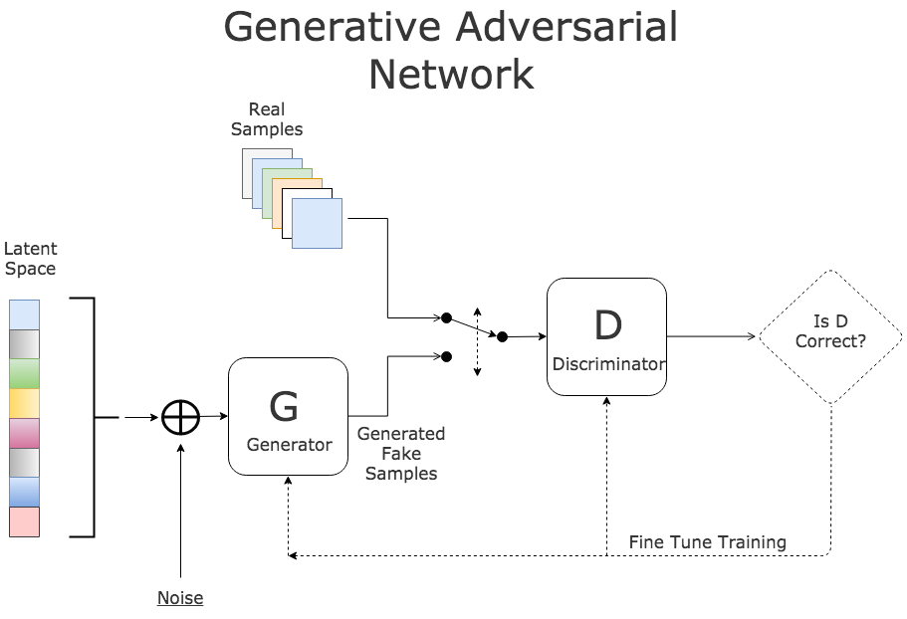
What is adversarial training/Generative Adversarial NNs?

Slide 6
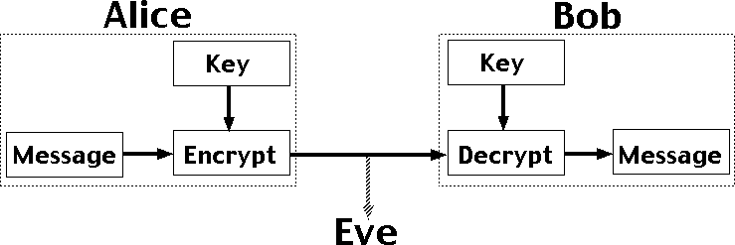
Alice, Bob, and Eve Symmetric Cryptosystem Problem

Slide 7
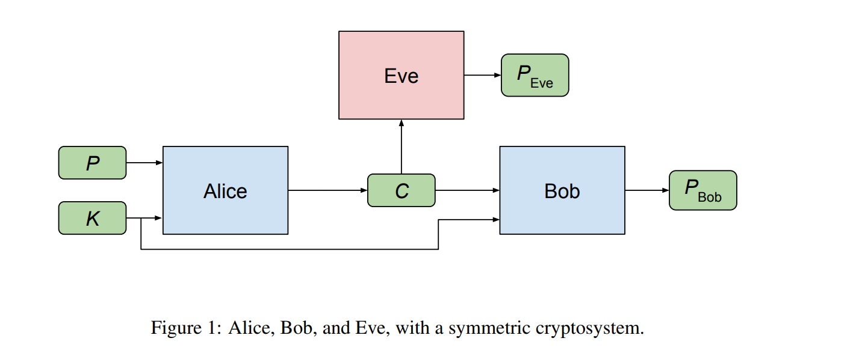
How can we use a GAN to encrypt messages?
LEARNING TO PROTECT COMMUNICATIONS WITH ADVERSARIAL NEURAL CRYPTOGRAPHY Abadi et al. https://arxiv.org/pdf/1610.06918.pdf
Notes:
gan approach to learning symmetric encryption (shared-key encryption, in which the same key is used to encrypt and decrypt)

Slide 8
System Organization
Three parties: Alice, Bob, and Eve
Alice and Bob wish to communicate securely, and Eve wishes to eavesdrop on their communication.
Desired security property is secrecy (not integrity)
The adversary is a “passive attacker” that can intercept communications but that is otherwise quite limited: it cannot initiate sessions, inject messages, or modify messages in transit.

Slide 9
Objectives
Eve’s goal: reconstruct P accurately (minimize the error between P and P_{Eve}
Alice and Bob's goal(s): Alice and Bob want to communicate clearly (to minimize the error between P and P_{Bob} ) but also to hide their communication from Eve.
Note: Eve’s objectives contrast with Alice and Bob’s therefore great candidate for adversarial training.
Alice and Bob discover a cryptosystem to achieve their objectives.

Slide 10
Math Summary
Alice Network: C = A(θ_{A}, P, K)
Bob Network: P_{Bob} = B(θ_{B}, C, K)
Eve Network: P_{Eve} = E(θ_{E}, C)
L1 distance d(P, P’ ) = Σ_{i=1,N} |P_{i} − P’_{i}| where N is the length of plaintexts
Bob Reconstruction Error: L_{B}(θ_{A}, θ_{B}, P, K) = d(P, B(θ_{B}, A(θ_{A}, P, K), K))
Eve Reconstruction Error: L_{E}(θ_{A}, θ_{E}, P, K) = d(P, E(θ_{E}, A(θ_{A}, P, K)))
Loss for Alice and Bob: L_{AB}(θ_{A}, θ_{B}) = L_{B}(θ_{A}, θ_{B}, P, K) - L_{E}(θ_{A}, θ_{E}, P, K) (combination reflects that Alice and Bob want to minimize Bob’s reconstruction error and to maximize the reconstruction error)

Slide 11
Mix and Transform Architecture
Input bits are mapped to [-1,1]
Alice and Bob
1 x Fully Connected Layer 2N x 2N where N is the length in bits of the message
4 x 1D Convolutional Layers:
filter sizes: 4, 2, 1, 1
input channels: 1, 2, 1, 1
output channels: 2, 4, 4, 1
strides: 1, 2, 1, 1
Activation Functions: Sigmoid and all layers except final one Tanh is used to bring values back to a range [-1, 1] that can map to binary values.
Eve
all the same except the Fully Connected Layer dimensions are N x 2N where N is the length in bits of the message because only receiving C

Slide 12
Training Details
P, K are vectors of same size generated from uniform distribution and values are mapped from [0,1] -> [-1,1]
All Network parameters randomly initialized.
Mini-batch Gradient Descent with the Adam Optimizer.
Alternate Training between the Alice-Bob and Eve training
training Eve on 2 mini-batches per step in order to give advantage to the adversary.
Paper reports that training goals typically achieved within 15,000 steps.

Slide 13
Doing work...

Slide 14
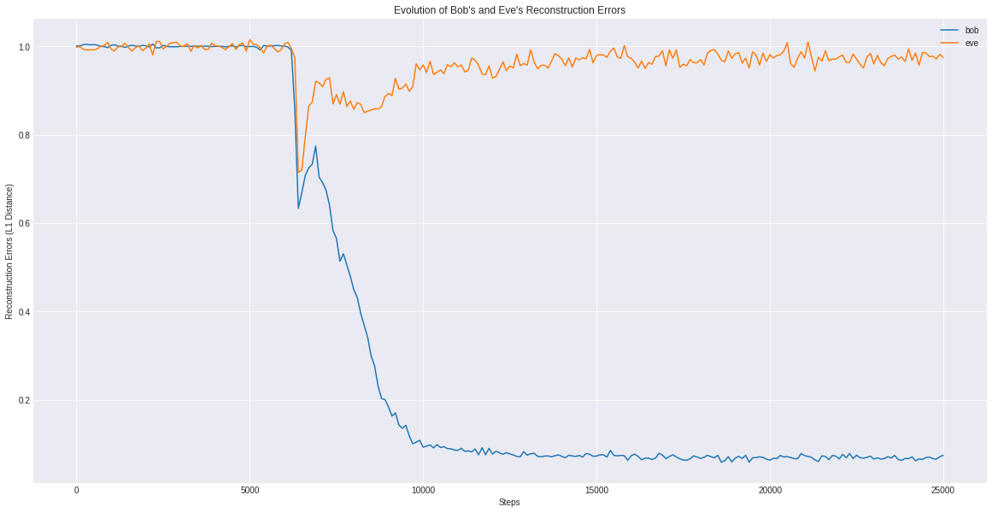
Results: Evolution of Bob’s and Eve’s Reconstruction Errors

Slide 15
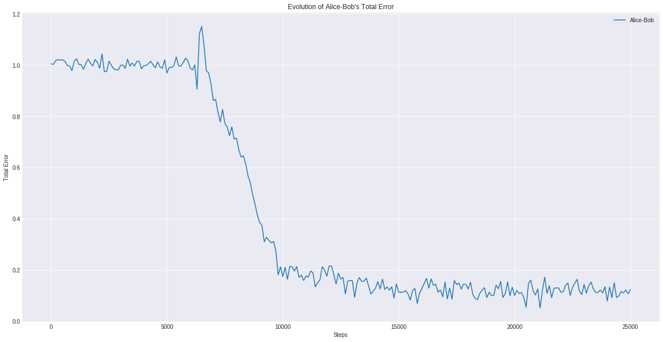
Results: Evolution of Alice-Bobs’ Total Error

Slide 16
Value of Machine Learning in Cryptography
Evidence that Quantum Computers will make current encryption methods obsolete.
Machine Learning encryption systems expose less vulnerabilities because of the variety and complexity of the learned encryption/decryption functions.
The same code and produce radically different encryption/decryption functions.
Democratization of high performance computing resources makes machine learning encryption methods available to wider audience.

Slide 17
Demo

Slide 18
Thank you
Questions?

