Slide 1
BTC/USD Price Prediction with News Sentiment
Does FinBERT news sentiment improve next-day return prediction over a technical-only baseline?
Machine Learning Project | April 2026
[Student Name(s) & ID(s) - UPDATE THIS]

Slide 2
Project Overview
Research Question
Can lagged FinBERT news sentiment improve next-day BTC/USD log-return prediction vs. a technical-indicator-only model?
Approach: Two-Stage Model
Stage 1 (Model A): LightGBM trained on 5 years of 16 technical indicators (RSI, MACD, Bollinger Bands, moving averages, volatility, volume, etc.)
Stage 2 (Model B): ElasticNet trained on the last 65 days to correct Model A's residuals using 11 FinBERT sentiment features from crypto news
Final Prediction = Model A + Model B correction
Pipeline Architecture
Step 1: Load OHLCV data + collect news articles
Step 2: Engineer 16 technical + 11 sentiment features
Step 3: Score headlines with FinBERT transformer
Step 4: Train LightGBM (Model A) on technicals
Step 5: Extract residuals, train ElasticNet (Model B)
Step 6: Walk-forward evaluation with expanding window
Step 7: Backtest with stop-loss / take-profit rules

Slide 3
Datasets & Features
Dataset A: BTC/USD OHLCV (Investing.com)
1,827 daily rows: Apr 2021 - Apr 2026
Columns: Date, Price, Open, High, Low, Volume
Source: investing.com/crypto/bitcoin/historical-data
Feature Groups
Technical (16 features - Model A):
log_return, return_lag1, hl_spread, oc_spread vol_log, volume_change_pct, obv_change_pct price_vs_sma20/50/200, rsi_14, macd_hist bband_pos, atr_pct, vol_10d, vol_30d
Sentiment (11 features - Model B):
sentiment_mean/std/max/min/count positive_ratio, negative_ratio, sentiment_range sentiment_mom_3d/7d, bull_bear_ratio
Leakage Control:
All external features lagged by 1 day Last 65 days held out from Model A training
Dataset B: Crypto News (RSS + Pre-scraped)
75 days of news coverage (Jan - Apr 2026)
Sources: CoinDesk, CoinTelegraph, Decrypt, Bitcoin Magazine, CryptoSlate, The Block
Scored with ProsusAI/FinBERT transformer
External Signals (Optional)
Google Trends: bitcoin, btc, bitcoin price
Fear & Greed Index (Alternative.me)

Slide 4
Model Training
Model A: LightGBM Regressor
Target: next-day log return
Training: 1,762 rows (excl. 65-day news window)
Validation: 5-fold TimeSeriesSplit (no shuffle)
Early stopping: patience=50 iterations
Hyperparameters:
learning_rate=0.05, max_depth=4, num_leaves=15 subsample=0.8, colsample=0.8 reg_alpha=0.01, reg_lambda=0.01 min_child_samples=10
Cross-Validation Results:
Mean CV RMSE: 0.0263 +/- 0.0056
Model B: ElasticNet (Residual Corrector)
Target: Model A residuals (what A got wrong)
Training: 64 rows with actual news coverage
CV: TimeSeriesSplit (2-3 folds, auto-tuned)
Why ElasticNet?
Only 64 samples = needs strong regularization L1 (Lasso): automatic feature selection L2 (Ridge): handles correlated sentiment features ElasticNetCV auto-tunes alpha & l1_ratio
Result:
Best alpha=0.032, l1_ratio=0.90
Non-zero sentiment features: 0 / 11
Sentiment was fully regularized to zero (too few news samples for signal to emerge)

Slide 5
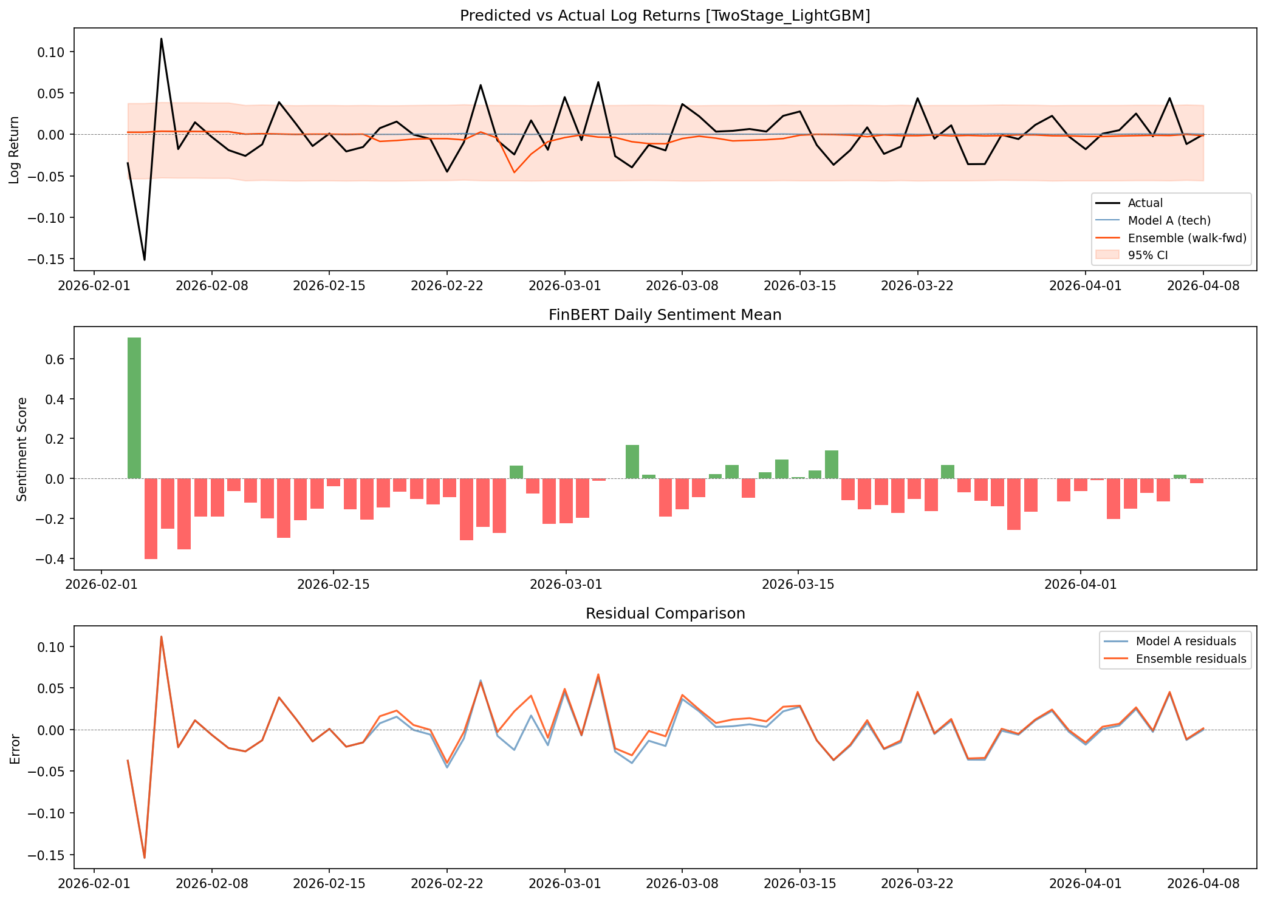
Evaluation: Predicted vs Actual Returns

Slide 6
Model Comparison Results
Walk-Forward Evaluation (last 50 days after 15-day warm-up)
Metric Model A (Tech Only) Ensemble (A+B)
RMSE 0.024682 0.025206
MAE 0.019022 0.019406
Direction Accuracy 46.00% 50.00%
Dir.Acc Lift -- +4.0 pp
Ablation Study: Feature Set Comparison (all LightGBM)
Variant Features RMSE Dir.Acc Backtest Return
A0: Tech Only 16 0.0334 43.1% -4.62%
A1: Tech + Sentiment 27 0.0334 43.1% -4.62%
A2: Tech + Trends 20 0.0338 44.6% -7.08%
A3: Tech + FGI 18 0.0335 41.5% -7.78%
A4: Tech + All 33 0.0343 43.1% -7.14%
Two-Stage (A+B) 27 0.0252 50.0% +0.88%
A1 vs A0 sentiment lift: 0.00 pp (sentiment adds nothing in single-stage LightGBM)
Two-Stage ensemble is the only profitable strategy (+0.88% vs Buy&Hold +6.97%)

Slide 7
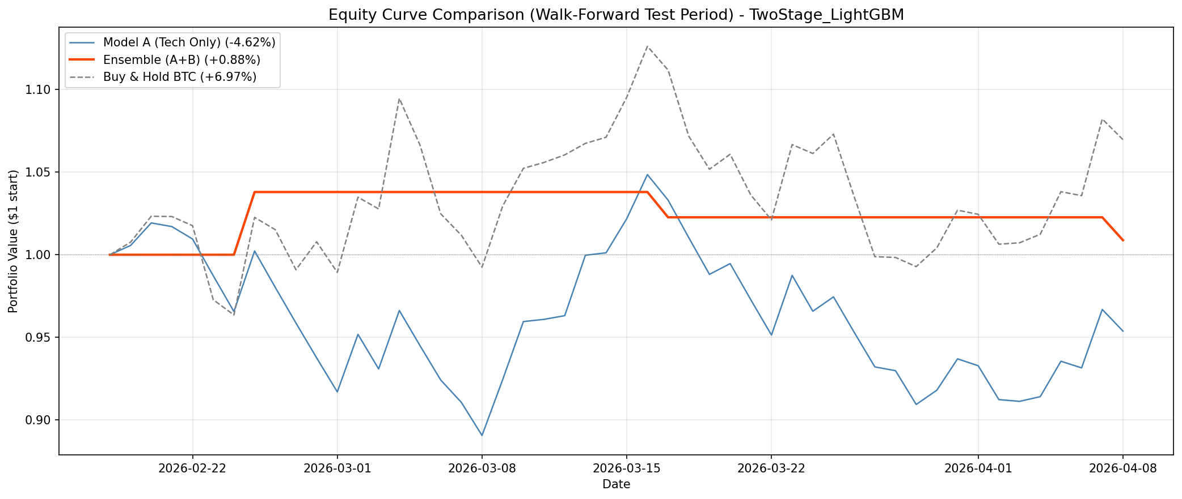
Backtest: Equity Curves
Backtest Summary (50 days)
Stop-Loss: -2% | Take-Profit: +4%
Trading Fee: 0.1% per trade
Model A (Tech Only)
Return: -4.62% | 49 trades | Win: 42.9% Sharpe: -0.52 | Max DD: -13.3%
Ensemble (A+B)
Return: +0.88% | 3 trades | Win: 33.3% Sharpe: +0.51 | Max DD: -2.8%
Buy & Hold BTC
Return: +6.97% | Sharpe: +1.07 Max DD: -11.9%
Key Insight: Ensemble trades rarely (3 vs 49) but avoids large losses. Conservative but risk-managed.

Slide 8
Improved Model: Direction Classifier + Confidence Threshold
3 Key Improvements
1. Direction Classification (not regression)
Predict UP or DOWN instead of exact return. Trading decisions only need direction, not magnitude. Simpler, more learnable task.
2. Single-Stage Model (tech + sentiment)
Train ONE model on ALL 1,762 rows with both feature types. LightGBM handles sparse sentiment naturally (tree-based splits).
3. Confidence Threshold Trading
Only trade when P(up) >= threshold. Filters low-conviction signals, dramatically reduces bad trades.
Threshold Analysis (Tech + Sentiment)
Threshold Trades Accuracy F1
50% 65 60.0% 0.552
52% 36 52.8% 0.485
55% 10 70.0% 0.769
58% 4 75.0% 0.857
Key insight: at 55% threshold, accuracy jumps from 60% to 70% while trading only 10/65 days. Quality over quantity.
At 58% threshold: 75% accuracy, F1=0.857 (only 4 trades but very high conviction)

Slide 9
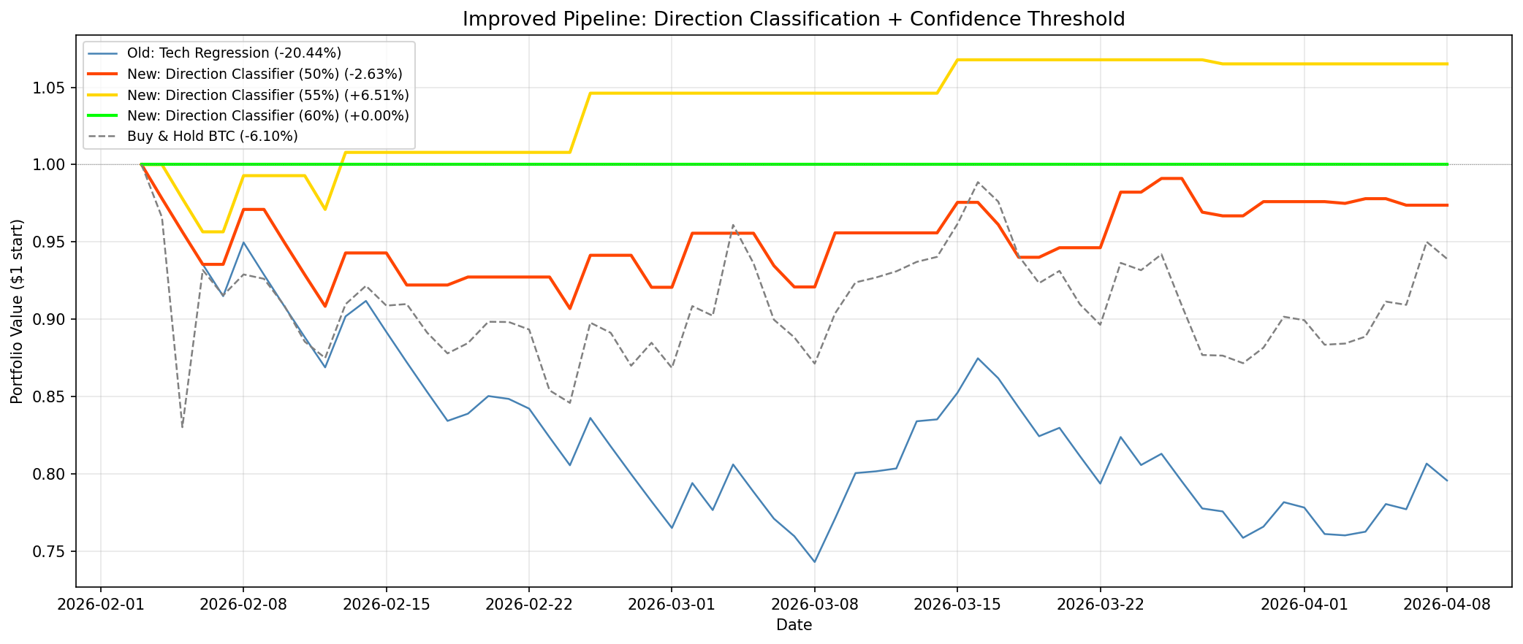
Improved Backtest Results
Strategy Comparison
Old: Tech Regression
Return: -20.4% | 64 trades Sharpe: -2.35 | Max DD: -25.7%
New: Classifier (50% threshold)
Return: -2.6% | 29 trades Sharpe: -0.30 | Max DD: -9.3%
New: Classifier (55% threshold)
Return: +6.51% | 8 trades Sharpe: +1.67 | Max DD: -4.4%
Buy & Hold BTC
Return: -6.1% | Sharpe: -0.20 Max DD: -17.0%
55% threshold BEATS Buy & Hold:
+6.51% vs -6.10% Sharpe 1.67 vs -0.20 Max DD -4.4% vs -17.0%
Improvement: +26.95 pp over old model

Slide 10
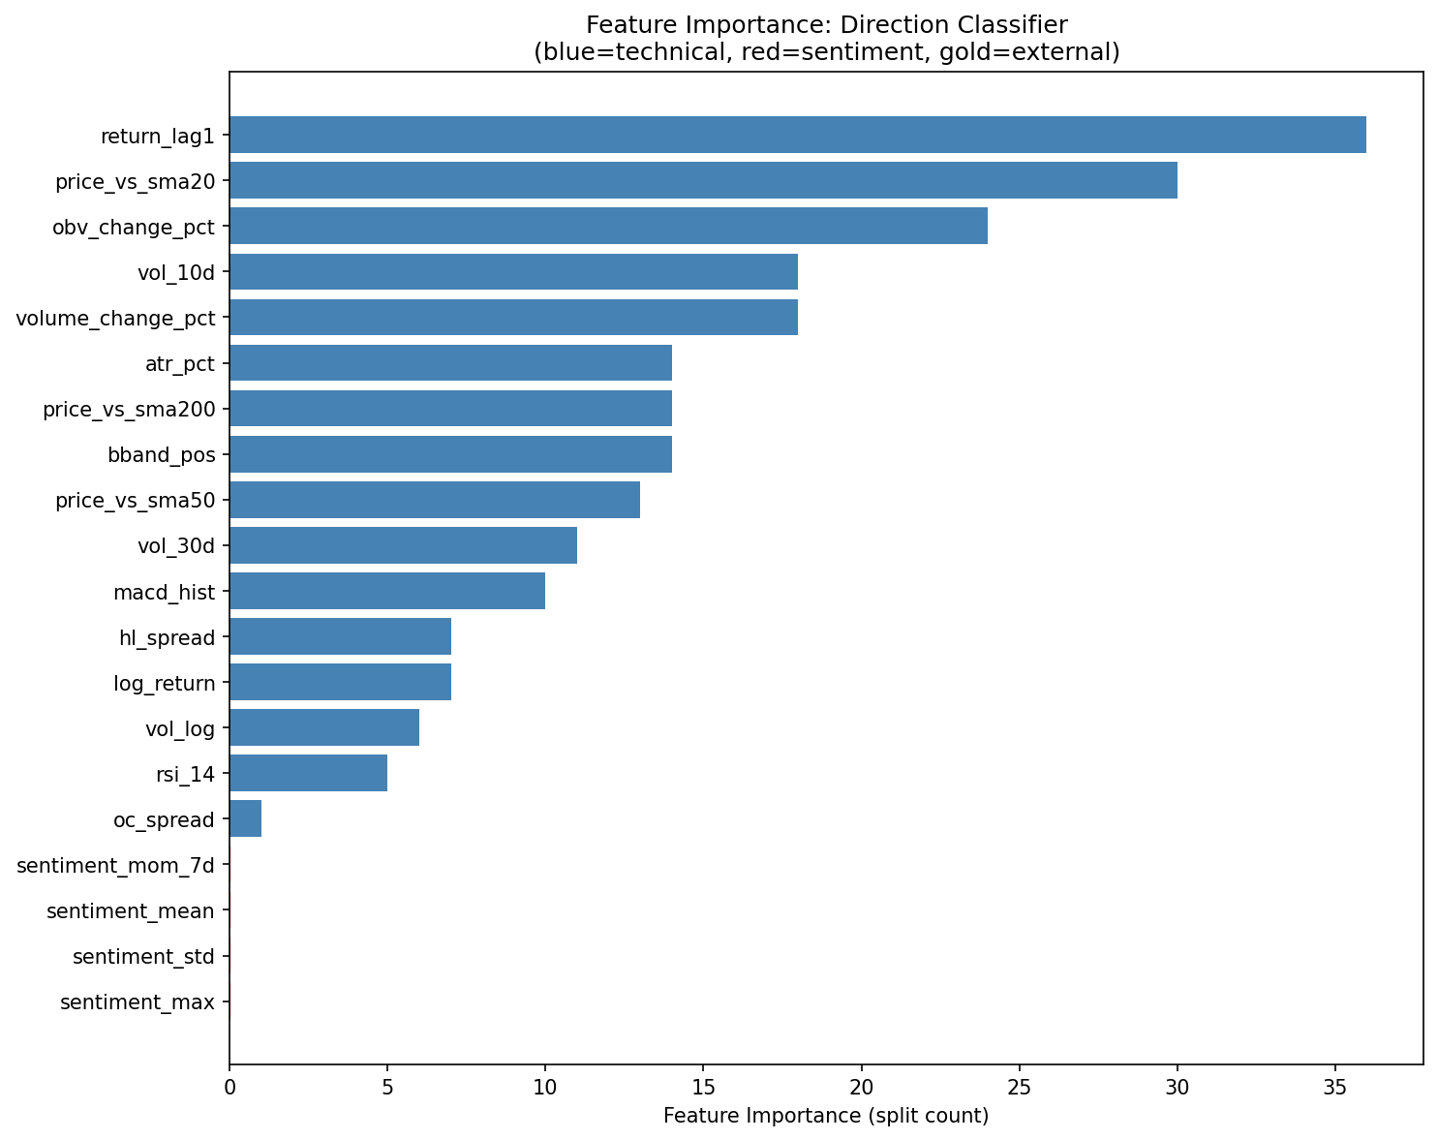
Feature Importance: Direction Classifier
Top Drivers
Most important features:
1. return_lag1 (37) - yesterday's return 2. price_vs_sma20 (30) - trend position 3. obv_change_pct (24) - volume flow 4. vol_10d (18) - short-term volatility 5. volume_change_pct (18) - volume shift
Sentiment features:
sentiment_mom_7d, sentiment_mean, sentiment_std, sentiment_max all show near-zero importance.
Why? Only 72/1,827 days have real news. 96% of rows have zero/forward-filled sentiment = no signal for tree splits.
Conclusion: The improvement comes from classification + confidence threshold, not from sentiment features.

Slide 11
What We Learned / Limitations
Key Findings
Direction classification + confidence threshold is the key breakthrough: +6.51% return, Sharpe 1.67, beating Buy & Hold (-6.1%)
Confidence threshold is critical: at 55%, accuracy jumps from 60% to 70% by filtering out low-conviction predictions (8 vs 64 trades)
Sentiment adds NO value in any model config (A1 = A0 exactly, feature importance near zero) due to sparse news coverage (72/1,827 days)
Max drawdown dramatically improved: -4.4% (new) vs -25.7% (old regression) vs -17.0% (Buy & Hold)
Improvement of +26.95 pp over old regression model (-20.4% to +6.51%) by changing the problem framing, not the features
Limitations
News coverage too sparse: 72 out of 1,827 days means sentiment features have near-zero impact
FinBERT was pretrained on financial text, but crypto-specific slang may not score well
Short backtest window (65 days) makes performance metrics statistically unreliable
No transaction cost modeling beyond flat 0.1% fee; slippage, spread, and market impact are ignored
High confidence threshold (55%+) trades very rarely (8 out of 65 days) - small sample size for statistical significance
Model may be overfitting to recent regime; needs longer out-of-sample testing

Slide 12
Summary & Conclusions
Answer to Research Question
Sentiment does NOT improve prediction (A1 = A0, feature importance near zero).
However, switching from regression to direction classification with a 55% confidence threshold produces +6.51% return (Sharpe 1.67), beating Buy & Hold (-6.1%). Improvement of +26.95 pp over the original regression model.
The breakthrough is problem framing (classification + confidence filtering), not the features. Sentiment needs denser news coverage (72/1,827 days is too sparse).
Predictions / Future Work
More news sources (Twitter/Reddit) could provide daily coverage for all trading days
Multi-day horizons (3-5 day returns) would reduce noise in the target variable
Adaptive threshold: adjust confidence cutoff based on market volatility regime
Longer out-of-sample test (6-12 months) to validate the 55% threshold strategy
Data Sources
BTC/USD OHLCV: investing.com /crypto/bitcoin/historical-data
News: CoinDesk, CoinTelegraph, Decrypt, Bitcoin Magazine, CryptoSlate, The Block (RSS)
Sentiment Model: ProsusAI/FinBERT (HuggingFace transformers)
Fear & Greed: alternative.me API
Google Trends: pytrends library

Slide 13
Thank You
Questions?
Code & data available on request [GitHub/OneDrive link - UPDATE THIS]

