Slide 1
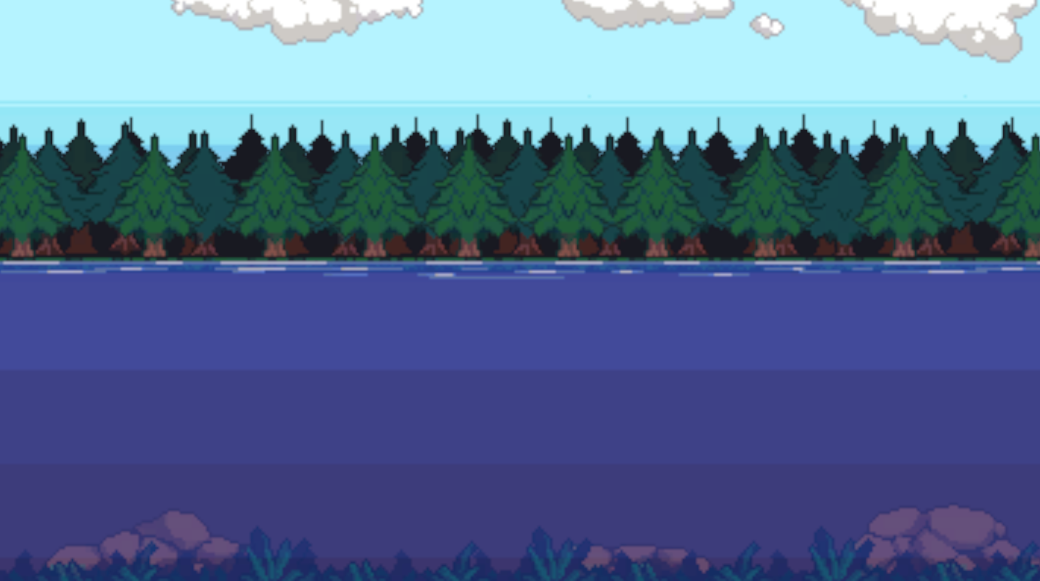
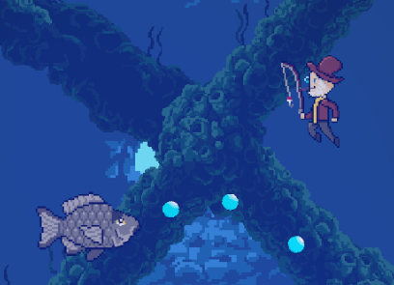
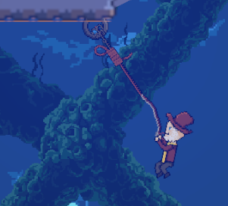
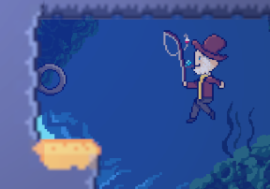
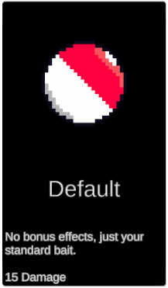
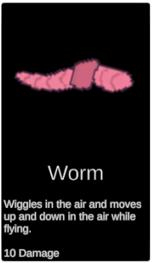
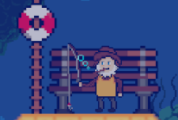
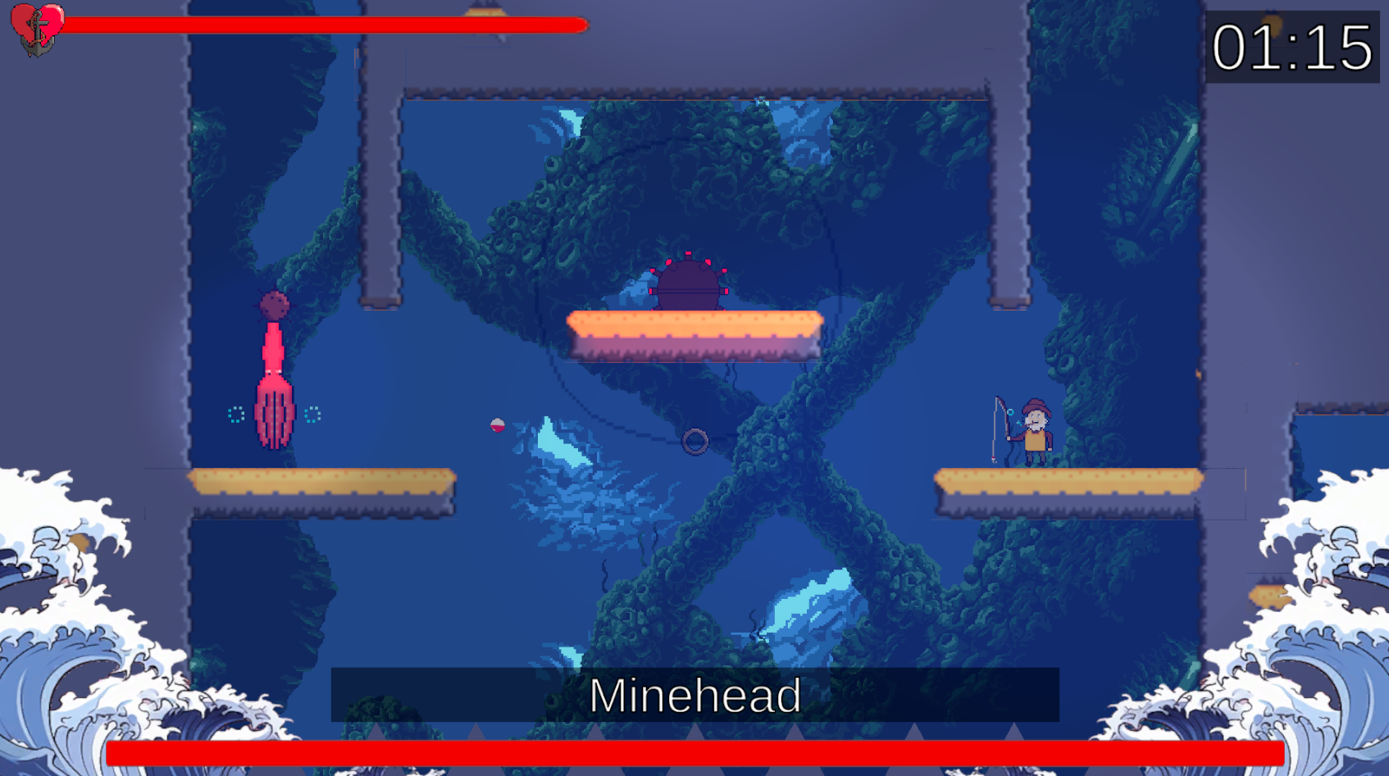
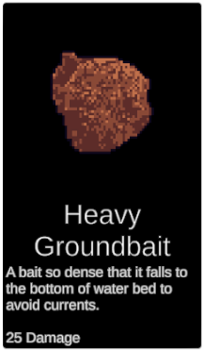
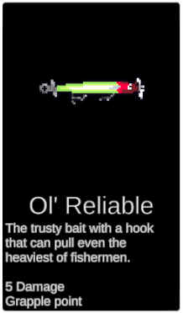



Michael Hooper michael.hooper@students.plymouth.ac.uk BSc (Hons) Computer Science (Games Development)
Hook line and slinger
Summary
Play as a fisherman on the search for the most delicious fish in the land.
Swing around with your trusty fishing rod and throw bait to catch fish.
Master your fishing technique before being tested by challenging bosses.
Bait
Throughout the game, there are various types of bait that the player can obtain that provide different play patterns.
For people of all ages who like games like Cuphead and Hollow Knight
A fishing rod for grappling hook
Pause menu in the style of a restaurant menu
Defeated fish and bosses appear on the menu as food with prices
Additional features include:
Play on pc or controller!
Speedrun timer.
Data stored locally.
More levels in the future.
And much more!
Move from one area to the next to encounter diverse enemies and challenges.
Use your fishing rod to grapple to rings around each level.
Use grapple points to fly through the world or to reveal hidden paths.
Sit at benches to rest and switch up your loadout.
Fight various bosses that test different mechanics

