Slide 1
Project Architecture
Professional Object Oriented Programmers
(Michael Aliberti, Liam Murray, Alexander Pozin, Theodor Waalberg, Dmitry Zimin)

Slide 2
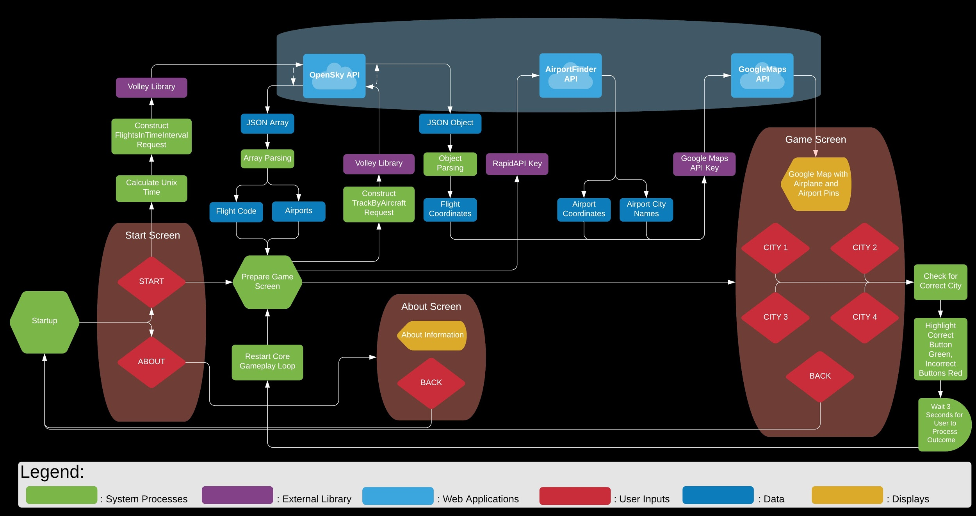

Slide 3
Aero Nav
An android app game
User presented with location and path of plane along with four destination choices
The user is then able to examine the and guess which city is the plane’s destination.
This goal will be accomplished principly through the use of a GUI and multiple APIs.

Slide 4
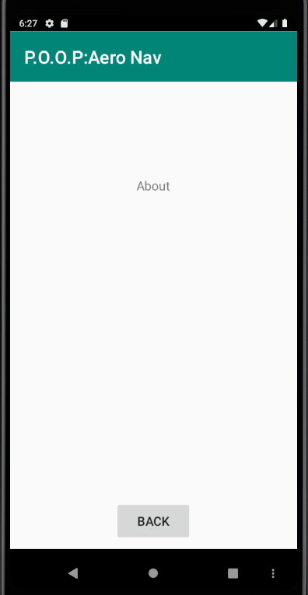
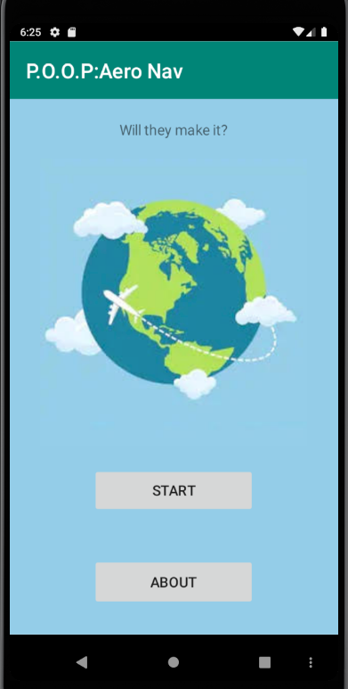
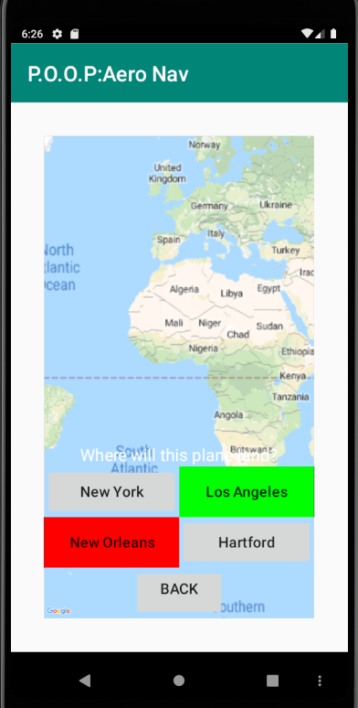
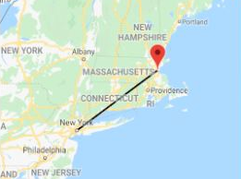
GUI
3 pages
Main
Game
About
Example of flight path and plane marker

Slide 5
APIs
OpenSky:
Purpose: To acquire the longitude and latitude of a plane currently in flight, as well as the plane’s point of origin and destination.
AirportsFinder:
Purpose: To acquire the name of the city in which the destination airport resides as well as three other city names for creating incorrect options.
Google Maps:
Purpose: To generate the map, plane location icon, and path vector.

Slide 6


API Interactions
App opened, play button hit
OpenSky provides plane locations, points of origin, and destinations
AirportFinder uses the destination information to provide the destination city name and coordinates and also provides additional city names and coordinates
Google Maps receives plane, point of origin, and possible destinations for one plane, all of which it plots on a map
The GUI receives the possible destinations to put into the button options

