Slide 1
Medical School Admissions Dataset Curation via Web Scraping and Exploratory Data Analysis

Slide 2
AUTHOR & Background
Michael Welsh (mjw467@drexel.edu) – CHOP Researcher

Slide 3
Overview of Project (1 of 2)
Average acceptance rate out of the ~170 medical schools in the U.S. is around 5.5%
Airfare for interviewing alone can exceed $500, on top of the other hundreds of dollars to apply and send primary/secondary applications to just a single school
Despite these expenses, it's necessary to apply to 20-30 schools to get an acceptance, and for many, you cannot afford, both literally and figuratively, to not get accepted and reapply the following year
How do you pick your list of schools to maximize your chances of acceptance?

Slide 4
Overview of Project (2 of 2)
In this final project, medical school admission statistics are scraped off the Association of American Medical Colleges' (AAMC's) Medical School Admission Requirements (MSAR) website (https://students-residents.aamc.org/) and turned into a dataset
AAMC provides a wealth of knowledge at the school-level, but falls short of having any sort of analysis across all schools, especially tailored to individual applicants, which is the motivation behind this project
Now, this dataset includes numerous things such as MCAT (Medical College Admissions Test)/GPA quantiles, in/out-of-state acceptance rates/bias, demographics, geographics, funding and institution type, residency match rates by specialty, etc
Exploratory data analysis is then performed to determine the list of schools my fiancée (PA resident), based on her background, should apply to, to maximize her chances of acceptance this cycle

Slide 5
Dataset Curation & Data Usage (1 of 8)
AAMC provides yearly reports of MSAR for every medical school in the United States and surrounding regions (such as Canada)
Accessing their data requires a subscription account
Their data usage policy states:
One can use their data for personal and non-profit educational/research purposes (so long as data sharing is restricted)
Web scraping using traditional methods is explicitly prohibited, but manual user-level scraping is allowed

Slide 6
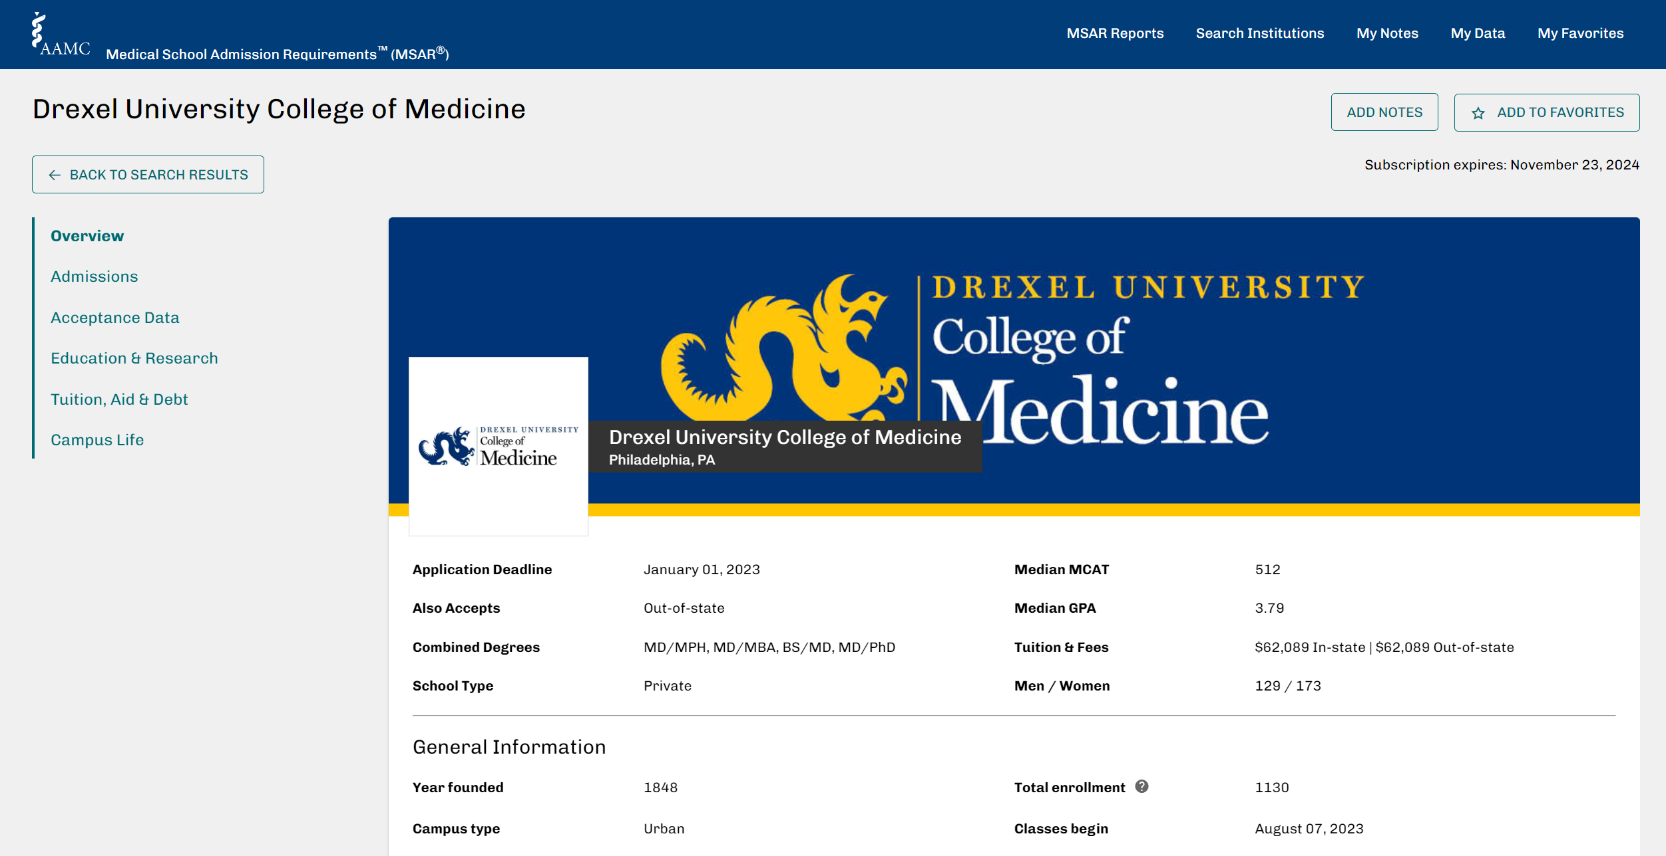
Dataset Curation & Data Usage (2 of 8)

Slide 7
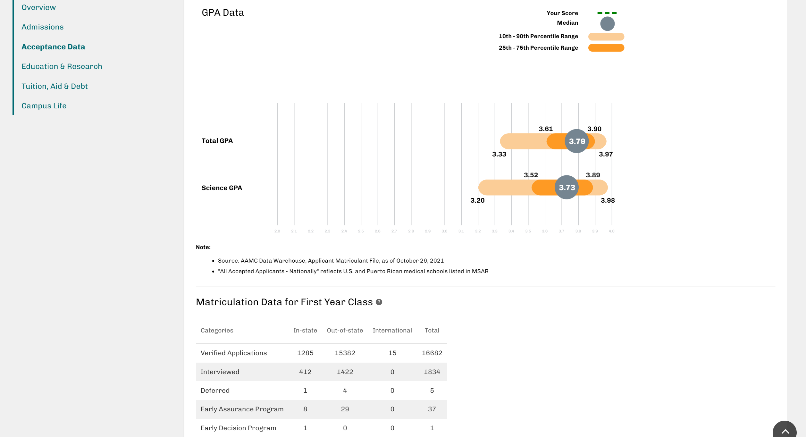
Dataset Curation & Data Usage (3 of 8)

Slide 8
Dataset Curation & Data Usage (4 of 8)
For each school, I manually copy/pasted the entire associated webpage text into a standalone text file
Then, using regular expressions and some python wizardry, I parsed each text file representing each school and created a usable CSV file
Some manual intervention was required for some schools that have inconsistent formats in some features
The only strictly-manual recording needing to be done was of the GPA/science GPA quantiles and if any applicants matriculated from Pennsylvania (due to regular expression limitations and a lack of standardized format on their website)
During curation, some medical schools were excluded by default because they did not meet the following inclusion criteria:
School must have provided data (some schools didn't because they were just founded or are stingy)
School must be in the U.S
If the school is not in PA, then it must accept out-of-state students
The end result was a dataset of 139 schools and 152 features
Despite all these features, only a small subset was determined useful in this analysis

Slide 9
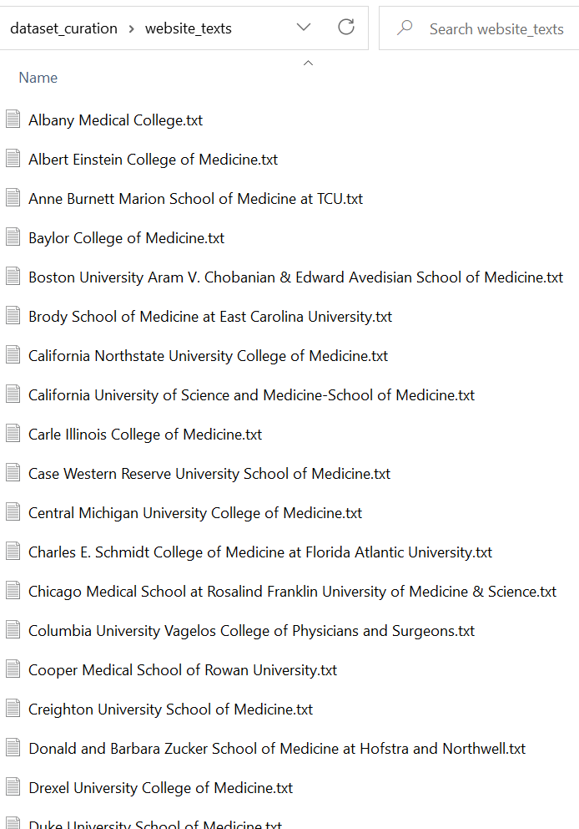
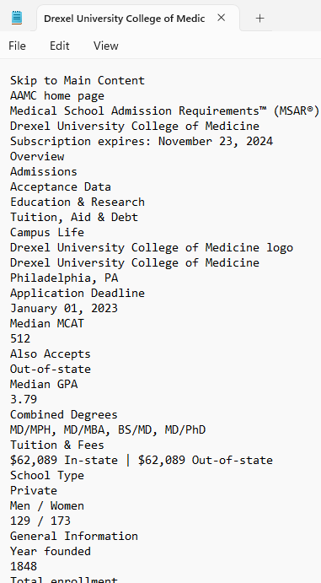
Dataset Curation & Data Usage (5 of 8)

Slide 10
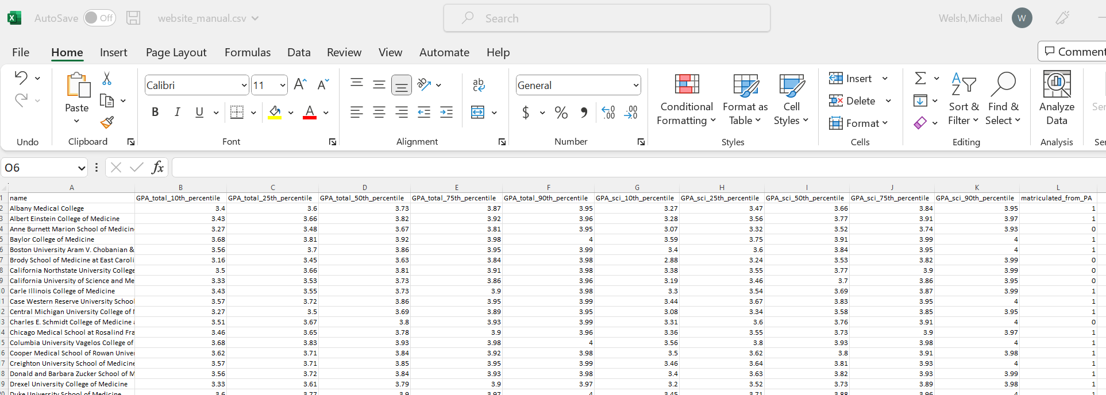
Dataset Curation & Data Usage (6 of 8)

Slide 11
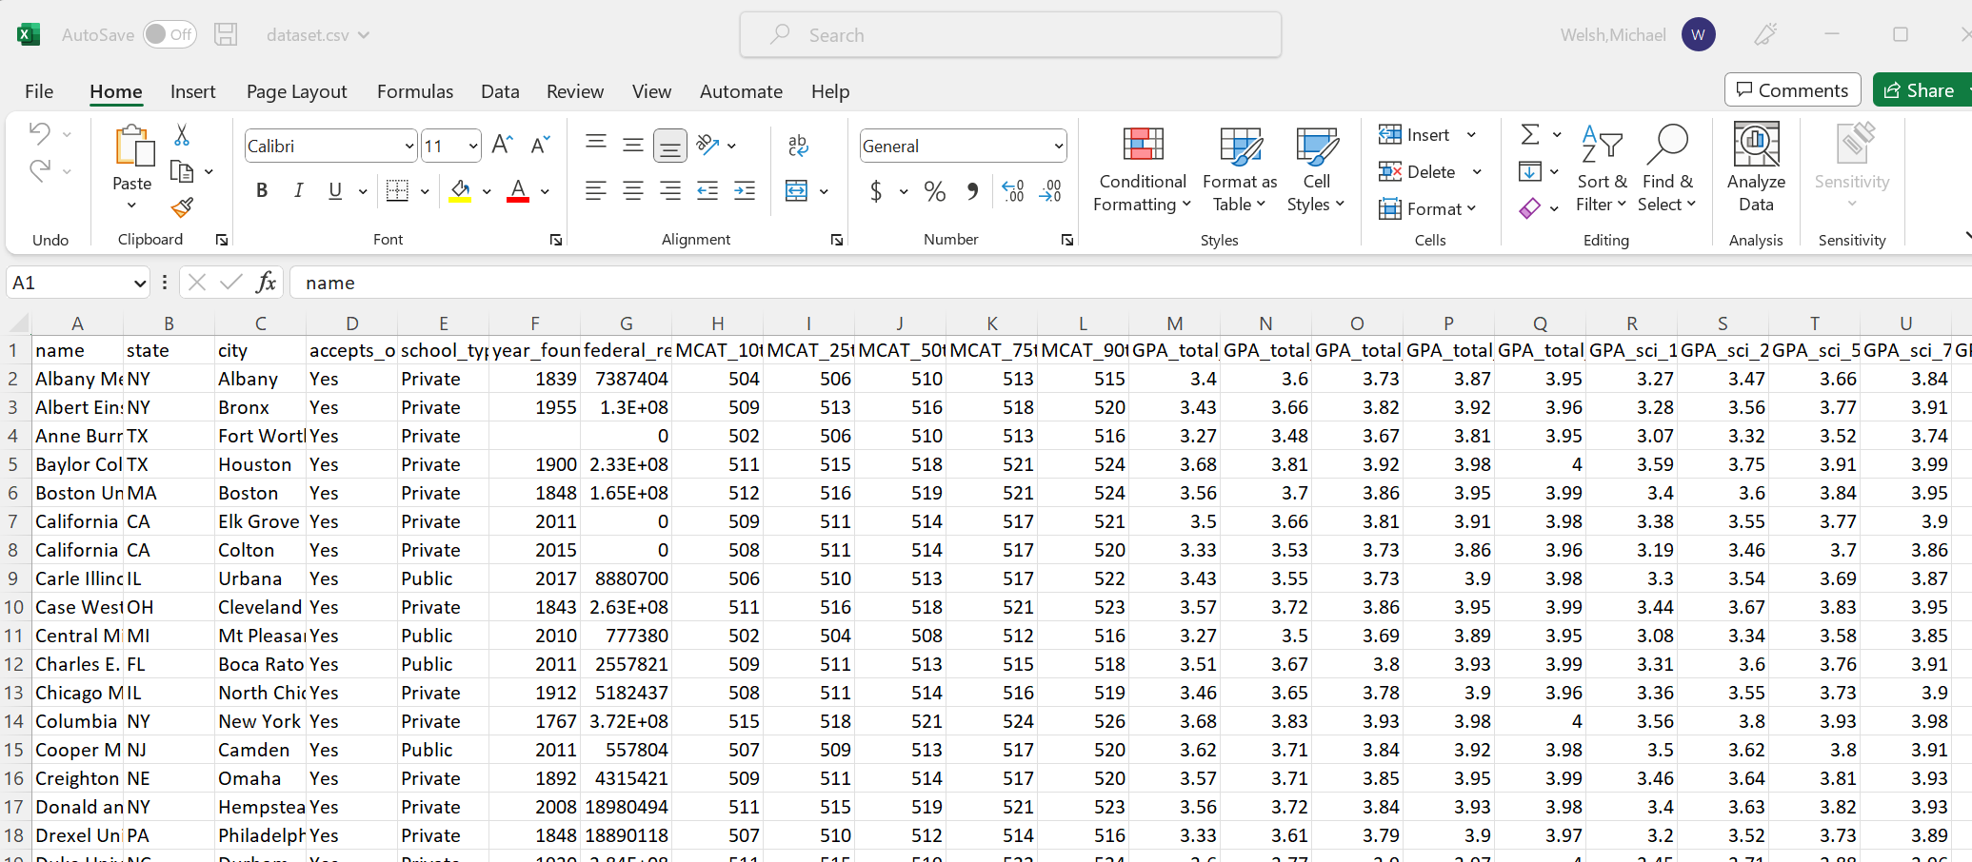
Dataset Curation & Data Usage (7 of 8)

Slide 12
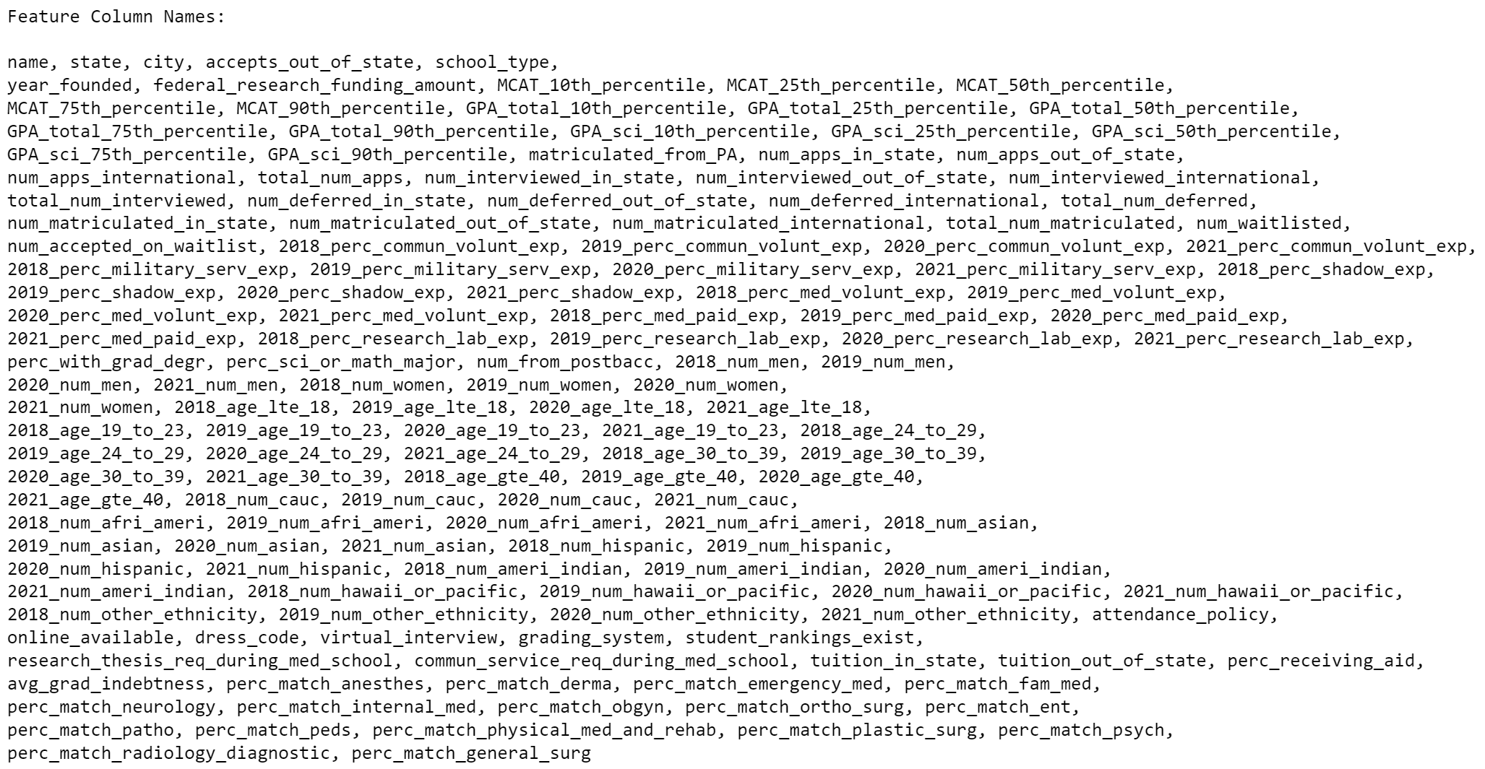
Dataset Curation & Data Usage (8 of 8)

Slide 13
Analytic Approach (1 of 7)
The goal is to determine the list of schools my fiancée (PA resident), based on her background, should apply to, to maximize her chances of acceptance this cycle
This can easily be done if a means of ranking/ordering schools based on chances of acceptance exists
MCAT/total-GPA/science-GPA quantiles (quantiles of fiancée's stats relative to that respective school), and the odds of being interviewed as a PA resident, were determined to be the most important factors in estimating chances of acceptance with a school
The higher these 4 metrics, the higher the chances of acceptance into that respective school
It's hard to say which metric is more important (weighs more) than the others and by how much; however, it’s well known that a person's MCAT score is weighed more heavily by interview committees than other scores
With these 4 metrics, a pseudo-ranking algorithm was developed and used to rank/order schools based on chances of acceptance
First, these 4 metrics will be further explained…

Slide 14
Analytic Approach (2 of 7)
We are only given the 10/25/50/75/90 % quantile values for each school
The goal is to estimate which quantile the user's stats belong to for each test for each school
If we can determine the difference between Q2 and Q1, and Q3 and Q2 are roughly equal (in other words, if (Q2 - Q1) / (Q3 - Q2) is roughly equal to 1), then we can conclude the distribution is roughly normal and can estimate the mean/std accordingly to further calculate the quantiles of the user's stats for that respective school
In other words, if roughly normal, we could say:
mean = median
std = (Q2 − Q1) / 0.674 = (Q3 − Q2) / 0.674

Slide 15
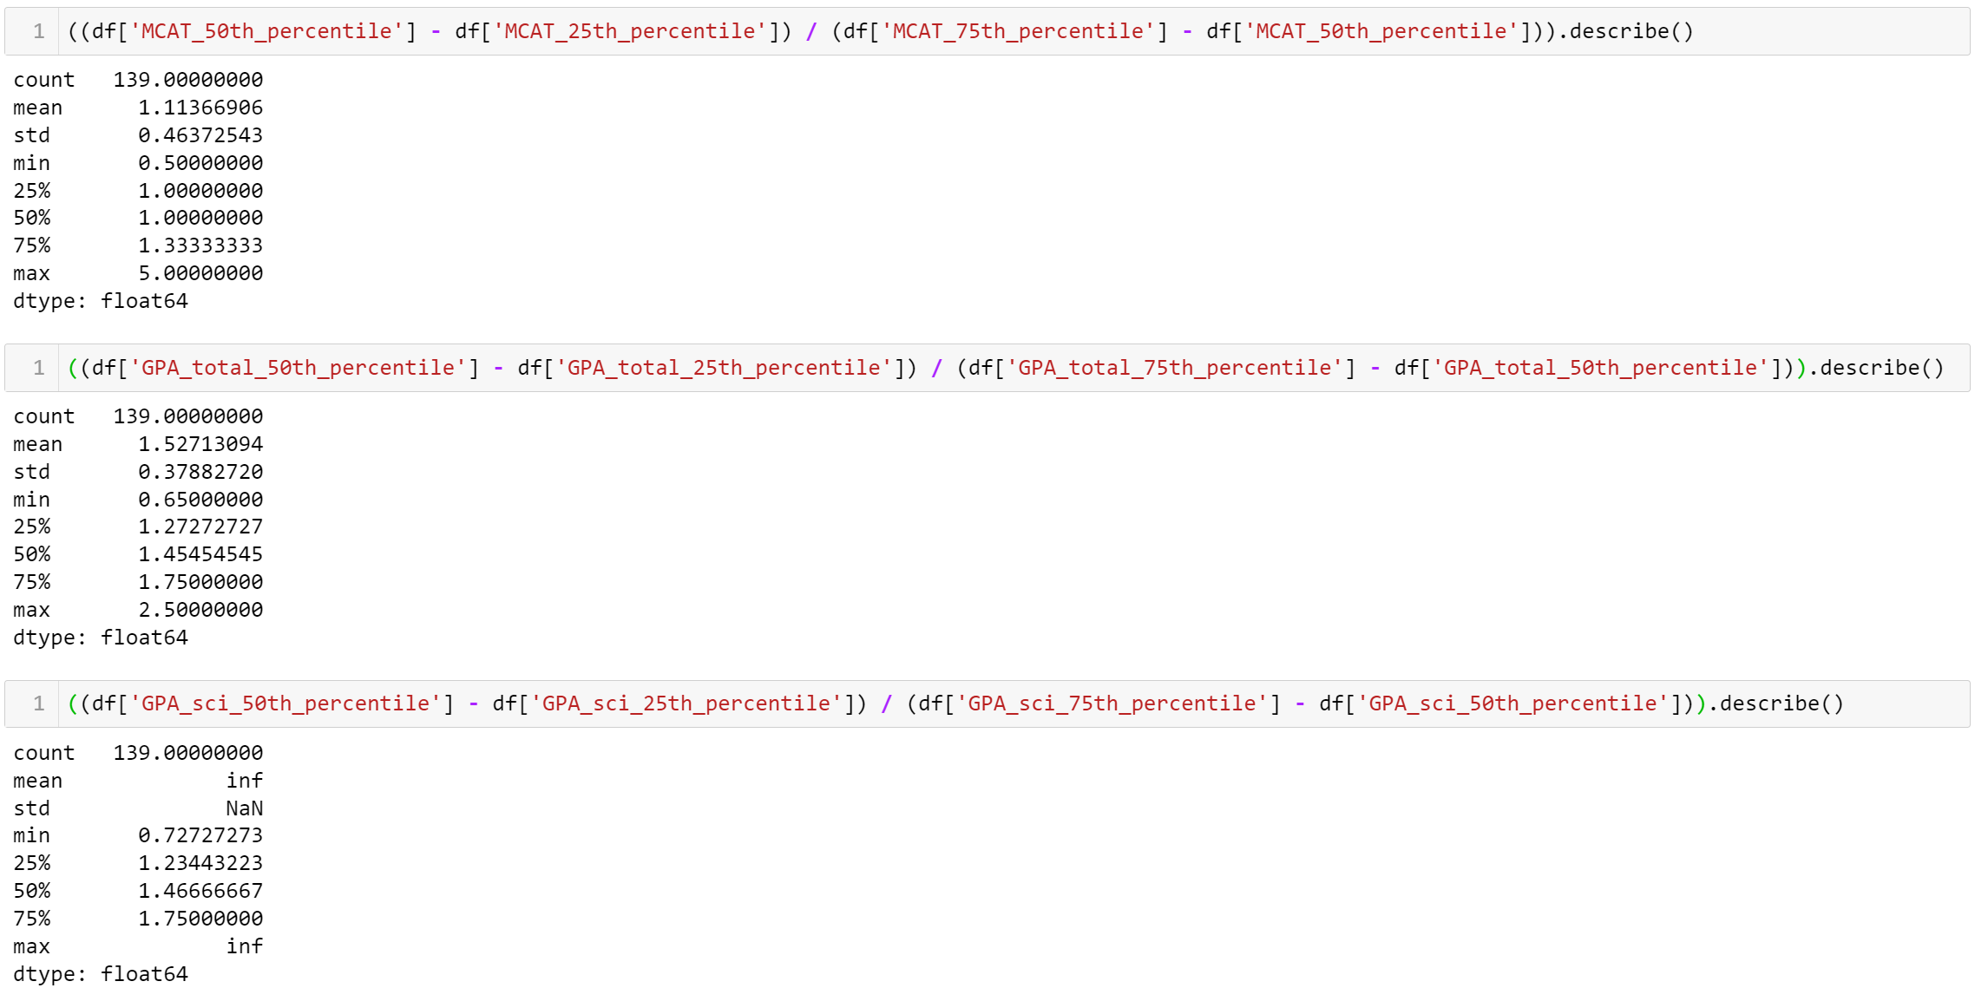
Analytic Approach (3 of 7)

Slide 16
Analytic Approach (4 of 7)
We end up seeing the MCAT score across all schools is fairly normal, with the mean being roughly equal to the median (outliers definitely exist, which skews the distribution slightly left, since the mean is marginally greater than the median)
Similarly, the total GPA is also fairly normal, with the mean and median being roughly equal and the mean being slightly larger than the median indicating the distribution being slightly skewed left
The science GPA has some divide-by-zero issues, meaning some Q3's = Q2's, which is a phenomenon I did see in curating this dataset, but Q1/median/Q3 is pretty much the same as the total GPA, so we can conclude it is also fairly equal
All in all, we can conclude that the MCAT, total GPA, and science GPA's reported by schools are fairly normal; therefore, we can estimate the mean/std fairly accurately, which are then used to calculate what quantile's the user's stats are in for each school
Stats used to calculate quantile placement relative to each school:
MCAT = 512
Total GPA = 3.69
Science GPA = 3.48

Slide 17
Analytic Approach (5 of 7)
The next step was to analyze the odds of being interviewed given the user is a PA resident
We do interviews here instead of whether or not they matriculated, because it is common knowledge that no one will turn down an interview, but people most certainly turn down out-of-state schools (assuming they got offers elsewhere) due to inflated out-of-state tuition prices
In other words, the odds of matriculation are potentially more biased than the odds of being interviewed
3 schools had no interview data, so their matriculation data was used in-place for a rough estimate of what their interview data might be
Since it was only 3 schools, this imputation method is fine
Any odds(interview | PA resident) >= 1 is great, because it means you are that many times more likely to get interviewed purely based on living in PA than if you didn’t live in PA

Slide 18
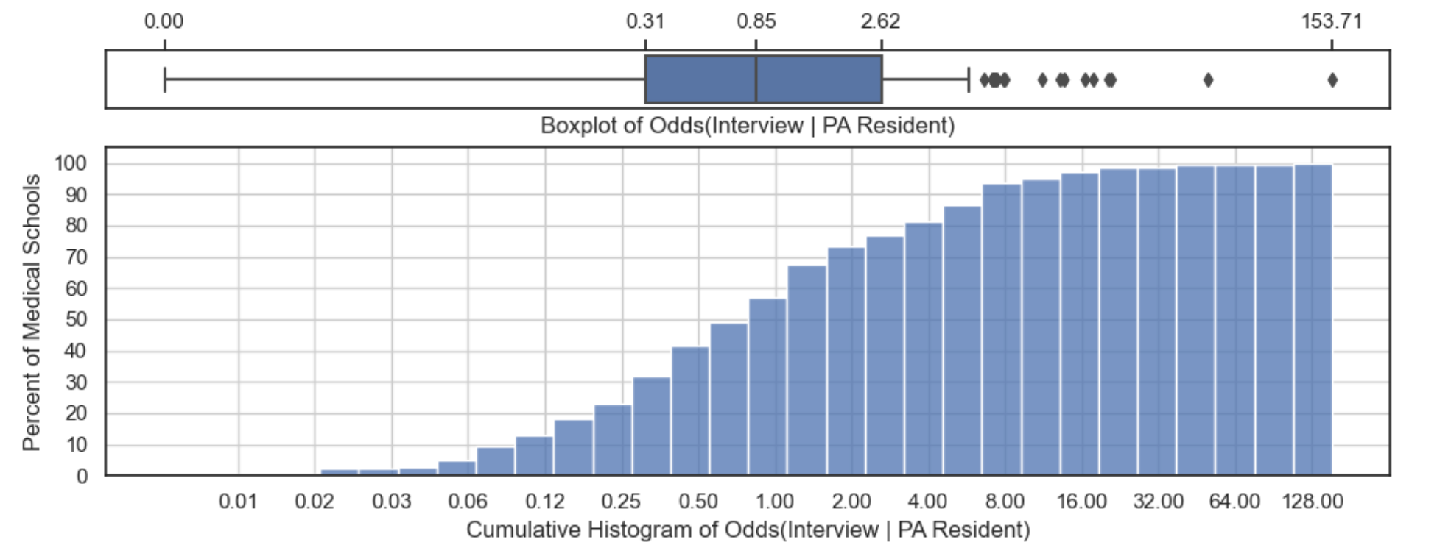
Analytic Approach (6 of 7)

Slide 19
Analytic Approach (7 of 7)
With the 4 calculated metrics, the schools can be ranked via the pseudo-ranking algorithm
The way this is done is by counting from 1.0 to 0.0 and keeping track of which schools have all 4 metrics greater than or equal to the counter (a sort of quantile threshold)
This allows us to determine which schools fall at a specific quantile
If multiple schools fall at a specific quantile, they are sorted by the above 4 metrics in order (so sorted first by MCAT quantile because we can generally say its most important, then by total-GPA quantile, then science-GPA quantile, and finally by Odds)
The result is a pseudo-ranking of schools from best (rank 1) to worst (rank 139) chances of acceptance

Slide 20
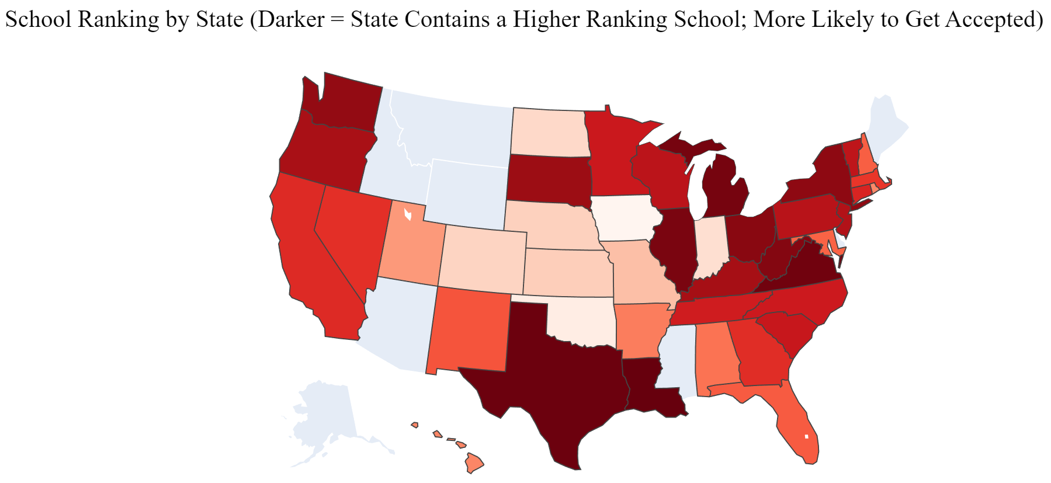
Results (1 of 5)
I first analyze the rankings by state using a choropleth map
It's apparent that the northeast, south, and west-coast states have schools that have the greatest chances of acceptance

Slide 21
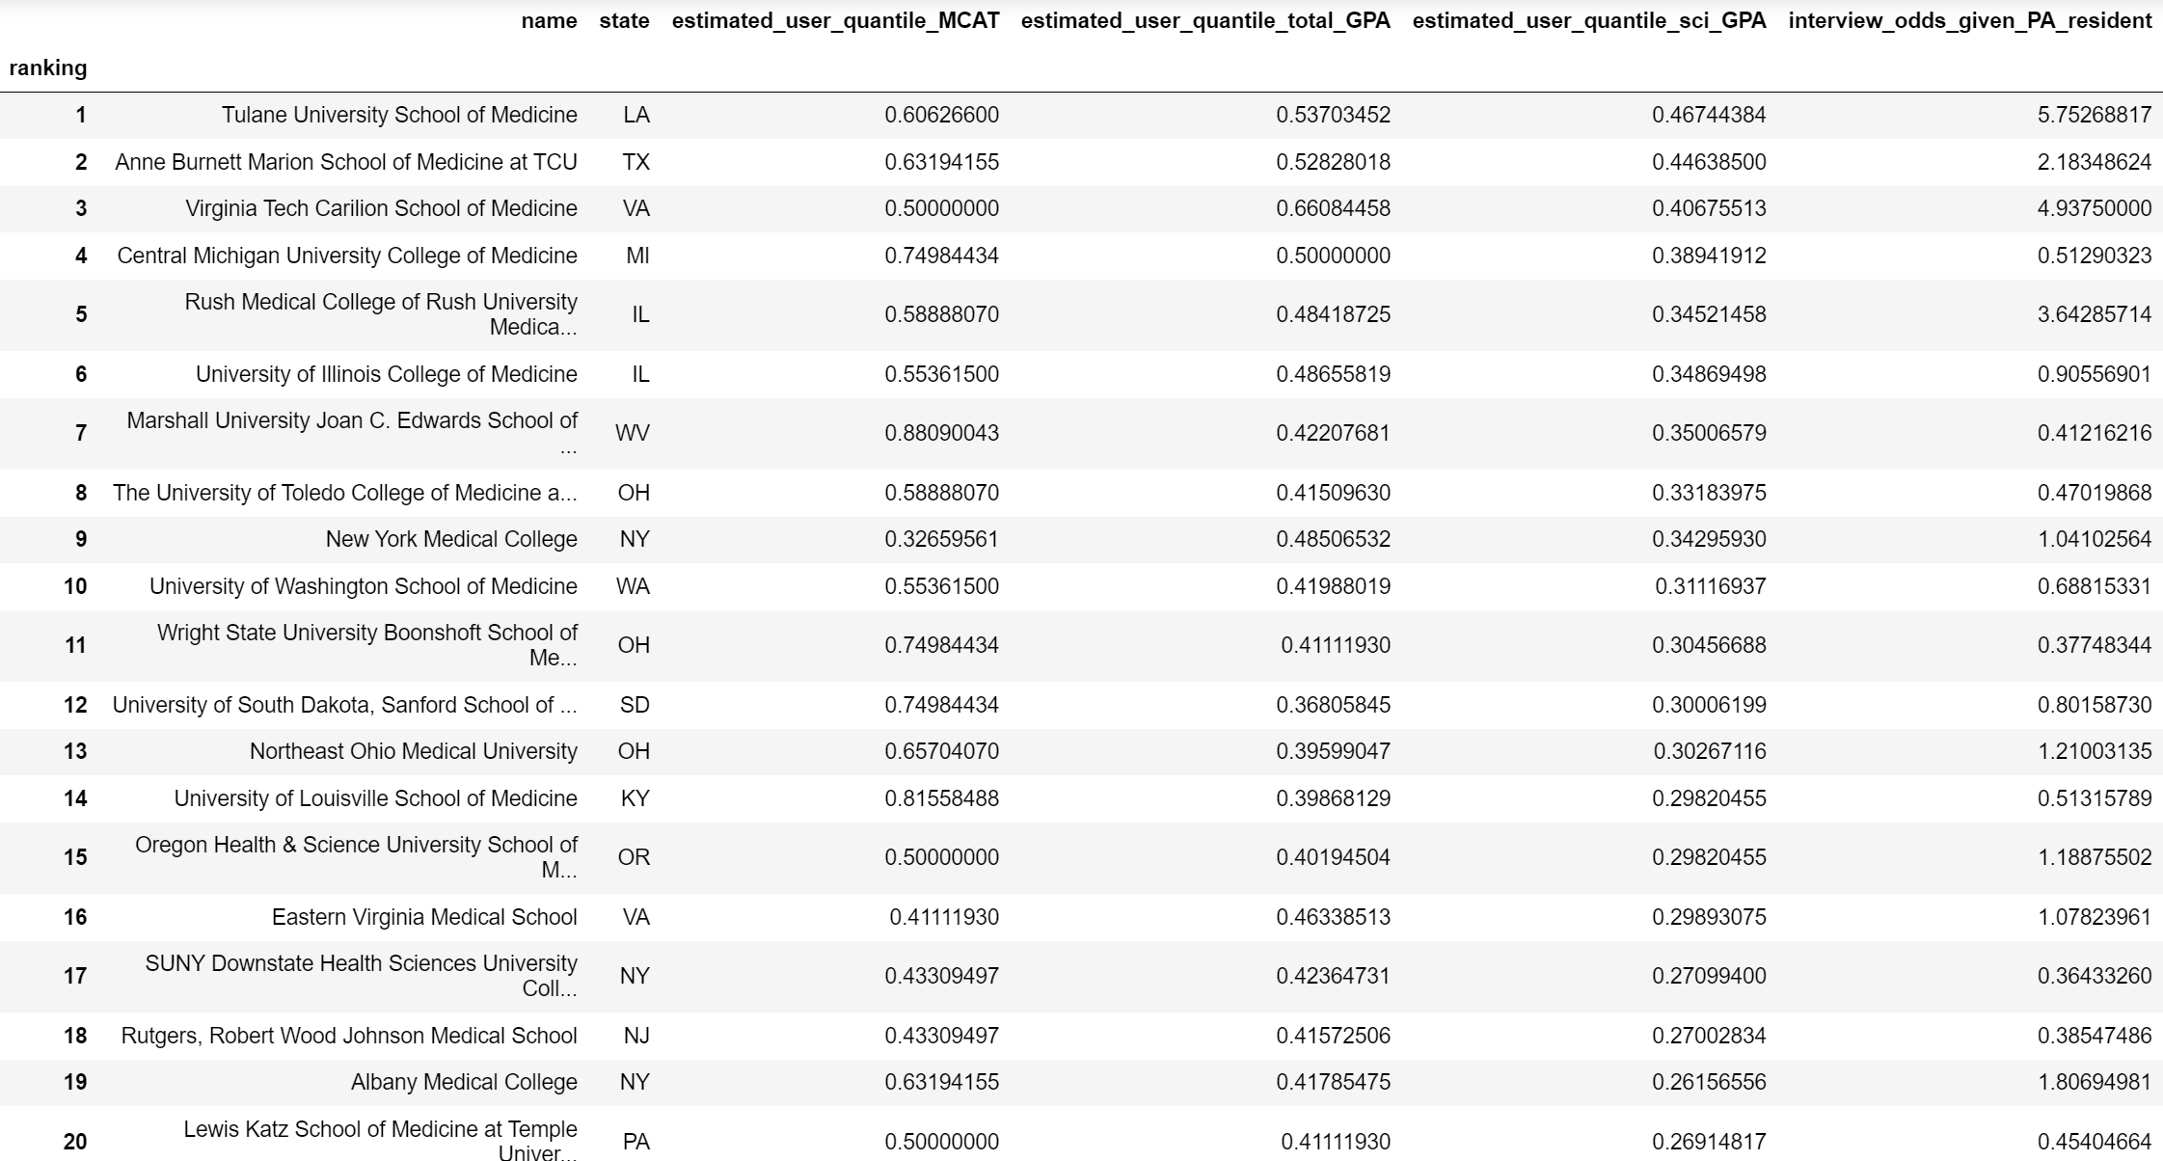
Results (2 of 5)
Next, I list the top 20 schools

Slide 22
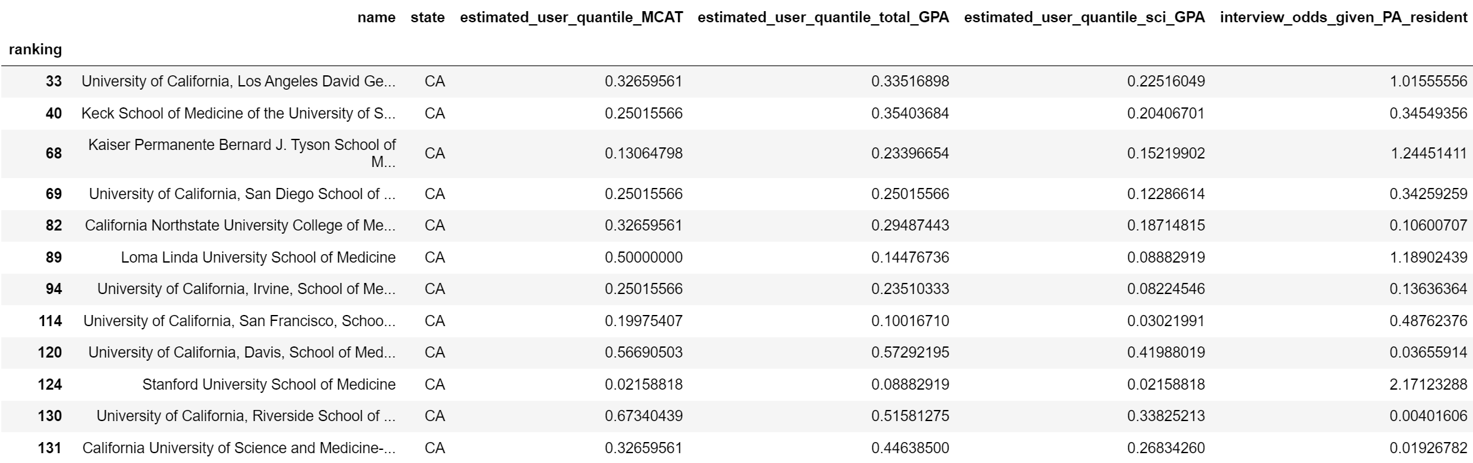
Results (3 of 5)
Then, I list all schools in just California (we want to eventually move here)

Slide 23
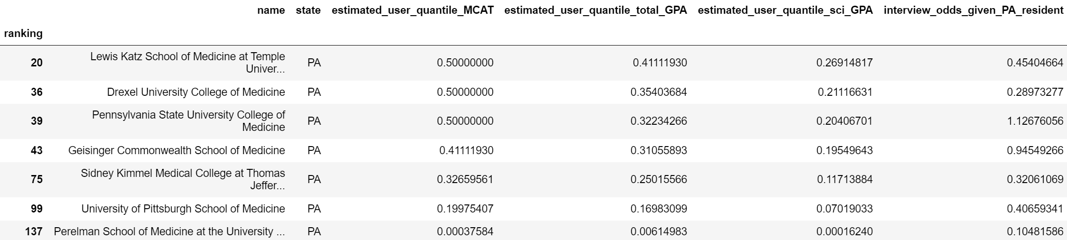
Results (4 of 5)
Then, I list all schools in just Pennsylvania (location, in-state tuition, etc)
One thing worth noting is she went to PSU for her undergraduate degree; Penn State Hershey Medical School has a known bias towards Penn State undergrads and her chances of acceptance at Hershey are presumably higher than the listed metrics

Slide 24
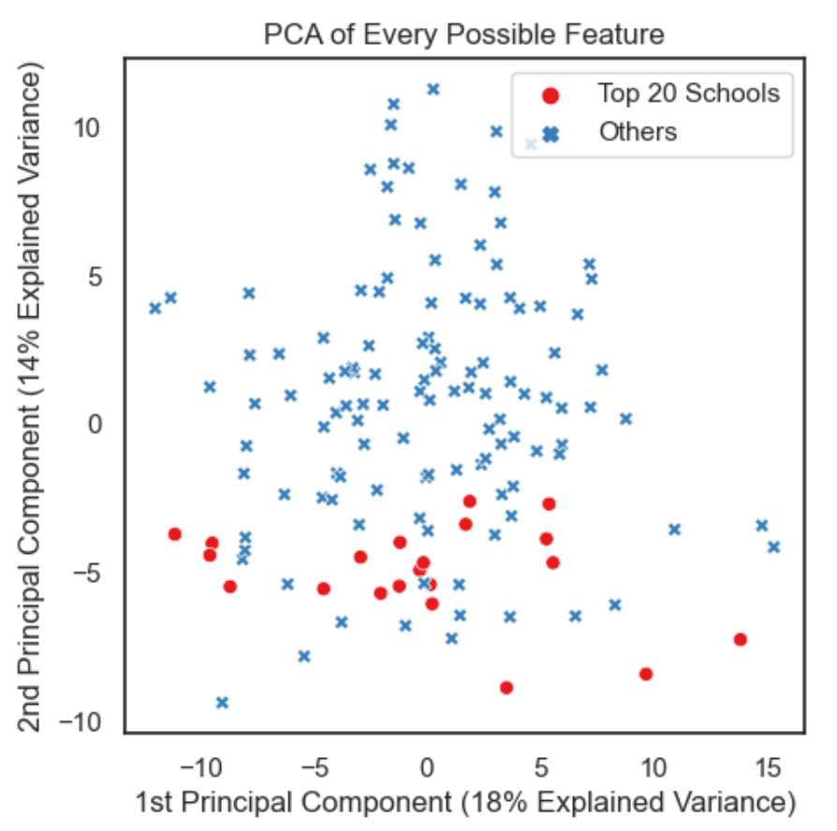
Results (5 of 5)
Finally, I perform PCA on all features (including the 4 new metrics)
It’s clear the top 20 ranked schools aren't obvious and PCA/Clustering methods provide much less insight in this context than our analytic approach

Slide 25
Limitations
The hardest part of this project was the dataset curation process
It took a substantial amount of time collecting data due to the sheer number of schools and features, even with using regular expressions
AAMC's data usage policy means an automatic pipeline to download updated yearly information is prohibited, meaning this project would always require the manual data collection step if turned into a tool for other users, and I'd have to limit how information is shared to further adhere to their usage policy
Also, I did my analysis from the perspective of a PA applicant who wants to stay in the U.S, which obviously isn't representative of all applicants
All this said, I was able to produce a realistically great list of schools for my someone like my fiancée to apply to; thus, I achieved my goal

Slide 26
Questions?

