Slide 1
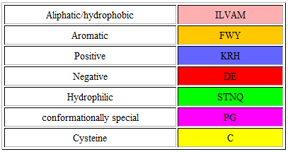
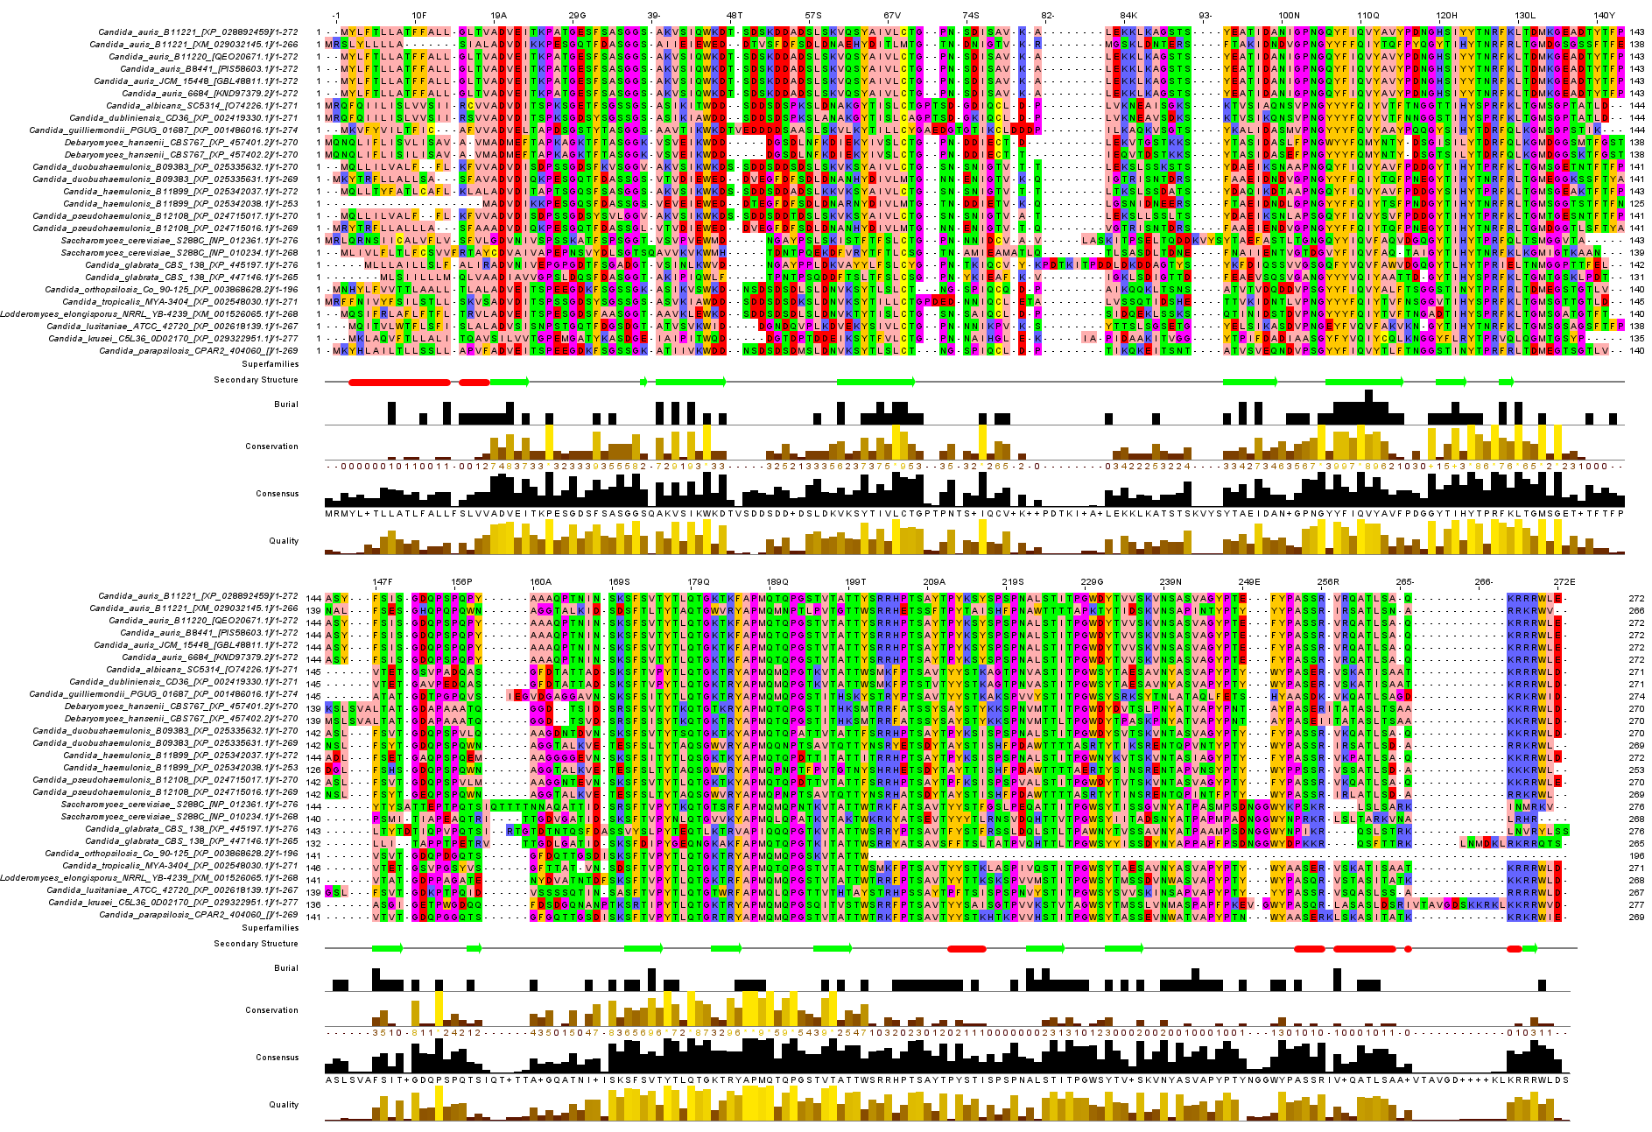
Beta Sheets
Alpha Helices
Signal Peptide
GPI-anchored superfamily
KRE9 superfamily
Figure 1: Multiple Sequence Alignment

Slide 3
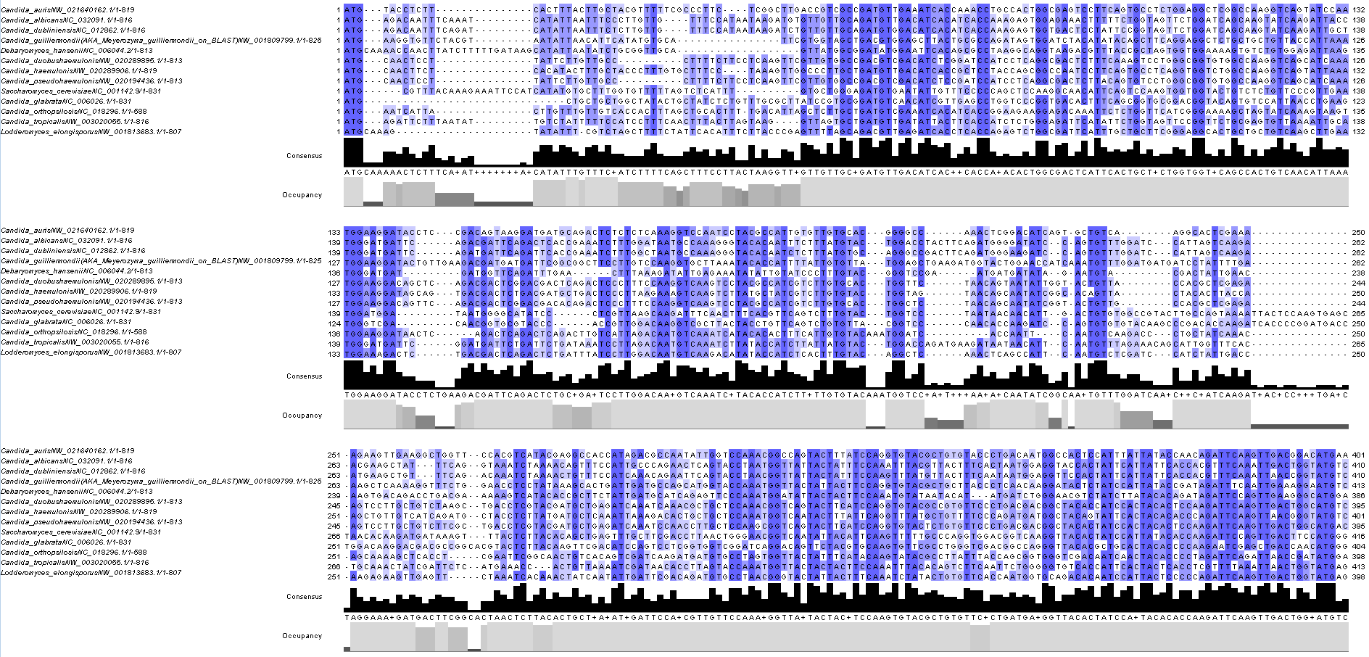
Multi-sequence Alignment

Slide 4
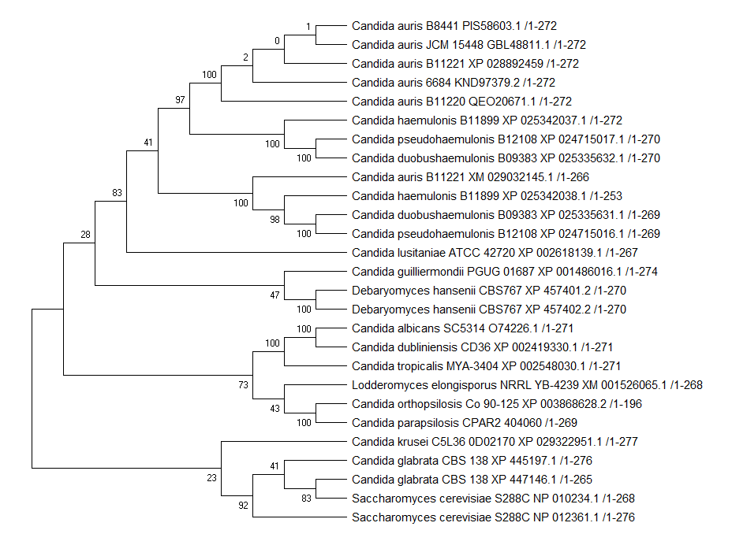
Maximum Parsimony Tree
Maximum Parsimony analysis of taxa
The evolutionary history was inferred using the Maximum Parsimony method. Tree #1 out of 5 most parsimonious trees (length = 1540) is shown. The consistency index is ( 0.636856), the retention index is ( 0.693188), and the composite index is 0.451923 ( 0.441461) for all sites and parsimony-informative sites (in parentheses). The percentage of replicate trees in which the associated taxa clustered together in the bootstrap test (100 replicates) are shown next to the branches [1]. The MP tree was obtained using the Subtree-Pruning-Regrafting (SPR) algorithm (pg. 126 in ref. [2]) with search level 1 in which the initial trees were obtained by the random addition of sequences (10 replicates). This analysis involved 27 amino acid sequences. There were a total of 323 positions in the final dataset. Evolutionary analyses were conducted in MEGA X [3]. 1. Felsenstein J. (1985). Confidence limits on phylogenies: An approach using the bootstrap. Evolution 39:783-791.
2. Nei M. and Kumar S. (2000). Molecular Evolution and Phylogenetics. Oxford University Press, New York.
3. Kumar S., Stecher G., Li M., Knyaz C., and Tamura K. (2018). MEGA X: Molecular Evolutionary Genetics Analysis across computing platforms. Molecular Biology and Evolution 35:1547-1549.
Disclaimer: Although utmost care has been taken to ensure the correctness of the caption, the caption text is provided "as is" without any warranty of any kind. Authors advise the user to carefully check the caption prior to its use for any purpose and report any errors or problems to the authors immediately (www.megasoftware.net). In no event shall the authors and their employers be liable for any damages, including but not limited to special, consequential, or other damages. Authors specifically disclaim all other warranties expressed or implied, including but not limited to the determination of suitability of this caption text for a specific purpose, use, or application.
FIGURE 2: Maximum Parsimony Tree

Slide 5
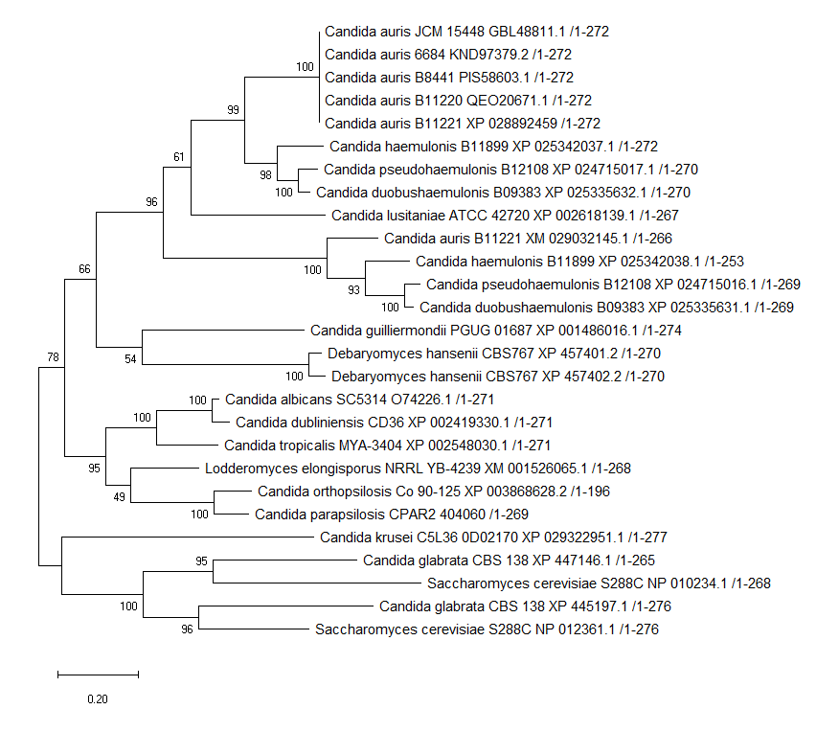
Maximum Likelihood Tree
Evolutionary analysis by Maximum Likelihood method The evolutionary history was inferred by using the Maximum Likelihood method and JTT matrix-based model [1]. The tree with the highest log likelihood (-8507.65) is shown. The percentage of trees in which the associated taxa clustered together is shown next to the branches. Initial tree(s) for the heuristic search were obtained automatically by applying Neighbor-Join and BioNJ algorithms to a matrix of pairwise distances estimated using a JTT model, and then selecting the topology with superior log likelihood value. The tree is drawn to scale, with branch lengths measured in the number of substitutions per site. This analysis involved 27 amino acid sequences. There were a total of 323 positions in the final dataset. Evolutionary analyses were conducted in MEGA X [2].
1. Jones D.T., Taylor W.R., and Thornton J.M. (1992). The rapid generation of mutation data matrices from protein sequences. Computer Applications in the Biosciences 8: 275-282.
2. Kumar S., Stecher G., Li M., Knyaz C., and Tamura K. (2018). MEGA X: Molecular Evolutionary Genetics Analysis across computing platforms. Molecular Biology and Evolution 35:1547-1549.
Disclaimer: Although utmost care has been taken to ensure the correctness of the caption, the caption text is provided "as is" without any warranty of any kind. Authors advise the user to carefully check the caption prior to its use for any purpose and report any errors or problems to the authors immediately (www.megasoftware.net). In no event shall the authors and their employers be liable for any damages, including but not limited to special, consequential, or other damages. Authors specifically disclaim all other warranties expressed or implied, including but not limited to the determination of suitability of this caption text for a specific purpose, use, or application.
FIGURE 3: Maximum Likelihood Tree

Slide 6
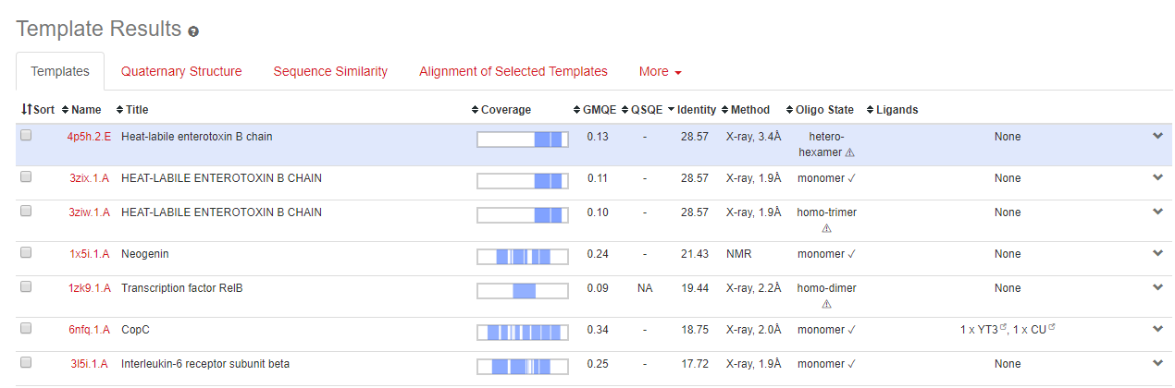
SWISS-MODEL

Slide 7
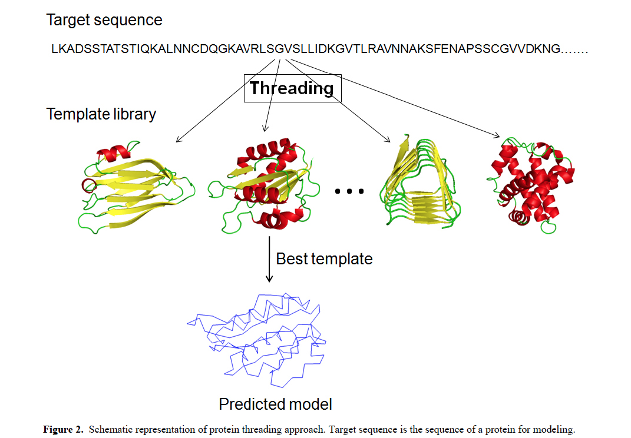
Protein Threading
Jun-tao Guo, Ying Xu. 2009. Towards modeling of amyloid fibril structures. Frontiers in Bioscience 13, 4039-4050.

Slide 8
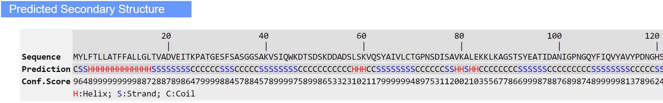

Slide 9
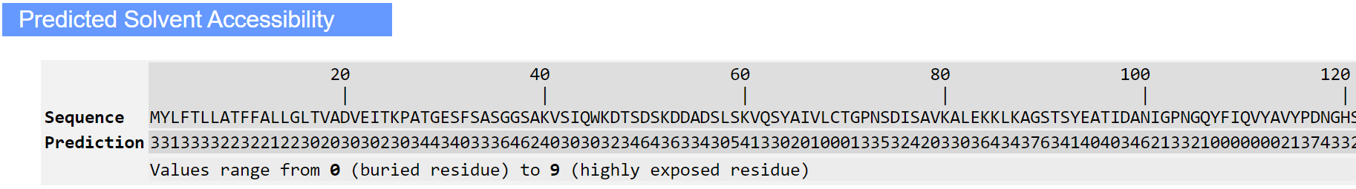

Slide 10
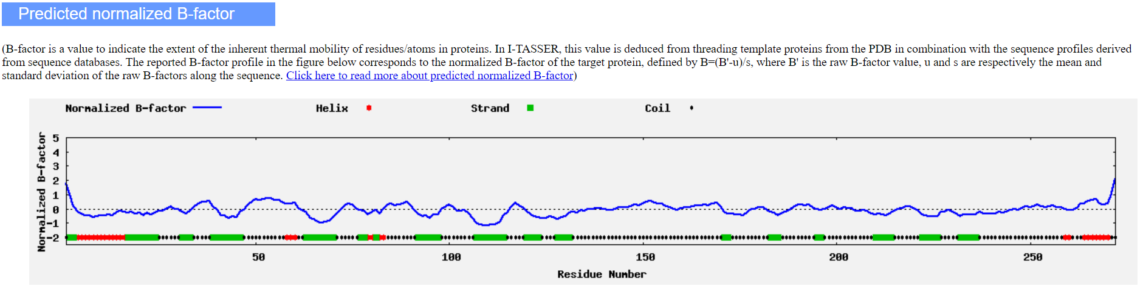
Lower B-factor → Relatively More Stable Residue

Slide 11
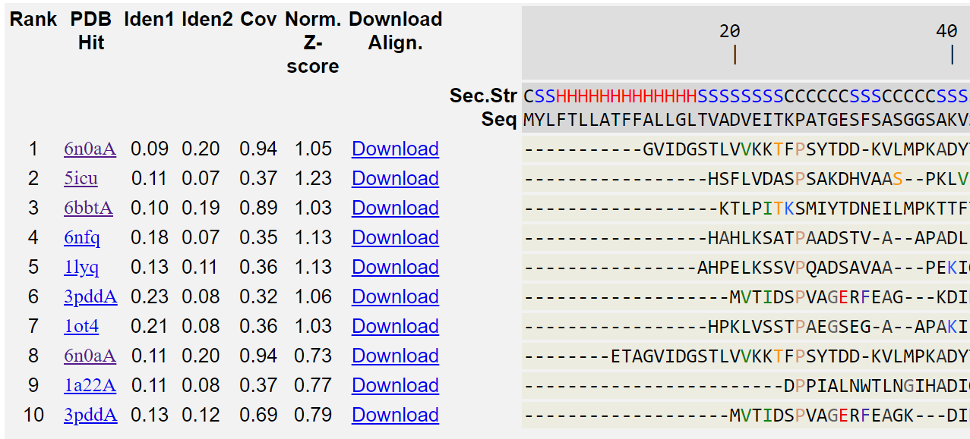
Top 10 threading templates used by I-TASSER
Z-score above 1 indicates a good alignment; my Z-scores are close to or below 1, indicating the protein is a hard target to model

Slide 12
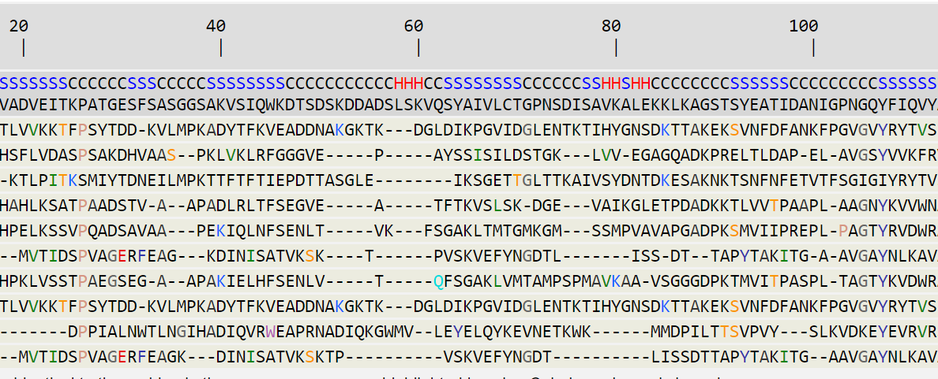
Top 10 threading templates used by I-TASSER: sequence alignment

Slide 13
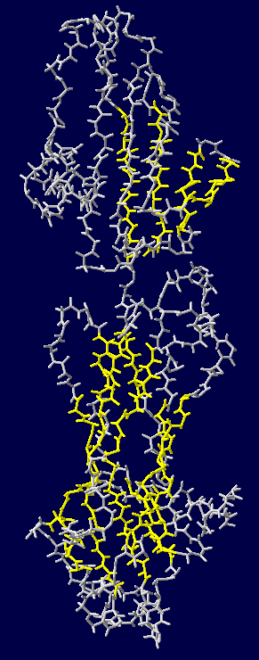
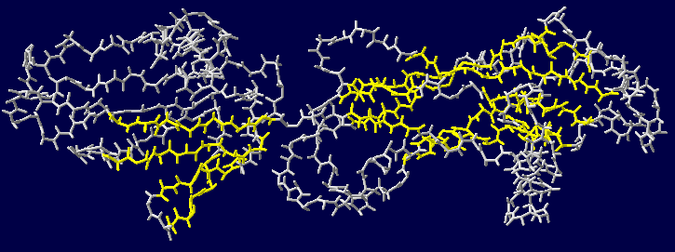
Figure 3: PDB file of predicted structure for CJI97_000055 in DeepView
Yellow = beta sheets

Slide 14
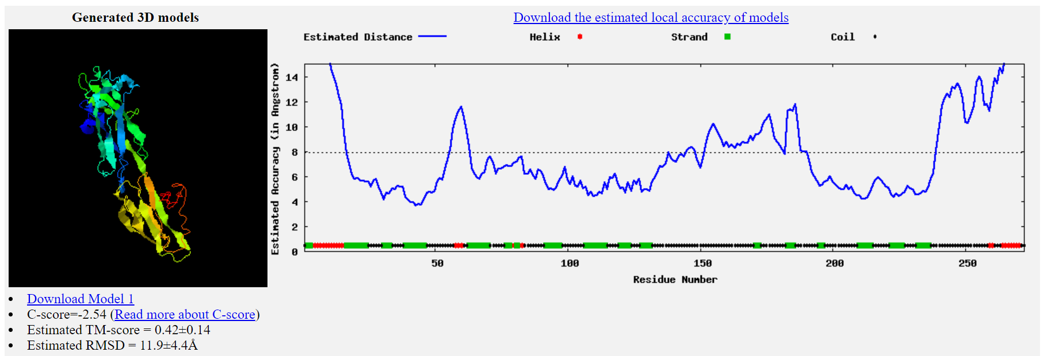
Figure 2: First of Top 5 final models predicted by I-TASSER
C-score > -1.5 indicates a model of correct global topology; these C-scores are below -1.5, so the models are low-confidence

Slide 15
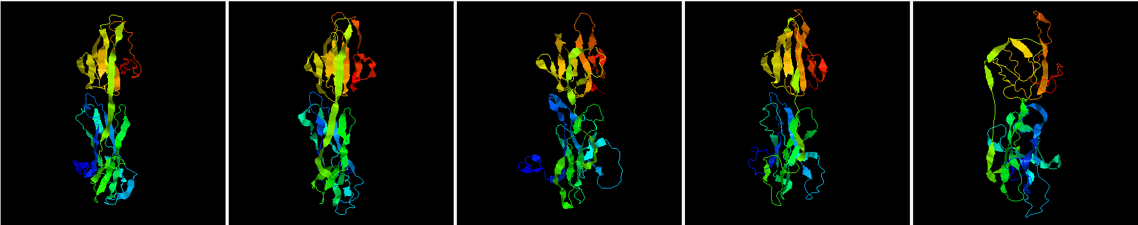
Top 5 final models predicted by I-TASSER

Slide 16
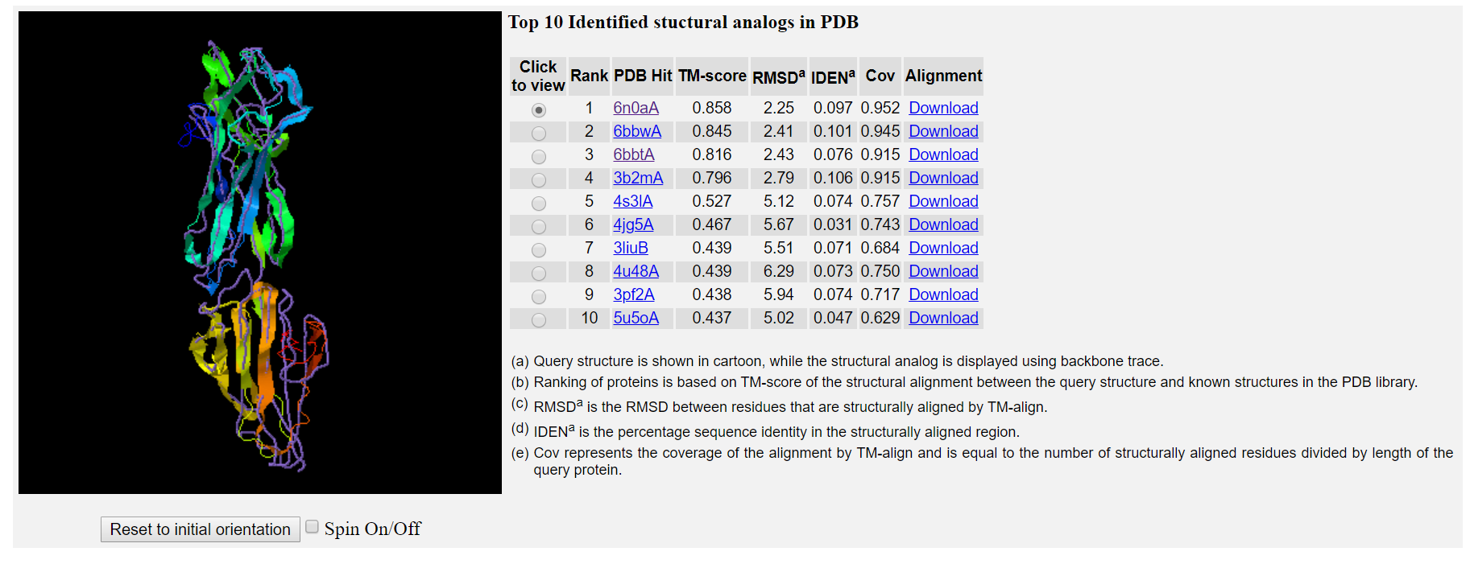
Proteins structurally close to the target in the PDB
6N0A: Structure of the major pilin protein (T-18.1) from Streptococcus pyogenes serotype MGAS8232
Purple = structural analog model
Cartoon Ribbons = my protein’s predicted structure

Slide 17
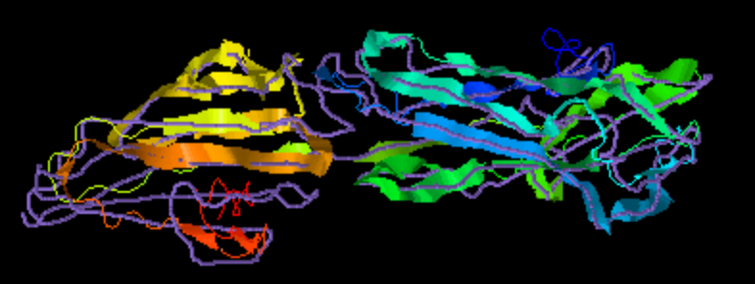
Threading with I-TASSER (V)
Purple = structural analog model
Cartoon Ribbons = my protein’s predicted structure
- Matches fairly well except for some loops, such as the region at 162-174 bp

Slide 18
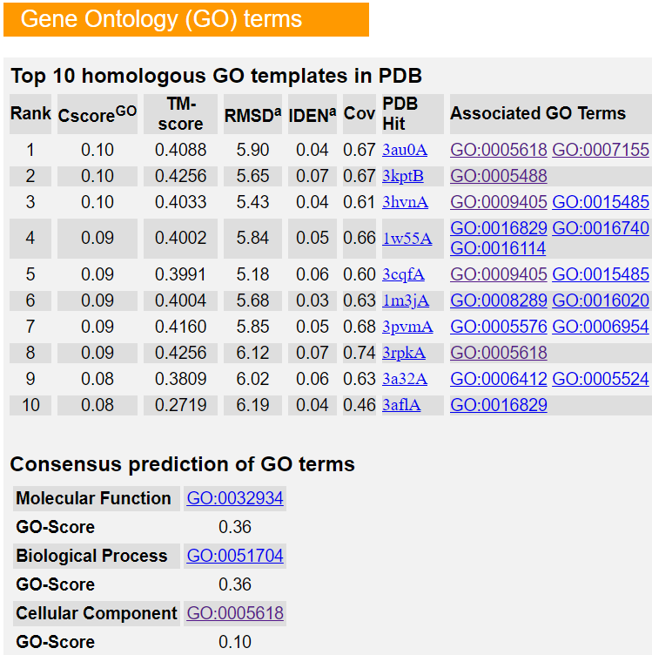
Threading with I-TASSER (VI)
C-Score is measured between 0-1
My C-scores are all 0.1 or lower, so results are low-confidence
Results from top three templates:
cell wall
binding: The selective, non-covalent interaction of a molecule with one or more specific sites on another molecule.
pathogenesis: Processes that generate the ability of an organism to induce an abnormal/detrimental state in other organisms.
cholesterol binding: Interacting selectively and non-covalently with cholesterol.
Results from consensus prediction (derived from the occurrence of gene ontology terms among the selected templates)
sterol binding: Interacting selectively and non-covalently with a sterol.
multi-organism process: A biological process which involves another organism of the same or different species.
cell wall

Slide 19
Threading with I-TASSER (Conclusions)
Results from I-TASSER match expectations for the protein CJI97_000055 since it is known to contain a GPI-anchored domain involved in adhesion
Confidence-related scores (Z-score, C-score) were all relatively poor, so the results should be referenced with caution
Threading was the only option for modeling the structurally uncharacterized CJI97_000055
Highlights need for actual modeling of the protein for further analysis

Slide 20
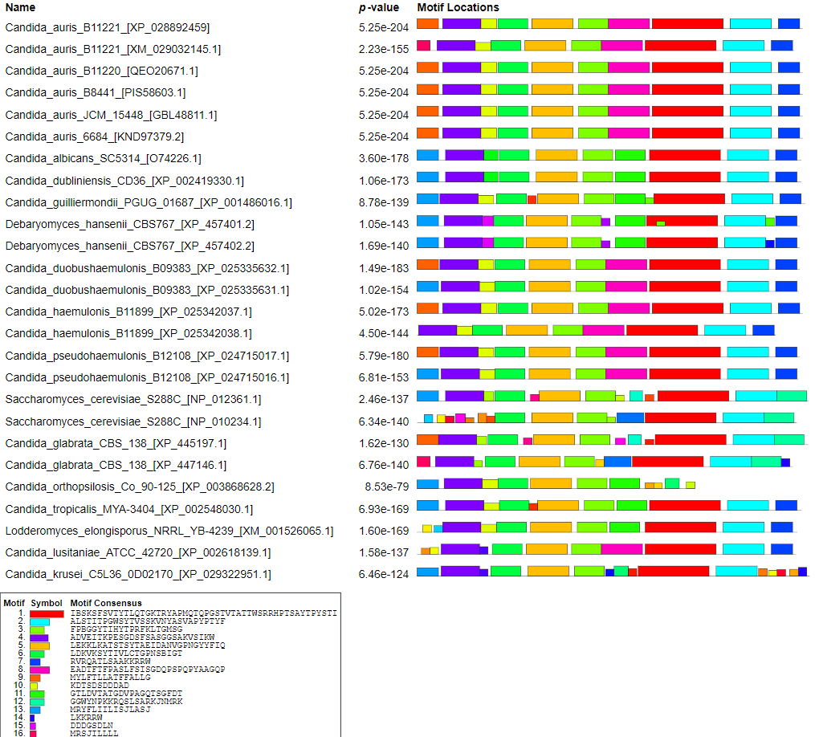
Figure 5

Slide 21
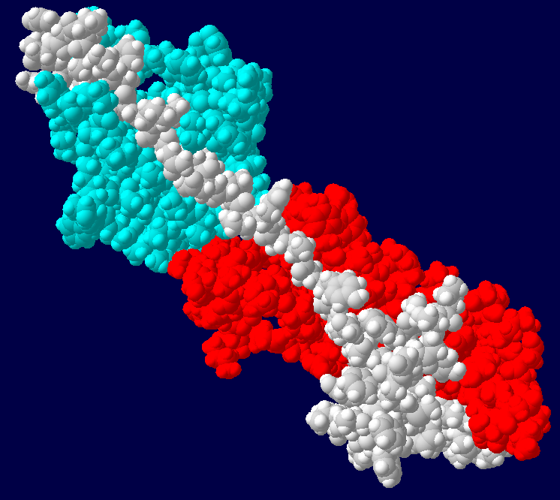
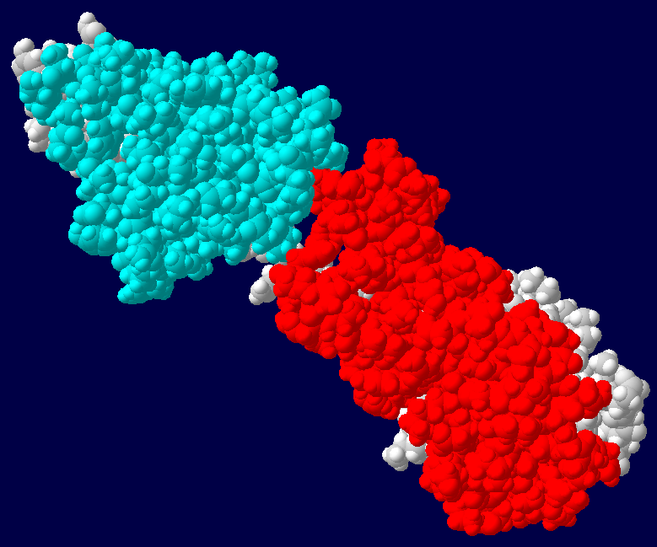
GPI-anchored
domain
GPI-anchored
domain
KRE9
domain
KRE9
domain
Figure 6: Front and Back Views of I-TASSER predicted protein model of C. auris protein CJI97_000055
Red=GPI-anchored superfamily domain; Teal=KRE9 superfamily domain

Slide 22
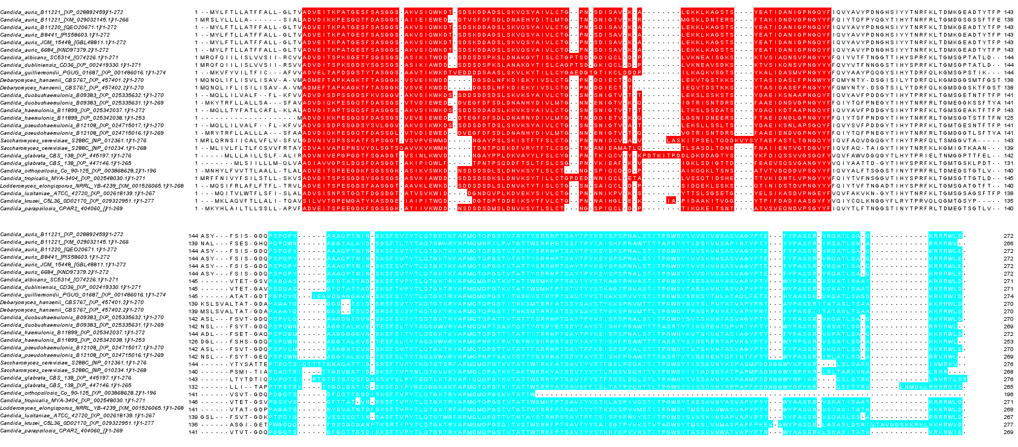
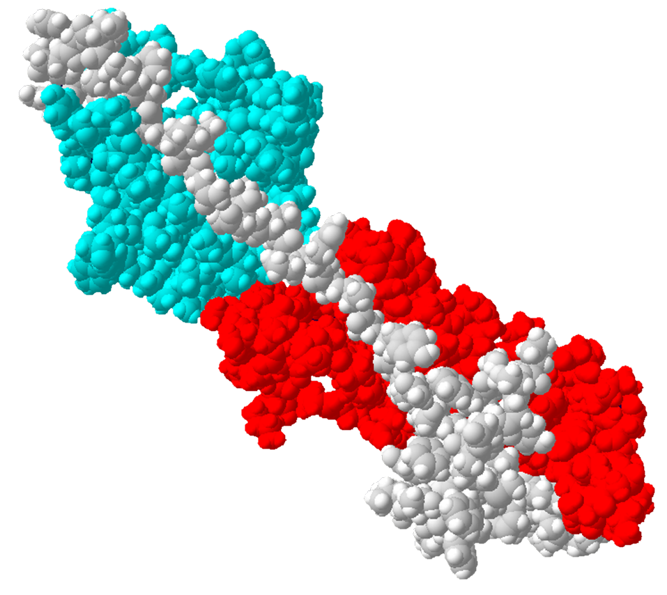
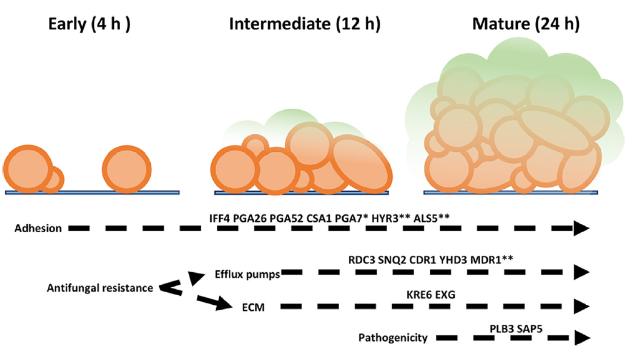
Upregulation
Biofilm Formation
Figure 7: Possible Path of CJI97_000055 Upregulation for Biofilm Formation
Red = Red=GPI-anchored superfamily domain; Teal=KRE9 superfamily domain
(biofilm formation image from Kean et al.)

Slide 23
CJI97_000055
Figure 7: Possible Path of CJI97_000055 Upregulation for Biofilm Formation
(biofilm formation image from Kean et al.)

